Slide 1
Python
Simply Beautiful
Val Neekman

Slide 2
History
“Python is a widely used general-purpose, high-level programming language. Its design philosophy emphasizes code readability, and its syntax allows programmers to express concepts in fewer lines of code than would be possible in languages such as C.”
“Python supports multiple programming paradigms, including object-oriented, imperative and functional programming or procedural styles. It features a dynamic type system and automatic memory management and has a large and comprehensive standard library.”
Wikipedia

Slide 3
Audience
You have already been exposed to at least one other programming language

Slide 4
Python – Is it radically different?
It looks much like several earlier languages
Java
Python
Exceptions
Objects
Imports

Slide 5


C++ ←→ Python

Slide 6
Data Structures
List [ ]
The most used data structure in Python. It is versatile and can contain different data types.
It is mutable with indices start from zero. It can be sliced, concatenated ..etc.
Its closest relative is the “string” which unlike list is immutable.
Tuple ( )
It is immutable and is surrounded by parentheses
However, it can hold mutable data (e.g. list and dict)
Dictionary { }
Is an associative collections represented by key:value
Keys must be hashable and unique
Data can be of any im/mutable types
Set { }
Is an unordered collection of unique values
All elements in a set must be hashable (hint: immutable elements)

Slide 7
Data Structures – List [‘when’, 2, ’use’]
The data doesn't have to be unique.
L = [1, 1, 2, 3, 4, 5, 5, 1]
A single collection of mixed data.
L = ['a', 1, 2.0, (1,0), [2,3,], {1,2}, {1: 2}]
The data order is important.
L = [1, 1, 1, 2, 3, 4, 5, 5]
The ability to change or extend data is required.
append(), insert(), remove(), pop() … etc.
A stack or a queue is required.
appending/removing elements from the beginning/end -- append() vs pop().

Slide 8
Data Structures – Tuple (‘when’, 2, ’use’)
The data doesn't have to be unique.
T = (1, 1, 2, 3, 4, 5, 5, 1)
A single collection of mixed data.
T = ('a', 1, 2.0, (1,0), [2,3,], {1,2}, {1: 2})
The data order is important.
T = (1, 1, 1, 2, 3, 4, 5, 5)
The data needs to be read only. (e.g. configuration data)
Immutable (read only)

Slide 9
Data Structures – Dictionary {‘when’: ‘2-use’}
The data requires a logical association between key:value
D = {1: ‘a’, 2: ‘b’, 3: ‘c’,}
A single collection of mixed data with unique keys
D = {1: ‘a’, (1,2): ‘b’, ‘foo’: ‘c’, 2.0: ‘two’,}
The data order is not important.
Order is not guaranteed
3rd party collections (OrderedDict) library can be used. (Performance?)
The data can change often
Mutable

Slide 10
Data Structures – Set {‘when’, ’2’, ’use’}
A unique set of data is required.
S = {1, 2, 3, 4, 5}
A single collection of mixed data is required.
S = {'a', 1, 2.0, (1,0))
The data order is important.
S = {1, 3, 4, 5, 2}
The data can change often
Mutable
Use frozenset() for immutable (read only)
The data can be manipulated mathematically
Difference, union, intersection, symmetric difference.

Slide 11
Python Class -- Definition
A class is a blueprint/template for creating extensible objects (hint: object-oriented)
A way of aggregating similar data and functions
An essential data / functionally abstraction
Allows for creating maintainable complex programs
Has a set of default constructor /destructor
__init__(), __del__()
An object created by the class constructor is called an instance of that class

Slide 12
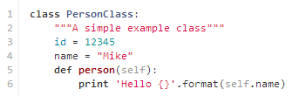
Python Class -- Example

Slide 13
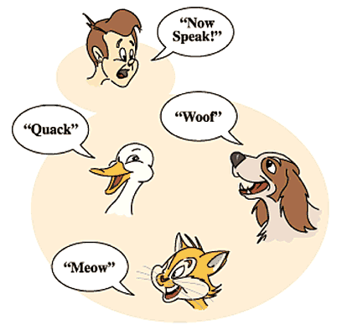
Python Class -- Polymorphism
Poly (many)
Morph (form/shape)

Slide 14
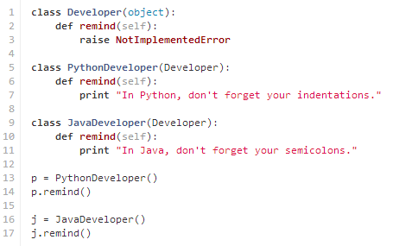
Python Class -- Polymorphism
The ability to change form base on input/context

Slide 15
Python Class -- Mixins
Mixins in Python, are classes that allow a set of clearly defined methods packaged together into a single in/dependent cohesive unit to be used to add specific functionalities to other classes by “mixing” them in.

Slide 16
Python Class -- Mixins
Mix & Match Functionalities
Mixins
Mixins
Mixins
Mixins
Access
Level
Lab
Kitchen
Lobby
Janitor
Chef
Technician
Restricted Access Level

Slide 17
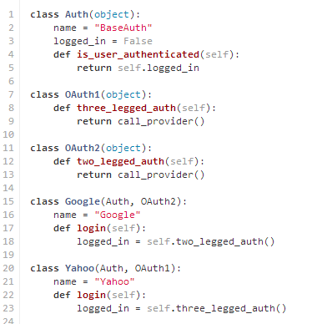
Python Class -- Mixins
Mix & Match Functionalities

Slide 18
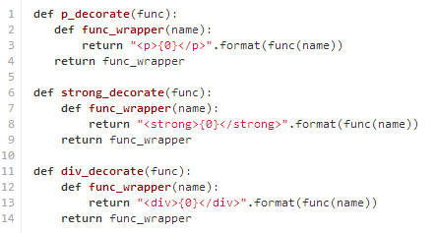
Python -- Decorator
Wrap a function in another function

Slide 19
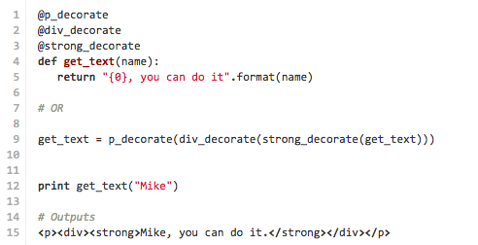
Python – Decorator Usage

Slide 20
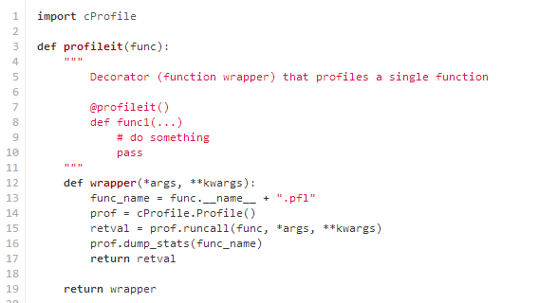
Python - Profiler
See how your program is performing. Find the bottleneck.

Slide 21
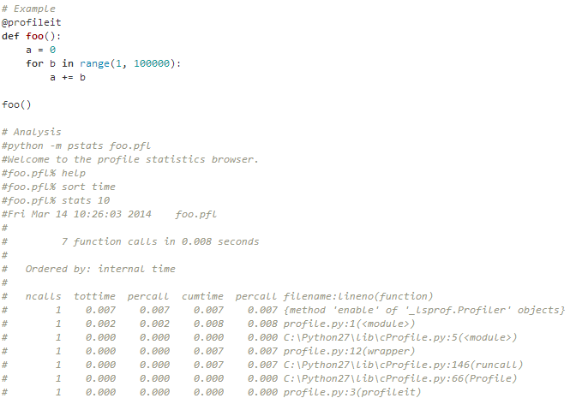
Python – Profiler Usage

Slide 22
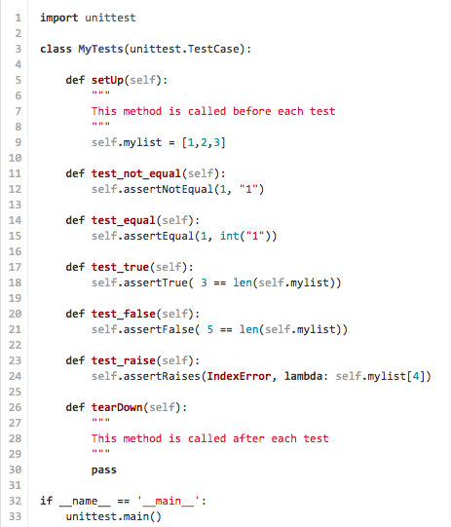
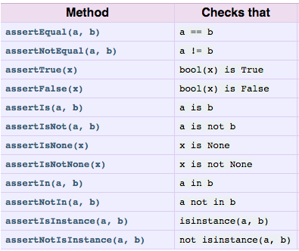
Python -- Unittest
Test what you ship
Ship what you test

