Slide 1
A REVIEW OF RECENT PEER-TO-PEER BOTNET DETECTION TECHNIQUES
Priyanka; Mayank Dave
Electronics and Communication Systems (ICECS), 2015 2nd International Conference
報告人：張育恩

Slide 2
Outline
Abstract
Introduction
P2P Botnet Life Cycle
P2P Botnet Detection And Detection Techniques
Conclusion

Slide 3
Abstract
In the recent years, Peer-to-Peer (P2P) botnets have emerged as a serious threat against the network security.
Earlier P2P botnet detection techniques have some shortcomings.
In this paper, we list recent P2P botnet detection techniques that overcome the weaknesses of previous technique and also list their advantages and disadvantages.

Slide 4
Introduction
Botnet is a network of bots coordinating over network to launch various illicit activities.
The computers are made part of botnet army by exploiting their vulnerabilities.
There are basically two types of botnets:
Centralized
De-centralized

Slide 5
Introduction(Cont'd)
Centralized
Bots get commands from the C&C server.
It suffers from single-point of failure problem.
De-centralized
P2P botnets
No central server, no central point of failure.
It have high resemblance with legitimate P2P traffic

Slide 6
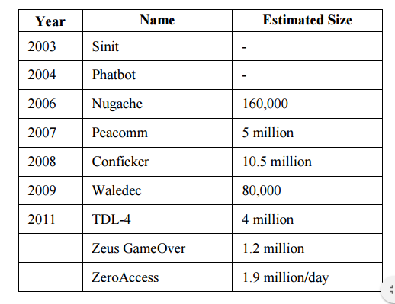
Introduction(Cont'd)
P2P botnets have made various companies’ and banks’ websites their victims.
WordPress, PayPal , MasterCard, Yahoo
P2P Botnet

Slide 7
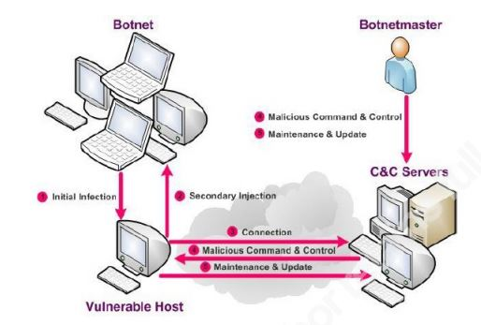
P2P Botnet Life Cycle
Consists of four phases:
I. Initial infection
II. Secondary injection
III. Connection phase
IV. Maintenance

Slide 8
P2P Botnet Detection And Detection Techniques
A. Big Data Analytics
Kamaldeep et al,“Big Data Analytics framework for Peer-to-Peer Botnet detection using Random Forests”, Information Science Journal, Elsevier, 2014, pp. 488-497.
Framework developed for P2P botnet detection.
Advantages
Quasi-real time processing and detection(99.7% accuracy).
The developed framework was able to handle big-data.
Limitations
Require continuous monitoring of network.

Slide 9
P2P Botnet Detection And Detection Techniques (Cont'd)
Traffic Sniffer Module:
Sniffs packets from the network using dumpcap and save them to pcap files.
The files are then submitted to HDFS.
Feature Extraction Module:
Using Tshark and Apache Hive.
The main vantage of framework is that the features required for detection can be chosen at the run-time.
Machine Learning Module:
Using Apache Mahout.
Random forest algorithm is used for detection.

Slide 10
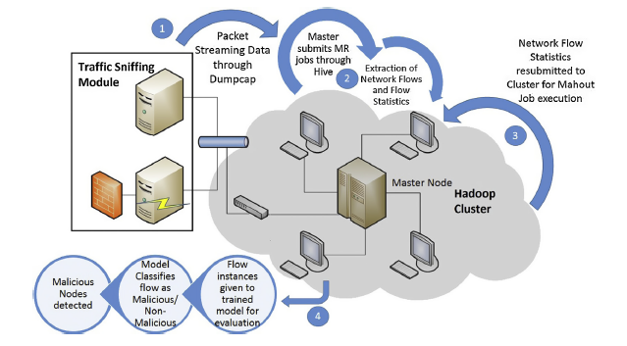

P2P Botnet Detection And Detection Techniques (Cont'd)

Slide 11
P2P Botnet Detection And Detection Techniques (Cont'd)
B. Dye Pumping
Coskun et al, “Friends of an enemy: identifying local members of peer-to-peer botnets using mutual contacts, In Proc. of ACSAC-2010, ACM, 2010, pp. 131-140.
Bots are detected on the basis of mutual contacts they are having.
Advantages
No traffic analysis required.
Limitations
Seed bot required to be known prior to detection.
Computational complexity.
It won’t work for botnet which has structured P2P topology.

Slide 12
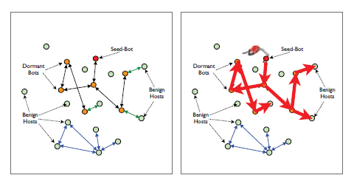
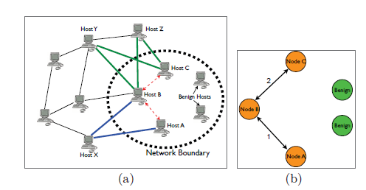
P2P Botnet Detection And Detection Techniques (Cont'd)
(c)
(d)

Slide 13
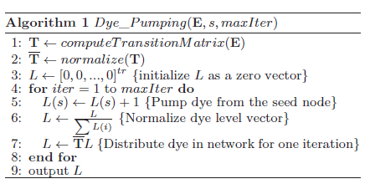
P2P Botnet Detection And Detection Techniques (Cont'd)
The nodes having mutual contacts with the seed bot or to other suspected bots, are given some fraction of that node’s dye.
The nodes having dye value above certain threshold are finalized as bots.

Slide 14
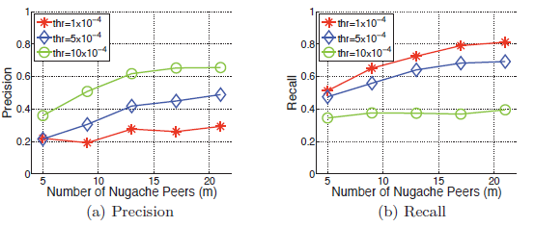
P2P Botnet Detection And Detection Techniques (Cont'd)

Slide 15
P2P Botnet Detection And Detection Techniques (Cont'd)
C. Emule-like Networks’ Periodic Search Packet Based
Yong et al,“Detecting Parasite P2P Botnet in eMule-like Networks through Quasi-periodicity Recognition”, Information Security and Cryptology - ICISC 2011 Springer, 2011, Volume 7259,pp. 127–139.
Parasite botnet detected by searching for periodic search requests.
Advantages
Detects bots prior to attack.
Limitations
Can detect malicious nodes in monitored network only.

Slide 16
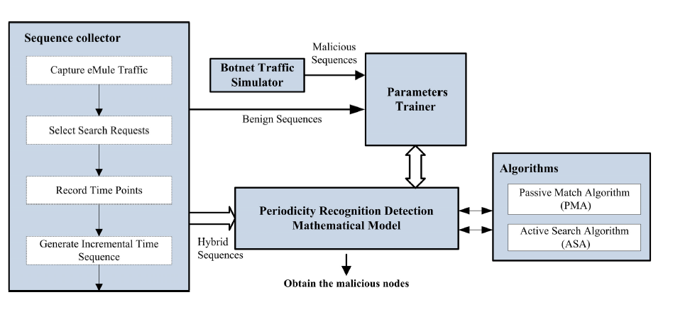
P2P Botnet Detection And Detection Techniques (Cont'd)

Slide 17
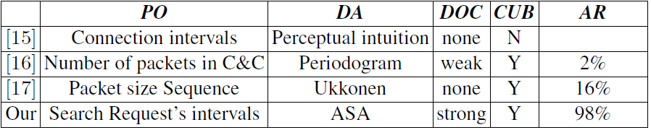
P2P Botnet Detection And Detection Techniques (Cont'd)

Slide 18
P2P Botnet Detection And Detection Techniques (Cont'd)
D. P2P Botnet Detection Using SVM
Barthakur et al, “A Framework for P2P Botnet Detection Using SVM”, Proc. IEEE International Conference on Cyber-Enabled Distributed Computing and Knowledge Discover, 2012, pp. 195-200.
Botnet detection using SVM.
Advantages
Can detect bots exchanging encrypted traffic.
Limitations
Not able to detect bots exchanging benign data.

Slide 19
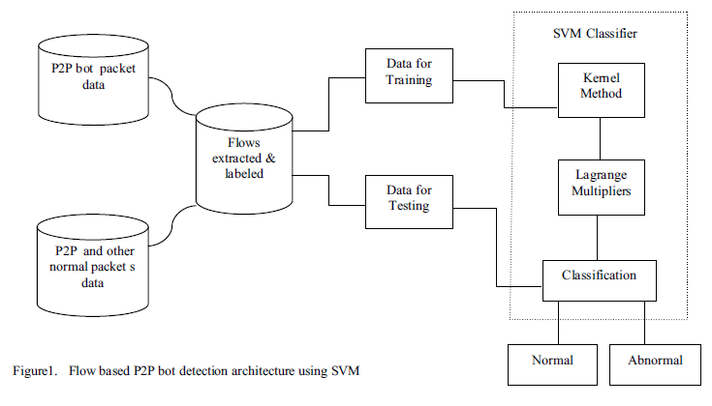
P2P Botnet Detection And Detection Techniques (Cont'd)

Slide 20
P2P Botnet Detection And Detection Techniques (Cont'd)
Data capture
Using perl script
Filter : It discards flows that involves local broadcast activities in the network.
Feature selection
The botmaster keeps the ratio of largest packets in a flow to as low as possible.
Bots keeps changing communication ports, which results in less bytes being transferred with each flow.
Variances with respect to different flow parameters are expected to be low.
Experiment
Accuracy is above 99%
The false positive rate (FPR) for bot and normal data are as low as 0.11 and 0.003 respectively

Slide 21
P2P Botnet Detection And Detection Techniques (Cont'd)
E. Stealthy Botnet Detection
Zhang et al. , “Building a Scalable System for Stealthy P2P-Botnet Detection”, IEEE Transactions on Information Forensics and Security, January 2014, Vol. 9, No. 1, pp. 27-38.
Botnet detected deriving statistical fingerprints.
Advantages
Able to detect stealthy botnets.
Limitations
Can detect bots in the monitored network only.

Slide 22
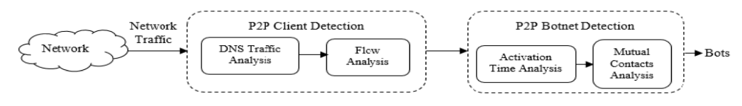
P2P Botnet Detection And Detection Techniques (Cont'd)
P2P Clients Identification
The hosts involved in any kind of P2P communication are first identified by DNS traffic analysis and suspected P2P clients are then passed through fine-grained detection for confirmation.
They are finalized as P2P clients if they have same flow size and exchange control messages with large number of peers of various networks.
P2P Bots Detection
Finalized peer clients are labelled as suspected hosts on the basis of their activation time and number mutual contacts.

Slide 23
P2P Botnet Detection And Detection Techniques (Cont'd)
F. Traffic Flow Analysis
Sheng et al, “A Distributed Botnet Detecting Approach Based on Traffic Flow Analysis”, IEEE Second International Conference on Instrumentation & Measurement, Computer, Communication and Control, 2012, pp. 124-128.
General botnet detection approach based on traffic flows analysis.
Advantages
Can detect both centralized and de-centralized botnets.
Limitations
The framework can detect bots in the monitored network only
The P2P botnet detection accuracy is low.

Slide 24
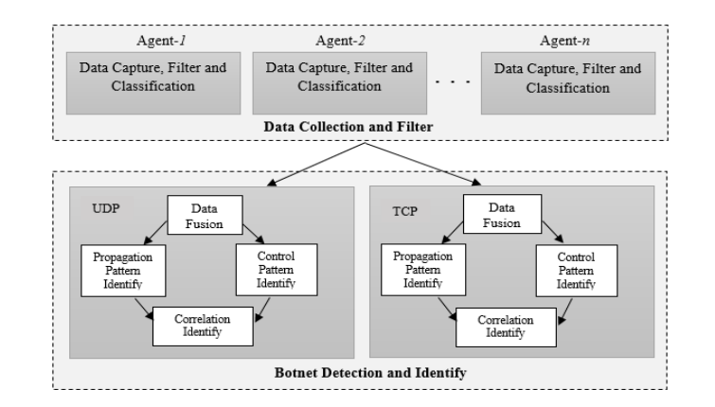
P2P Botnet Detection And Detection Techniques (Cont'd)

Slide 25
P2P Botnet Detection And Detection Techniques (Cont'd)
First Part :
Data Collection and Filter
Data capture is implemented through network program development kit WinPcap.
Data filter
White-list
Dynamic study : They defined the continuous flow as a legal flow, and picked up the DestIP updating the White-List.
Data classify
divided enormous data into three sections, TCP-based, UDP-based and others.

Slide 26
P2P Botnet Detection And Detection Techniques (Cont'd)
Second Part :
Data fusion
Flows divided into several new flow sets.
Propagation pattern identify:
Find the abnormal flows and output a list of suspicious host IP and the suspicion degree.
Control pattern identity
Find the flows which are low frequency but periodically occur.
Also output a list of suspicious host IP and the suspicion degree.
Correlation identify
Use the results from previous identify and obtain a new degree.
If the new degree is bigger than threshold that we set, it’s a benign host, otherwise, it’s the suspicious host, which belong to some botnet.

Slide 27
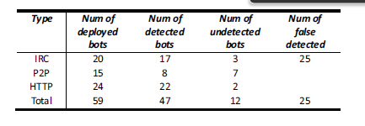
P2P Botnet Detection And Detection Techniques (Cont'd)

Slide 28
Conclusion
Previous detection approaches have some weaknesses such as less accuracy, high FPRs, unable to detect stealthy botnets.
All these problems are solved by various recent approaches described here.
But none of the techniques discussed here, is solely able to address all the problems.
We can develop techniques by combining two or more techniques, which will exclusively address all the detection problems of P2P botnets.

