Slide 1
Sell Smart. Track Everything.
FishSale
Tracker System.
Connect buyers, manage fish types, and record every transaction.
FishSale Tracker System · Java Swing Desktop Application · 2026
Presented by: Jasmin C. Unabia

Slide 2
FISHSALE TRACKER
Sell Smart. Track Everything.
OVERVIEW
01
Introduction
02
Rationale
What is FishSale Tracker?
Why was it built?
03
Purpose
04
Beneficiaries
Goals of the system
Who benefits?
05
Users and Roles
06
System Features
Admin and Seller
Key functionalities
07
ERD Diagram
Database structure
FishSale Tracker System | Every Catch Counts | All Rights Reserved

Slide 3
FISHSALE TRACKER
Sell Smart. Track Everything.
INTRODUCTION
What is it?
Built with
FishSale Tracker is a desktop app for recording and managing fish sales. Built with Java Swing.
Java Swing — NetBeans IDE
Database
What does it do?
SQLite (fishsale.db)
Handles login, sales recording, buyer and fish type management, and receipt printing — in one place.
Users
Admin and Seller roles
Who is it for?
Fish traders who want to replace manual record-keeping with a fast, organized digital system.
Output
Auto-generated receipts
FishSale Tracker System | Every Catch Counts | All Rights Reserved

Slide 4
FISHSALE TRACKER
Sell Smart. Track Everything.
RATIONALE
The Problem
Our Solution
Sales tracked on paper or memory
All sales saved in a central database
Transaction records get lost
Every transaction recorded with receipt
No way to check buyer history fast
Buyer records linked to each sale
Manual calculations cause errors
Auto subtotal and total calculation
Admin cannot monitor all sellers
Admin views all transactions at once
FishSale Tracker System | Every Catch Counts | All Rights Reserved

Slide 5
FISHSALE TRACKER
Sell Smart. Track Everything.
PURPOSE
This system was built to:
Secure Access
Record Sales
Role-based login for Admin and Sellers. New accounts need Admin approval.
Create multi-item sales with fish type, kg, and price. Auto-calculates totals.
Generate Receipts
Track Transactions
Print receipts for every completed sale transaction.
Admin sees all sales. Sellers view only their own history.
Manage Fish and Buyers
Keep a catalog of fish types and a list of registered buyers.
FishSale Tracker System | Every Catch Counts | All Rights Reserved

Slide 6
FISHSALE TRACKER
Sell Smart. Track Everything.
BENEFICIARIES
Admin
Seller
Buyer
Full system access. Manages users, buyers, fish types, and all sales.
The main user. Records daily fish sales and tracks own transactions.
Registered by Admin. Linked to every sale for record-keeping.
Manage users and account status
Create new sales with fish items
Registered by Admin only
Add and edit buyers and fish types
View own sales history
Linked to sales for tracking
View all transactions
Print receipts for buyers
No login access needed
Full dashboard stats
Edit personal profile
Info updated anytime by Admin
FishSale Tracker System | Every Catch Counts | All Rights Reserved

Slide 7
FISHSALE TRACKER
Sell Smart. Track Everything.
USERS AND STAKEHOLDERS
ADMIN
SELLER
BUYER
Manage users and account status
Log in with approved account
Registered by Admin
Add buyers and fish types
Record new sales
Linked to every sale
View all transactions
View own sales history
Contact info stored
Full dashboard access
Print receipts
No login needed
Approve new accounts
Edit own profile
Can be updated by Admin
FishSale Tracker System | Every Catch Counts | All Rights Reserved

Slide 8
FISHSALE TRACKER
Sell Smart. Track Everything.
SYSTEM FEATURES
Secure Login
Multi-item Sales
Fish Catalog
Role-based auth, Admin/User
Fish, kg, price, auto total
Saltwater / Freshwater / Brackish
Login with account status check.
New accounts require Admin approval.
Add fish items with quantity and price.
System auto-calculates the total.
Organized fish type records with
category and code for each type.
Buyer Management
Receipts
Dashboard
Register and link buyers
Auto-generate and print
Stats for sales and users
Add buyer details and link them
to every sale transaction.
Print receipts for every sale
directly from the system.
See transaction count, revenue,
and account status at a glance.
FishSale Tracker System | Every Catch Counts | All Rights Reserved

Slide 9
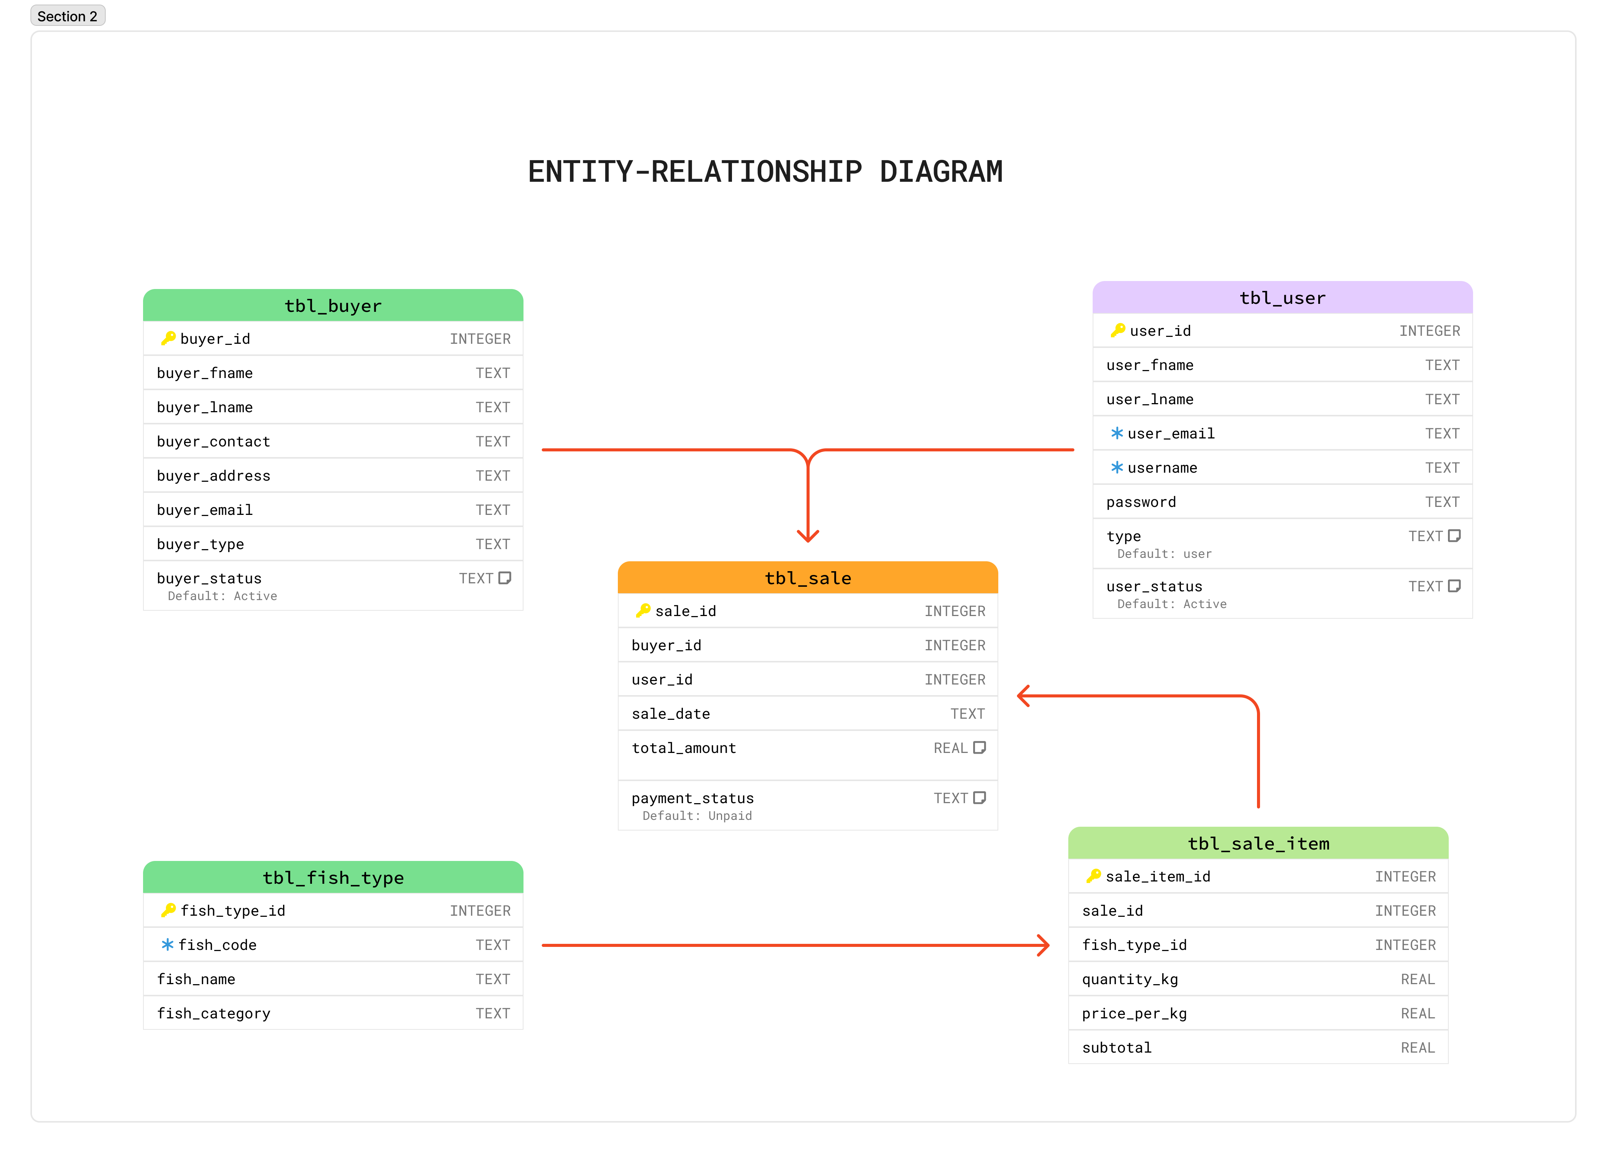
FISHSALE TRACKER
Sell Smart. Track Everything.
ERD DIAGRAM
tbl_user
tbl_buyer
user_id
tbl_sale
PK
buyer_id
user_fname
buyer_fname
user_lname
PK
sale_id
buyer_lname
1
N
buyer_id
N
1
user_email
FK
buyer_contact
username
FK
user_id
buyer_email
password
sale_date
buyer_type
type
total_amount
buyer_status
user_status
payment_status
1
N
tbl_fish_type
tbl_sale_item
fish_type_id
PK
sale_item_id
1
N
fish_code
FK
sale_id
fish_name
FK
fish_type_id
fish_category
quantity_kg
price_per_kg
subtotal
PK = Primary Key | FK = Foreign Key | AI = Auto-Increment | UQ = Unique
FishSale Tracker System | Every Catch Counts | All Rights Reserved

Slide 10
FISHSALE TRACKER
Sell Smart. Track Everything.
LIVE APPLICATION
PLAY
DEMO
FishSale Tracker · Java Swing Application

Slide 11
FISHSALE TRACKER
Sell Smart. Track Everything.
CONCLUSION
FishSale Tracker makes it simple to sell smart and track everything — replacing paper records with a fast, organized system.
Admin
Manages users, buyers, fish types, and monitors all transactions.
Sellers
Create sales, auto-calculate totals, and print receipts instantly.
Security
Role-based access keeps data organized and protected.
Database
All records saved in SQLite — fast, reliable, and easy to back up.
FishSale Tracker System | Every Catch Counts | All Rights Reserved

Slide 12
FISHSALE TRACKER
Sell Smart. Track Everything.
THANK YOU
Sell Smart. Track Everything.
FishSale Tracker System · 2025 · Every Catch Counts

