Slide 1
Fashion Hub: A Modern E-Commerce Platform
Developed using the Laravel PHP Framework
Team Members:
Aayushi – 92300527124
Eva– 92300527120

Slide 2
Project Overview
The Vision:
A high-performance, responsive fashion web application delivering a fluid shopping experience.
Key Focus:
A scalable web solution integrating a powerful backend with a high-fashion UI.
Core Objectives:
Secure user management, dynamic product displays, and real-time cart functionality.

Slide 3
Tech Stack & Core Technologies
Framework: Laravel (PHP)
Frontend: Blade, CSS3 (Tailwind/Bootstrap), JavaScript
Backend: PHP 8.x (Controller-based architecture)
Database: MySQL
Environment: Composer & Vite

Slide 4
Why Laravel & PHP?
Laravel Power:
Built-in routing, authentication, and caching.
Blade Templates:
Reusable UI components with dynamic data binding.
MVC Architecture:
Clear separation of Models, Views, and Controllers.

Slide 5
Data Backbone: MySQL & Eloquent ORM
MySQL:
Stores users, products, and orders.
Eloquent ORM:
Expressive PHP syntax instead of complex SQL.
Migrations:
Database version control across environments.

Slide 6
Module 1 – Secure Authentication
Secure Register/Login
Password encryption using Bcrypt
Session-based user tracking
Middleware-protected checkout and profile pages

Slide 7
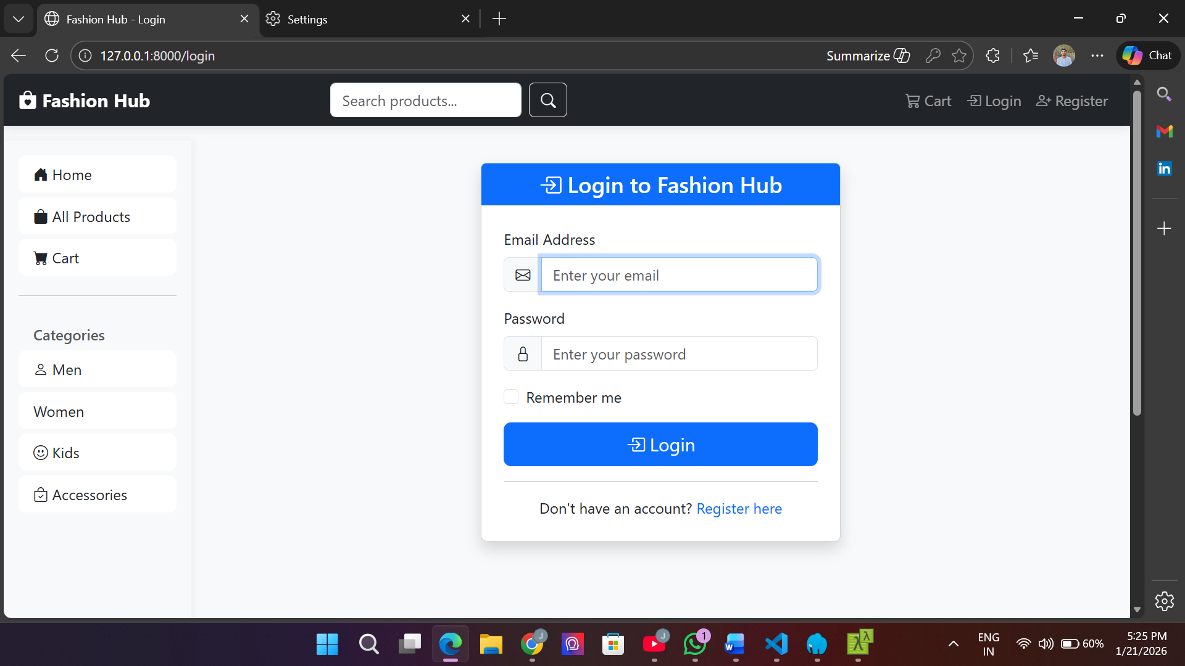

Slide 8
Module 2 – Dynamic Product Catalog
SEO-friendly dynamic routes
Responsive design for desktop & mobile
Real-time product data from MySQL

Slide 9
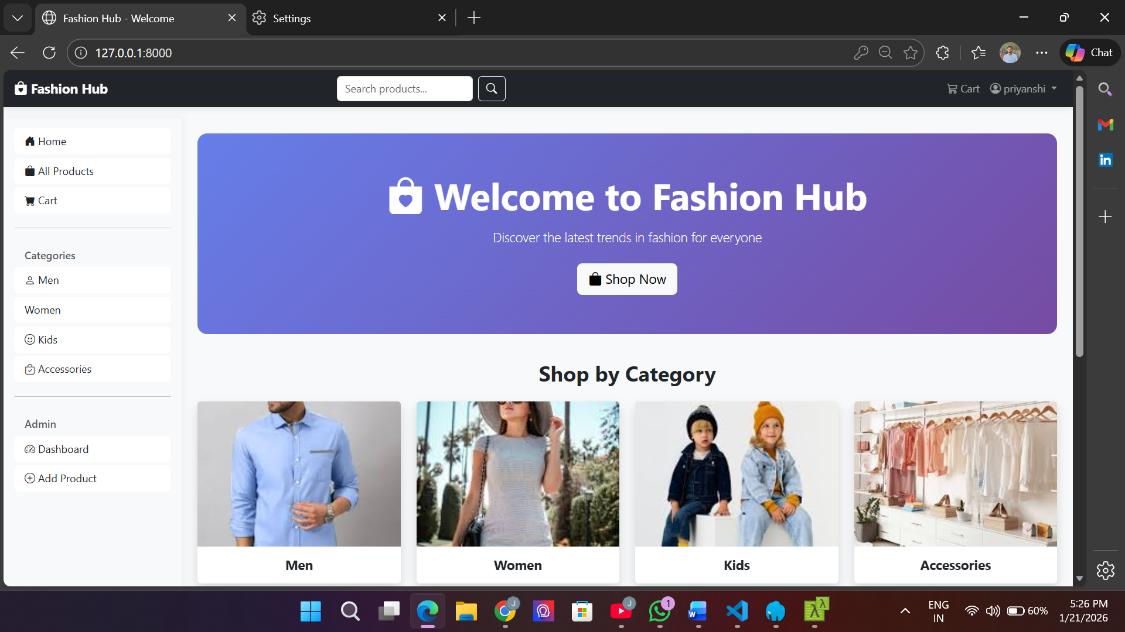

Slide 10
Module 3 – Shopping Cart & Sessions
Laravel session-based cart tracking
Persistent cart saved to database after login
Stock validation before adding items

Slide 11
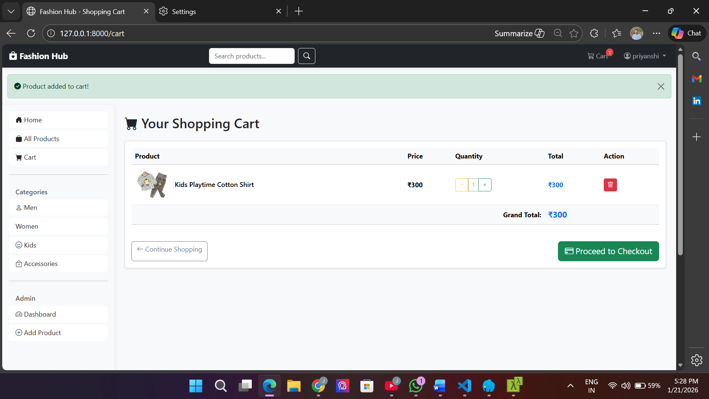

Slide 12
Development Challenges & Solutions
State Sync:
AJAX-based cart updates
Security:
CSRF protection & SQL injection prevention
Performance:
Image optimization & caching

Slide 13
Conclusion & Future Roadmap
Conclusion:
Professional Laravel-based e-commerce platform.
Future Enhancements:
Payment Gateway integration
AI-based product recommendations
Admin dashboard

