Slide 1
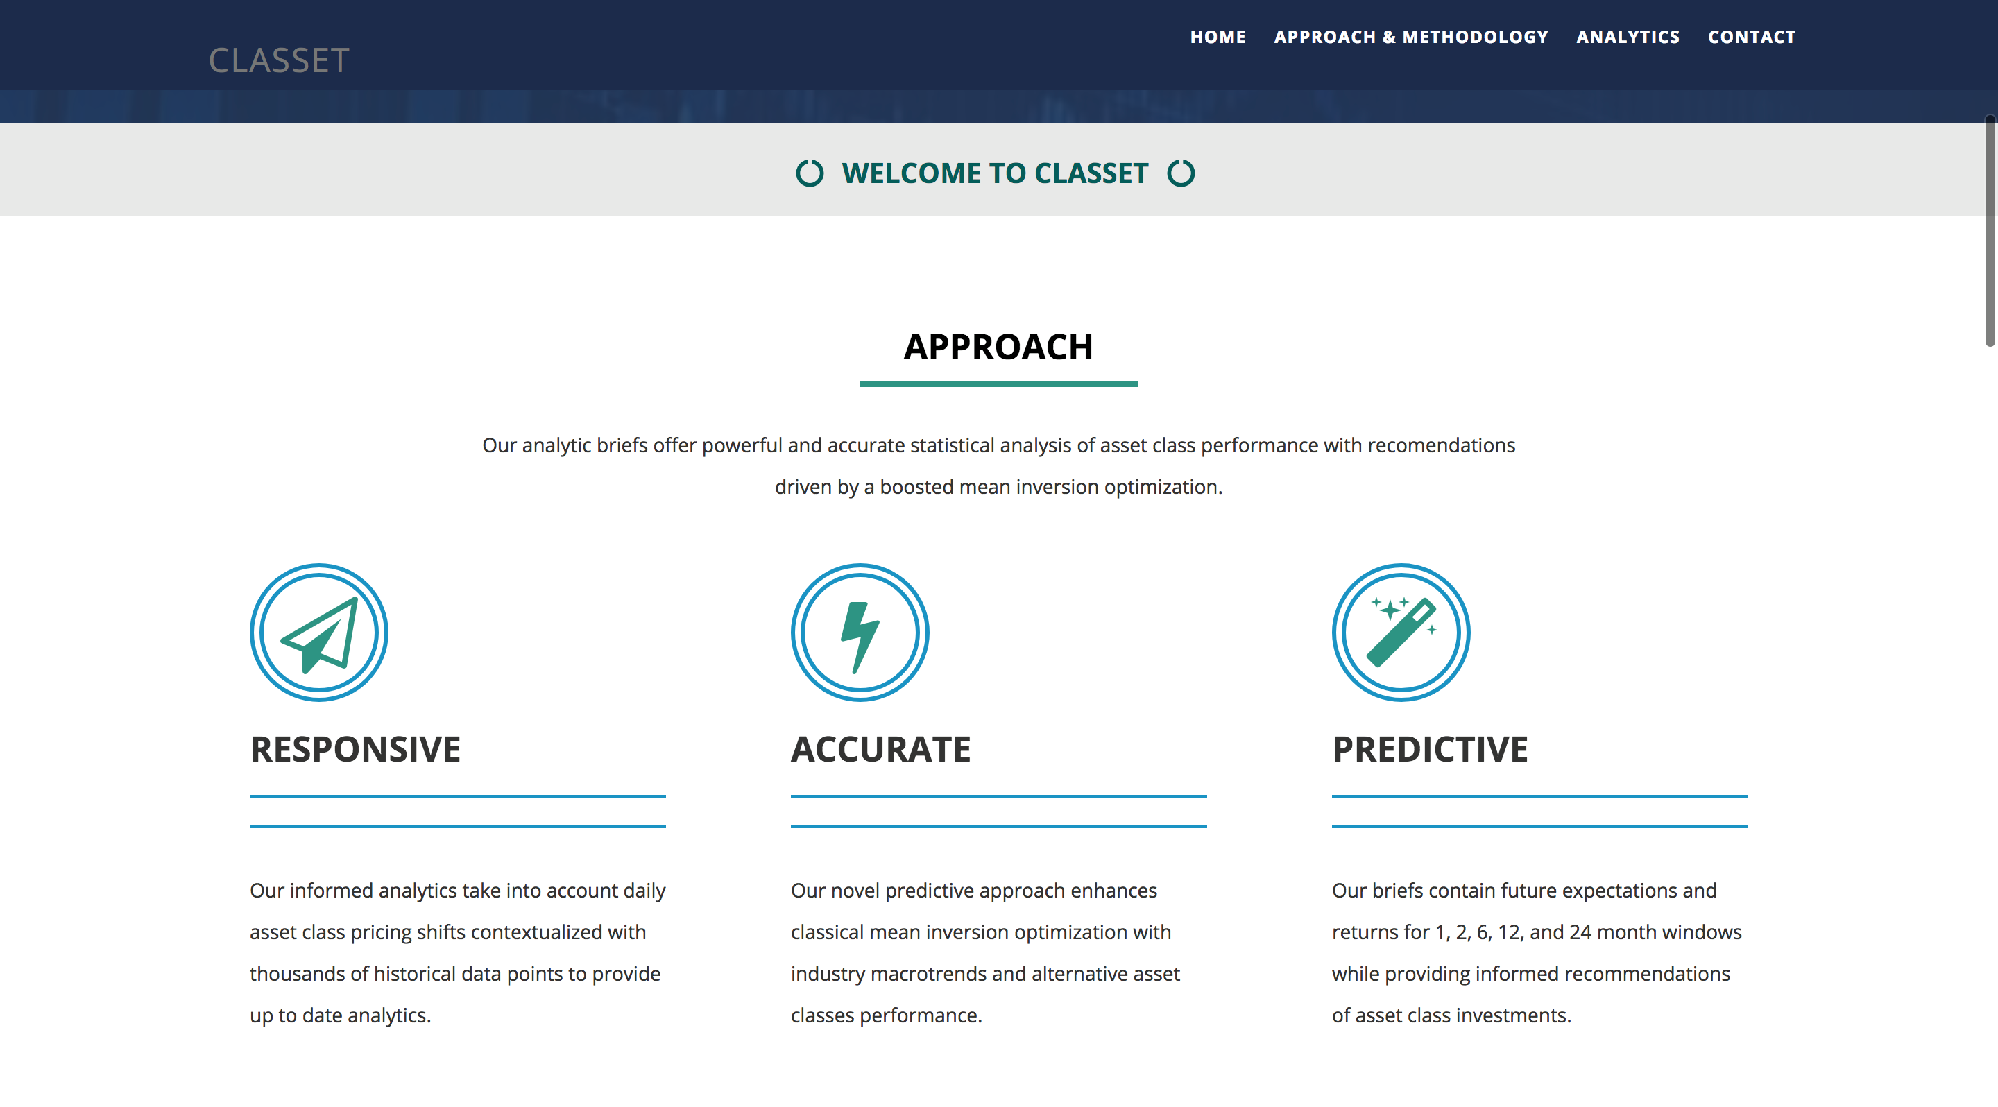
Notes:
Welcome to Classet: A Web Application providing investment recommendations across asset classes.
Our application is responsive, accurate, and predictive.
(1) Responsive, contextualizes up to date with historical data
(2) Predictive, providing momentum and forecasts over time intervals for asset classes
(3) Accurate, driven by a complex statistical backend reliant on an enhanced form of mean inversion

Slide 2
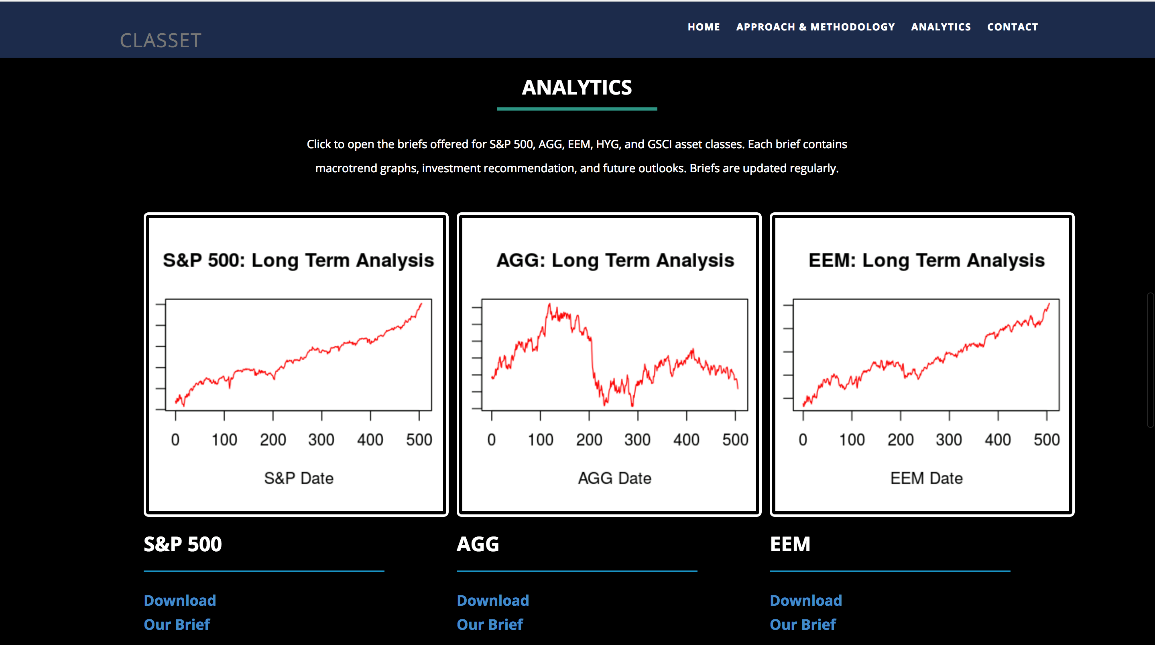
Notes:
Mean reversion analysis: in the long term prices will return to their predicted value – if it goes down it will usually come back up
Investment approach: best companies a) have an upward long-term trend b) have a downward short-term trend but have plateau-ed and c) are undervalued (predicted by historical analysis, interrelationships between asset classes)

Slide 3
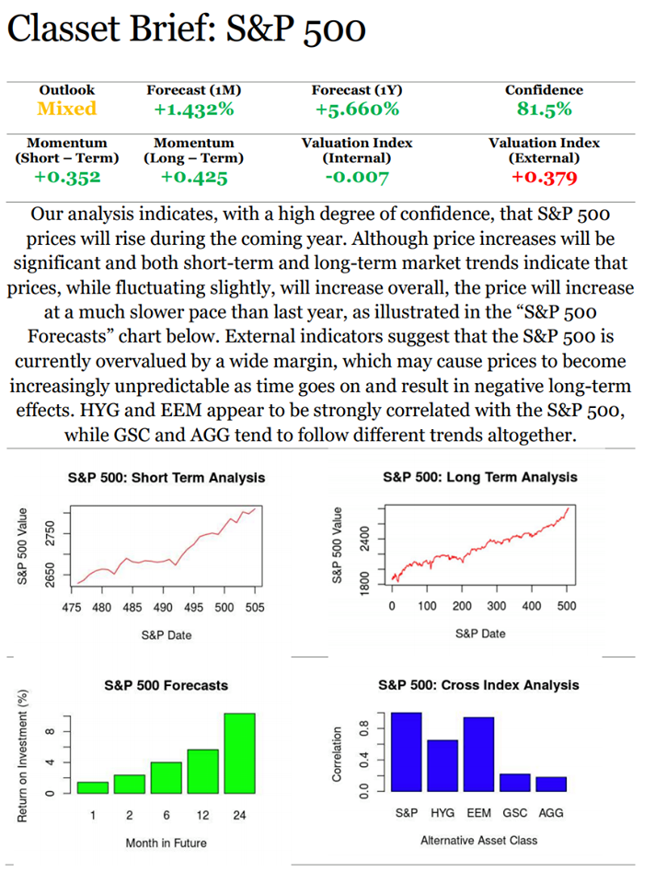
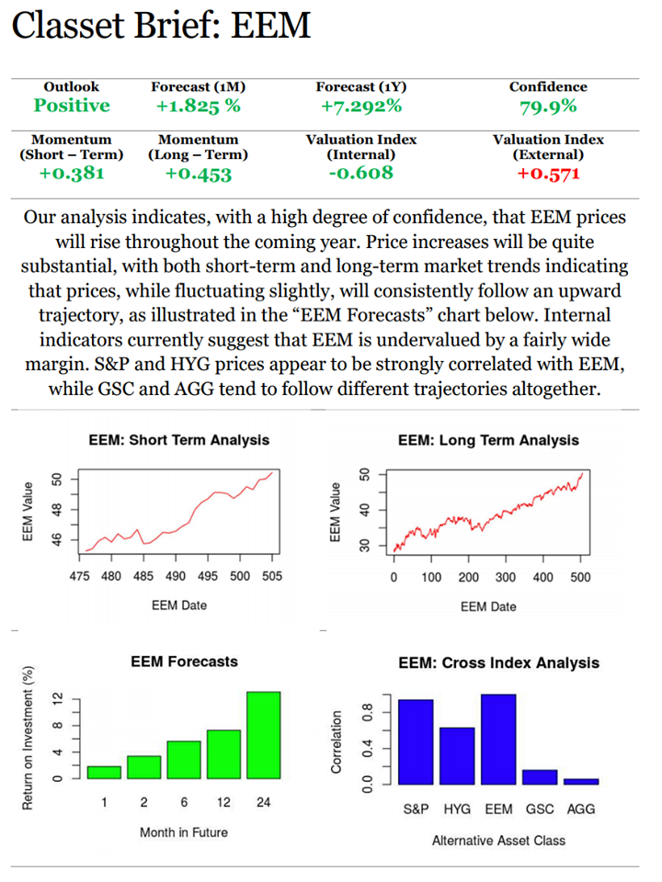
Notes:
Here’s a look at some of our investment briefs, featuring visuals and accessible forecasts. Super simple
Statistics calculated and visualizations generated in a 800-line algorithm in R
Backend summarized: make forecasts based on a weighted combination of momentum (both short and long term) and mean reversion (if it’s currently over or undervalued)
We recognize BOTH the optimal time to buy AND the optimal time to sell

Slide 4
Future
Total Addressable Market: 1B+ Global Users
Service Platform for Businesses ($17B Market)
Education and Insights Platform for Individual Clients ($10B Market)
Accessible investment recommendations with high ROI (ex. Our POC: ROI: 2X in 5 yrs.)
Easily expandable to any number of stocks or assets (ex. Capital One Stock)

