Slide 1
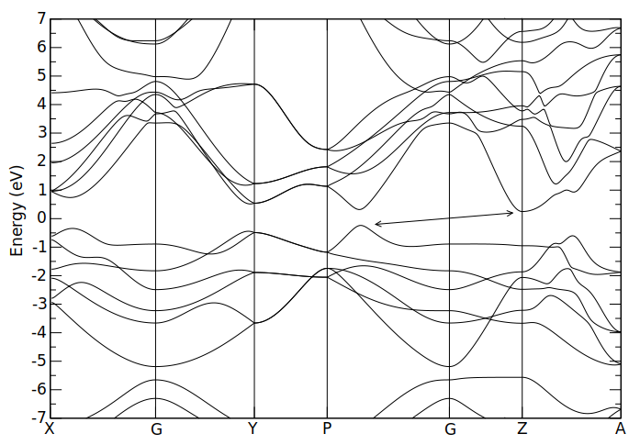
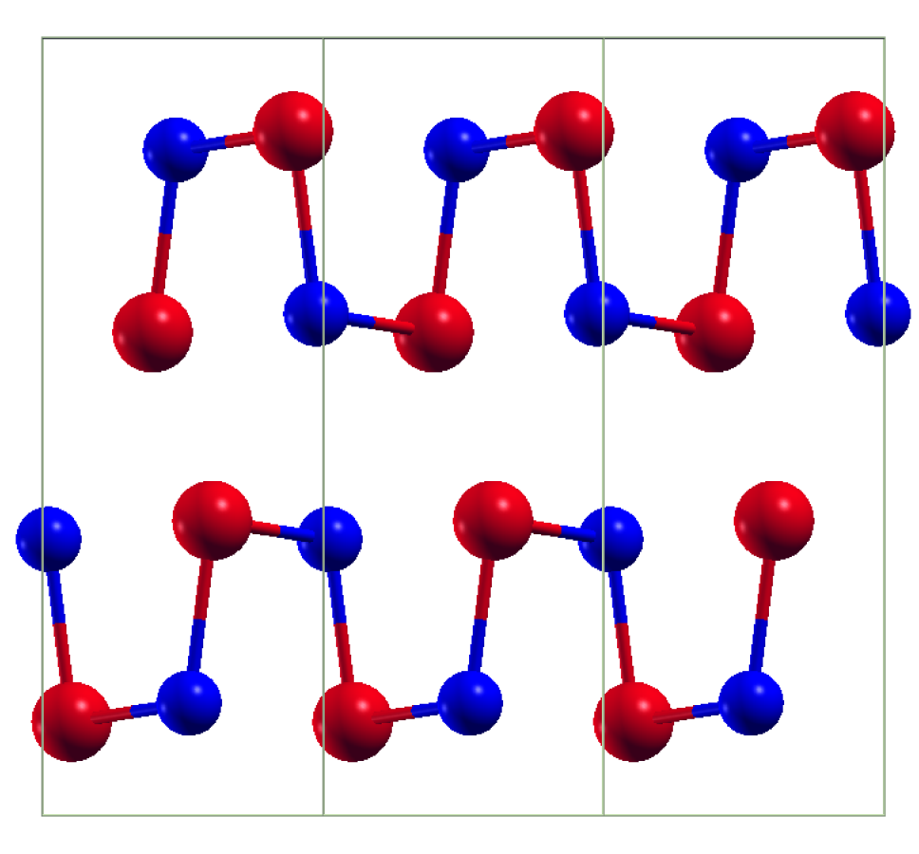
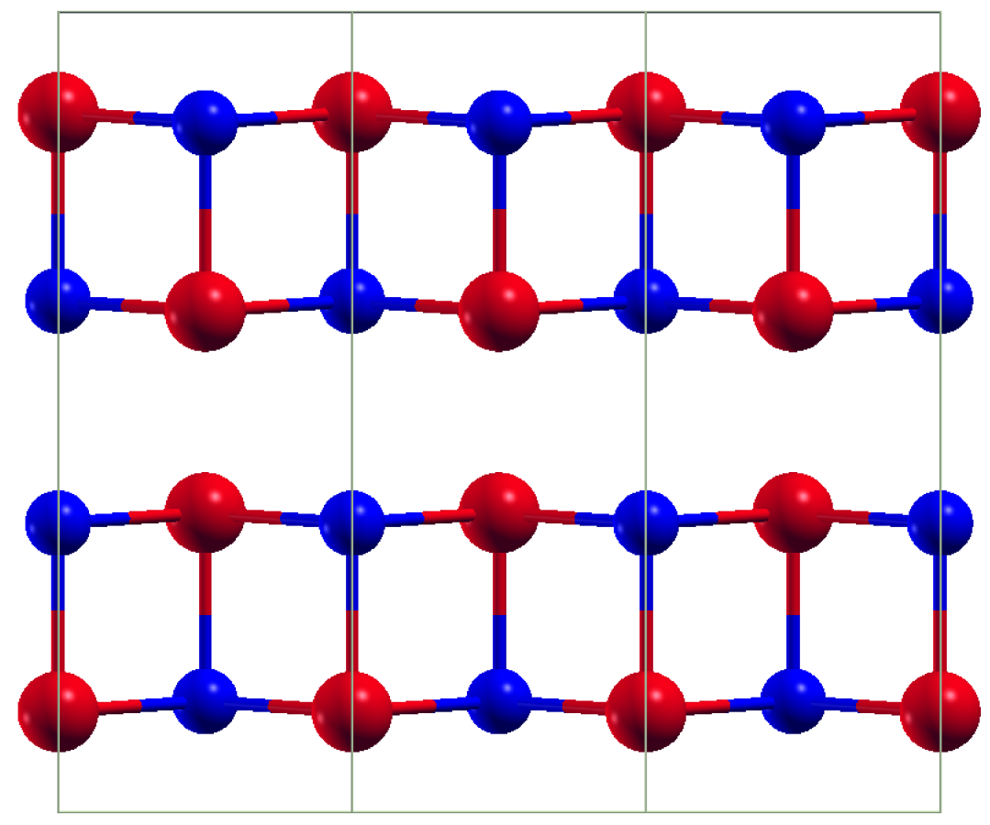
- Anisotropic crystal structure
- Narrow gap semiconductor
- Structural phase transition
Low T, low symmetry
Pnma
High T, high symmetry
Cmcm
Tc = 800 K

