Slide 1
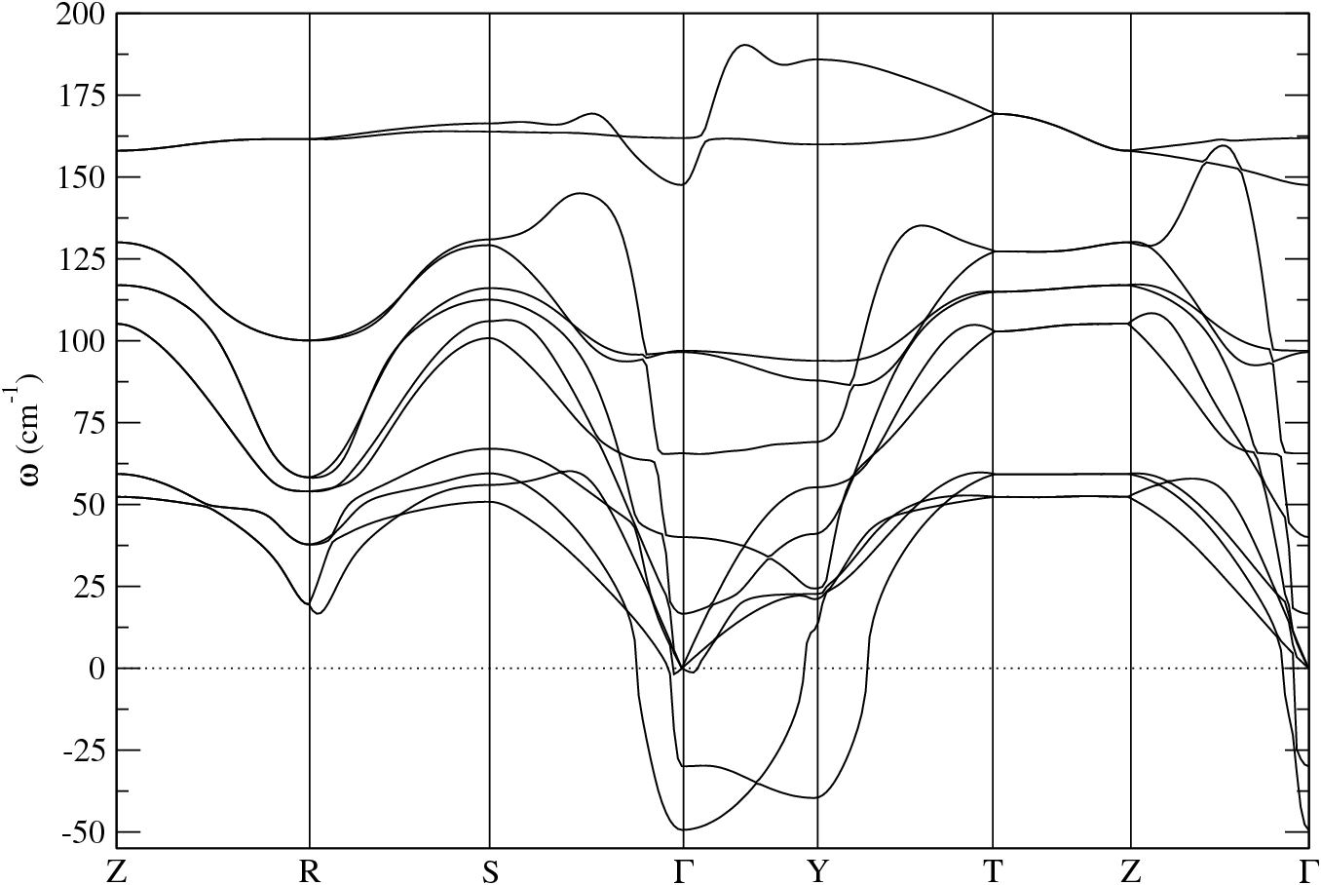
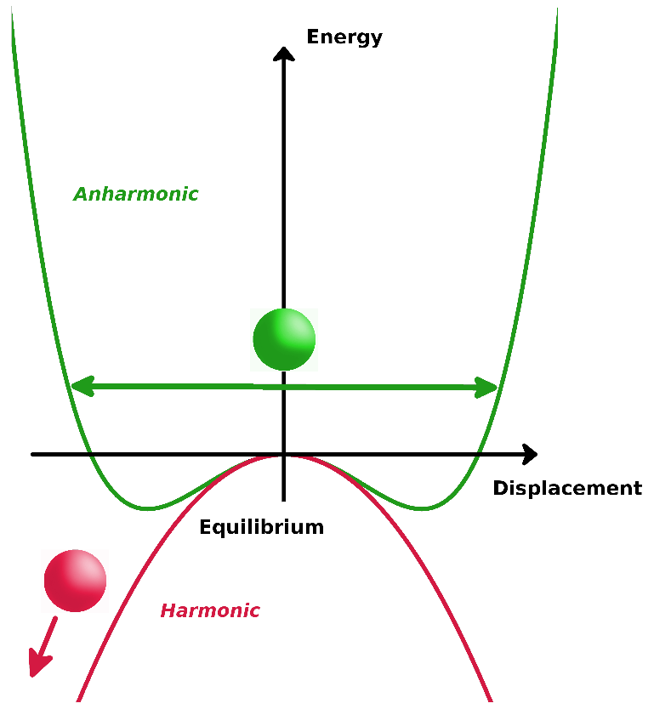
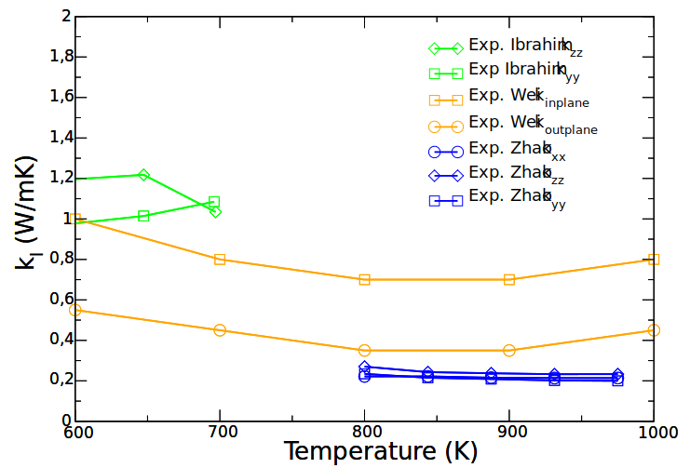
- Lattice instabilities in the harmonic approximation
- Ultralow thermal conductivity
- Experimental discrepancy
- Value
- Anisotropy
L.-D. Zhao et al. Nature 508, 373 (2014)

