Slide 1
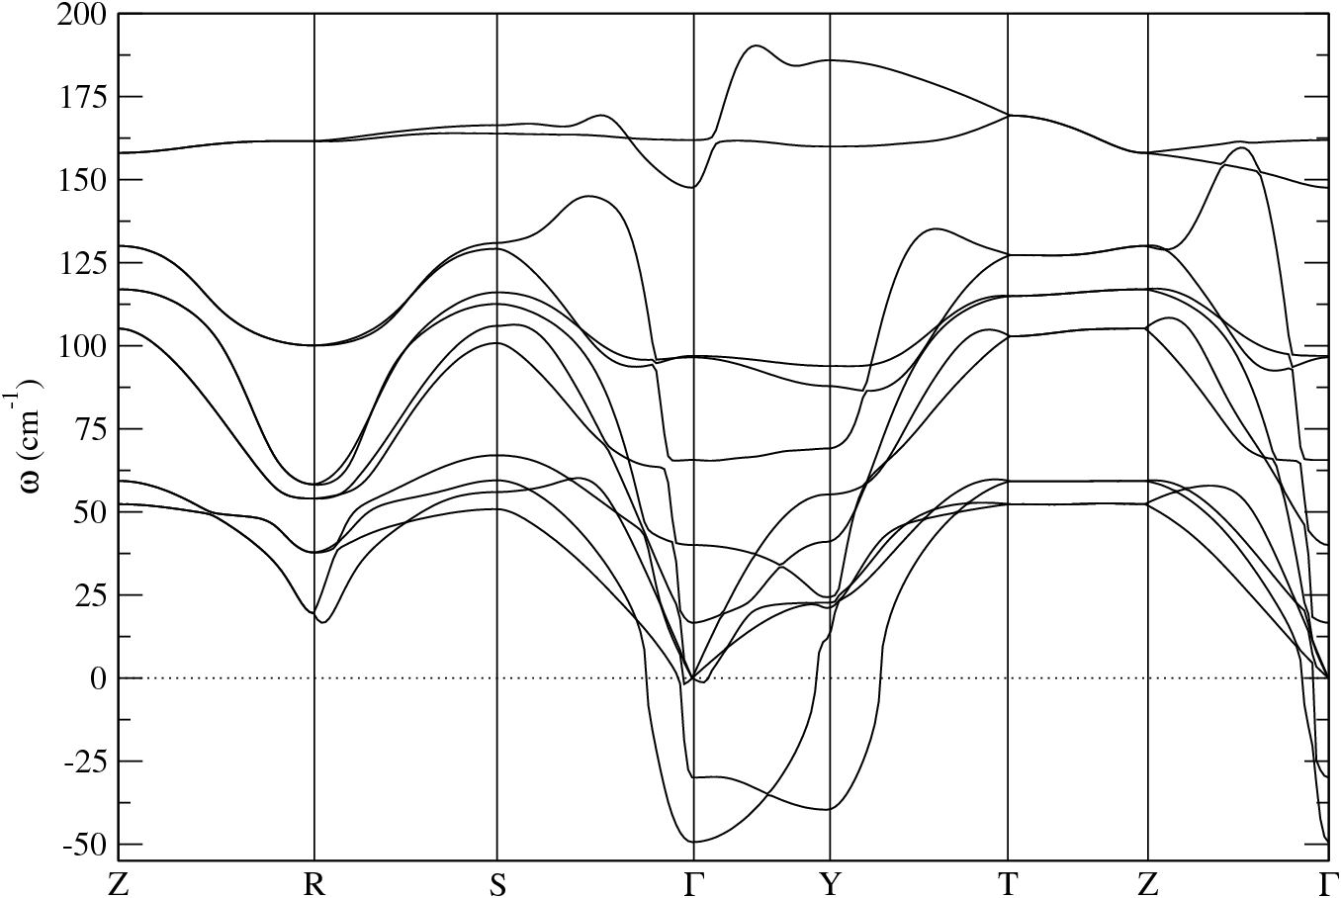
Cmcm
Pnma
x
+
=
y

