Slide 1
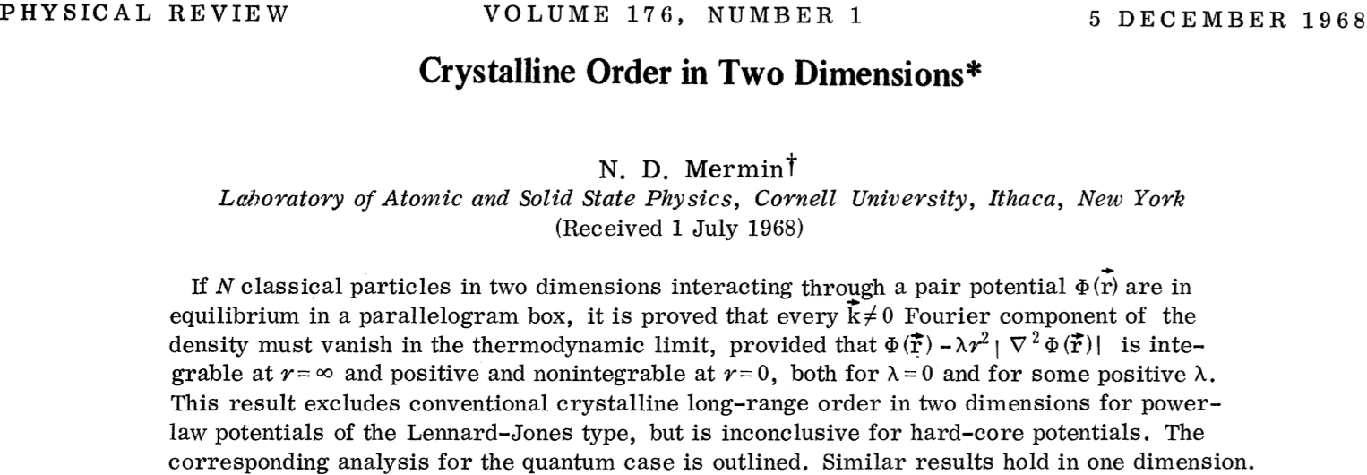
- The existence of 2D materials was not believed to be possible.
- Nowadays there is a whole branch of science sploiting their applications.

