Slide 1
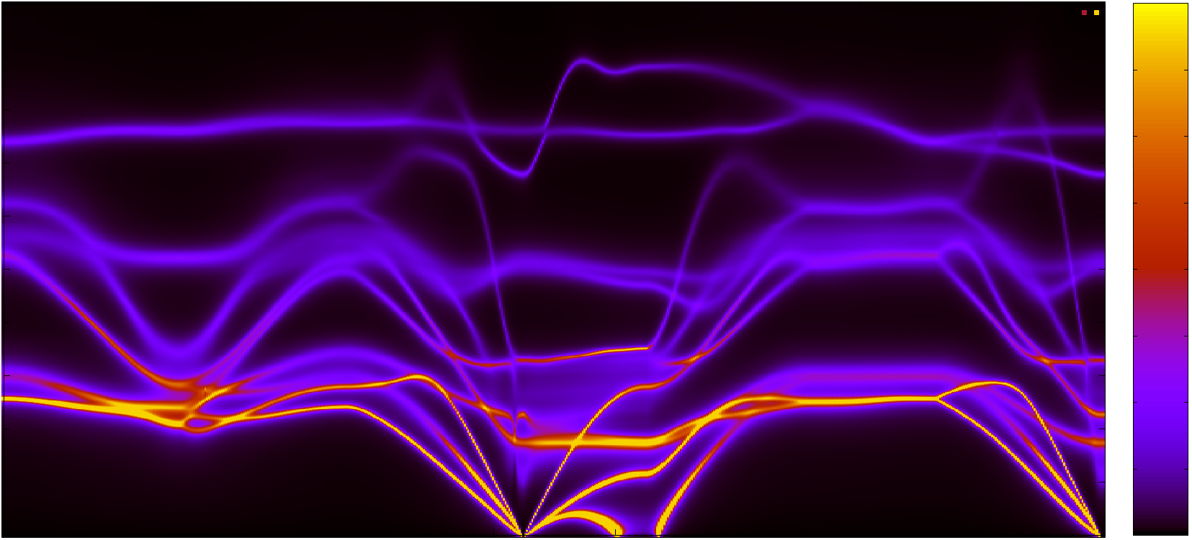
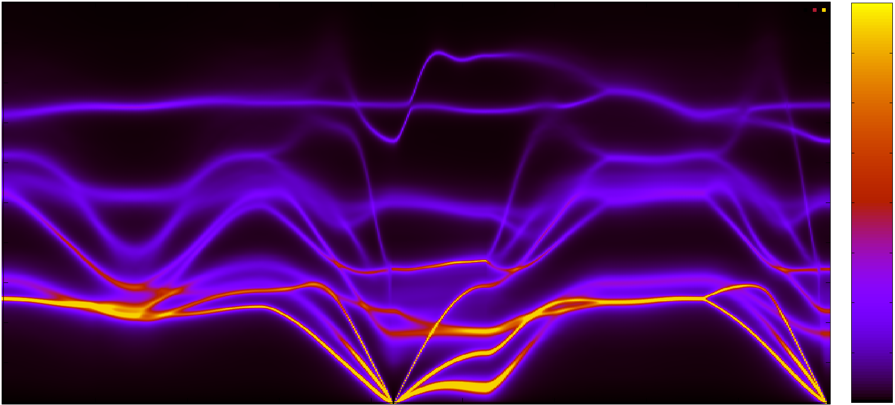
200
1500
175
150
125
1000
ω (cm⁻¹)
100
75
500
50
25
Below Tc
0
0
200
1500
175
150
125
1000
ω (cm⁻¹)
100
75
500
50
25
Above Tc
0
0
Z
R
S
Г
Y
T
Z
Г

