Slide 1
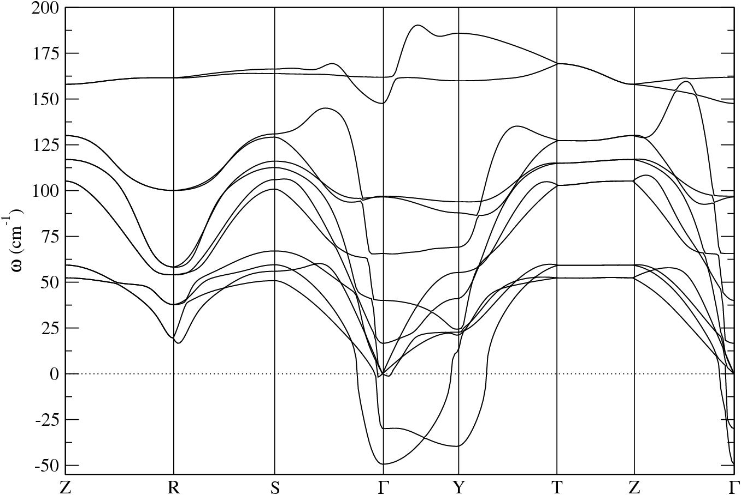
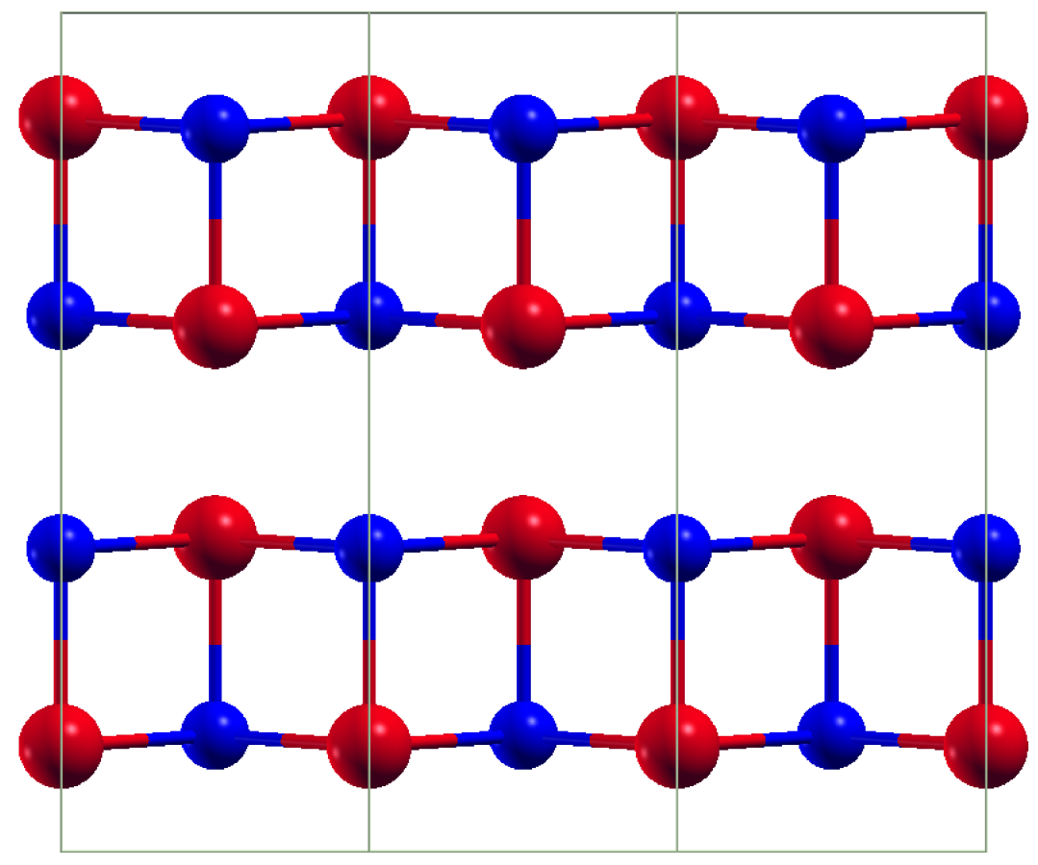
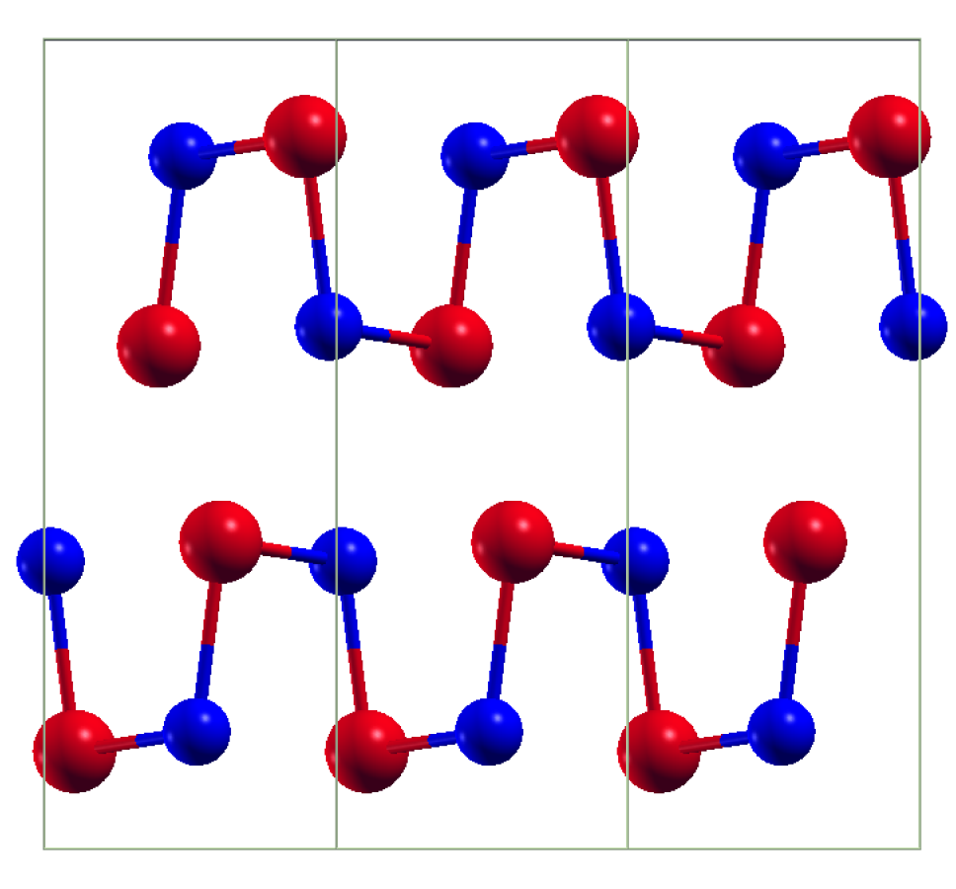
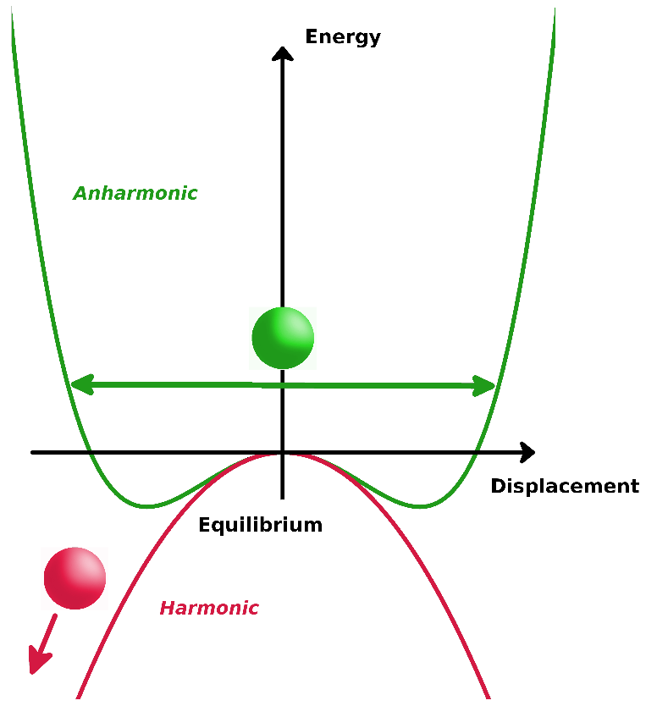
SnSe is not an exception:
High T
Cmcm
LATTICE INSTABILITIES
PHASE TRANSITION
Tc = 800 K
Low T
Pnma
Very low lattice thermal conductivity 0.3-1.0 W/mK (800 K)

