Slide 1
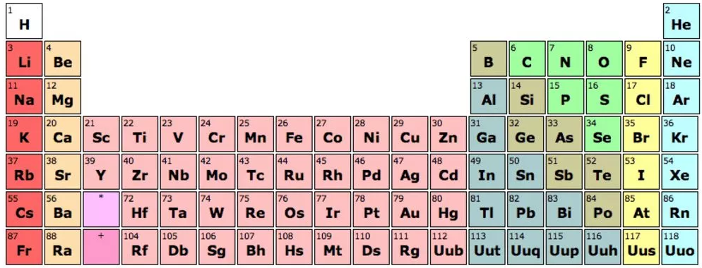
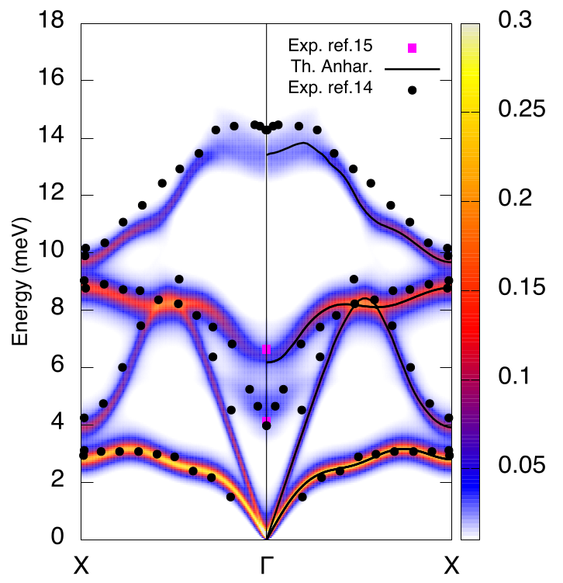
Chalcogenides
Monochalcogenides: PbTe, SnTe, GeTe, SnS...
Low lattice thermal conductivity
They show strongly anharmonic features:
- Lattice instabilities in the harmonic phonons
- Ferroelectric transitions
- Incipient ferroelectricity
- Special features in the phonon spectral function
G. A. Ribeiro et al. Physical Review B 97, 014306 (2018)

