Slide 1


High dimensional ambient space
$$x$$
$$Φ(⋅)$$
Nonlinear mapping
Inverse-mapping
Low dimensional manifold space

Slide 2




Input
$$φ^{−1}$$
Data Acquisition And
System Model
Input image
Model Estimate ($φ)$
Deep
Learning
Network
DLN
Iterate
Loss
Deep learning iteration
DL params ($θ)$
Output
Unroll Network
Model Agnostic DL Architecture
Model Aware DL Architecture

Slide 3

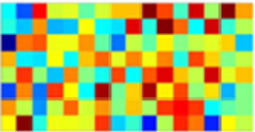
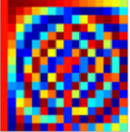







$$y$$
$$Φ$$
$$Ψ$$
$$α$$
$$=$$
Measurements
Sparse representation
$$x=Ψα$$
Non-sparse signal
$$x$$

Slide 4
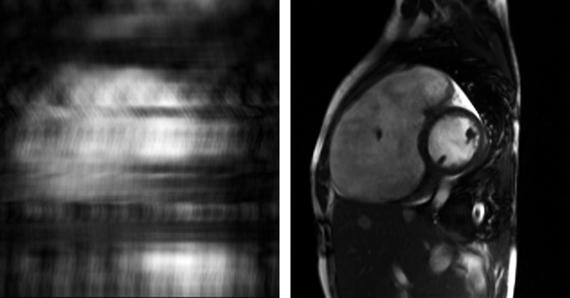
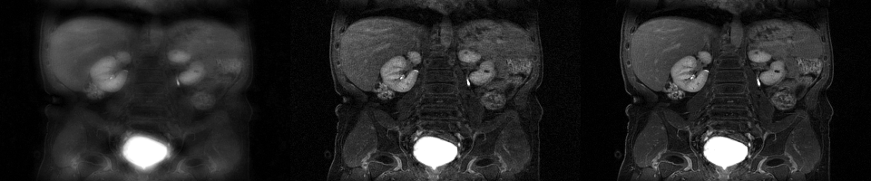
Left: Aliased image reconstructed from accelerated data acquisition. Right: Reconstructed high-quality images using our image reconstruction techniques.

Slide 5
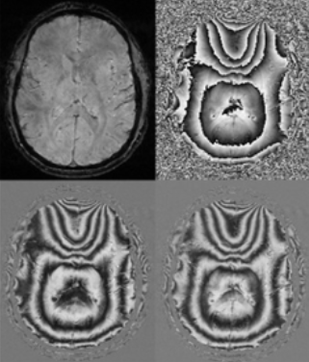
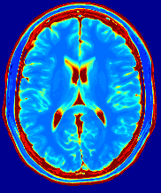
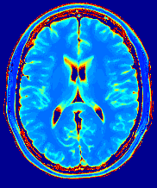
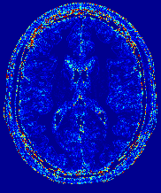
Left: Strong phase components in QSM imaging. Clockwise: Magnitude, Phase, Imaginary, and Real components of an image in QSM imaging. Right: Parameter Mapping MRI. Left to right: Gold standard, image reconstructed from reduced data samples, and error map.

Slide 6
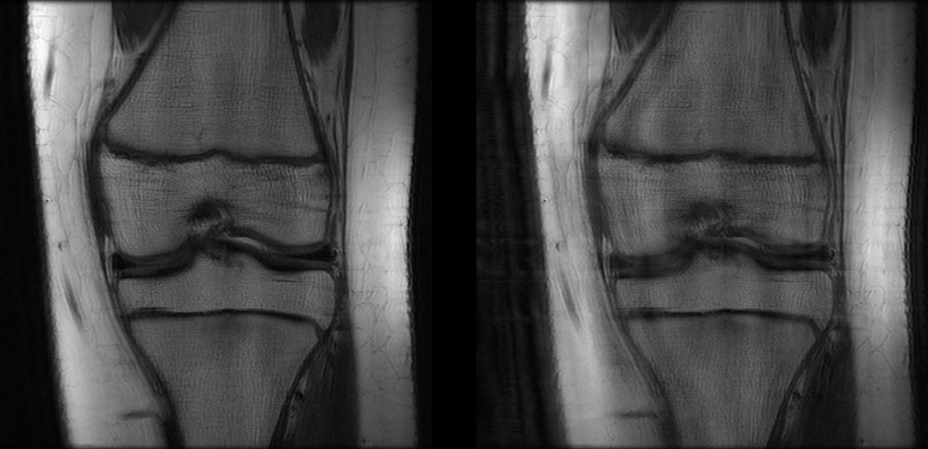
Motion free and motion simulated knee MR images.

Slide 7
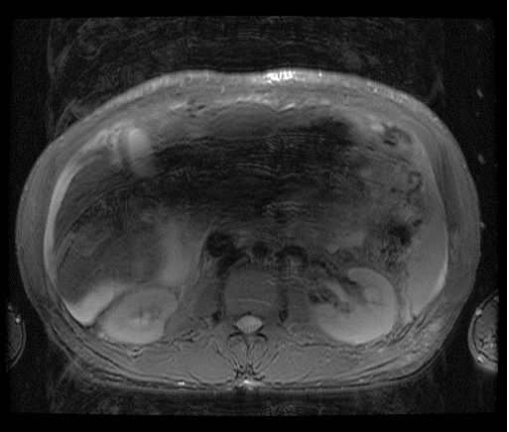
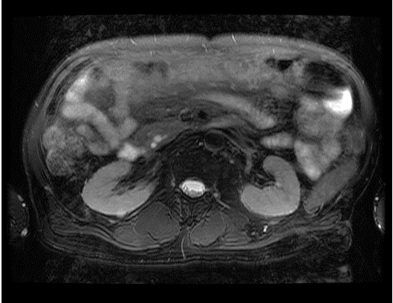
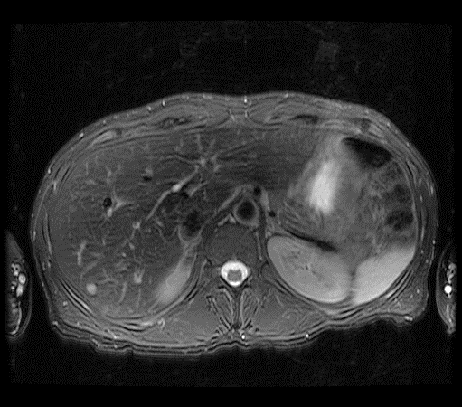
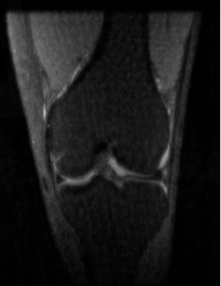

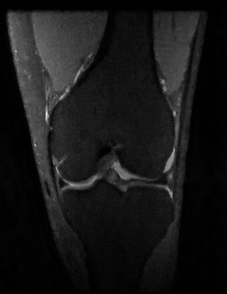
RNMSE = 0.0512
SSIM = 0.775
RNMSE = 0.0679
SSIM = 0.798
Top: Images with different degrees of artifacts pertaining degrees of motion. Bottom: Two different reconstructed versions of gold standard center image with conflicting quantitative reconstruction metric.

