Slide 1
Introduction to FPGA Simulation and Debug

Slide 2
Objective
Understand and select appropriate debugging tools for FPGA designs.
Hands on use of four different FPGA debug tools
Simulation
Modelsim
Actual Hardware
In-System Sources and Probes
Signal Tap Logic Analyzer
System Console Instrumentation
Notes:
The objective of this course is to familiarize students with various debugging tools available in Quartus by giving an introduction on how to use those tools. Further, try to understand which type of tool would be used to debug which designs. After completion of the labs, the student will be able to use Modelsim, have basic knowledge of signal tap , in-system signals and probe and System Console. We will start with Simulation Debugging Tool – Modelsim , move on to ISSP and Signal Tap and end with system Console

Slide 3
Simulation with ModelSim

Slide 4
Why Simulation?
+ Include wide range of analyses
+ Reduce development costs
+ Brings innovative products faster to market
+ Provide results that are impossible to measure on physical prototype.
+ High visibility of all signals in design
- Can take a very long time to run for large designs or excessive stimulus
- Designer has to predict and create stimulus that matches actual behavior
Notes:
Why would you use simulations for debugging? There are a lot of pros for using simulation for debugging. Firstly, design simulations are able to include wide range of analyses that virtually test behavior of a product under various operating and environmental conditions. As opposed to trial-and-error, a smart simulation process allows targeted implementation of design choices in various stages of the development cycle.
This drastically reduces the need for recurrent, time-consuming testing on expensive physical prototypes, and subsequently shortens the total development time. An effective design simulation process helps companies reduce development costs and bring innovative products to the market faster than the competition. Also, simulations may provide results through simulation models which are hard or even impossible to measure on physical prototypes.

Slide 5
Testbenches
TESTBENCH
A test bench or testing workbench is an environment used to verify the correctness or soundness of a design or model.
Design Under Test
(DUT)
Stimulus
Output

Slide 6
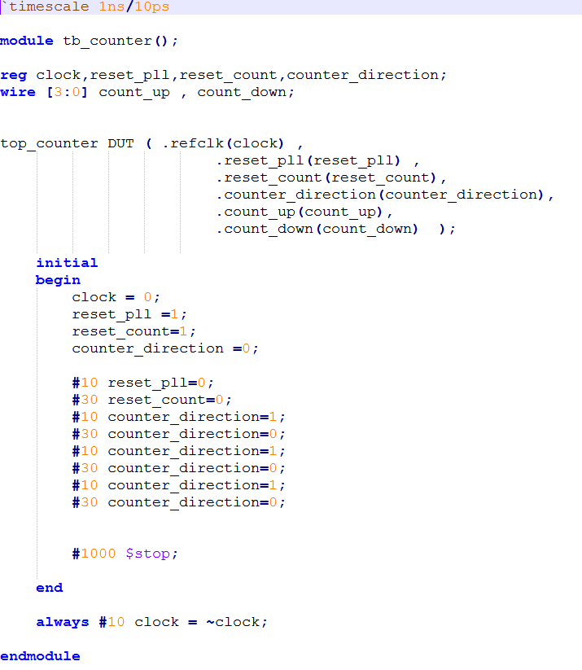
Verilog Testbench Constructs
Timescale
1st number is units, second is timing resolution
Inputs are reg, outputs are wires
Note: no module I/O
Initial Block
Runs only once (vs always block)
Stimulus
Best to change stimulus on the inactive edge of the clock – easier to read waveforms
Use $stop vs $finish or simulator closes
Clock

Slide 7
Handy Verilog Testbench Constructs
$dumpfile(“testbench_results.vcd”);
Specifies file to dump signals to view later in a waveform viewer
$dumpvars;
Dump all signals to dumpfile
$display("\t\ttime,\tclk,\treset,\tenable,\tcount");
Write text to console once
$monitor("%d,\t%b,\t%b,\t%b,\t%d",$time, clk,reset,enable,count);
Monitor signal activity – write upon events of sensitivity list

Slide 8
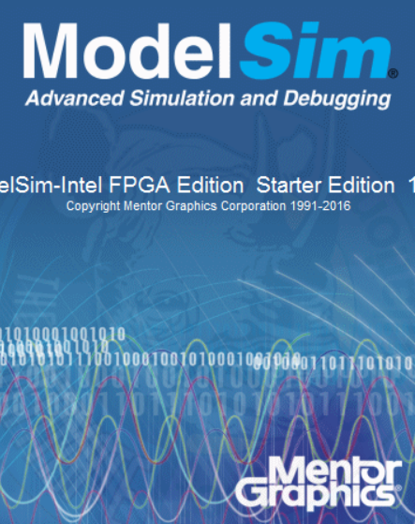
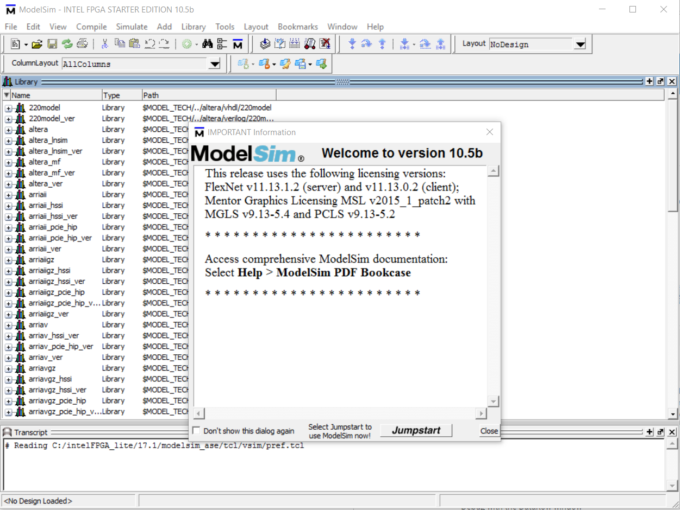
Mentor ModelSim Overview
ModelSim is a multi-language HDL (Verilog/VHDL) simulation environment. It can be used independently or Intel Quartus can create startup scripts and link designs to ModelSim.
Intel Quartus has a license to distribute Modelsim-Altera with Quartus .
Free Starter Edition: <=10K lines of code, runs slower
Notes:
For simulation debugging, we use the Modelsim Software. Modelsim is a multi-language HDL Simulation environment that can be used independently or Quartus can help create libraries and link the designs to ModelSim. For designs, proper functionality and timing is important to ensure success and ModelSim software simplifies it.

Slide 9
ModelSim
Create Project
Performed in Quartus
Compile Design
Note:
Only functional (non-timing) simulation is supported
Back-annotated timing model gate level simulations are not supported
Startup Script
Simulate
This script will link in all of external IP libraries so you don’t have to
OK
NO
Fix Design
YES
Done
Notes:
To verify that a design operates correctly we use simulation, which is a process of testing the design by applying inputs to a circuit and observing its behavior. The output of a simulation is a set of waveforms that show how a circuit behaves based on a given sequence of inputs. For using ModelSim from Quartus, we first create a project and compile the design in Quartus itself. Then use the modelsim tool for simulation debugging for the design. If the design is not working as required, we go back and fix the design and reiterate the steps until the design is functioning properly.

Slide 10
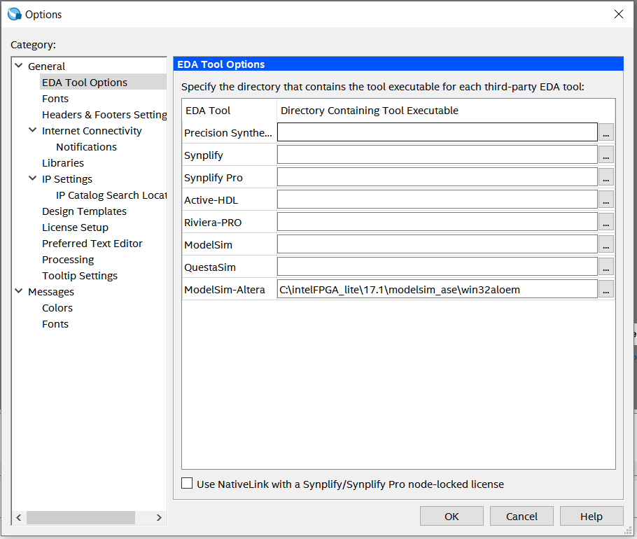
Setting up ModelSim from Intel Quartus
Specify EDA Tool Setting to generate simulation files.
Tools → Options → EDA Tool Options In ModelSim-Altera, enter the executable path
This path might be different for your own installation!
Notes:
How to set up ModelSim from Quartus. (Demo)
Go to Tools -> options -> EDA Tool Options & mention the executable pathway.
We use ModelSim-Altera as we get a free license with the download of Quartus. Has the same features as the ModelSIm PD edition, except needs the design to be 100% Verilog or 100% vhdl does not support mixed designs.

Slide 11
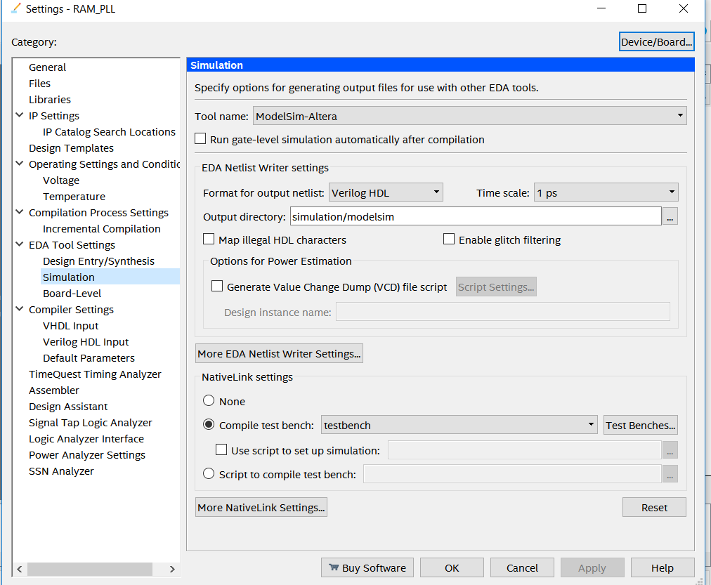
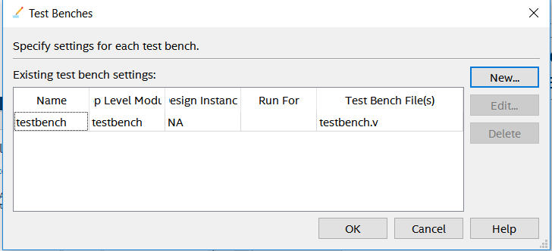
Setting up ModelSim from Intel Quartus
Assignments → Settings→ EDA Tools Settings → Simulation
In NativeLink Settings → Test Benches → NEW
Add New testbench → OK
Notes:
After that, need to be able to compile the testbench separately. Select the textnech file from assignments->Settings ->EDA Tools ->Simulation

Slide 12
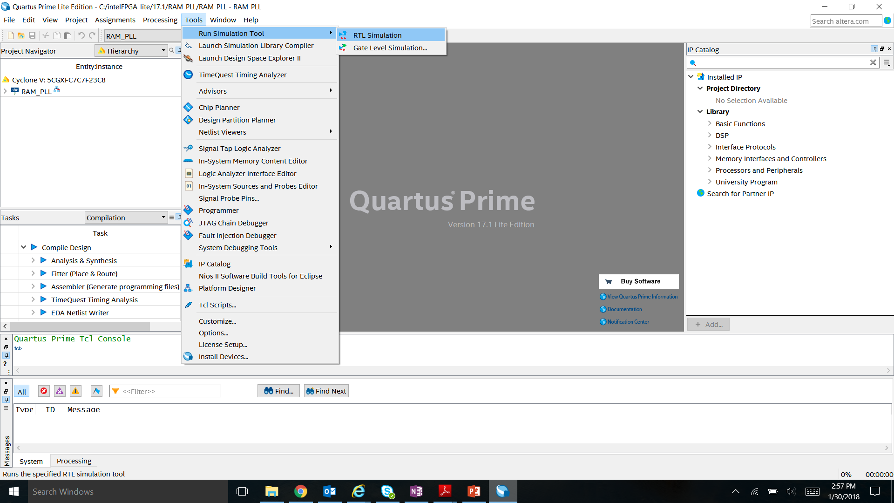
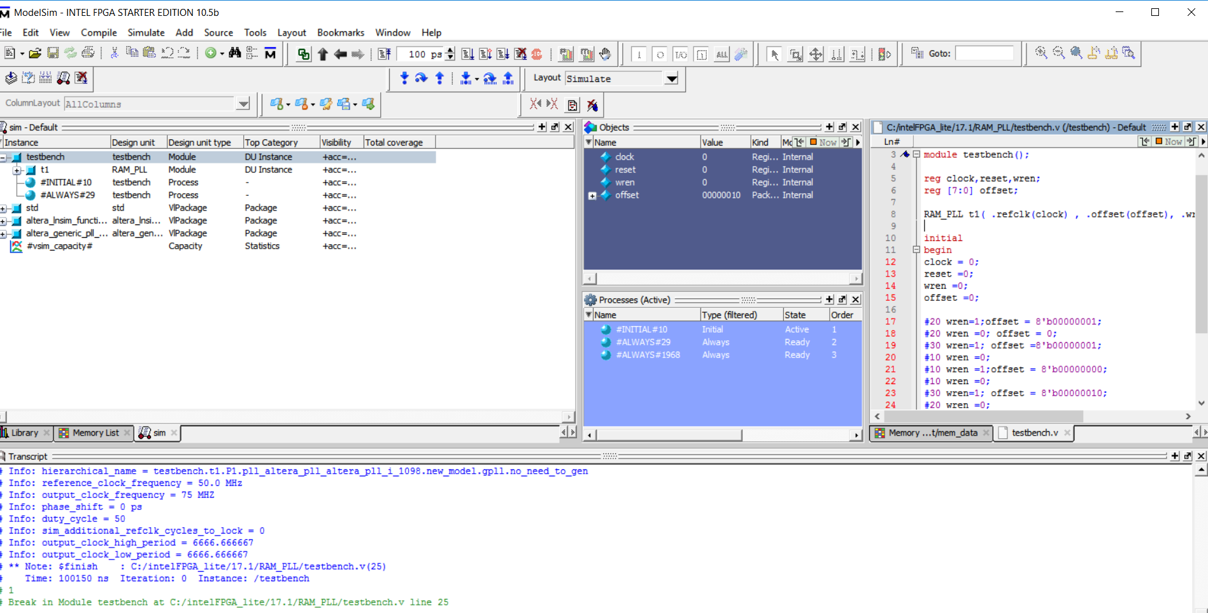
ModelSim GUI
Launching ModelSim from Quartus Tools →Run Simulation Tool → RTL Simulation
Simulation Objects
Testbench File
Command Transcript Window
Notes:
Show ModelSIM GUI. //DEMO
When Modelsim opens up, you will see all these windows. Each window has a different use. Transcript window allows you to write commands to run/stop simulations/ load designs. Simulation objects window allows you to view all different objects defined in the design. The files windows allows you to view Testbench and all the design files.
Different windows – transcript, files, simulation objects

