Slide 1
IMAGE INPAINTING
Made By:
SHOEB SIDDIQUI (2018701017)
SOWMYA AITHA (2018702007)
TANU SHARMA (2018702012)
https://github.com/unatsharma/DipProject.git

Slide 2

INTRODUCTION
What is Image Inpainting?
How is it done?
What are its applications?

Slide 3
INPAINTING
It is the process of reconstructing lost or
deteriorated parts of images or videos.
In digital world, it can is also known as image or
video interpolation.
In this project, we implemented an algorithm to
do so on digital images.

Slide 4

motivation
Recovering deteriorated old photographs (having cracks, scratches, torn etc)
Removing objects from images like stuntmen using cables or cords and actors using microphones
Eliminating text embedded or overwritten on images

Slide 5
approach
Start with an image and corresponding mask
Performing steps 3 and 4 iteratively and simultaneously
The structure of the area surrounding Ω is continued in the gap, contour lines are drawn via the prolongation of those arriving at ∂Ω.
The different regions inside Ω, as defined by the contour lines, are filled with color, matching those of ∂Ω.
After every few iterations of step 2, anisotropic diffusion is performed to ensure correct evolution of direction.

Slide 6
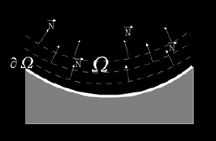
INFORMATION PROPAGATION

Slide 7
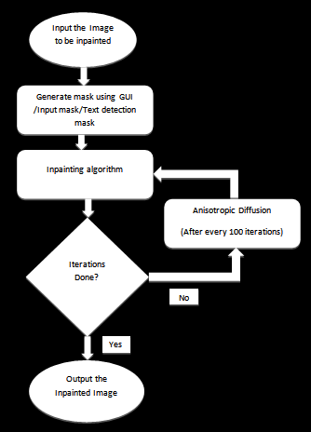
FLOW CHART

Slide 8
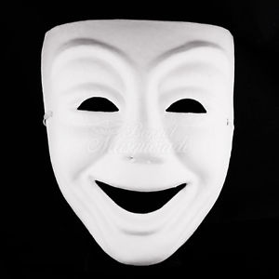
How to get mask?
TEXT DETECTION
UPLOADING MASK IMAGE
GENERATING MASK

Slide 9


Text detector
Algorithm:
Convert RGB to Gray
Find Gradient(G) and Edge(E) images using Sobel

Slide 10


Divide image into mxm non-overlapping blocks and find feature(F) for each block
Block classification to distinguish text and non-text edges
Finally perform closing and dilation to get better results

Slide 11
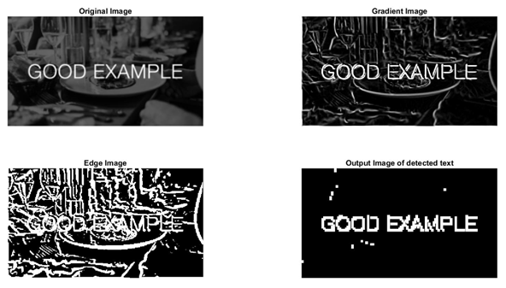
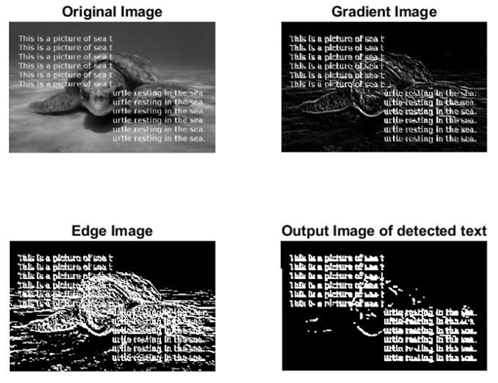
OUTPUTS

Slide 12
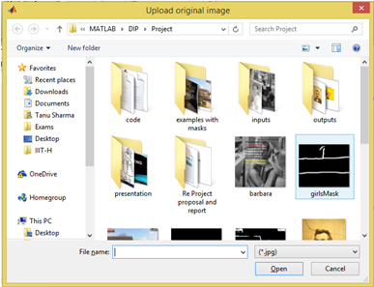
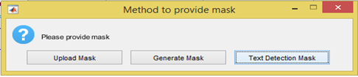
GUI

Slide 13
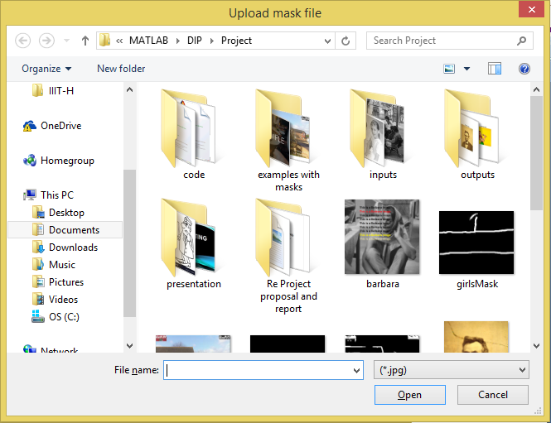
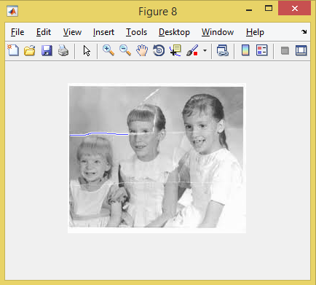

Slide 14
INPAINTING ALGO
Algorithm:
Convert RGB to HSI and work on each channel separately
For each pixel in the region to be inpainted repeat steps 3-5
Obtain the gradient of the Laplacian(L) that signifies the direction of information evolution.
Obtain the norm(N) of gradient, signifying the direction of the isophote lines.
Obtain a normalised gradient, given the direction of propagation of the curve and proportionally change the pixel value.

Slide 15

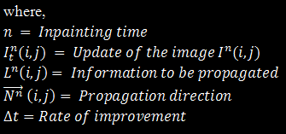
Equations used

Slide 16
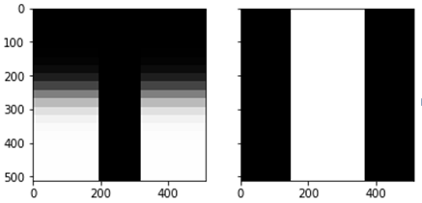

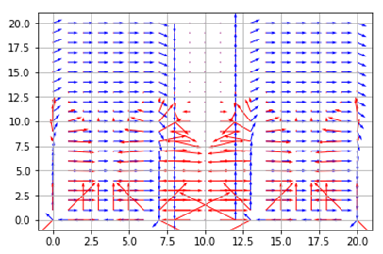
outputs
Before inpainting
Original image and mask(Left), Laplacian(Center) and Norm of gradient in blue, gradient of L in red(Right)

Slide 17

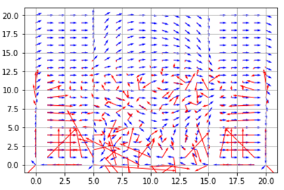
After 10,000 iterations of inpainting
Inpainted Image(Left) and Norm of gradient in blue, gradient of L in red(Right)

Slide 18
ANISOTROPIC DIFFUSION
Algorithm:
Work on each channel of the image separately
Find the gradient in all the eight directions
For each gradient image, calculate diffusion constants
Obtain sum of the dot products of each diffusion constant with the respective gradient
Add fraction of the improvement obtained to channel
Repeat Step 2-5 for n iterations.

Slide 19


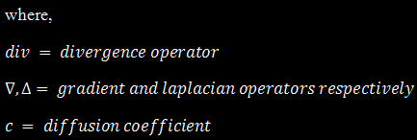
Equations used

Slide 20
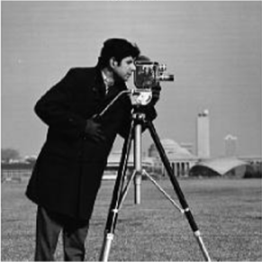
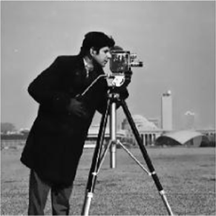
outputs
Image before
Anisotropic
Diffusion(Left)
and Image
after Anisotropic
Diffusion(Right)

Slide 21
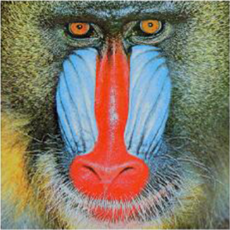
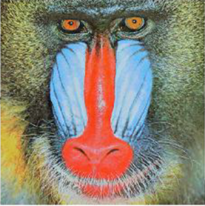
Image before
Anisotropic
Diffusion(Left)
and Image
after
Anisotropic
Diffusion(Right)

Slide 22

WE
GOT THE
SUCCESS

Slide 23
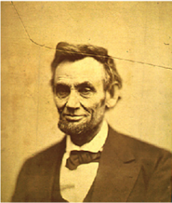

OUTPUTS
BEFORE
AFTER

Slide 24
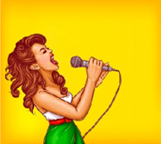
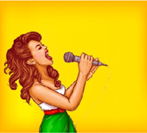
BEFORE
AFTER

Slide 25
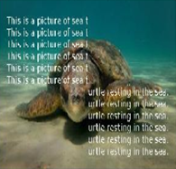
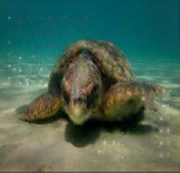
BEFORE
AFTER

Slide 26

WHERE
DOES
IT
FAIL…

Slide 27
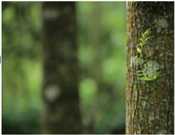
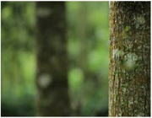
FAILURES
Texture not reproduced

Slide 28
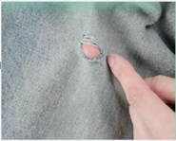
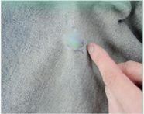
Texture not reproduced

Slide 29
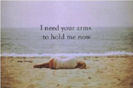
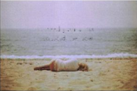
Improper mask used

Slide 30
CONCLUSIONS
This algorithm performs quite well under ideal conditions that are:
Region to be inpainted is smooth
There are no textures that need to be filled in
There is enough information at the boundary to be used
The mask is accurate

Slide 31

challenges
The time increases non-linearly with respect to the maximum width of the inpainting mask.
Non-smooth textures/noisy/high frequency changes in the region cause issues.
Mask extraction is generally inaccurate.

Slide 32
REFERENCES
[1] "Image Inpainting" by Marcelo Bertalmio and Guillermo Sapiro
[2] "Scale Space and Edge Detection Using Anisotropic Diffusion" by Pierto Perona and Jitendra Malik
[3] "Edge Based Method for Text detection from Complex Document Images" by Matti Pietikainen and Oleg Okun
[4] Wikipedia
[5] Some images obtained from internet

Slide 33


