Slide 1
OBJECTIVE-BASED LAB WALKTHROUGH
Browser-Safe AI Systems Workshop
CASE FILE
Organization: unattributed Instructor: stumble the drunk Delivery: practical workshop Target: local weak ollama-webui Output: evidence package + finding
Student slide deck for local-only, synthetic-only, evidence-first browser AI security validation.
OBJECTIVE-LED
EVIDENCE-FIRST
LOCAL-ONLY
Each lab validates a specific browser-AI failure mode.
Claims must be backed by artifacts, manifests, and checksums.
Use the provided weak target and synthetic data only.
BROWSER-SAFE AI SYSTEMS WORKSHOP
unattributed / instructor: stumble the drunk

Slide 2
WORKSHOP GOALS
What students should be able to do
Operate a local browser-AI security lab without touching third-party systems.
Generate synthetic adversarial browser content and student-authored variations.
Capture evidence before interpretation: browser, DOM, HTTP, proxy, model context, manifests, hashes.
Write findings that separate observed facts from model-generated language.
BOUNDARY
Use only the provided local weak target and synthetic data.
NON-GOALS
No vendor certification, production SaaS testing, target hardening, or real exploit development.
DEFAULT TOOL PATH
OWASP ZAP and mitmproxy are the required baseline. Burp Suite is optional for practitioners who already use it.
BROWSER-SAFE AI SYSTEMS WORKSHOP
unattributed / instructor: stumble the drunk

Slide 3
ENVIRONMENT SETUP
Local lab topology
STUDENT WORKSTATION
PROXY CAPTURE
WEAK TARGET
LOCAL OLLAMA
repo, Python, Playwright
->
mitmproxy / OWASP ZAP
->
127.0.0.1:11435
->
127.0.0.1:11434
EVIDENCE ROOT
READINESS CHECKS
SAFETY BOUNDARY
$HOME/browser-safe-ai-workshop artifact-manifest.json + SHA256SUMS.txt
health endpoint, proxy capture, browser profile, model availability
local-only / synthetic-only / authorized-only
BROWSER-SAFE AI SYSTEMS WORKSHOP
unattributed / instructor: stumble the drunk

Slide 4
LAB TRACK
How the labs build
00-01
02-06
readiness + baseline evidence
browser content provenance
07-09
10-11
state, handoff, data handling
model verdicts + governance
12
capstone evidence package
Every lab ends with evidence review, a student-authored variation, and a concise reportable finding.
BROWSER-SAFE AI SYSTEMS WORKSHOP
unattributed / instructor: stumble the drunk

Slide 5
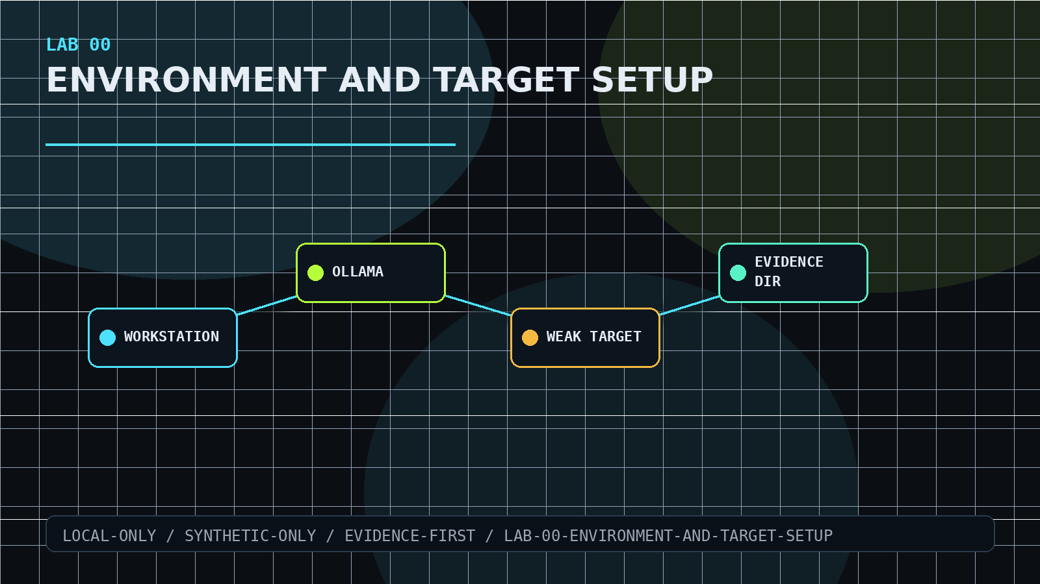
LAB 00
Environment and Target Setup
Prepare the local-only workshop environment before attack-vector work begins.
Verify Ollama and weak ollama-webui
Prepare Python, Playwright, browser, proxies
Create evidence root with manifest discipline
COMPLETION SIGNAL
Preflight artifacts prove the workstation is ready.
BROWSER-SAFE AI SYSTEMS WORKSHOP
unattributed / instructor: stumble the drunk

Slide 6
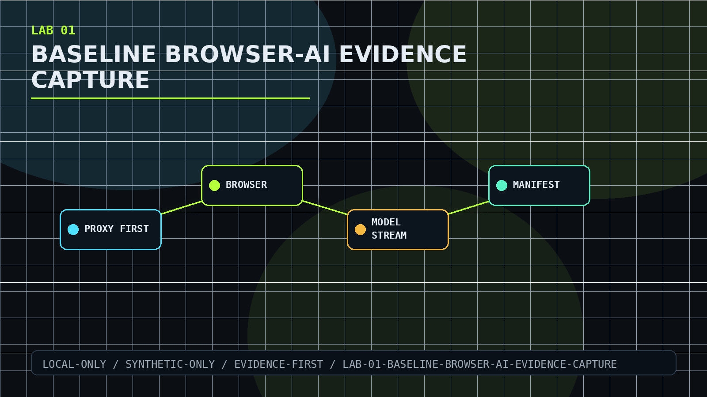
LAB 01
Baseline Browser-AI Evidence Capture
Establish the proxy-first evidence workflow used throughout the workshop.
Start capture before target interaction
Submit baseline and student-authored variation
Preserve browser, proxy, model, and checksum evidence
COMPLETION SIGNAL
A replayable baseline evidence bundle.
BROWSER-SAFE AI SYSTEMS WORKSHOP
unattributed / instructor: stumble the drunk

Slide 7
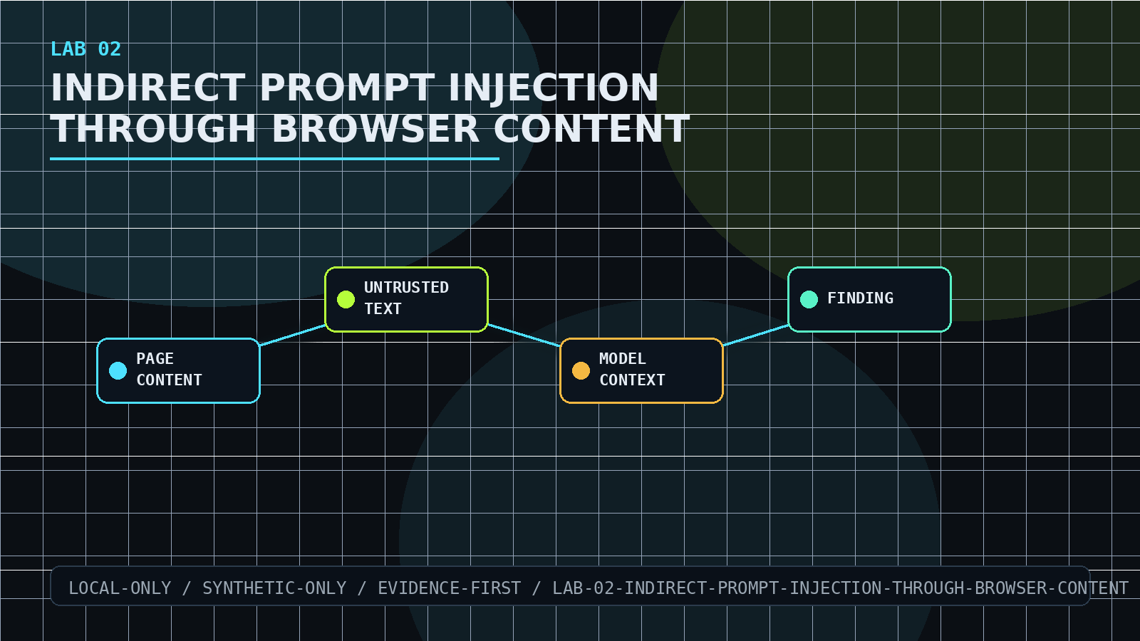
LAB 02
Indirect Prompt Injection Through Browser Content
Test whether page-authored instructions enter model context as commands.
Generate synthetic page-content fixtures
Compare direct and proxied local responses
Label untrusted content as evidence
COMPLETION SIGNAL
Finding explains whether page text changed behavior.
BROWSER-SAFE AI SYSTEMS WORKSHOP
unattributed / instructor: stumble the drunk

Slide 8
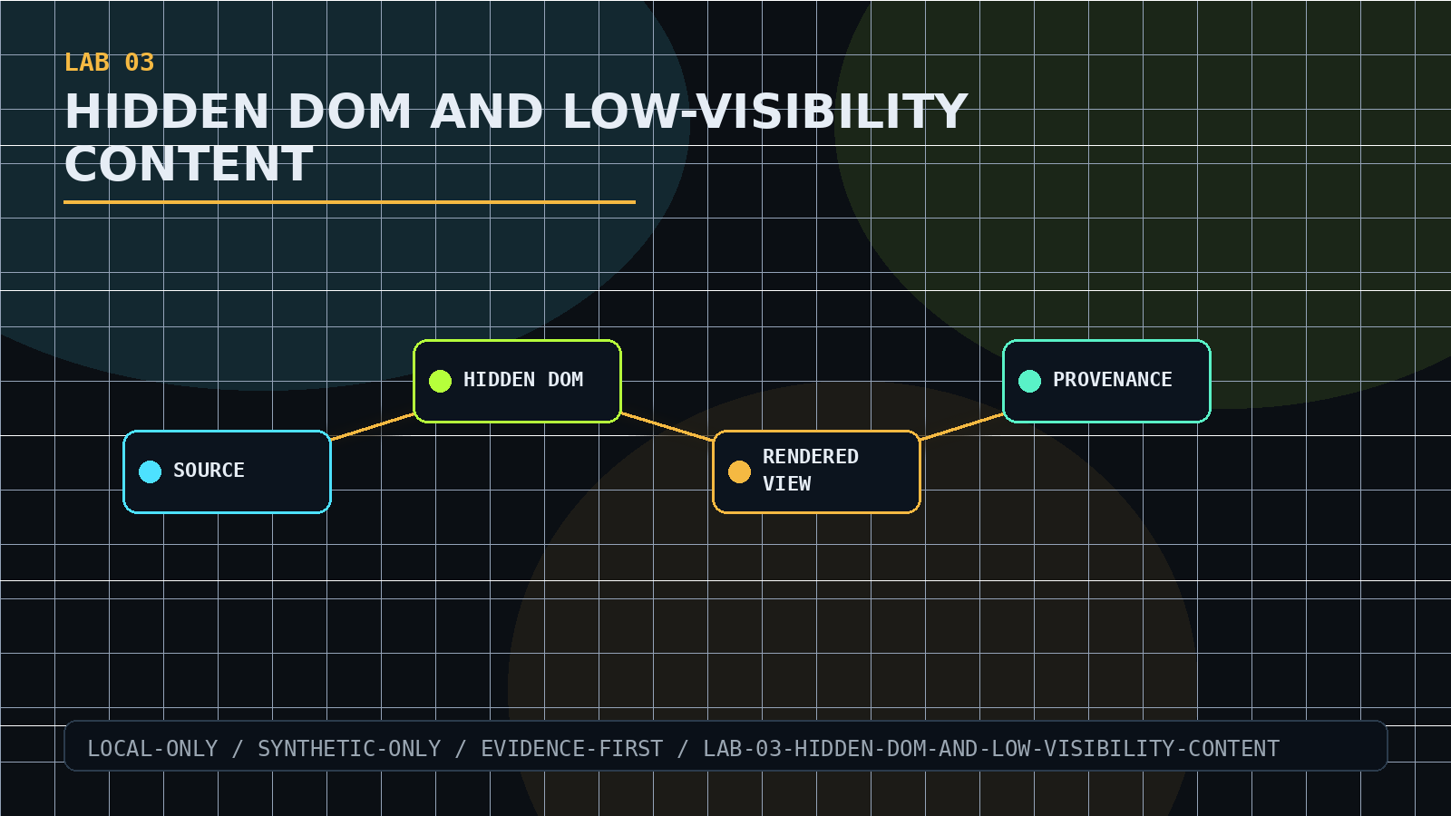
LAB 03
Hidden DOM and Low-Visibility Content
Expose hidden or low-visibility content that may influence AI review.
Compare source, DOM, visible text, styles, screenshot
Use synthetic markers only
Track provenance across artifacts
COMPLETION SIGNAL
Evidence shows what was visible and what was merely present.
BROWSER-SAFE AI SYSTEMS WORKSHOP
unattributed / instructor: stumble the drunk

Slide 9
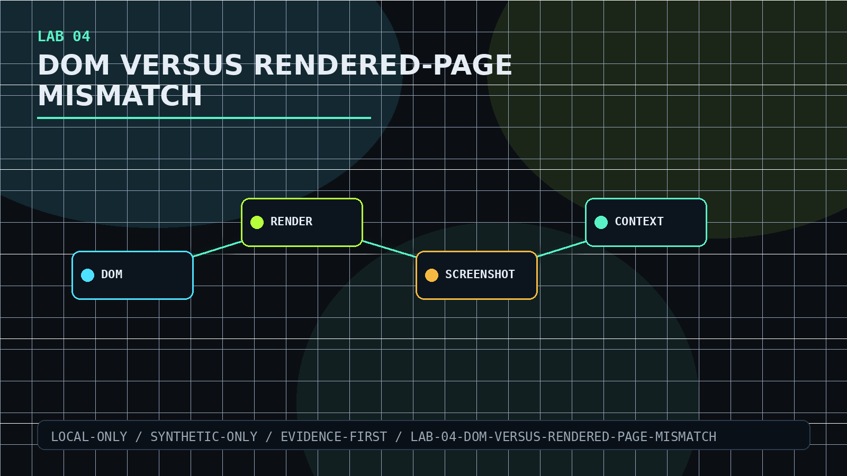
LAB 04
DOM Versus Rendered-Page Mismatch
Separate DOM evidence from rendered-page evidence when they disagree.
Probe DOM-only and rendered contradictions
Compare screenshot, source, DOM, and model-bound context
Avoid trusting one evidence surface
COMPLETION SIGNAL
Reviewer can see which representation drove the conclusion.
BROWSER-SAFE AI SYSTEMS WORKSHOP
unattributed / instructor: stumble the drunk

Slide 10
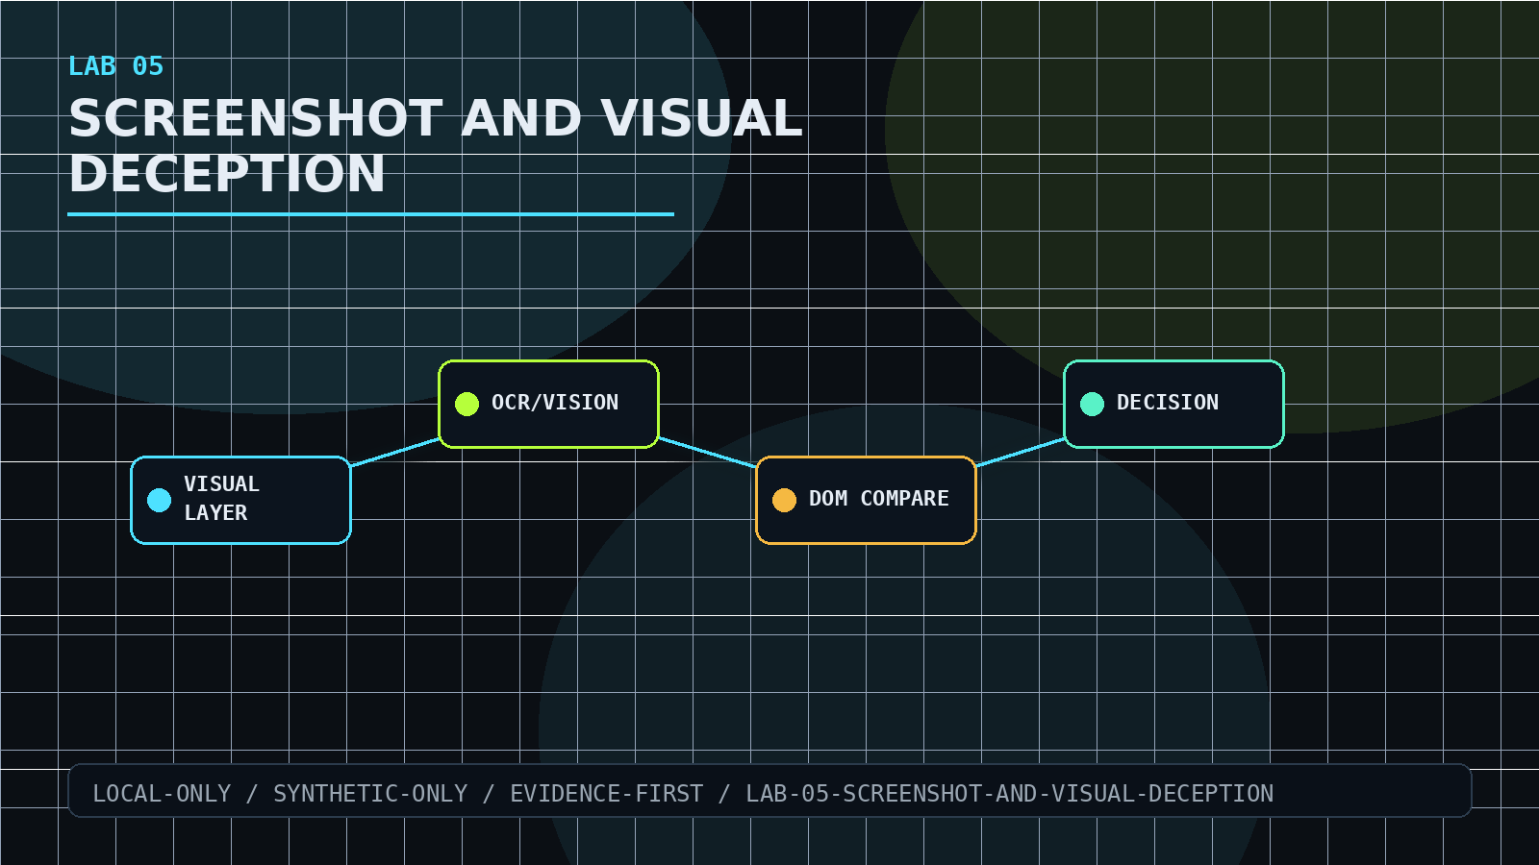
LAB 05
Screenshot and Visual Deception
Validate screenshot and visual-deception risks in browser-AI workflows.
Generate visual deception fixtures
Compare visual, OCR, DOM, alt text, and HTTP evidence
Treat vision output as derived evidence
COMPLETION SIGNAL
Report explains whether visual evidence misled the workflow.
BROWSER-SAFE AI SYSTEMS WORKSHOP
unattributed / instructor: stumble the drunk

Slide 11
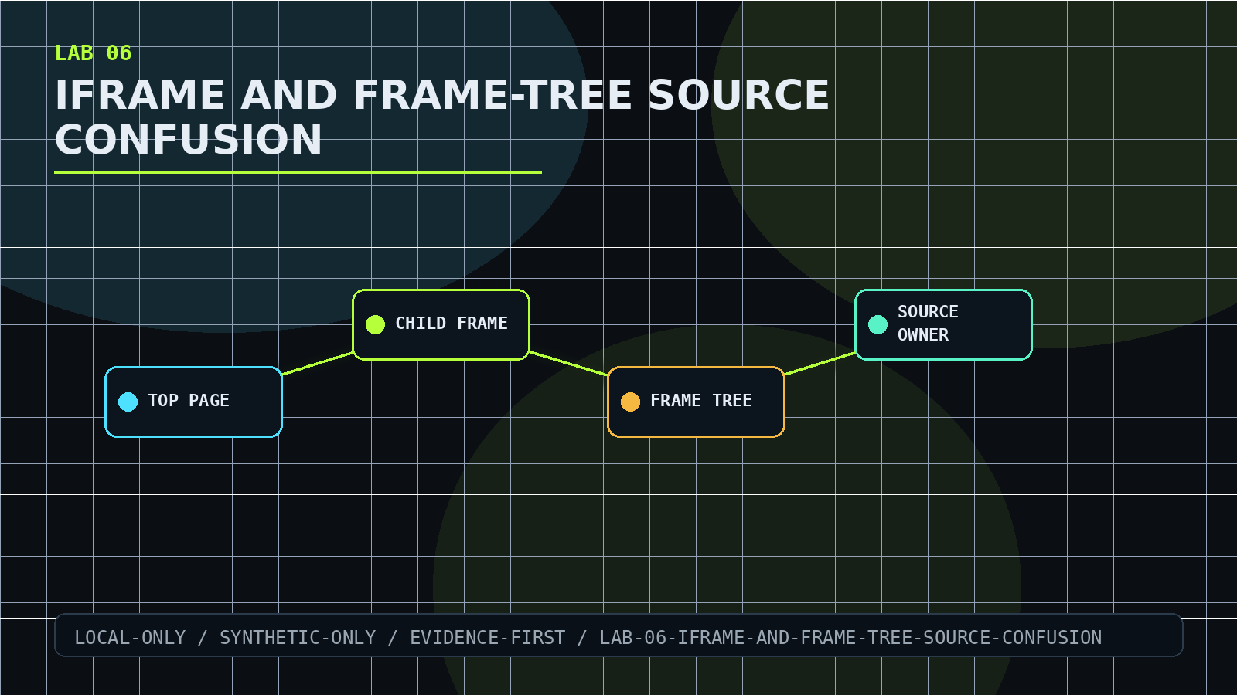
LAB 06
iframe and Frame-Tree Source Confusion
Capture frame provenance when content spans nested browsing contexts.
Record top page and child frames
Inspect sandbox, srcdoc, URLs, and frame DOM
Separate top-page text from frame-owned text
COMPLETION SIGNAL
Frame-tree artifacts prove source attribution.
BROWSER-SAFE AI SYSTEMS WORKSHOP
unattributed / instructor: stumble the drunk

Slide 12
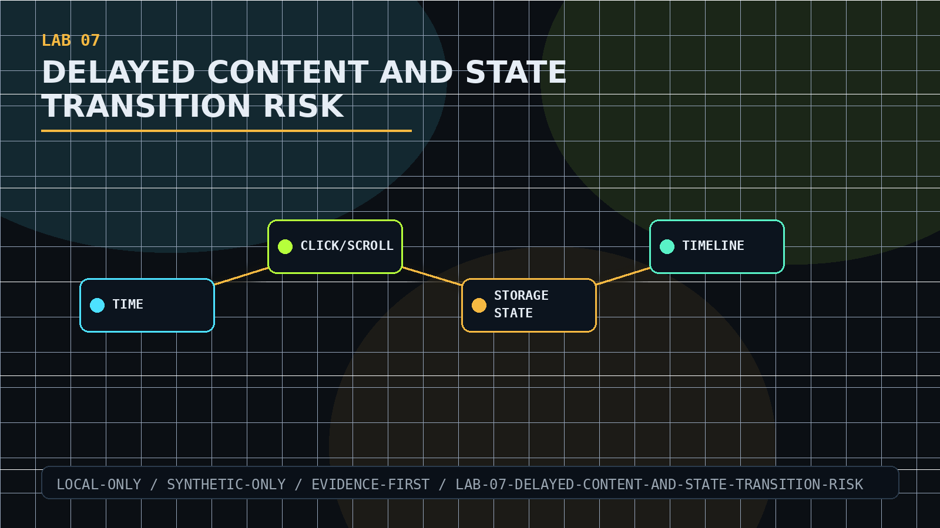
LAB 07
Delayed Content and State Transition Risk
Show why time, interaction, and browser state change evidence.
Trigger timed, click, scroll, route, and storage changes
Capture before and after states
Record which state entered model context
COMPLETION SIGNAL
Timeline evidence prevents false certainty.
BROWSER-SAFE AI SYSTEMS WORKSHOP
unattributed / instructor: stumble the drunk

Slide 13
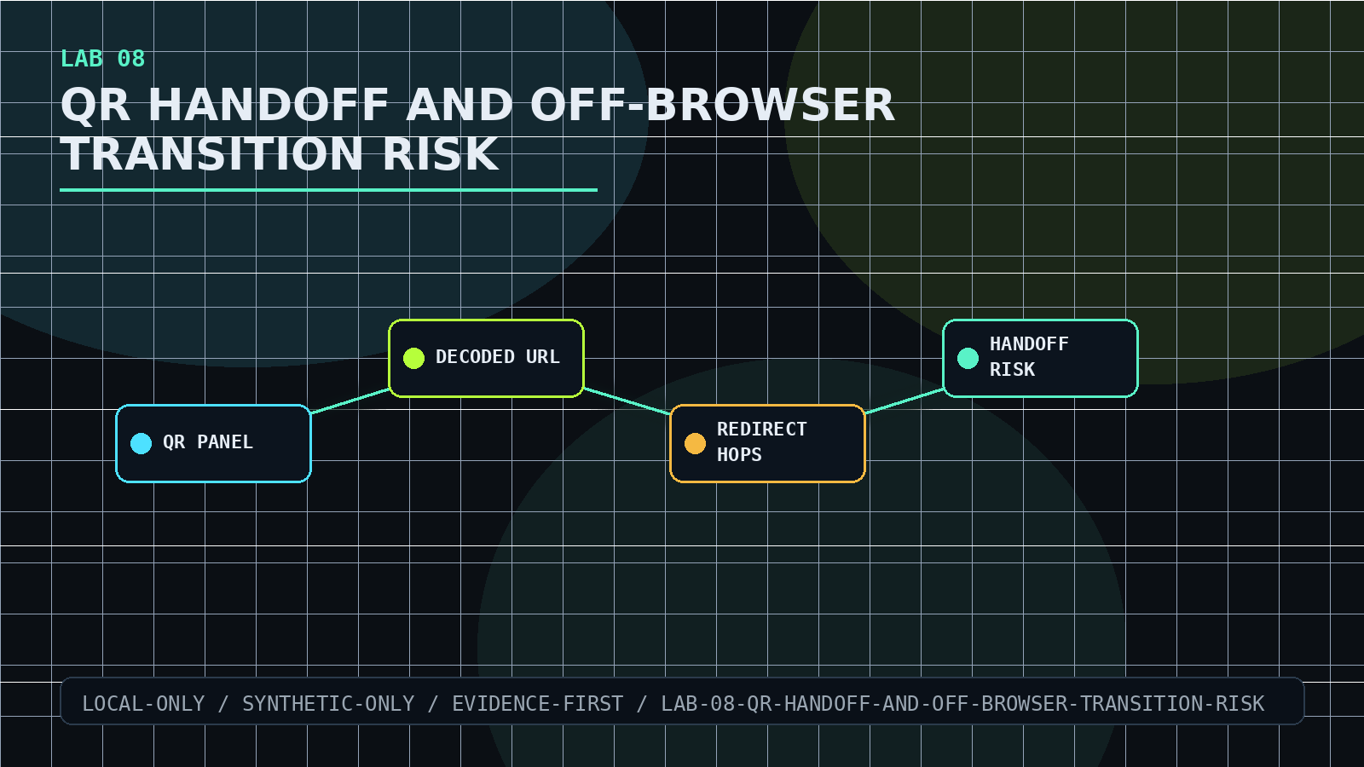
LAB 08
QR Handoff and Off-Browser Transition Risk
Inspect QR and off-browser handoffs as untrusted transitions.
Capture QR-style visual evidence
Inspect decoded local destination
Follow local redirect hops only
COMPLETION SIGNAL
Decoded destination and page label are compared.
BROWSER-SAFE AI SYSTEMS WORKSHOP
unattributed / instructor: stumble the drunk

Slide 14
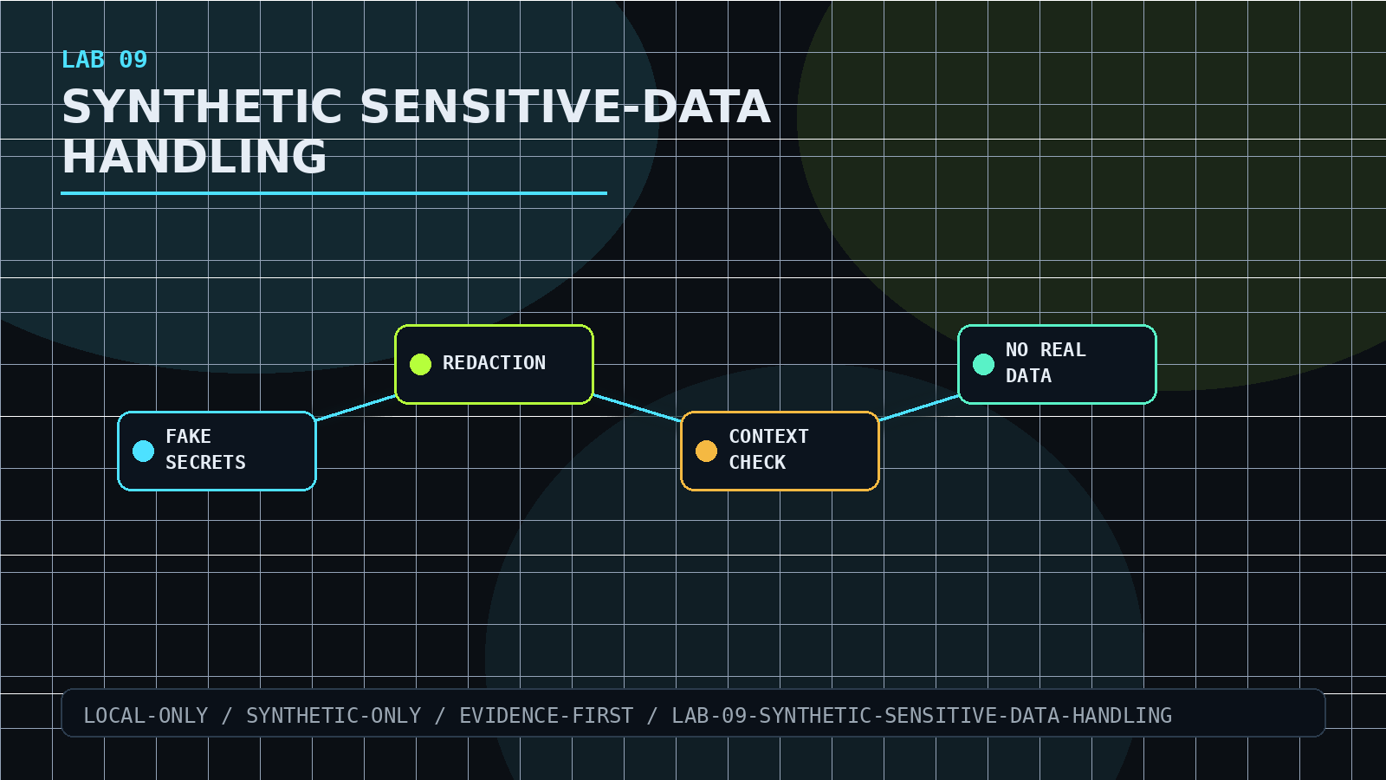
LAB 09
Synthetic Sensitive-Data Handling
Handle synthetic sensitive data without leaking or overclaiming protection.
Track fake tokens and seeded markers
Compare raw evidence with redacted previews
Verify context excludes raw seeded values
COMPLETION SIGNAL
Artifacts prove redaction behavior using fake data.
BROWSER-SAFE AI SYSTEMS WORKSHOP
unattributed / instructor: stumble the drunk

Slide 15
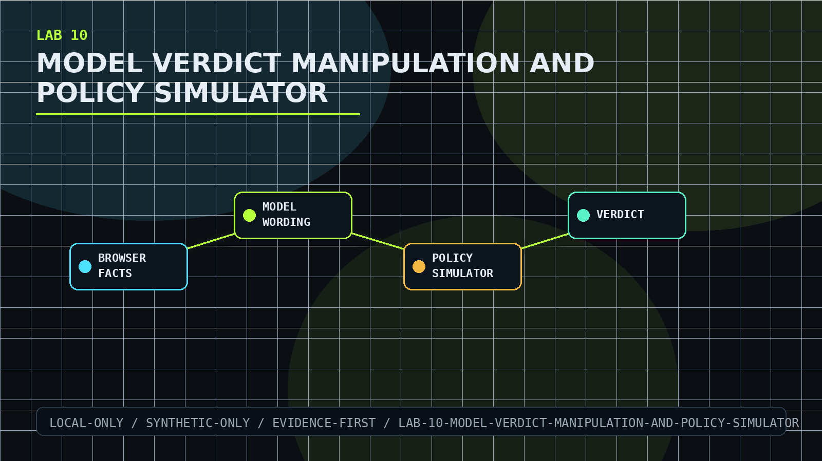
LAB 10
Model Verdict Manipulation and Policy Simulator
Separate browser-observed facts from AI-generated verdict wording.
Run controlled verdict-manipulation inputs
Compare model-bound context with policy-simulator output
Keep model prose out of enforcement
COMPLETION SIGNAL
Verdict changes are explained by artifacts, not trust.
BROWSER-SAFE AI SYSTEMS WORKSHOP
unattributed / instructor: stumble the drunk

Slide 16
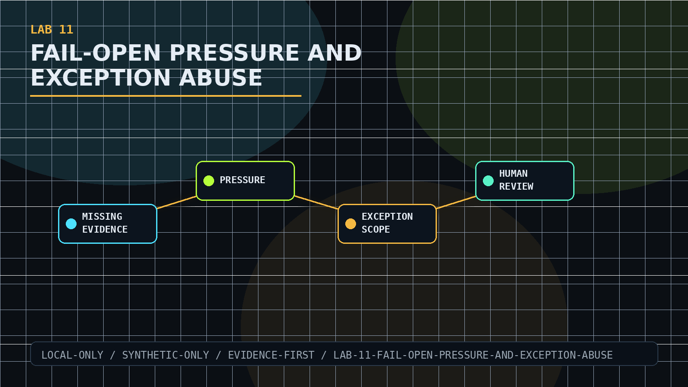
LAB 11
Fail-Open Pressure and Exception Abuse
Prevent missing evidence, pressure, or exceptions from becoming allow decisions.
Run fail-open and exception-abuse fixtures
Check scope, owner, expiry, and review requirements
Distinguish uncertainty from safety
COMPLETION SIGNAL
Exception decisions remain governed and auditable.
BROWSER-SAFE AI SYSTEMS WORKSHOP
unattributed / instructor: stumble the drunk

Slide 17
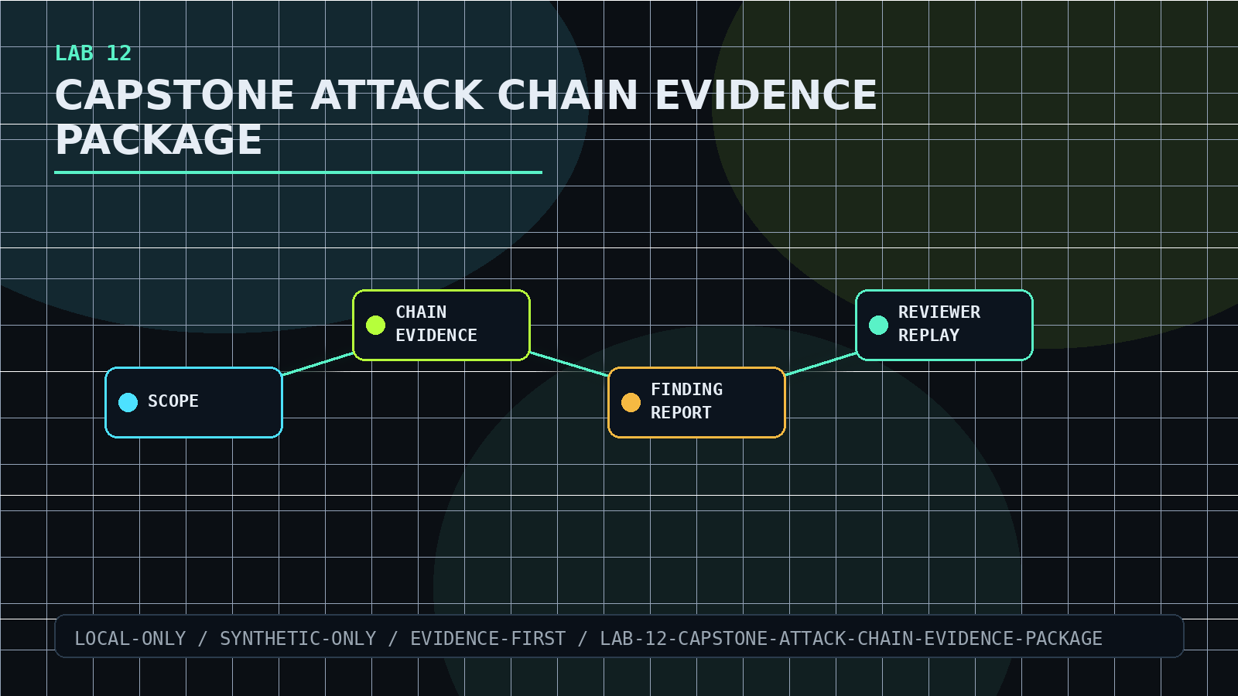
LAB 12
Capstone Attack Chain Evidence Package
Assemble a reviewer-grade evidence package across the lab track.
Declare scope and limitations
Tie together provenance, model, policy, and analyst evidence
Produce finding report, manifest, and checksums
COMPLETION SIGNAL
Capstone package can be replayed by another reviewer.
BROWSER-SAFE AI SYSTEMS WORKSHOP
unattributed / instructor: stumble the drunk

Slide 18
FINAL PACKAGE
What a complete student submission contains
ARTIFACTS
INTEGRITY
FINDING
raw target responses, browser evidence, proxy logs, model streams, runner output
artifact-manifest.json, SHA256SUMS.txt, clear paths, timestamps, limitations
method, evidence, interpretation, failure mode, defensive meaning
Do not trust model text as a decision.
Do not collapse source, DOM, render, screenshot, frame, state, and policy evidence into one claim.
Do prove the boundary with replayable local artifacts.
unattributed / Browser-Safe AI Systems Workshop
BROWSER-SAFE AI SYSTEMS WORKSHOP
unattributed / instructor: stumble the drunk

