Slide 1
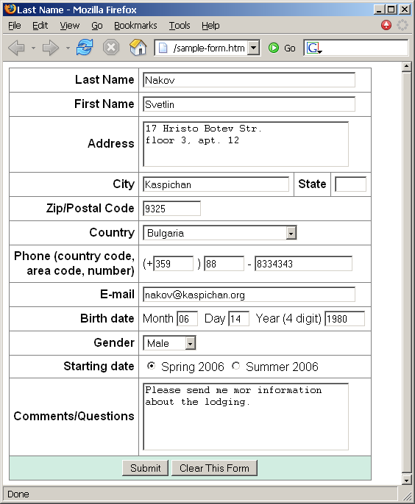
Homework (2)
Create a Web form that looks like this sample:

Slide 2
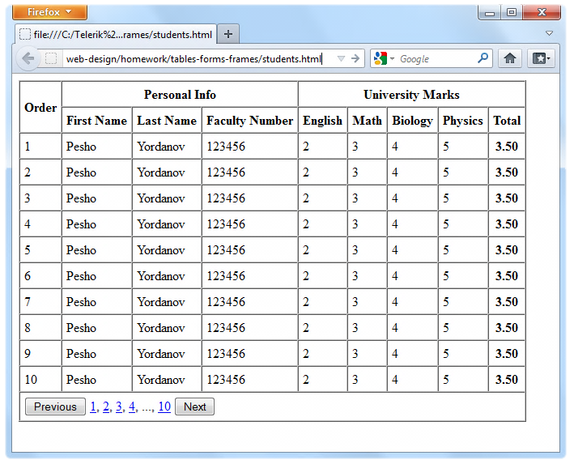
Homework (4)
Create the following using tables and forms:

Slide 3
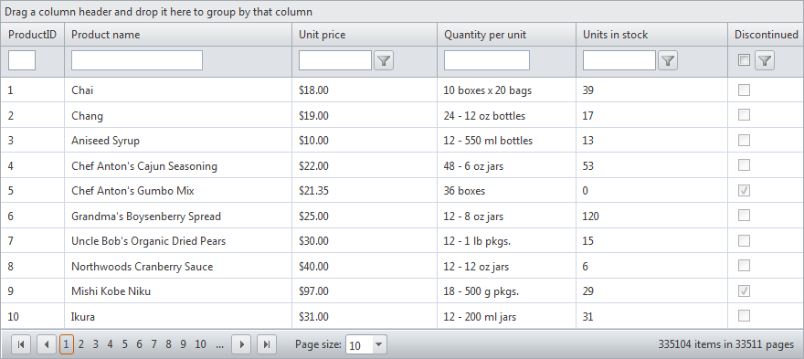
Homework (5)
Construct the following Grid component:
Try to make a HTML page, that looks just like the example
Not required to style for the homework

Slide 4
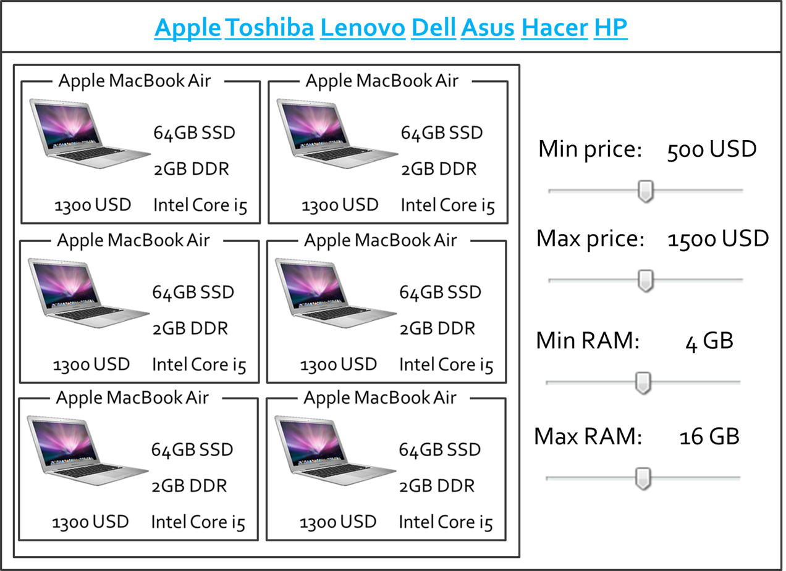
Homework (7)
*Create the following HTML Page
Hint: Use Fieldsets and Nested tables

