Slide 1
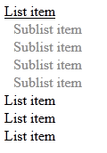
Homework
Create tree view like the following:
When the mouse goes over an item the sub list should be shown
The tree view should work with unlimited number of sub lists

Slide 2
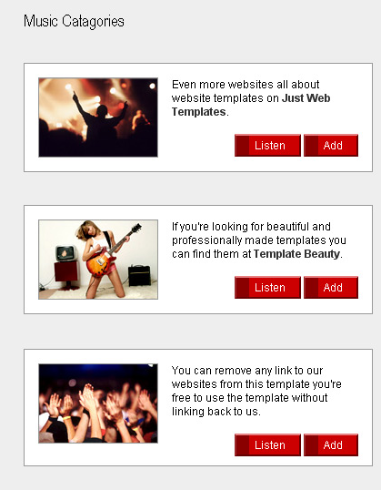
Homework (2)
Create the following Web page using external CSS styles. Buttons should consist of PNG images with text over them.

Slide 3
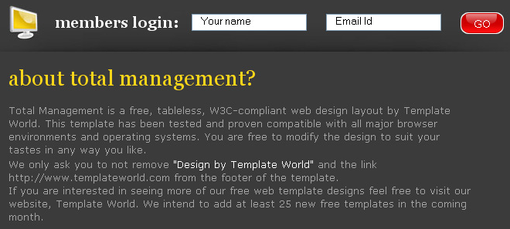
Homework (3)
Create the following Web page using HTML with external CSS file. Note that the images should be PNG with transparent background.

Slide 4
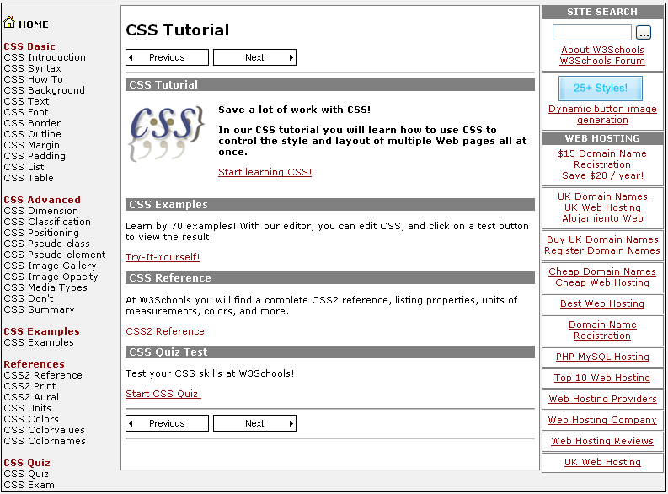
Homework (4)
Given the picture below create the Web site
Use CSS and HTML 5

Slide 5
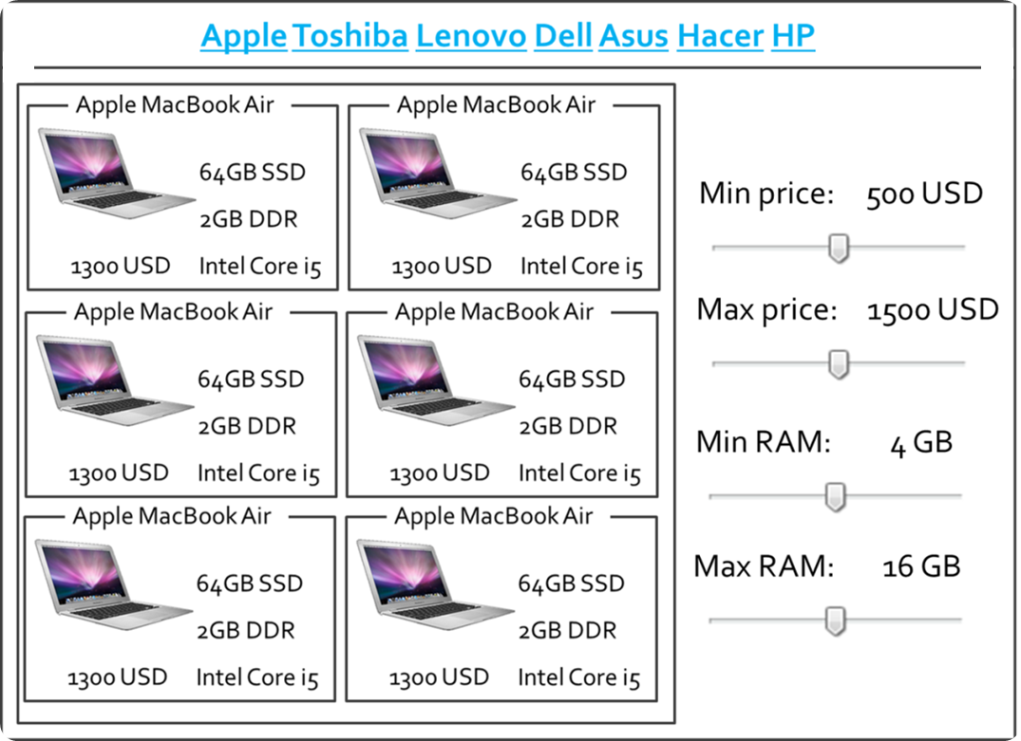
Homework (5)
Create the following HTML 5 Page
Do it without tables

Slide 6
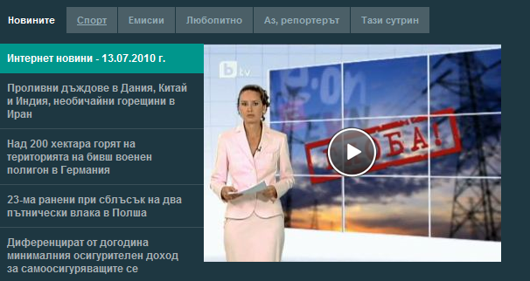
Homework
Create the following Web page using HTML and external CSS. Using tables, inline styles and deprecated tags is not allowed.

