Slide 1
Homework
Create a slider control using jQuery
The slider can have many slides
Only one slide is visible at a time
Each slide contains HTML code
i.e. it can contain images, forms, divs, headers, links, etc…
Implement functionality for changing the visible slide after 5 seconds
Create buttons for next and previous slide

Slide 2
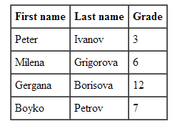
Homework (2)
Using jQuery implement functionality to insert a DOM element before or after another element
By given an array of students, generate a table that represents these students
Each student has first name, last name and grade
Use jQuery
Implement functionality to change the background color of a web page
i.e. select a color from a color picker and set this color as the background color of the page

Slide 3
Homework (3)
*Implement a GridView control
Rows can be added dynamically
A header row can be added dynamically
Each GridView can have at most one header row
Each row can have a nested GridView
Each GridView can have at most one nested GridView

