Slide 1
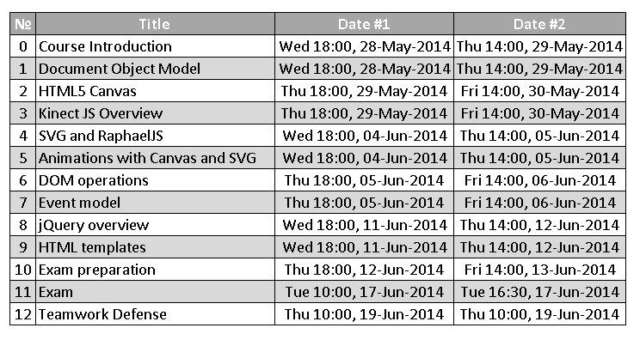
Homework
Create the following using Handlebars.js

Slide 2
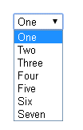
Homework (2)
Create a dynamic select using Handlebars.js
The options in the select should be generated based on a collection of JavaScript objects
Example:
var items = [{
value: 1,
text: 'One'
}, {
value: 2,
text: 'Two'
}];
var selectHTML = selectTemplate(items);

Slide 3

Homework (3)
*Create a jQuery plugin for ListView
Apply a template for each item of a collection
Using the data-template attribute set the ID of the template to use for the items
Must work with different collections and templates
*More examples on the next slides
<ul id="books-list" data-template="book-item-template"></ul>
<script id="book-item-template" type="…">
<li class="book-item">
<a href="/#books/{{id}}">
<strong>{{title}}</strong>
</a>
</li>
</script>
$('#books-list').listview(books);

Slide 4
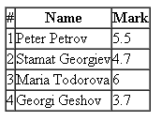
Homework (4)
*(cont.)Create a jQuery plugin for ListView
<table>
<thead>
<tr><th>#</th><th>Name</th><th>Mark</th></tr>
</thead>
<tbody id="students-table" data-template="students-row-template">
</tbody>
</table>
<script id="students-row-template" type="…">
<tr class="student-row">
<td>{{number}}</td>
<td>{{name}}</td>
<td>{{mark}}</td>
</tr>
</script>
$('#students-table').listview(students);

Slide 5
Homework (5)
*Extend the previous task to set the template inside the DOM element, instead of setting it with data-template
<table>
<thead>
<tr><th>#</th><th>Name</th><th>Mark</th></tr>
</thead>
<tbody id="students-table">
<tr class="student-row">
<td>{{number}}</td>
<td>{{name}}</td>
<td>{{mark}}</td>
</tr>
</tbody>
</table>
$('#students-table').listview(students);

