Slide 1
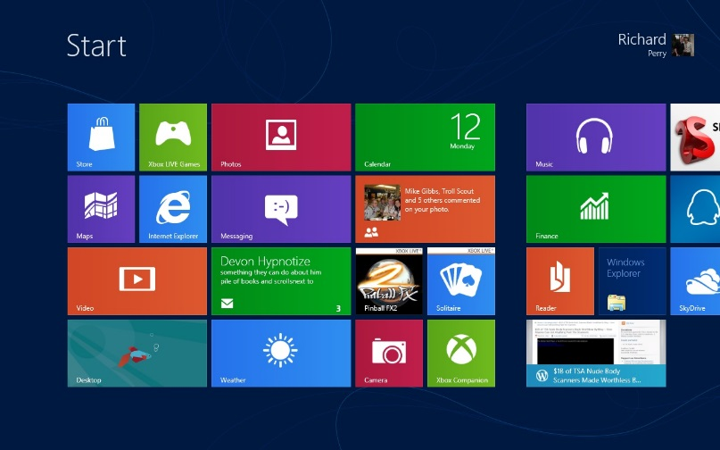

Homework
Implement the image (MEAN) with SVG
Use both circles and paths
Implement the Windows 8 start screen with SVG
*Implement the first two tasks using the SVG DOM API and JavaScript

