Slide 1


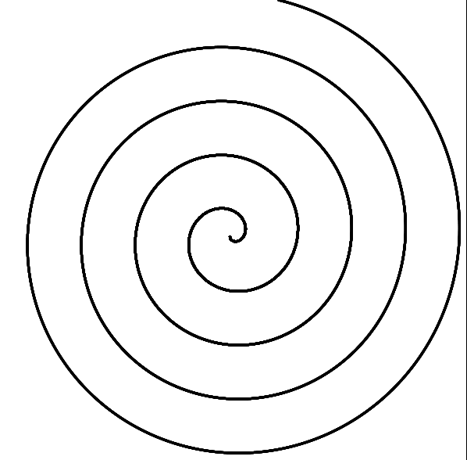
Homework
Create the following images using Raphael:
Create a spiral with Raphael
*Hint: use many circles with radius 1px

