Slide 1
Quantization Benchmarking with LLaMA
Damir Sarsenov

Slide 2
Outline
Introduction & Background
Motivation
Problem Statement & Research Focus
Related Research (Two Papers)
Method 1: GPTQ (ICLR 2023)
Method 2: Tender (ISCA 2024)
Comparative Findings (Quality, Performance, Energy)
Proposed Benchmark Protocol (future work)
Conclusion & Future Work
References (Two Papers)

Slide 3
Introduction & Background
LLaMA‑class models are memory/latency/energy intensive.
Quantization reduces precision to shrink memory and raise utilization.
We focus on two research directions: GPTQ and Tender.

Slide 4
Motivation
Capacity & bandwidth: Lower‑bit weights shrink HBM footprint and traffic.
Latency/throughput: Reduced precision can increase tokens/s if kernels and scheduling are well supported.
Energy considerations: Smaller data movement and higher utilization can reduce energy per token.

Slide 5
Problem Statement & Research Focus
Survey GPTQ (weight‑only PTQ) and Tender (co‑design).
Compare impact on quality, tokens/s, TTFT, memory; discuss energy.
Propose a minimal, fair protocol for future benchmarks.

Slide 6
Related Research (Two Papers Only)
GPTQ (ICLR 2023): one‑shot, Hessian‑aware weight‑only quantization.
Tender (ISCA 2024): tensor decomposition + runtime requantization co‑design.

Slide 7
Method 1 — GPTQ (ICLR 2023): Proposed Solution
One‑shot post‑training, weight‑only (3–4‑bit) quantization.
Uses approximate second‑order info to minimize reconstruction error.
Architectural angle: cuts HBM traffic; potential speedups with kernels.

Slide 8
Method 2 — Tender (ISCA 2024): Proposed Solution
Decomposed quantization with power‑of‑two scale spacing.
Avoids frequent de/quantization when accumulating partial sums.
Architectural angle: better utilization; minimal HW changes.

Slide 9
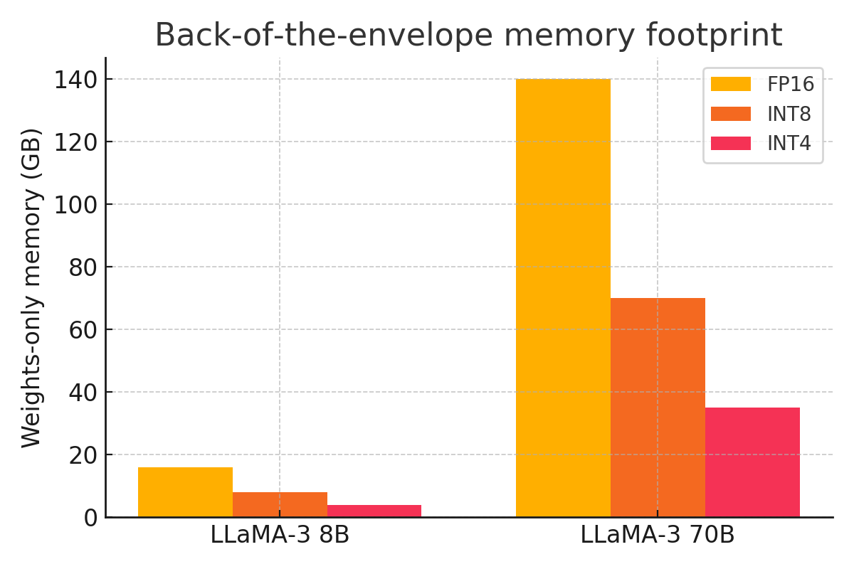
Comparison: Memory Footprint (weights‑only)

Slide 10
Findings — Accuracy/Quality (from the two papers)
GPTQ shows that 3–4‑bit weight‑only PTQ can closely track full‑precision quality on language modeling benchmarks for large Transformers.
Tender reports higher accuracy than prior low‑precision schemes under its decomposition and requantization strategy.

Slide 11
Findings — Performance (TTFT, tokens/s)
GPTQ reports end‑to‑end inference speedups vs FP16 with optimized kernels on A100/A6000 in their evaluations.
Tender reports throughput gains by avoiding frequent requantization when accumulating partial sums, improving hardware utilization.

Slide 12
Findings — Energy Considerations
Both methods reduce data movement due to smaller weights, which generally correlates with lower energy per token; exact savings are workload‑dependent.

Slide 13
Method Trade‑offs (at a glance)
Method | Precision Regime | Key Idea | Strengths | Caveats
GPTQ (ICLR’23) | W4 (3–4‑bit weights only) | Hessian‑aware one‑shot PTQ | Strong accuracy‑vs‑size; simple deployment path | Throughput depends on kernel maturity; activations remain high precision
Tender (ISCA’24) | Low‑precision with decomposed tensors | Power‑of‑two scale spacing avoids frequent requantization | Higher accuracy/throughput vs prior schemes; minimal HW changes | Requires co‑design assumptions; reproduction may need research code

Slide 14
Proposed Benchmark Protocol (future work)
Report TTFT, tokens/s, memory, and energy/token with quality scores.
Fix engine/kernel versions; same prompts/seeds; identical flags.
Compare FP16/BF16 vs W4 (GPTQ). Document any Tender‑style configs explicitly.

Slide 15
Conclusion & Future Work
GPTQ: strong default for weight‑only 3–4‑bit with minimal accuracy loss.
Tender: co‑design path to low‑precision accumulation with fewer requantizations.
Future: standardized energy/token reporting; broader kernel support; reproducible protocols.

Slide 16
References (Two Papers)
1) Frantar, Ashkboos, Hoefler, Alistarh. GPTQ: Accurate Post‑Training Quantization for Generative Pre‑trained Transformers. ICLR 2023.
2) Lee, Lee, Sim. Tender: Accelerating Large Language Models via Tensor Decomposition and Runtime Requantization. ISCA 2024.

