Slide 1
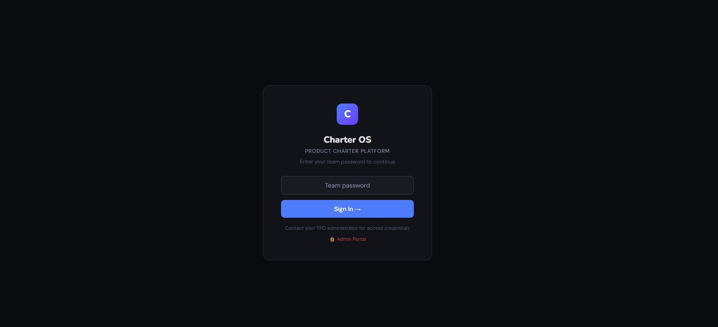
C
Charter OS
PRODUCT CHARTER PLATFORM
Introducing CharterOS
An AI-Powered Platform for Product Office Teams
From raw ideas to approved Product Charters — guided by Agentic AI with Human in the Loop governance.
"Move from traditional project delivery to structured Product Management — faster, smarter, with built-in governance."
Confidential — Internal Use Only

Slide 2
TABLE OF CONTENTS
What We Will Cover Today
01
The Challenge
02
What is Charter OS?
Why Product Offices struggle without a structured charter process
Platform overview, 5 components, and how it fits your context
03
Bring Your Own Documents
04
How It Works — Teams
How teams feed their existing work into the AI input layer
Step-by-step walkthrough from login to completed charter
05
Human in the Loop
06
Visual CBA & Value
The governance model — approval gates at every section
KPIs, cost benefit analysis, charts and financial justification
07
TPO Admin Portal
08
Export & Outputs
Real-time oversight — department tiles, drill-down, read-only view
PDF charter, management slides, backup and HTML export
09
Agentic AI Capabilities
10
The 6 CharterOS Agents
The 6 AI capabilities and the benefits each one delivers
Sequential agent architecture and context chain breakdown
11
Benefits Summary
12
Next Steps
What CharterOS delivers for teams, TPO admins and the organisation
Pilot plan, roadmap and path to organisational capability offering

Slide 3
THE CHALLENGE
Why Product Offices Struggle Today
⏱
No Structured Process
🔀
Manual & Fragmented
Teams start from scratch every time — no standard, no template, no consistency.
Meeting notes, Excel trackers, Word docs, email chains — knowledge is siloed.
🤖
AI Left on the Table
👁
No Oversight
The intelligence to draft and analyse exists — but is never harnessed in the charter process.
Leadership has zero real-time visibility into what Product Office teams are working on.

Slide 4
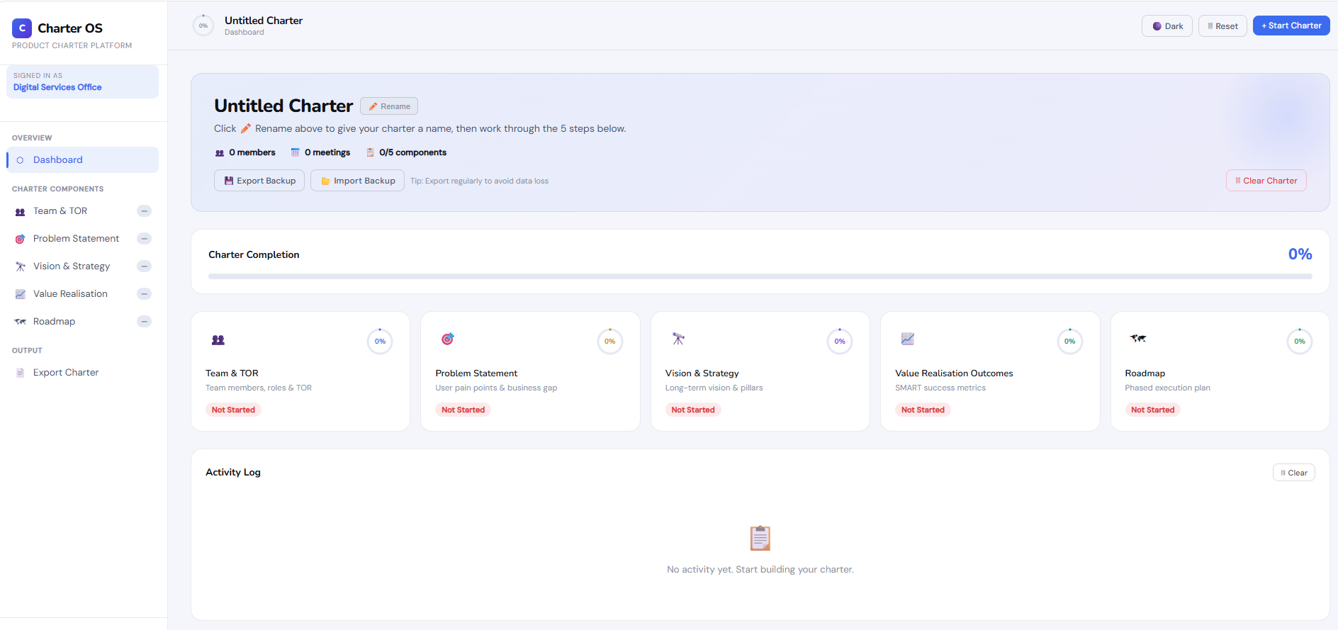
SOLUTION
What is Charter OS?
Charter OS is an AI-powered Product Charter platform that guides Product Office teams through every stage of charter development — from team formation to roadmap approval — with Agentic AI doing the heavy lifting and humans approving at each gate.
THE 5 CHARTER COMPONENTS
01
Team Structure & TOR
5
AI
✓
👁
02
Problem Statement
Structured Components
Agentic Generation
Human in the Loop
TPO Admin Oversight
03
Vision & Strategy
04
Value Realisation
05
Product Roadmap

Slide 5
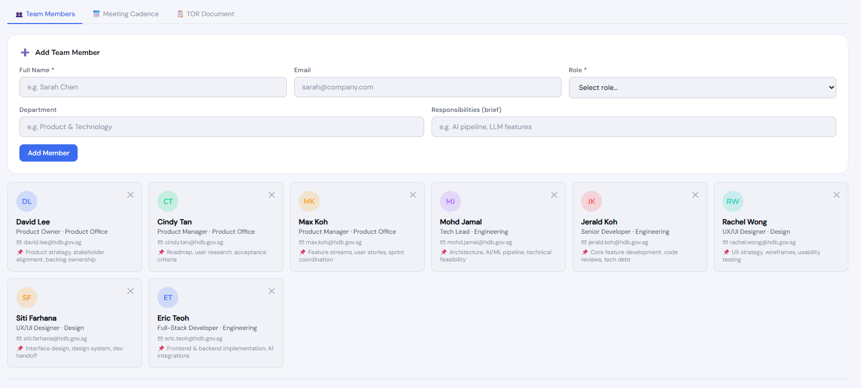
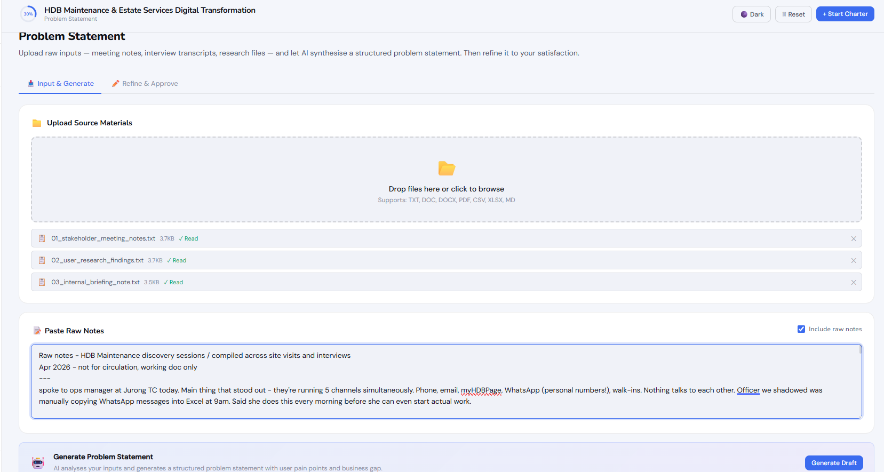
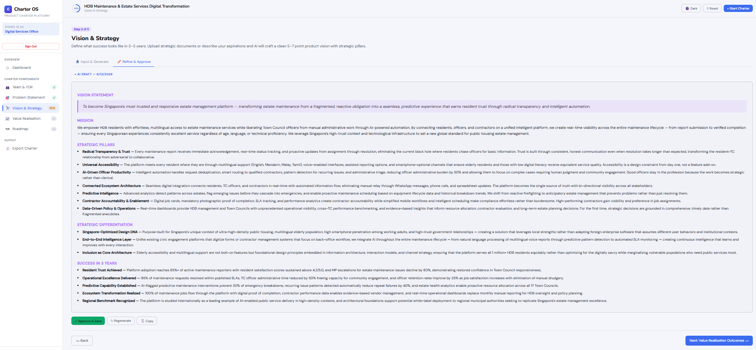
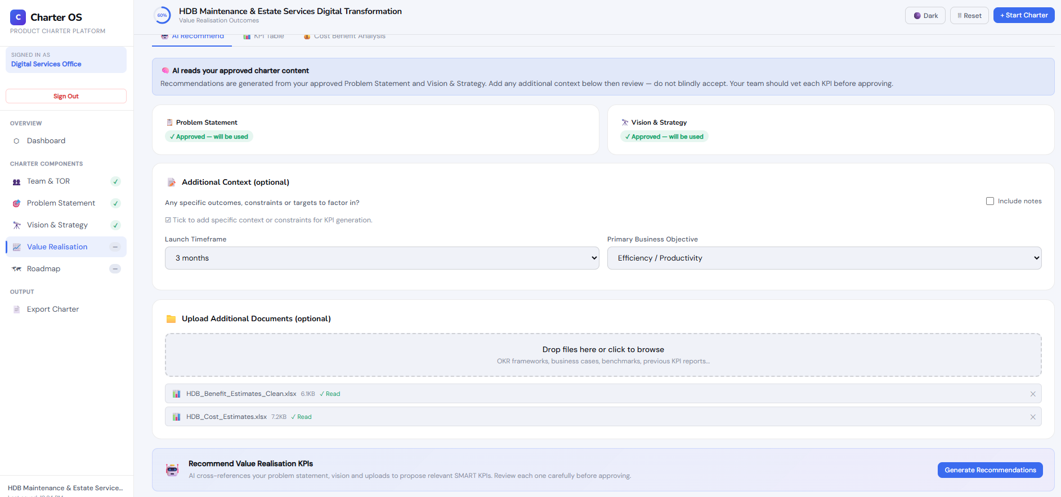
HOW IT WORKS
The CharterOS Workflow
01
02
03
04
05
Login & Start Charter
Build Team & TOR
Problem Statement
Vision & Strategy
Value Realisation
Team logs in with unique password
Add members, meetings. AI generates TOR
Upload notes & files. AI synthesises the gap
Strategic docs in. AI crafts the vision
KPIs + CBA generated from your data
→
→
→
→

Slide 6
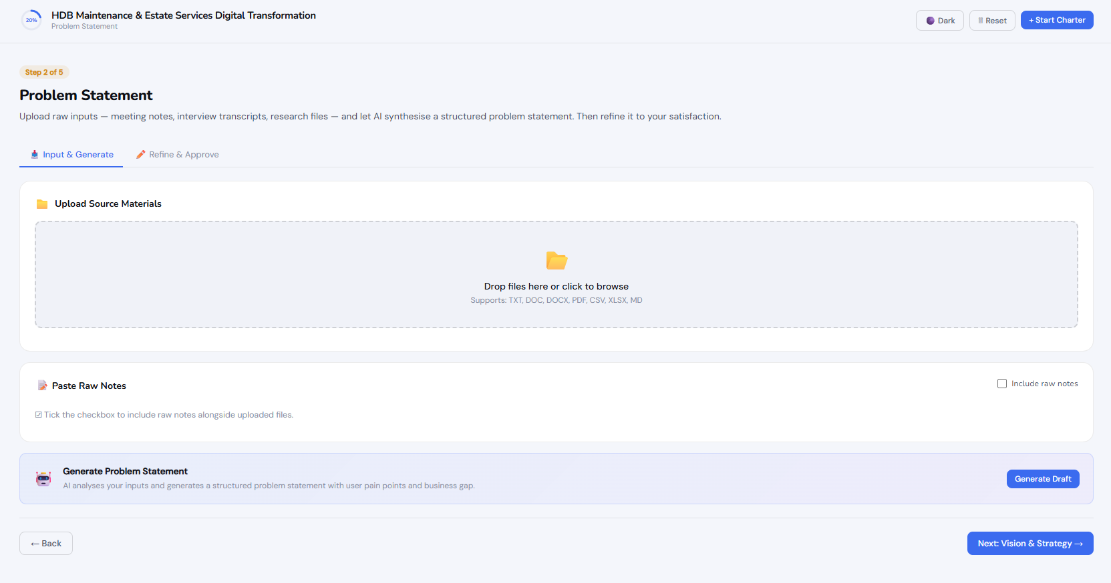
AI INPUT LAYER
Bring Your Own Documents — No Starting From Scratch
CharterOS accepts documents your team already has. Meeting notes, stakeholder interview transcripts, research findings, strategic briefing papers, Excel business cases — simply upload or paste them in. The AI reads everything and synthesises structured charter content.
📝
TXT / DOC / DOCX
Meeting notes, interview transcripts, briefing documents
📊
XLSX / CSV
Business cases, CBA models, benefit estimates, cost sheets
📄
PDF
Research reports, strategy papers, board submissions
📋
Raw Notes Paste
Unstructured notes typed directly — no formatting needed
🗂
Multiple Files
Upload several documents at once — AI synthesises across all
💡 No blank slate. No manual writing. Just upload what you have — CharterOS does the synthesis.

Slide 7
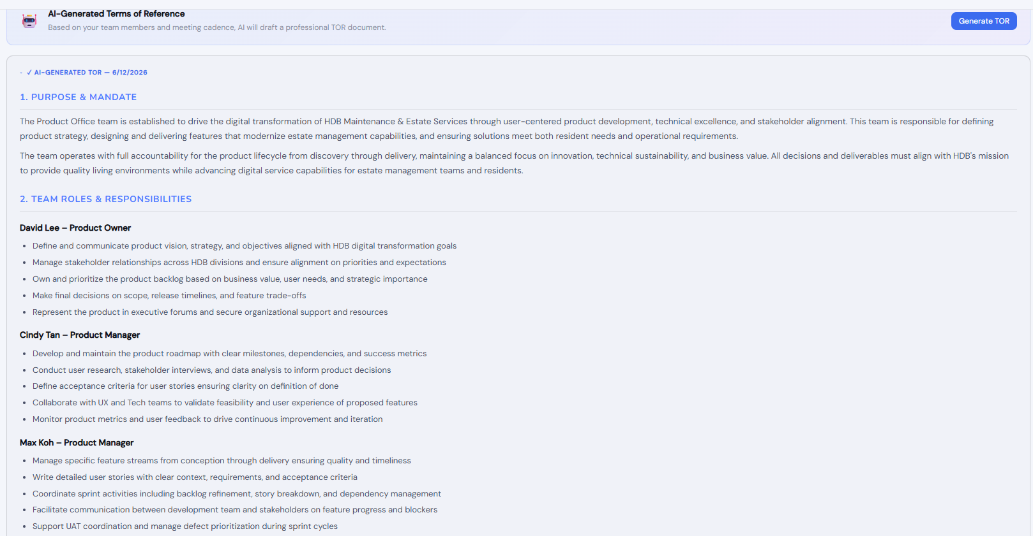
STEP 1 — TEAM & TOR
Team Formation & Terms of Reference
Product Office teams register their members and meeting cadence. CharterOS AI then generates a complete, professional Terms of Reference document — covering roles, responsibilities, decision authority, ways of working and escalation paths.
👥 Add team members with roles and responsibilities
📅 Define meeting cadence — standups, reviews, planning
🤖 One click — AI generates full TOR document
✅ Team lead reviews and approves — Human in the Loop
📊 Progress updates to 100% on approval

Slide 8
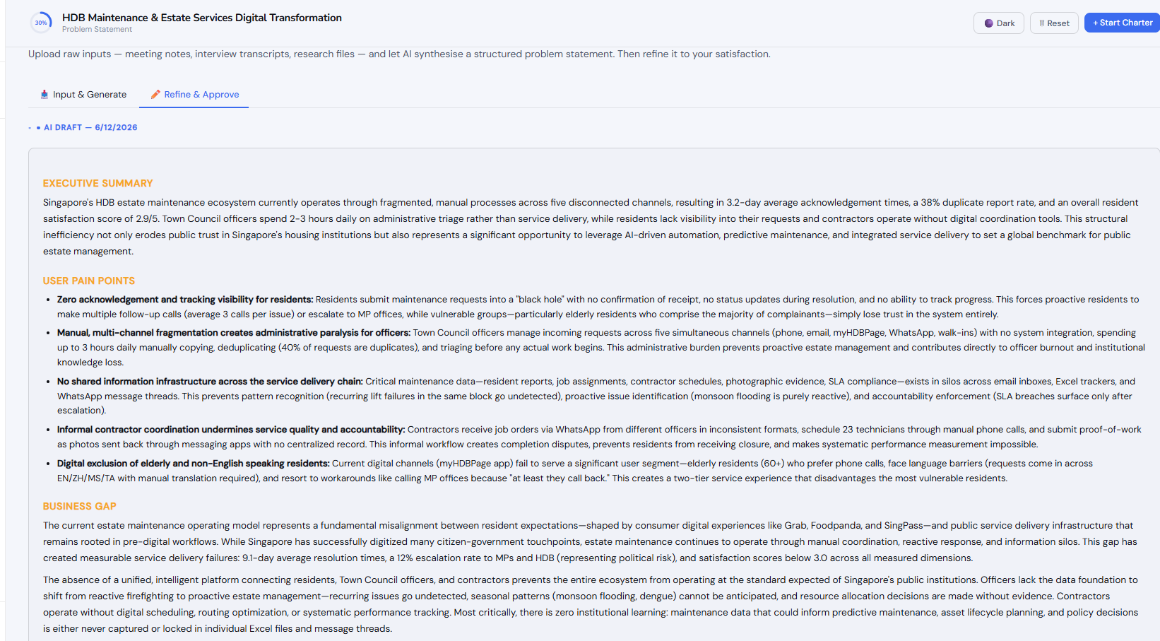
STEPS 2 & 3 — AI GENERATION
Problem Statement & Vision & Strategy
🎯 PROBLEM STATEMENT
🔭 VISION & STRATEGY
Upload stakeholder notes, research files, interview transcripts. AI synthesises a structured Problem Statement with User Pain Points and Business Gap — ready to refine and approve.
Upload strategic documents, exec papers, workshop notes. AI crafts a compelling long-term vision with strategic pillars aligned to your product context.

Slide 9
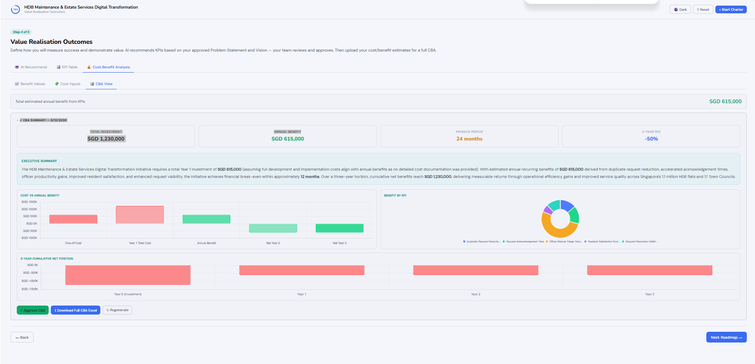
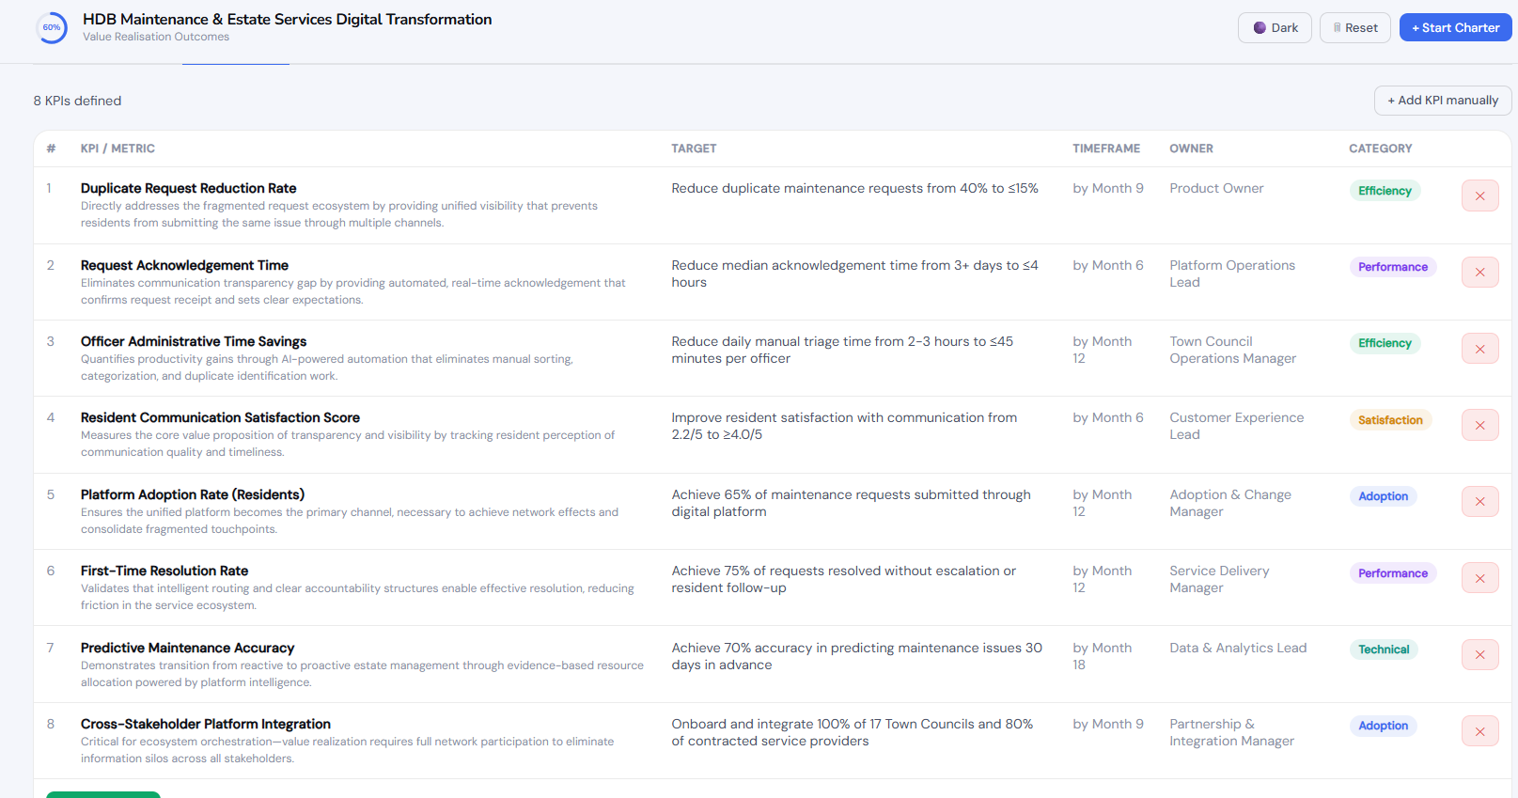
STEP 4 — VALUE REALISATION
KPIs, CBA & Financial Justification
CharterOS transforms raw business cases into structured value evidence. AI recommends SMART KPIs from approved charter content. Teams upload cost and benefit estimates. AI generates a full Cost Benefit Analysis with ROI, payback period and 3-year projections.
✓
AI-Recommended KPIs
Drawn from approved Problem Statement and Vision
✓
Excel Upload Matching
Upload your benefit & cost estimates — auto-matched to KPIs
✓
Full CBA Generated
ROI, payback period, 3-year net position
✓
Human Approval Gate
Team reviews and approves before moving to Roadmap

Slide 10
COST BENEFIT ANALYSIS
Visual CBA — Investment, Returns & 3-Year Projections
CharterOS generates a complete, visual Cost Benefit Analysis from your uploaded Excel data. The CBA View shows financial metrics, interactive charts and a 3-year net position — all in one place, ready for steering committee presentations.
✓
SGD Summary Cards
Total investment, annual benefit, payback period and 3-year ROI at a glance
✓
Cost vs Benefit Chart
Bar chart comparing one-off costs, Year 1 total cost, annual benefit and net positions
✓
Benefit by KPI
Donut chart breaking down benefit contribution per KPI — shows which KPIs drive the most value
✓
Cumulative Net Position
Year 0 to Year 3 waterfall chart showing the investment-to-return journey
✓
Download Full CBA
Export the complete CBA as an Excel file for finance team submission

Slide 11
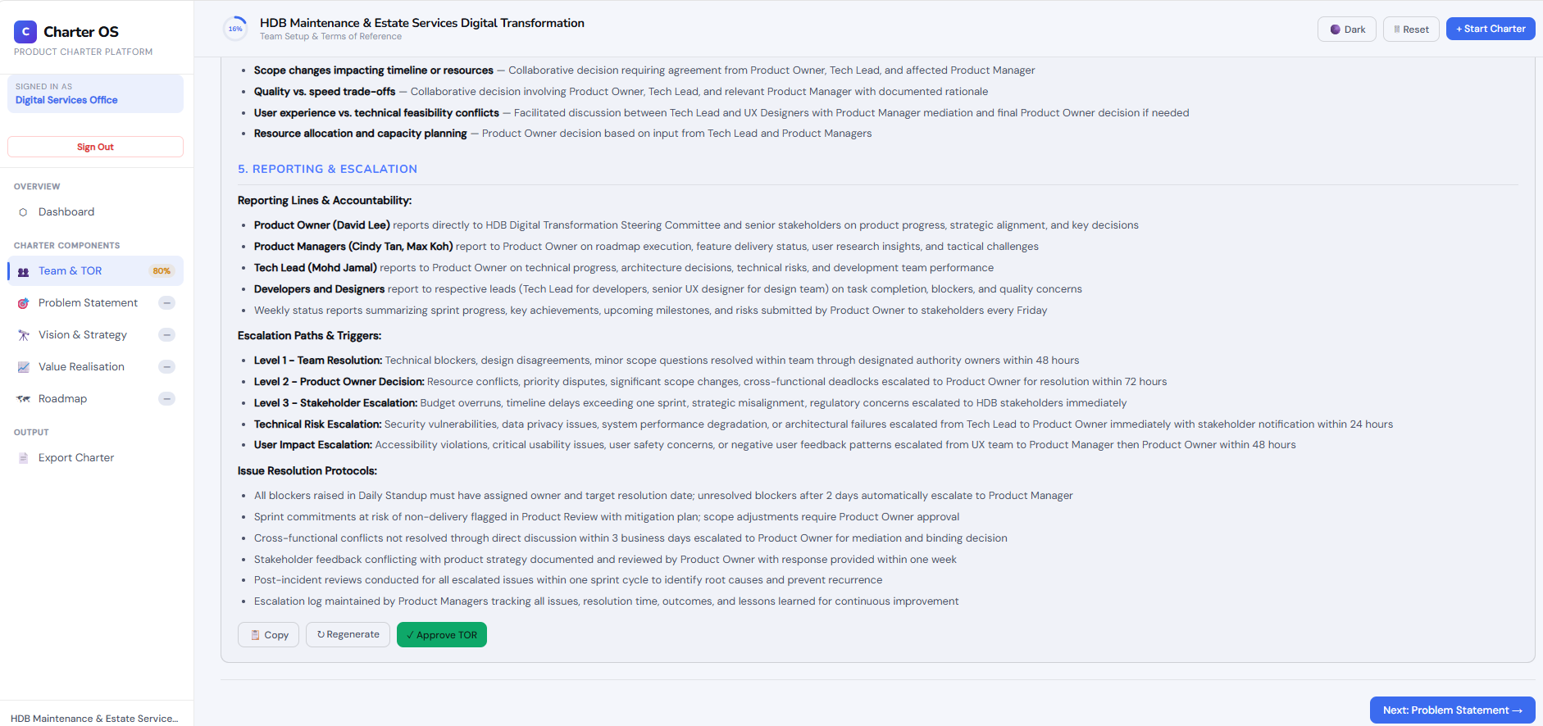
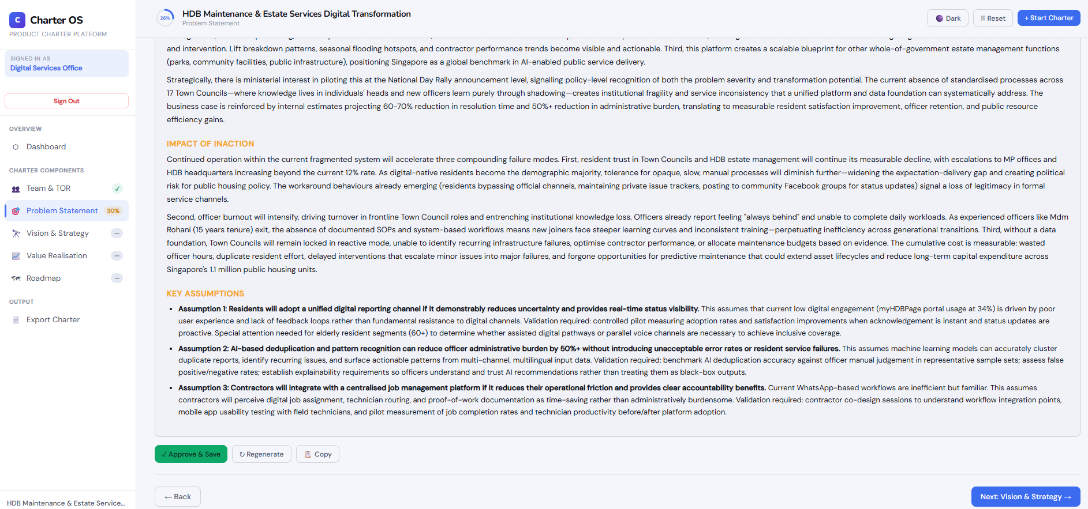
GOVERNANCE MODEL
Human in the Loop — Approval at Every Gate
CharterOS enforces a structured governance model. AI generates — humans decide. No section can be marked complete without explicit team approval. This ensures accountability, quality assurance, and organisational sign-off at every stage.
1
Team & TOR
→ Team & TOR = 100%
TOR reviewed and approved by Product Owner
2
Problem Statement
→ Problem = 100%
AI draft reviewed, refined and approved by team
3
Vision & Strategy
→ Vision = 100%
Vision document reviewed and approved by team
4
Value Realisation
→ Value = 100%
KPIs and CBA approved — financial case signed off
5
Product Roadmap
→ Roadmap = 100%
Two-stage: Phases & Tasks approved, then Gantt Timeline approved
🔒 Every approval is timestamped in the Activity Log — full audit trail for compliance and governance.

Slide 12
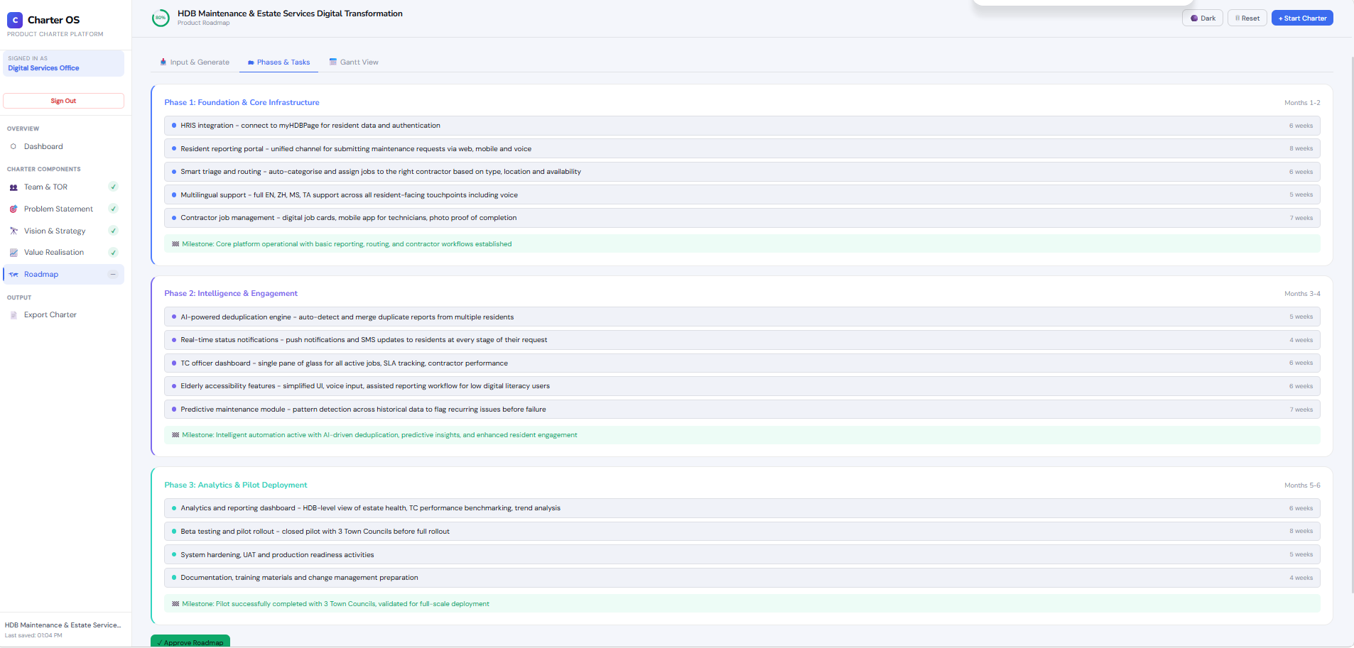
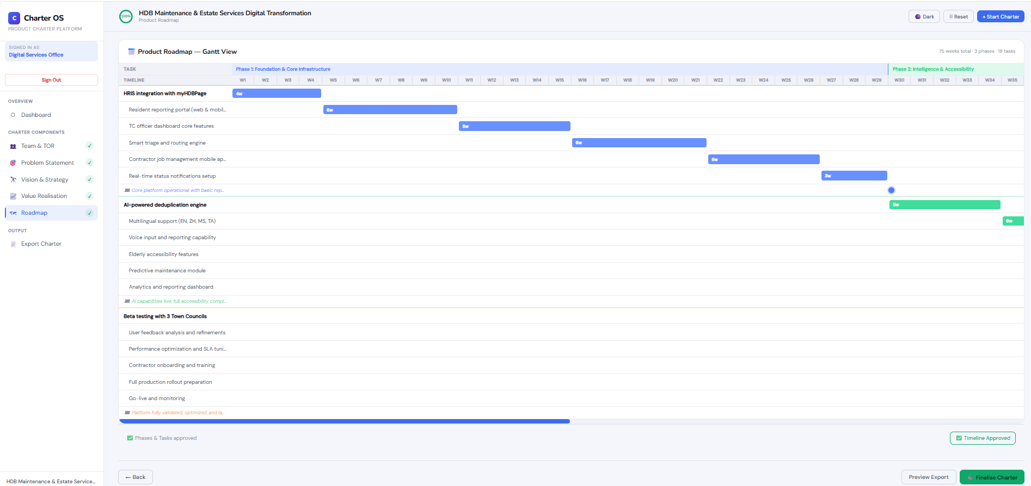
STEP 5 — PRODUCT ROADMAP
Phased Execution Plan & Gantt Timeline
Upload epics, sprint plans or backlog items. AI structures a phased product roadmap visualised as a Gantt chart. Two-stage approval: Phases & Tasks first, then Timeline — reinforcing governance and Human in the Loop discipline.
📋
Upload Epics
Backlog, sprint plans, strategic initiatives
🤖
AI Structures Phases
Tasks, durations, milestones auto-generated
✅
Approve Tasks
Review phases and tasks — Human gate 1
📅
Approve Timeline
Review Gantt — Human gate 2 — 100% complete

Slide 13
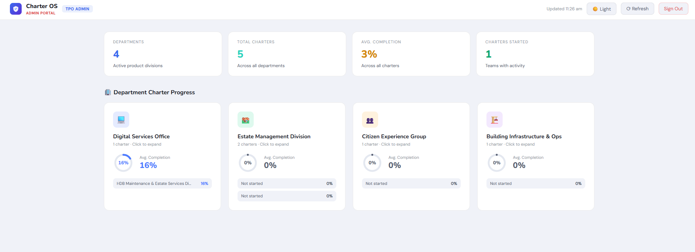
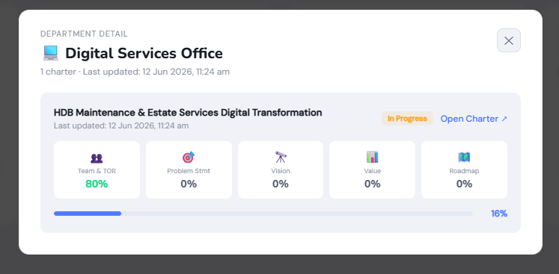
TPO ADMIN PORTAL
Real-Time Oversight Across All Departments
TPO Administrators get a live dashboard showing charter progress across all Product Office teams and departments — with drill-down to individual charter detail and read-only access to any team's charter at any point.
4 Departments
Monitor Digital Services, Estate Management, Citizen Experience, Building Infra
5 Charters
Track multiple charters per department — Estate Management runs 2 simultaneously
Live Progress
Section-by-section completion % — Team & TOR, Problem, Vision, Value, Roadmap
Drill-Down View
Click any department tile to see individual charter breakdown and open charter read-only
Auto-Refresh
Dashboard refreshes every 60 seconds — always current, no manual updates needed

Slide 14
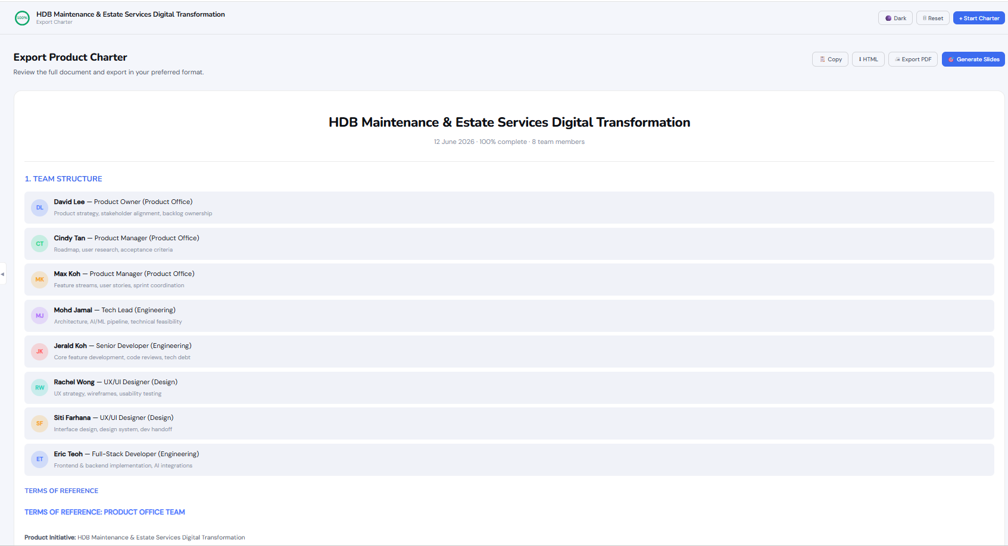
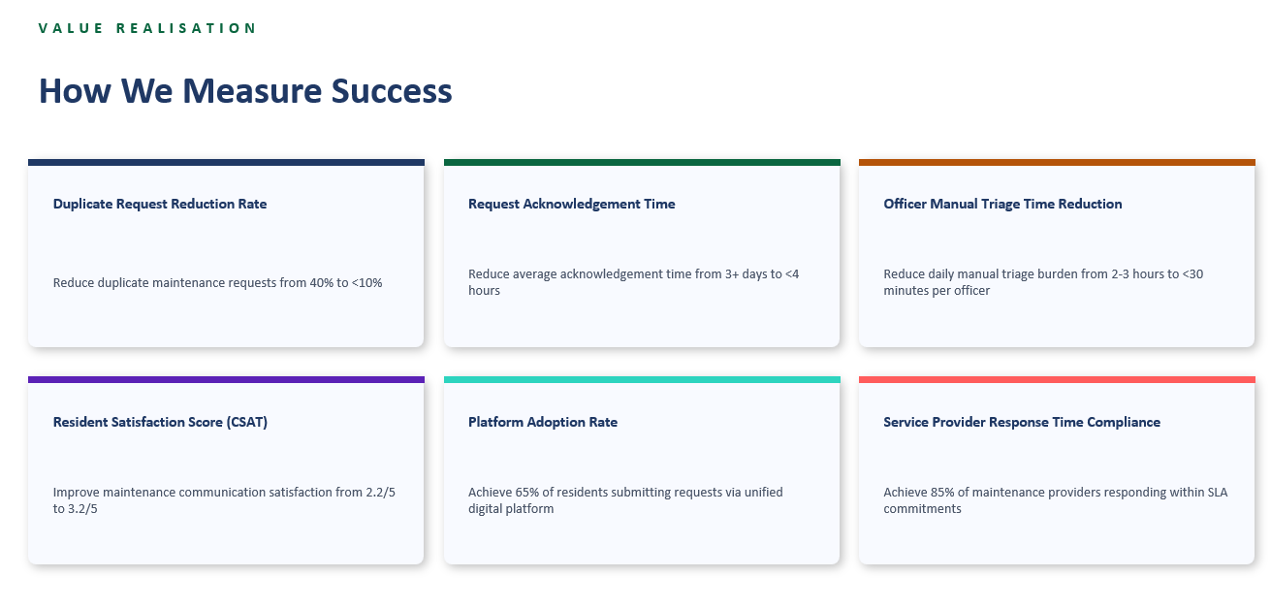
OUTPUT & EXPORT
From Charter to Deliverable in One Click
📄
Export PDF
📊
Generate Slides
Full Product Charter document — team structure, TOR, problem statement, vision, KPIs, CBA, roadmap with Gantt
Auto-generated 10-slide management presentation deck — ready for stakeholder briefings
📋
Copy / HTML
💾
Backup & Restore
Export charter content as clean HTML or copy to clipboard for any document tool
Export JSON backup of full charter state — restore anytime, share across environments

Slide 15
ARCHITECTURE
Agentic AI with Human in the Loop Governance
CharterOS is built on a principled governance model: AI does the synthesis and drafting, humans retain decision authority at every gate. This is not automation replacing judgment — it is AI amplifying capability while preserving accountability.
📥
🤖
👁
✅
📊
📄
Raw Input
Agentic AI
Human Review
Human Approval
Progress
Export
→
→
→
→
→
Notes, files, research, data
Synthesise, draft, structure, analyse
Team reviews and refines
Explicit sign-off at every gate
TPO sees live completion status
Publish charter as deliverable
🔒 Why This Matters for Product Management Transformation
Traditional waterfall delivery has no formal product charter discipline. CharterOS gives Product Offices the operating model to shift towards structured product delivery — with AI removing the effort barrier and governance ensuring the rigour. Every charter section requires explicit human approval before the team progresses. This is not a shortcut — it is a capability accelerator.

Slide 16
BENEFITS
What CharterOS Delivers
1
For Product Office Teams
2
For TPO Administrators
3
For the Organisation
✓
80%+ reduction in charter drafting time
✓
Real-time visibility across all departments
✓
Accelerates transition to Product Management delivery
✓
Consistent, structured output every time
✓
No more chasing teams for status updates
✓
Builds institutional knowledge in structured charters
✓
AI handles synthesis — humans focus on strategy
✓
Department-level and charter-level drill-down
✓
Positions Singapore public agencies as product-led
✓
Built-in approval workflow ensures governance
✓
Read-only charter access from admin portal
✓
Replicable across any Product Office context

Slide 17
NEXT STEPS
Roadmap for CharterOS Adoption
Q3 2026
Pilot with 5 Teams
Run CharterOS prototype with 5 Product Office teams across 4 departments. Capture feedback and measure charter completion time vs baseline.
Q3 2026
Refine Value Realisation
Complete the Value Realisation and CBA module — improve benefit matching, add milestone-based projections, enhance financial modelling.
Q4 2026
Enhance Final Charter Doc
Improve the PDF and PPTX export quality. Add charter version control, comment and annotation capability.
Q4 2026
Scale to All Departments
Onboard remaining Product Office teams. Establish CharterOS as the standard tool for all new product initiatives.
2027
Enterprise & Client Offer
Package CharterOS as an organisational capability offering for public sector clients moving to Product Management delivery models.

Slide 18
C
Charter OS
PRODUCT CHARTER PLATFORM
Thank You
"From raw ideas to approved charters — powered by Agentic AI, guided by human judgment, built for Product Management excellence."
Questions & Discussion
Confidential — Internal Use Only · June 2026

Slide 19
AGENTIC AI CAPABILITIES
What Each Capability Does & Why It Matters
🎯
Goal-Directed Behaviour
🔗
Context Carry-Forward
📂
Multi-Source Synthesis
Each agent has a specific structured output target — not just a response
Each agent reads approved outputs of prior agents before generating
A single agent reads across multiple uploaded files simultaneously
Every section produces a guaranteed complete deliverable. Teams get consulting-grade documents — not vague AI responses.
KPIs are traceable to Vision. Vision is grounded in the Problem. The charter tells one coherent story — not 5 disconnected sections.
Teams no longer spend weeks synthesising discovery notes. Upload everything — AI extracts the signal across all sources at once.
🏗
Autonomous Structuring
📊
Output Parsing & Tool Use
✅
Human-Gated Orchestration
Agent decides phases, task sequencing and durations — not the user
CBA Agent parses its own output to power live charts and Excel exports
No agent proceeds without explicit human approval of the prior section
The Roadmap Agent makes judgment calls a junior PM would spend days on. Teams get a structured phased plan in seconds.
The AI does not just write — it produces machine-readable data that feeds visual dashboards. Charts are generated automatically.
Bounded autonomy. AI acts within each section; humans control every gate. This is what makes Agentic AI safe to deploy in organisations.
"CharterOS is not a chatbot with a nice UI. It is a chain of goal-directed agents — each producing a structured deliverable, each building on what came before."

Slide 20
AGENT ARCHITECTURE
The 6 CharterOS Agents — Sequential & Context-Aware
TOR Drafter
⬇ IN
Team members + meeting cadence + product context
CONTEXT CHAIN
01
5-section governance document: Mandate, Roles, Ways of Working, Decision Authority, Escalation
Agent 1: TOR
Autonomous
⬆ OUT
↓
⬇ IN
Raw notes + uploaded files (TXT/DOCX/XLSX/PDF) + product name
↓
02
Problem Analyst
Agent 2: Problem
Multi-Source
⬆ OUT
5-section problem statement: Executive Summary, Pain Points, Business Gap, Inaction, Assumptions
↓
↓
Agent 3: Vision
Vision Strategist
⬇ IN
Approved Problem Statement + strategic notes + uploaded docs
03
Context-Aware
⬆ OUT
Vision Statement, Mission, 5-7 Strategic Pillars, Differentiation, Success in 3 Years
↓
Agent 4: KPIs
↓
KPI Recommender
⬇ IN
Approved Problem + Vision + milestones + benefit/cost files
04
↓
JSON: 6-8 SMART KPIs with target, timeframe, owner, category, rationale
Agent 5: CBA
Context-Aware
⬆ OUT
↓
⬇ IN
Approved KPIs + benefit values + cost estimates + uploaded Excel
↓
05
CBA Analyst
Agent 6: Roadmap
Tool-Using
⬆ OUT
Financial narrative + parsed SGD figures → powers 3 live CBA charts + full Excel export
↓
↓
✅ Complete Charter
Roadmap Architect
⬇ IN
Product context + epics/features text + duration + team size
06
Autonomous
⬆ OUT
JSON phases with tasks + Gantt data → powers Phases & Tasks view and custom Gantt chart

