Slide 1
GIT as a chronological versioning tool with historical correctness

Slide 2
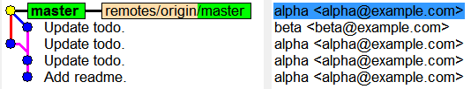
Two persons work on same branch

Slide 3
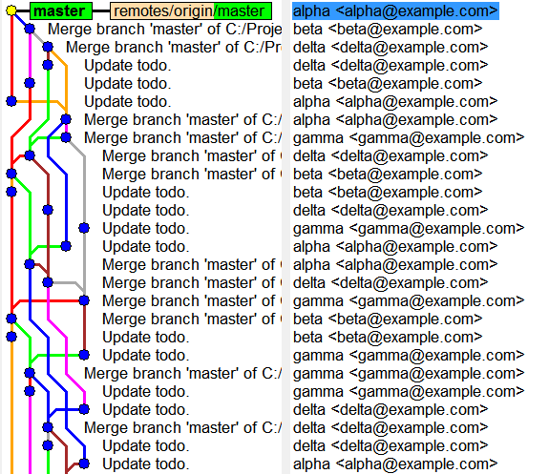
A small team, after some time

Slide 4
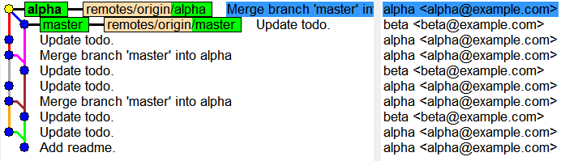
Two persons work on two branches

Slide 5
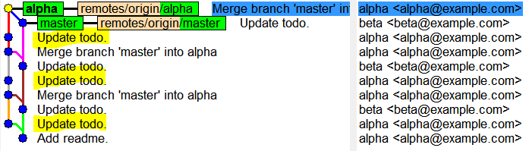
Related commits

Slide 6
GIT as an editing tool with manipulation of commit

Slide 7
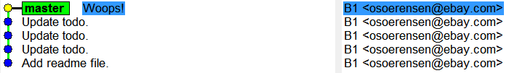
Error in last commit

Slide 8
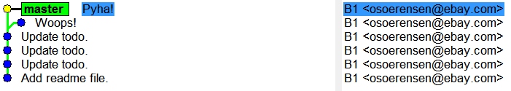
Fixing an error in last commit

Slide 9
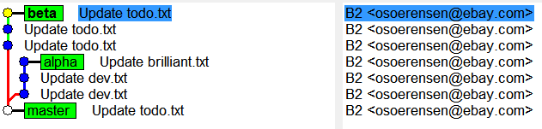
The coolest commit

Slide 10
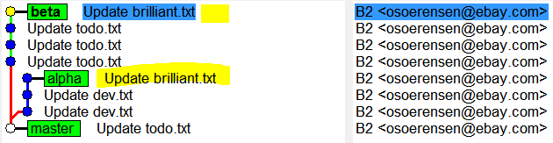
cherry-pick

Slide 11

Pull and merge

Slide 12
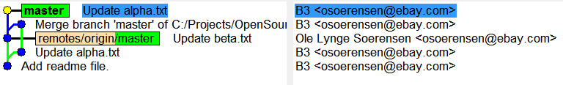
Rebase

Slide 13
Pull with rebase

Slide 14
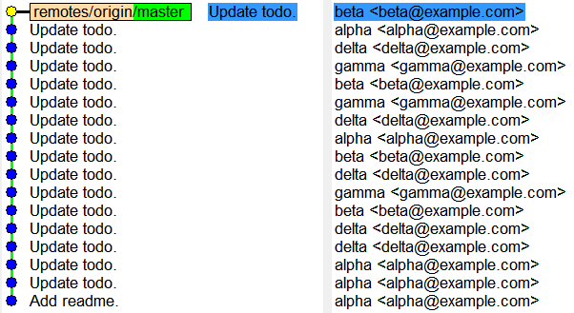
Linear history

Slide 15
GIT as your best friend with complete control over changes

