Slide 1
GIT as a chronological versioning tool with historical correctness

Slide 2
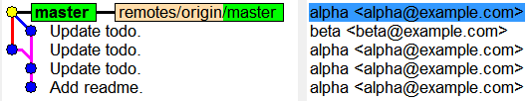
Two persons work on same branch

Slide 3
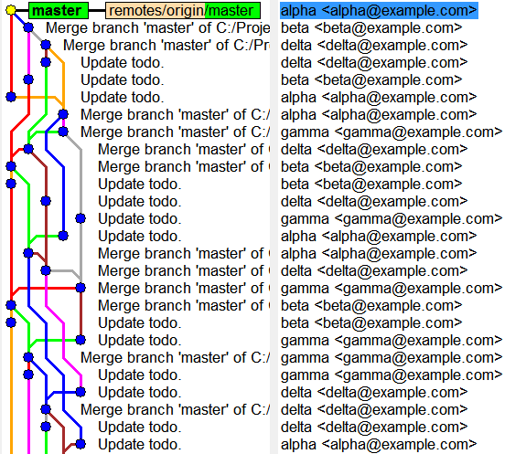
A small team, after some time

Slide 4
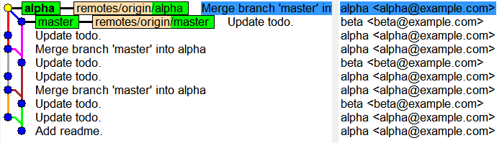
Two persons work on two branches

Slide 5
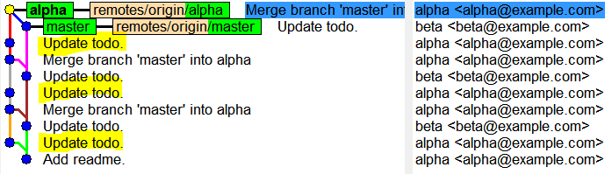
Related commits

Slide 6
GIT as an editing tool with manipulation of commit

Slide 7
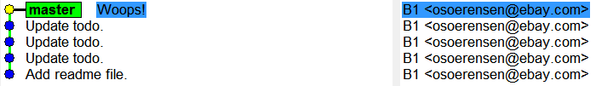
Error in last commit

Slide 8
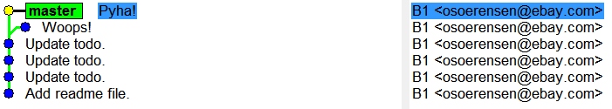
Fixing an error in last commit

Slide 9
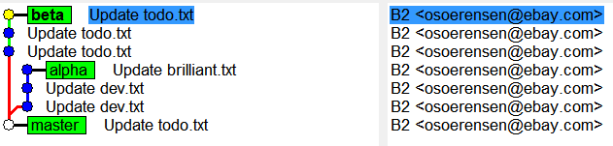
The coolest commit

Slide 10
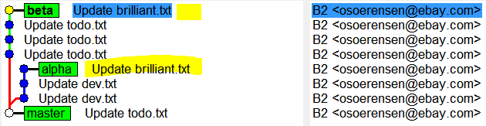
cherry-pick

Slide 11

Pull and merge

Slide 12
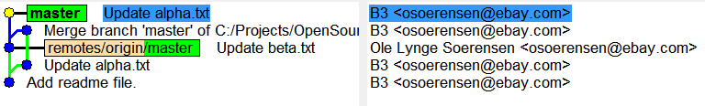
Rebase

Slide 13
Pull with rebase

Slide 14
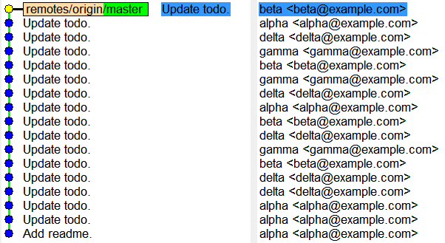
One branch with pull --rebase = Linear history

Slide 15
GIT as your best friend with complete control over changes

Slide 16
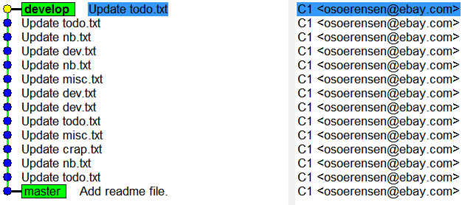
A nice mix of changes

Slide 17
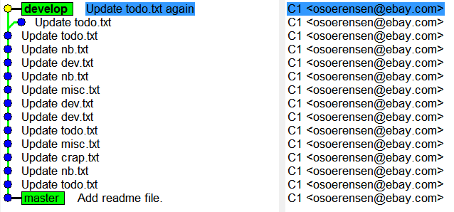
Reword

Slide 18
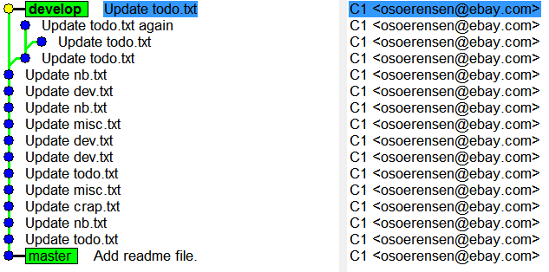
Squash / fix

Slide 19
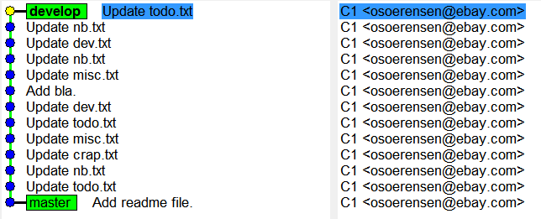
Edit / insert new commits

Slide 20
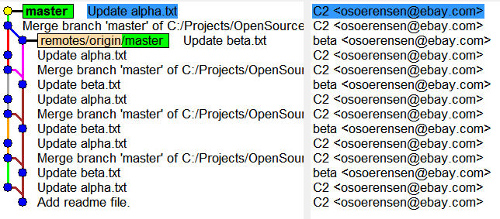
Local work alternating with merges of changes from other persons

Slide 21
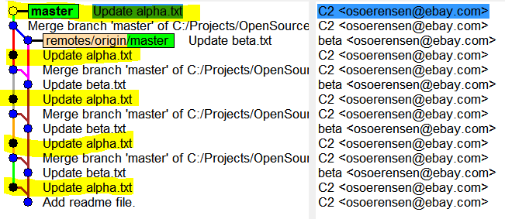
What have I changed?

Slide 22
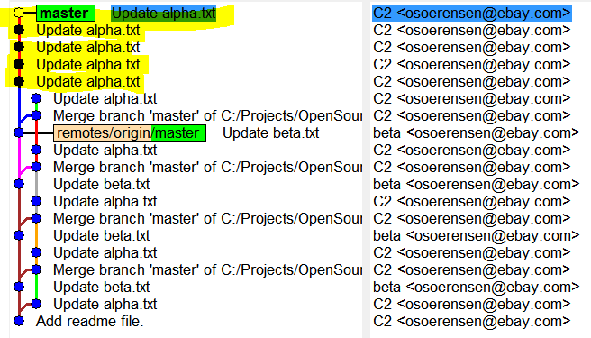
Rebase

Slide 23
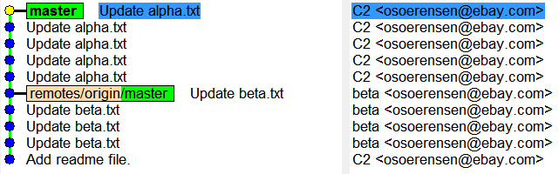
”Perler på en snor”

Slide 24
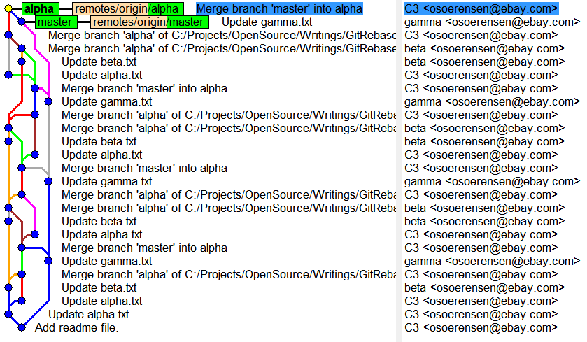
Completed work on a branch

Slide 25
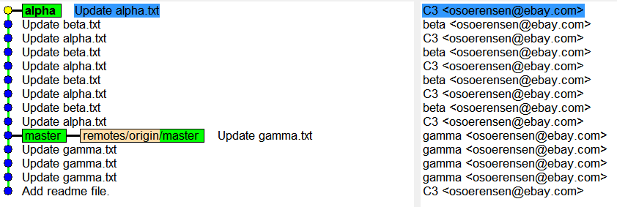
git rebase master

Slide 26
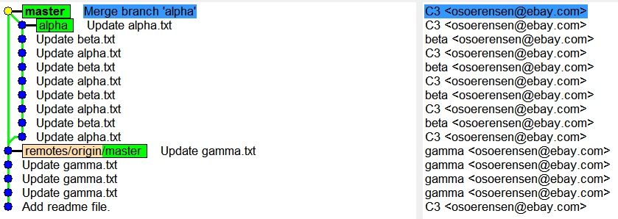
Merge simple history back to master

Slide 27
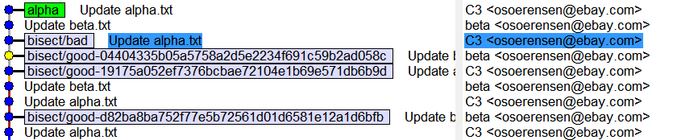
Bisecting…

