Slide 1
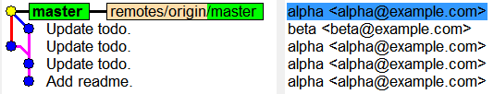
Two persons work on same branch

Slide 2
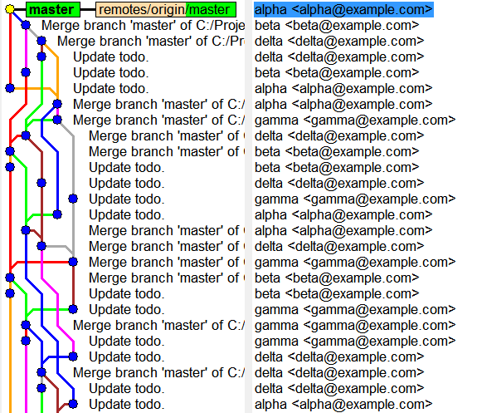
A small team, after some time

Slide 3
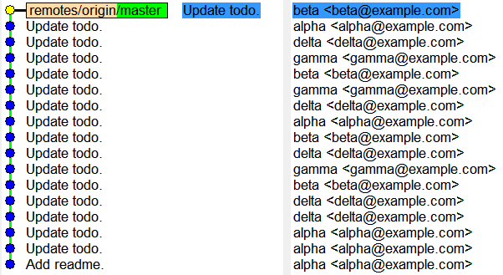
Pull with rebase

Slide 4
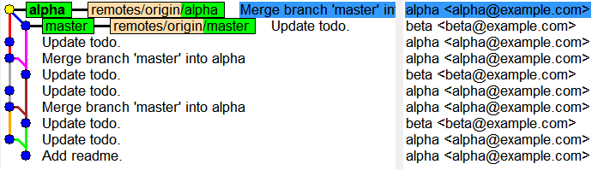
Two persons work on two branches

