Slide 1
GIT as a chronological versioning tool with historical correctness

Slide 2
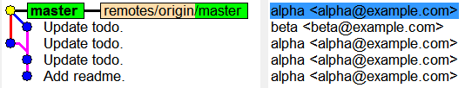
Two persons work on same branch

Slide 3
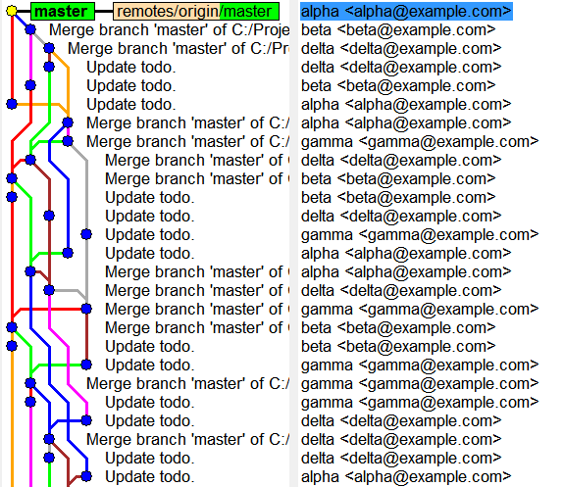
A small team, after some time

Slide 4
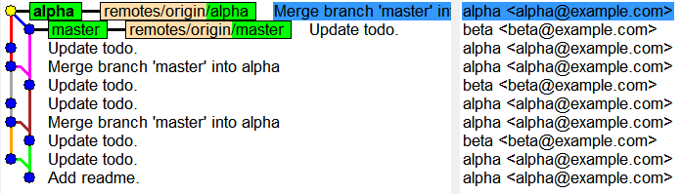
Two persons work on two branches

Slide 5
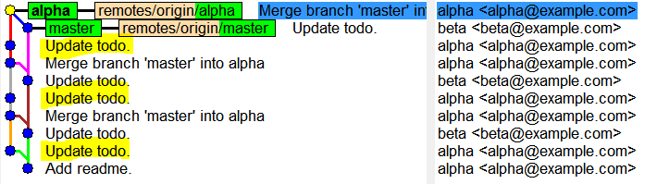
Related commits

Slide 6
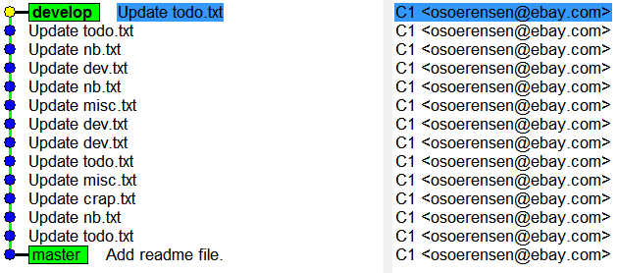
Hacking away

Slide 7
GIT as an editing tool with manipulation of commit

Slide 8
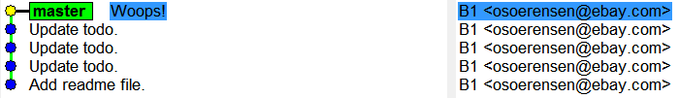
Error in last commit

Slide 9
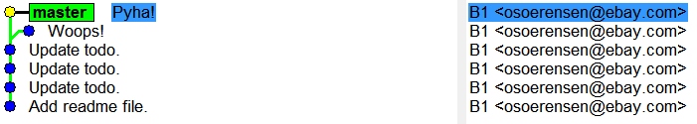
Fixing an error in last commit

Slide 10
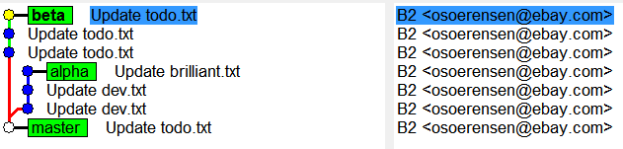
The coolest commit

Slide 11
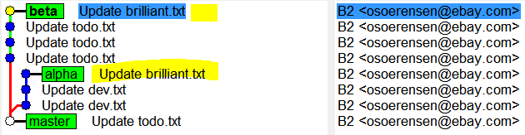
cherry-pick

Slide 12

Pull and merge

Slide 13
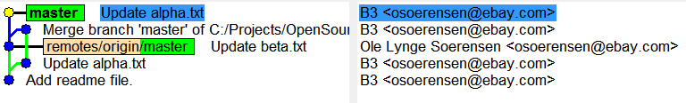
Rebase

Slide 14
Pull with rebase

Slide 15
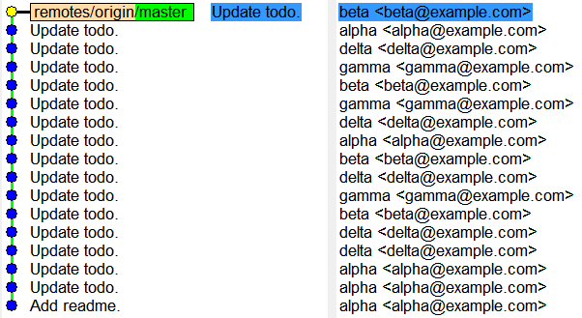
One branch with pull --rebase = Linear history

Slide 16
GIT as a true friend with complete control over history

Slide 17
A nice mix of changes

Slide 18
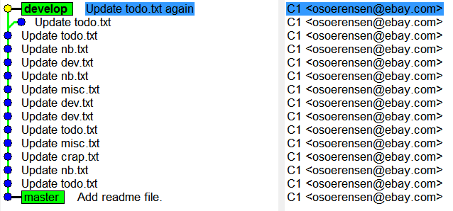
Reword

Slide 19
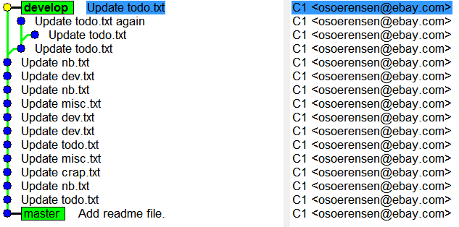
Squash / fix

Slide 20
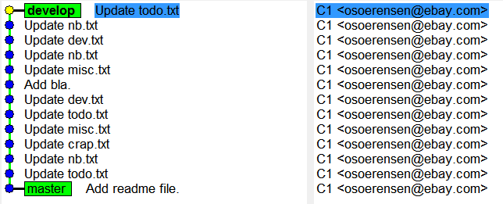
Edit / insert new commits

Slide 21
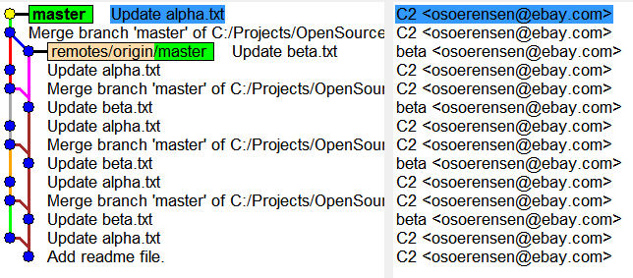
Local work alternating with merges of changes from other persons

Slide 22
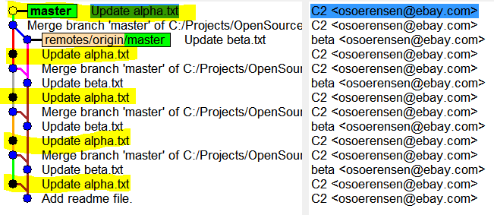
What have I changed?

Slide 23
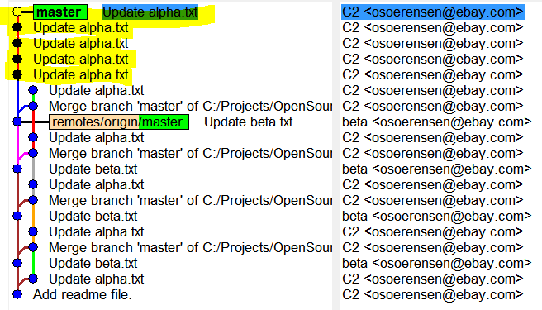
Rebase

Slide 24
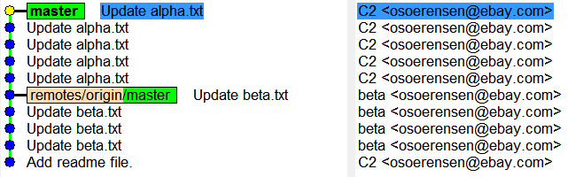
”Perler på en snor”

Slide 25
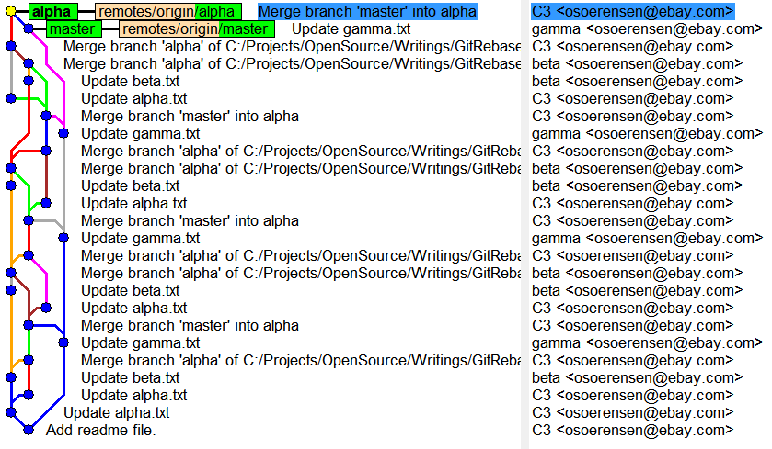
Completed work on a branch

Slide 26
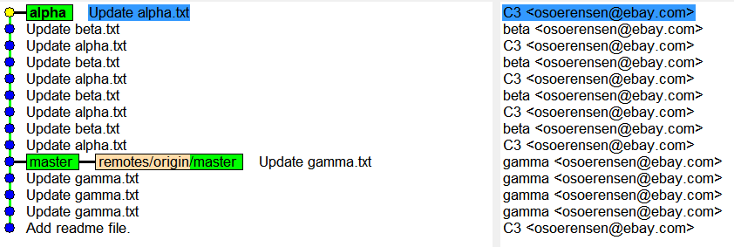
git rebase master

Slide 27
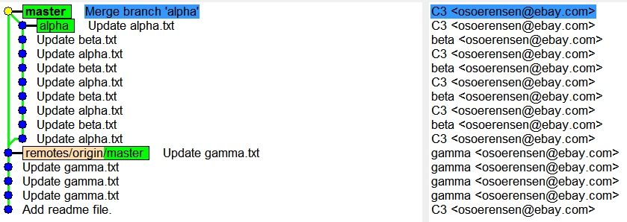
Merge simple history back to master

Slide 28
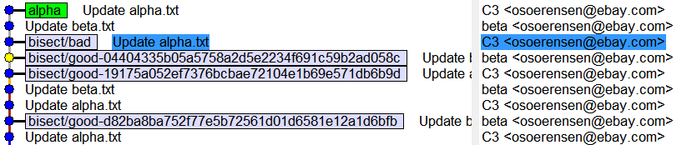
Bisecting…

