Slide 1
Computer Vision HW1
Department：資訊工程系碩士班
Name：魏榕佑
Student ID： 113598098

Slide 2
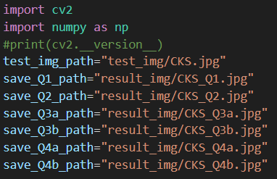
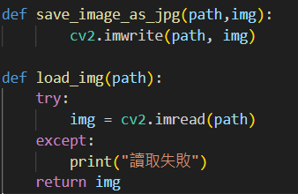
Code explanation
Set a storage path for easy access later.
These two functions are responsible for reading image and output image, respectively.

Slide 3
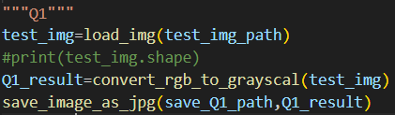
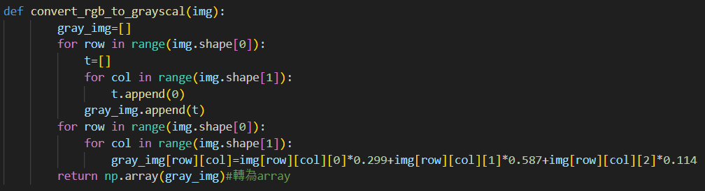
Q1 Code explanation
Step1.load image.
Step2.Pass the image to convert_rgb_to_grayscal function.
Step3.Store the result of the function in Q1_result.
Step4.Output the image as a JPG.
Step1.Create gray_img that a zero list of the same size as the input image.
Step2.Use the formula to convert RGB to grayscale.
Step3.Convert the gray_img to an array and return it.

Slide 4
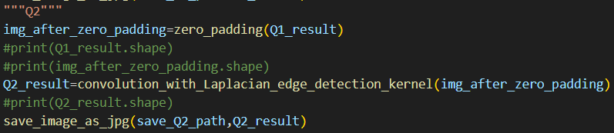
Q2 Code explanation
Step1.Pass the Q1_result to zero_padding function.
Step2.Store the result of the function in img_after_zero_padding.
Step3.Pass the img_after_zero_padding to convolution_with_Laplacian_edge_detection_kernel function
Step4.Store the result of the function in Q2_result.
Step5.Output the image as a JPG.

Slide 5
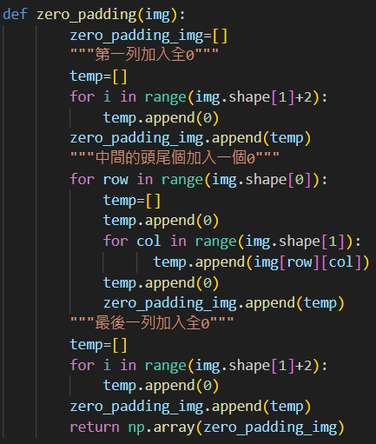
Q2 Code explanation
Step1.Create an empty list zero_padding_img.
Step2.Add a list of zeros with a length of original column+2 to zero_padding_img.
Step3.Add each row from the original image and add a zero at the beginning and end of each row to zero_padding_img.
Step4.Add a list of zeros with a length of original column+2 to zero_padding_img.
Step5.Convert the zero_padding_img to an array and return it.

Slide 6
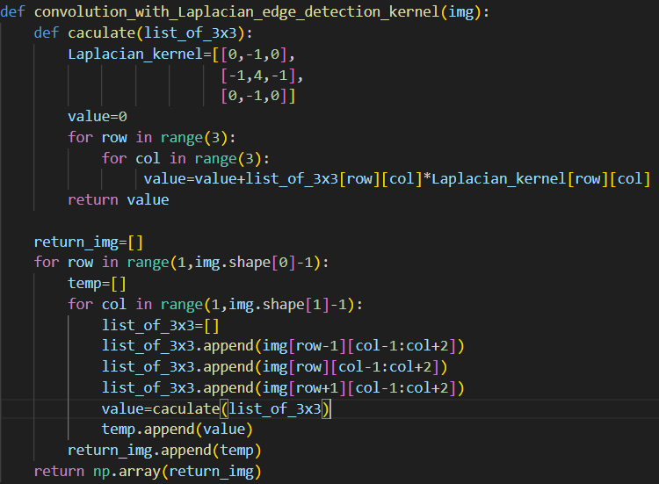
Q2 Code explanation
Step1.
In order, from (1,1)(1,2)...(1, number of image columns - 2) (2,1)(2,2) until (number of image rows - 2, number of image columns - 2).
Step2.
Extract a 3x3 list around the current point as the center and pass it to the calculate function for processing.
Step3.
The calculate function performs convolution by multiplying the passed 3x3 list with a predefined 3x3 list element-wise and summing all the products.
Step4.Store each of the result of the calculate function in temp
Step5.After completing each row, add the temp list to return_img.
Step6.Convert the return_img to an array and return it.

Slide 7
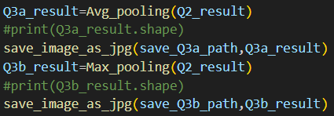
Q3 Code explanation
Step1.
Pass Q2_result to the Avg_pooling and Max_pooling functions respectively
Step2.
Save the results of the Avg_pooling and Max_pooling functions in Q3a_result and Q3b_result, respectively.
Step3.Output the image as a JPG.

Slide 8
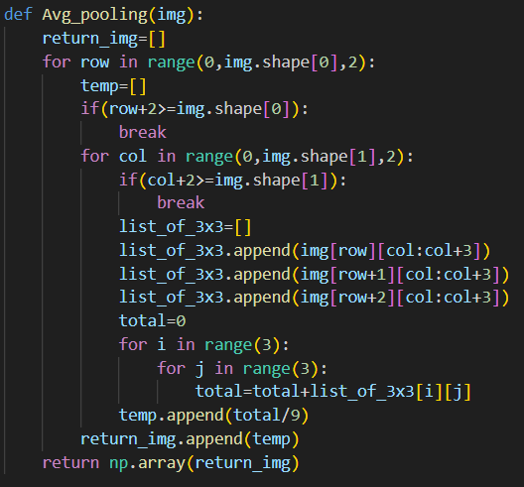
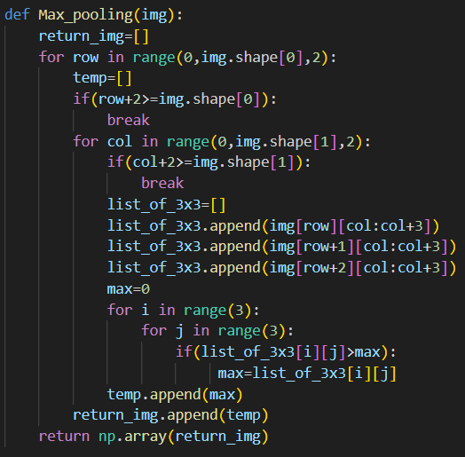
Q3 Code explanation
Step1.Create an empty list return_img
Step2.Do the for loop and from the current point, extend 2 positions to the right and downward to form a 3x3 list.
Step3-1.Avg_pooling sum all the elements in the extracted 3x3 list and calculate the average.
Step3-2.Max_pooling obtain the maximum value from the extracted 3x3 list.
Step4. Convert the return_img to an array and return it.

Slide 9
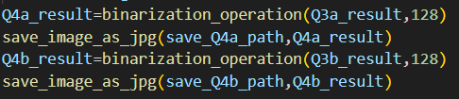
Q4 Code explanation
Step1.
Pass (Q3a_result,threshold) and (Q3b_result,threshold) to the binarization_operation function.
Step2.
Save the results of the binarization_operation function in Q4a_result and Q4b_result.
Step3.Output the image as a JPG.

Slide 10
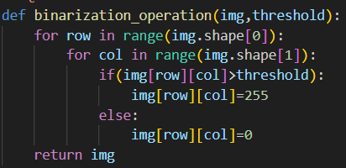
Q4 Code explanation
Step1.
Use a for loop to compare each point in the array with the threshold; if the point value is greater than the threshold, modify it to 255, otherwise change it to 0.
Step2.Return it.

Slide 11
END

