Slide 1
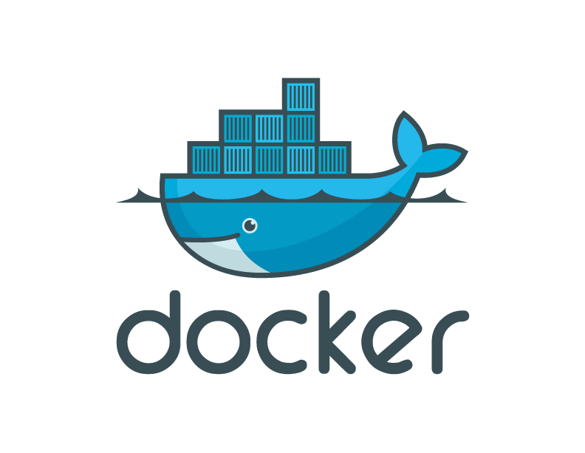
Future of Application Delivery

Slide 2
Market View: Evolution of IT
1995
2015
Thin app on mobile, tablet
Thick, client-server app on thick client
Well-defined stack:
- O/S
- Runtime
- Middleware
Assembled by developers using best available services
Running on any available set of physical resources
(public/private/
virtualized)
Monolithic
Physical
Infrastructure

Slide 3
Challenges
2015
Thin app on mobile, tablet
Assembled by developers using best available services
How to ensure services interact consistently, avoid dependency hell
How to avoid n X n different configs
Running on any available set of physical resources
(public/private/
virtualized)
How to migrate & scale quickly, ensure compatibility

Slide 4

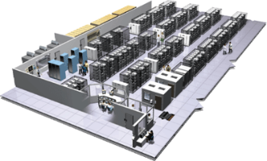
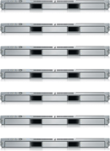
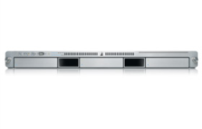
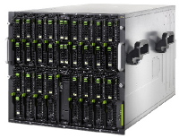

The Challenge
User DB
Static website
postgresql + pgv8 + v8
Queue
Analytics DB
nginx 1.5 + modsecurity + openssl + bootstrap 2
Do services and apps interact appropriately?
Redis + redis-sentinel
hadoop + hive + thrift + OpenJDK
Multiplicity of Stacks
Background workers
Web frontend
Python 3.0 + celery + pyredis + libcurl + ffmpeg + libopencv + nodejs + phantomjs
Ruby + Rails + sass + Unicorn
API endpoint
Python 2.7 + Flask + pyredis + celery + psycopg + postgresql-client
Production Cluster
Development VM
Public Cloud
Multiplicity of hardware environments
QA server
Can I migrate smoothly and quickly?
Disaster recovery
Customer Data Center
Contributor’s laptop
Production Servers

Slide 5
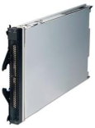
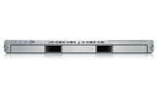
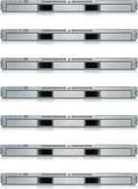

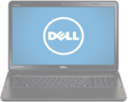
Results in N X N compatibility nightmare
? | ? | ? | ? | ? | ? | ?
? | ? | ? | ? | ? | ? | ?
? | ? | ? | ? | ? | ? | ?
? | ? | ? | ? | ? | ? | ?
? | ? | ? | ? | ? | ? | ?
? | ? | ? | ? | ? | ? | ?
Static website
Web frontend
Background workers
User DB
Analytics DB
Queue
 | Development VM | QA Server | Single Prod Server | Onsite Cluster | Public Cloud | Contributor’s laptop | Customer Servers

Slide 6
A useful analogy…

Slide 7
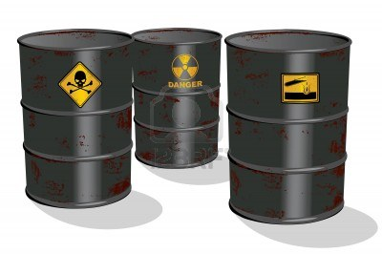
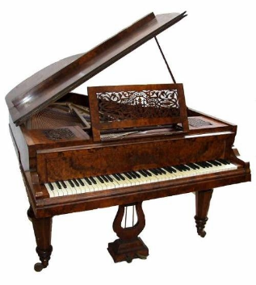

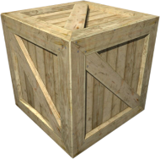
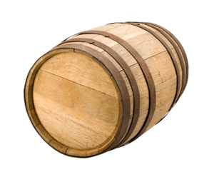
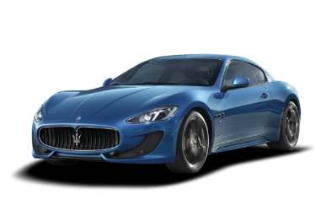
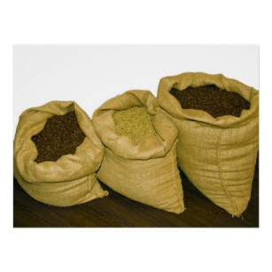



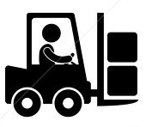
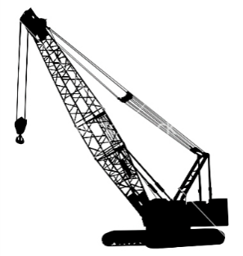
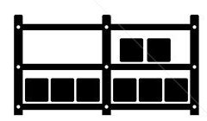

Cargo Transport Pre-1960
Do I worry about how goods interact (e.g. coffee beans next to spices)
Multiplicity of Goods
Multipilicity of methods for transporting/storing
Can I transport quickly and smoothly
(e.g. from boat to train to truck)

Slide 8
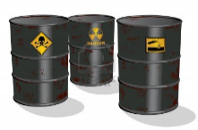

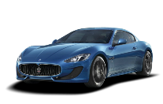


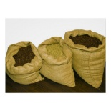


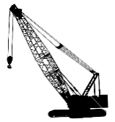



Also an NxN Matrix
 | ? | ? | ? | ? | ? | ? | ?
 | ? | ? | ? | ? | ? | ? | ?
 | ? | ? | ? | ? | ? | ? | ?
 | ? | ? | ? | ? | ? | ? | ?
 | ? | ? | ? | ? | ? | ? | ?
 | ? | ? | ? | ? | ? | ? | ?

Slide 9
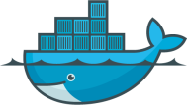
Contents
The challenge
The solution
Why Docker and Containers Matter?
How They Work?
Demo

Slide 10



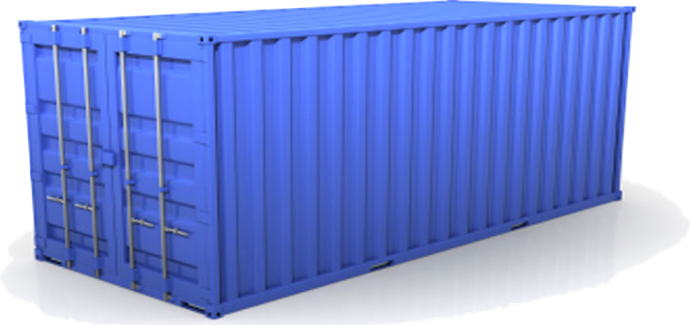
Solution: Intermodal Shipping Container
Do I worry about how goods interact (e.g. coffee beans next to spices)
Multiplicity of Goods
A standard container that is loaded with virtually any goods, and stays sealed until it reaches final delivery.
…in between, can be loaded and unloaded, stacked, transported efficiently over long distances, and transferred from one mode of transport to another
Can I transport quickly and smoothly
(e.g. from boat to train to truck)
Multiplicity of methods for transporting/storing

Slide 11


This eliminated the NXN problem…

Slide 12
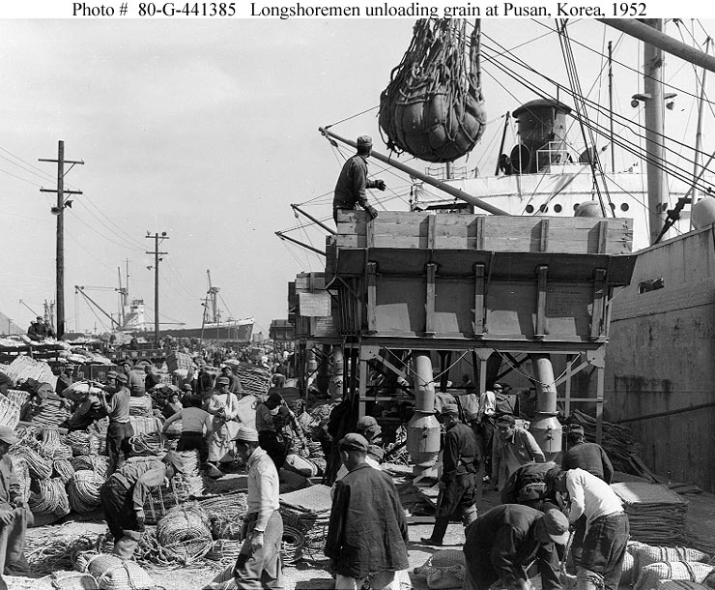
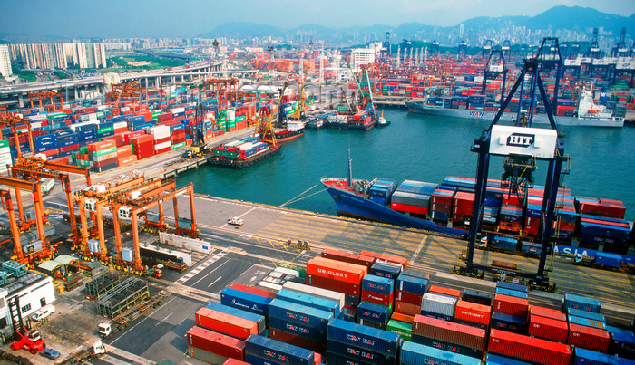
and spawned an Intermodal Shipping Container Ecosystem
90% of all cargo now shipped in a standard container
Order of magnitude reduction in cost and time to load and unload ships
Massive reduction in losses due to theft or damage
Huge reduction in freight cost as percent of final goods (from >25% to <3%)
massive globalizations
5000 ships deliver 200M containers per year

Slide 13
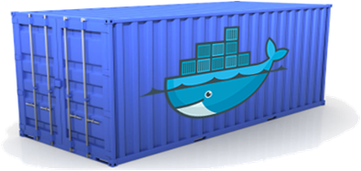
Docker is a shipping container system for code
Static website
User DB
Web frontend
Queue
Analytics DB
Do services and apps interact appropriately?
Multiplicity of Stacks
An engine that enables any payload to be encapsulated as a lightweight, portable, self-sufficient container…
…that can be manipulated using standard operations and run consistently on virtually any hardware platform
Multiplicity of hardware environments
Can I migrate smoothly and quickly
Development VM
QA server
Customer Data Center
Public Cloud
Production Cluster
Contributor’s laptop

Slide 14
Or…put more simply
Static website
User DB
Web frontend
Queue
Analytics DB
Do services and apps interact appropriately?
Multiplicity of Stacks
Developer: Build Once, Run Anywhere (Finally)
Operator: Configure Once, Run Anything
Multiplicity of hardware environments
Can I migrate smoothly and quickly
Development VM
QA server
Customer Data Center
Public Cloud
Production Cluster
Contributor’s laptop

Slide 15

Docker solves the NXN problem
Static website
Web frontend
Background workers
User DB
Analytics DB
Queue
 | Development VM | QA Server | Single Prod Server | Onsite Cluster | Public Cloud | Contributor’s laptop | Customer Servers

Slide 16
Contents
The challenge
The solution
Why Docker and Containers Matter?
How They Work?
Demo

Slide 17
Why containers matter
 | Physical Containers | Docker
Content Agnostic | The same container can hold almost any type of cargo | Can encapsulate any payload and its dependencies
Hardware Agnostic | Standard shape and interface allow same container to move from ship to train to semi-truck to warehouse to crane without being modified or opened | Using operating system primitives (e.g. LXC) can run consistently on virtually any hardware—VMs, bare metal, openstack, public IAAS, etc.—without modification
Content Isolation and Interaction | No worry about anvils crushing bananas. Containers can be stacked and shipped together | Resource, network, and content isolation. Avoids dependency hell
Automation | Standard interfaces make it easy to automate loading, unloading, moving, etc. | Standard operations to run, start, stop, commit, search, etc. Perfect for devops: CI, CD, autoscaling, hybrid clouds
Highly efficient | No opening or modification, quick to move between waypoints | Lightweight, virtually no perf or start-up penalty, quick to move and manipulate
Separation of duties | Shipper worries about inside of box, carrier worries about outside of box | Developer worries about code. Ops worries about infrastructure.

Slide 18
Why Developers Care
Build once…run anywhere
A clean, safe, hygienic and portable runtime environment for your app.
No worries about missing dependencies, packages and other pain points during subsequent deployments.
Run each app in its own isolated container, so you can run various versions of libraries and other dependencies for each app without worrying
Automate testing, integration, packaging…anything you can script
Reduce/eliminate concerns about compatibility on different platforms, either your own or your customers.
Cheap, zero-penalty containers to deploy services? A VM without the overhead of a VM? Instant replay and reset of image snapshots? That’s the power of Docker

Slide 19
Why Devops Cares?
Configure once…run anything
Make the entire lifecycle more efficient, consistent, and repeatable
Increase the quality of code produced by developers.
Eliminate inconsistencies between development, test, production, and customer environments
Support segregation of duties
Significantly improves the speed and reliability of continuous deployment and continuous integration systems
Because the containers are so lightweight, address significant performance, costs, deployment, and portability issues normally associated with VMs

Slide 20
Contents
The challenge
The solution
Why Docker and Containers Matter?
How They Work
Demo

Slide 21
Containers vs. VMs
App
A
App
A’
App
B
Containers are isolated,
but share OS and, where
appropriate, bins/libraries
Bins/
Libs
Bins/
Libs
Bins/
Libs
VM
Guest
OS
Guest
OS
Guest
OS
Guest
OS
Guest
OS
App A
App A’
App B
App B’
App B’
App B’
Container
Docker
Hypervisor (Type 2)
Bins/Libs
Bins/Libs
Host OS
Host OS
Server
Server

Slide 22
Why are Docker containers lightweight?
VMs
Containers
App
A
App
A
App
A’
App
A
App
A
App Δ
Bins/
Libs
Bins/
Libs
Bins/
Libs
Bins/
Libs
Bins/
Guest
OS
Guest
OS
Guest
OS
Guest
OS
Original App
(No OS to take
up space, resources,
or require restart)
Copy of
App
No OS. Can
Share bins/libs
Modified App
Union file system allows
us to only save the diffs
Between container A and container
A’
VMs
Every app, every copy of an
app, and every slight modification
of the app requires a new virtual server

Slide 23
What are the basics of the Docker system?
Container A
Docker
Container
Image Registry
Push
Search
Pull
Source Code Repository
Run
Build
Dockerfile
For
A
Container A
Container B
Container C
Docker
Docker Engine
Host 1 OS (Linux)
Host 2 OS 2 (Linux)

Slide 24
www.docker.io

