Slide 1
Specification
Source Diagrams
Notes:
Climate change, biodiversity, water consumption, modern slavery
Carbon tariffs, due diligence directive, etc – 16 regs just in EU plus US IRA
80 Euro/ton tariff , market access, access to capital, consumer price uplift
60% of claims have no evidence and 40% are false or misleading – will get worse.
Sunlight is the best auditor – transparency – fair for legitimate traders, un-sustainable behaviour nowhere to hide

Slide 2
Architecture
Source diagrams
Notes:
Climate change, biodiversity, water consumption, modern slavery
Carbon tariffs, due diligence directive, etc – 16 regs just in EU plus US IRA
80 Euro/ton tariff , market access, access to capital, consumer price uplift
60% of claims have no evidence and 40% are false or misleading – will get worse.
Sunlight is the best auditor – transparency – fair for legitimate traders, un-sustainable behaviour nowhere to hide

Slide 3










SECURE the data
FIND the data
VALUE the data
Scan barcode on the box or the document
Decentralised Access Control
(DAC)
Identity Resolver
(IDR)
Get list of links
Humans
Business Case Template
(BCT)
Or
Prove authority to access sensitive data, no matter where it is located.
Machines
Individual organisation business case for UNTP implementation
the DATA
Get the data
Digital Identity Anchor
(DIA)
Community Activation Program
(CAP)
Digital Traceability Event
(DTE)
Digital Product Passport
(DPP)
Digital Facility Record
(DFR)
Digital Conformity Credential
(DCC)
Get proof of identity and role from a trust authority and use it anywhere
A community level business case for collective action.
Traceability
Transparency
Trust
Verifiable Credentials Profile
(VCP)
UNDERSTAND the data
Value Assessment Framework
(VAF)
ASC
IFRS/GRI etc
Sustainability Vocabulary Catalogue
(SVC)
RBA
ASRO
maps to
ISO/IEC etc
catalogs
MLA
Make all credentials tamper-proof, verifiable, revokable & interoperable
ABNT
IRMA
UNEP/FAO etc
Ongoing post-implementation reporting to track value.
VCS
TSM
NGER
Etc..
ESRS/SEC etc
1000’s Sectoral/local rules
Global references

Slide 4
















Compliance
Ship ore
Ship metals
Ship batteries
Sell new vehicle
Sell used battery
🇦🇺
Authority
Lithium Mine
Processing
Plant
Battery Maker
Car Manufacturer
Consumer
Recycler
ID
ID
ID
ID
ID
ID
Guarantee of origin
Sale Event
Processing event
Manuf-acturing Event
Manuf-acturing Event
EPD
Mining permit
Mineral Passport
Sale Event
Sale Event
Sale Event
Authority
Sale Event
🇨🇦
Product Passport
Product Passport
Authority
Copper Mine
EU DPP
ID
ID
Material passport
EPD
EPD
Battery passport
CBAM tariff
Guarantee of origin
Sale Event
Ship materials
Mining permit
Mineral Passport
B2B due diligence
G2B assessment
Consumer choice
Notes:
Traceability events link the data. Credentials means you can trust the data. Entry point at any product /passport.
Product linking adds robustness – chain doesn’t break when some parties aren’t connected.
Did this in AU in a matter of weeks – which verifies that this is indeed cheap and easy.

Slide 5






Sell Cotton
Sell Thread
Ship Fabric
Ship Clothes
Sell Clothes
Fabric Maker
Garment Mfg
Retail Brand
Authority
State Gov
Cotton Farm
Cotton Mill
US Importer
Verify product passport and linked credentials
Country of Origin
(Cotton)
Sale Event
Transformation Event
Processing Event
Sale Event
Manufacturing Event
eCert Credential
Cotton Bale Passport
Sale Event
Sale Event
Thread Passport
Shirt Passport
Brand Passport
Guarantee of origin credential
Fabric Passport
US Verifier
Notes:
Traceability events link the data. Credentials means you can trust the data. Entry point at any product /passport.
Product linking adds robustness – chain doesn’t break when some parties aren’t connected.
Did this in AU in a matter of weeks – which verifies that this is indeed cheap and easy.

Slide 6






Sell herd
Sell fatter herd
Sell beef product
Sell grain
State Gov
Cattle farm
Grain farm
Saleyard
Feedlot
Processor
Authority
EU Importer
Verify product passport and linked credentials
Deforestation Credential
(cattle farm)
Movement Event
Feeding Event
Processing Event
Sale Event
eCert Credential
Deforestation Credential
(grain farm)
Livestock Passport
Sale Event
Sale Event
Grain Passport
Livestock Passport
Product Passport
Guarantee of origin credential
EU Verifier
Notes:
Traceability events link the data. Credentials means you can trust the data. Entry point at any product /passport.
Product linking adds robustness – chain doesn’t break when some parties aren’t connected.
Did this in AU in a matter of weeks – which verifies that this is indeed cheap and easy.

Slide 7

Humans
Scan barcode
Scan barcode
Machines
Discoverable & resolvable identifiers
Identity resolver
links
links
Digital Traceability Event
Digital Product Passport
Digital Conformity Credential
Sensor Data
Organisation
Sensor data
Accreditation
Event types
Facility Data
Scheme or Regulation
Product Information
Link to verifiable product traceability & transparency data
Association (assemble, package,..)
Transformation (manufacture,..)
Object (inspect, test, ..)
Conformity Attestation
Aggregation (consolidate, ..)
Transaction (sell, ship, transfer,..)
Provenance Data
Assessment Body
links
Sustainability Claims
links
Conformity Assessment
Product ID
ESG Metric Value
Products / Facilities
Location ID
Item/Batch Data
Criteria / Metrics
Party ID
Traceability Events
Assessed values
Digital Identity Anchor
Verify identity
Trust Registrar ID
Verify accreditation
Backed by strong governance
Member ID
Verify ownership
Member Name
Issues
Linked DIDs
Scope
Trusted Authority

Slide 8






UNTP - implementation for individual actors
DPCC
Digital Product Conformity Credential
CAB
Conformity Assessment Body
Issues
scan
Submit detailed conformity data / evidence
Links to
Shipped product
DPP
Digital Product Passport
Detailed business document (eg Invoice)
Links to
Issues
Business
scan
Links to
DTE
Digital Traceability Events
Issues
Discoverable if you have the product
Simple passports, certificates & events as verifiable credentials
Rich and confidential data remains private
Notes:
DPP is at the granularity of a shipped batch of product and has just what is needed for next stage. Scope 3 calculations simplified
Every actor can act independently. No need to setup system-system connections in advance.
DPP, credentials and events are both human and machine readable so you can go digital without demanding any technology maturity of your customers.

Slide 9
VCP, DPP, DCC, DTE, DFR,
IDR, DIA, DAC, SVC Pages
Source diagrams
Notes:
Climate change, biodiversity, water consumption, modern slavery
Carbon tariffs, due diligence directive, etc – 16 regs just in EU plus US IRA
80 Euro/ton tariff , market access, access to capital, consumer price uplift
60% of claims have no evidence and 40% are false or misleading – will get worse.
Sunlight is the best auditor – transparency – fair for legitimate traders, un-sustainable behaviour nowhere to hide

Slide 10
How the underlying data standard governance works
Using a DPP credential as an example.
W3C VC Project Governance
Externally and independently governed vocabularies.
(but should be stable and versioned)
W3C VCDM 2.0
JSON-LD context v2.0
Extends
schema.org
DPP Instance:
UNTP Project Governance
UNTP DPP 1.0
vocabulary.uncefact.org
“type”:[”VerifiableCredential”, “DigitalProductPassport”],
…
“type”:[“Facility”]
…
UNTP Digital Product Passport
V1.1
UNTP DPP 1.1
Meaning defined by
JSON-LD context
(extends VCDM)
References terms in
ref.gs1.org/epcis
Structure defined by
JSON Schema
(complete self-contained)
GRI, IFRS, etc
Is interoperable with
Extends
DLP Instance:
AATP Project Governance
“type”:[”VerifiableCredential”, “DigitalProductPassport”, “DigitalLivestockPassport”],
…
“type”:[“Facility”, “Farm”]
…
AATP DLP 0.9
AATP Digital Livestock Passport
V1.0
AATP DLP 1.0
vocab.daff.gov.au/aatp
Meaning defined by
JSON-LD context
(extends UNTP)
References terms in
Icar.org
Structure defined by
JSON Schema
(complete self-contained)
Other Ag standard

Slide 11
WHO issued the passport?
Manufacturer, producer, brand, etc. Industry sector, business name, & identifier
WHERE was the activity performed that created the products described by the passport? Facility name, ID & geolocation.
Digital Product Passport
Organisation
(Registered Entity ID)
WHAT product is this passport describing? Basic product data, name & SKU ID.
Facility Data
(Registered Location ID)
ORIGIN of the raw materials and component manufacturing in this product, broken down by country and percentage.
Product Information
(SKU ID)
Provenance Claims
(Guarantee of Origin ID)
CLAIMS ESG product properties (eg Scope 3 GHG, water usage, fair work, etc) . Categorized for easy roll-up to corporate reports
VALUE of specific ESG metrics such as carbon intensity, litres of water, etc for the specific product.
Sustainability Claims
(Conformity credential IDs)
ESG Metric Value
(Quota Allocation ID)
ITEM identity of an individual serial or batch of the product. Important because ESG metrics can vary (and be improved) by batch.
Item/Batch Data
(Batch ID/Serial ID)
TRACE of the product item/batch components through the entire value chain back to raw material inputs.
Traceability Events
(Event IDs)
Notes:
Traceability events link the data. Credentials means you can trust the data. Entry point at any product /passport.
Product linking adds robustness – chain doesn’t break when some parties aren’t connected.
Did this in AU in a matter of weeks – which verifies that this is indeed cheap and easy.

Slide 12
Digital Product Passport
Evidence
Business identity credential
From a government authority or a bank, confirming the identity of the passport issuer/ product owner.
Organisation
(Registered Entity ID)
Facility location credential
From a government land registrar or other geolocated evidence of physical location.
Facility Data
(Registered Location ID)
Product registration credential
From a trusted product register or trade mark authority confirming ownership of product or brand.
Product Information
(SKU ID)
Guarantee of origin credential
From a competent authority or accredited industry organisation confirming product provenance.
Provenance Data
(Guarantee of Origin ID)
Digital link resolution protocol links IDs to evidence
Sustainability Claims
(Conformity credential IDs)
Product conformity credential.
From a conformity assessment body providing ESG claim verification
ESG Metric Value
(Quota Allocation ID)
Quota allocation credential
Issued by an independent party confirming mass-balance based allocation of ESG value.
Item/Batch Data
(Batch/Serial/Shipment ID)
Entry point event credential
From passport issuer, the event that established the creation of the item / batch / shipment ID
Traceability Events
(Event IDs)
Traceability event credential graph
Other traceability events that are discovered from linked data that describe the full value chain.
Notes:
Traceability events link the data. Credentials means you can trust the data. Entry point at any product /passport.
Product linking adds robustness – chain doesn’t break when some parties aren’t connected.
Did this in AU in a matter of weeks – which verifies that this is indeed cheap and easy.

Slide 13
WHO has authorised the conformity assessment body to issue attestations against the defined standard or regulation.
UN Digital Conformity Credential
WHICH standard or regulation is this conformity attestation made against?
Accreditation
Scheme or Regulation
THE attestation of conformity that given set of products or facilities conform to standard or regulatory criteria.
Conformity Attestation
WHO is issuing this conformity attestation. Typically a conformity assessment body (CAB).
Assessment Body
WHAT specific assessments are made via this attestation. One attestation can make many assessments.
Conformity Assessment
WHICH products or facilities are the subject of this conformity assessment?
Products / Facilities
Criteria / Metrics
WHICH specific criteria within a given standard or regulation are covered by this assessment?
Assessed values
WHAT specific values (eg emissions intensity) are measured by this assessment?
Notes:
Traceability events link the data. Credentials means you can trust the data. Entry point at any product /passport.
Product linking adds robustness – chain doesn’t break when some parties aren’t connected.
Did this in AU in a matter of weeks – which verifies that this is indeed cheap and easy.

Slide 14
Sensor data such as GPS location, camera images, or physical measurements can be attached to any event. Sensor metadata & device signatures add integrity.
UNTP Traceability Event
Traceability events provide the links that allow output products to be connected to the input materials or components.
A transformation event lists the input materials that are consumed to make a list of output products (eg cotton bales to yarn).
An association event lists the identified components that are assembled into a larger product (eg motherboard, power supply, etc to build a desktop computer).
A transaction event describes the movement of a list of products from one facility to another.
An aggregation event describes temporary consolidation of products (packing / unpacking) for shipping.
An object event describes an interaction with a single product such as a test or inspection.
Any value chain of any complexity can be described by a combination of five event types.
Sensor Data
Sensor data
WHAT : All events must reference the physical products that they impact.
Ideally as a list of specific serialised item or batch numbers.
Optionally as a measured quantity of a product class.
Event types
Association (assemble, package,..)
Transformation (manufacture,..)
Object (inspect, test, ..)
Aggregation (consolidate, bundle,..)
Transaction (sell, ship, transfer,..)
WHERE : All events occur at a specific identified facility. Location identifiers must be resolvable to location metadata and geolocation.
Product ID
(quantity, item, batch)
WHO : Events are created by an identified party. Transaction events include both the sender / receiver (seller / buyer) party.
Location ID
(facility, farm, etc)
Party ID
(legal entity)
Notes:
Traceability events link the data. Credentials means you can trust the data. Entry point at any product /passport.
Product linking adds robustness – chain doesn’t break when some parties aren’t connected.
Did this in AU in a matter of weeks – which verifies that this is indeed cheap and easy.

Slide 15

WHO is the authority that is issuing this identity anchor credential?
WHICH decentralised identifiers have been verified by the authority as held by the registered member?
Digital Identity Anchor
Trust Registrar ID
Verified DID
WHO is the registered identity that is the subject of this credential?
Registered ID
Member Name
WHAT authorised roles does the registered member hold?
Scope
Authority
Manufacturer
resolves to
finds
Buyer
Issues
Issues
Verifies
Digital Identity Anchor
Digital Product Passport
✓
DPP credential is valid & not revoked
Barcode ID matches DPP product ID
DIA credential is valid & not revoked
DPP issuer ID matches DIA subject ID
DIA issuer ID is on trust anchor list
resolves to
✓
issuer : authority.gov
issuer : did:abcdxyz
✓
Business ID
1234567
Verified DID
abcdxyz
Product ID and data
✓
signature
status
signature
status
✓
Notes:
Traceability events link the data. Credentials means you can trust the data. Entry point at any product /passport.
Product linking adds robustness – chain doesn’t break when some parties aren’t connected.
Did this in AU in a matter of weeks – which verifies that this is indeed cheap and easy.

Slide 16




Anonymous party
https request
(item ID)
Publish open data
Redirect to
Identity Resolver
Anonymous party with secret
Manufacturer
https request
(item ID + secret)
Update links
Manage keys & access rules
secret
DID Auth or openID4VP Request (item ID + DIA)
Key manager
Redirect to
Publish encrypted data
Anonymous party with proof of identity and role
match item secret
and/or match DIA role
and/or match DIA identity
Durable storage
Digital Identity Anchor (DIA)
Notes:
Keys may be managed at manufacturer or delegated to the identity resolver.
DID Auth/openID4VP requests may optionally also include shared secrets.
Notes:
Traceability events link the data. Credentials means you can trust the data. Entry point at any product /passport.
Product linking adds robustness – chain doesn’t break when some parties aren’t connected.
Did this in AU in a matter of weeks – which verifies that this is indeed cheap and easy.

Slide 17






Product
Facility
Organisation
Clothing item
Chemical Plant
Brand
Global
GTIN
OSID
LEI
id.gs1.org/01
opensupplyhub.org
gleif.org
Scheme
969500XDJDCMABO52S07
ID
09520123456788
BR2024121BHXAQT
Cow
Farm
Farmer
National
NLIS
PIC
ABN
daf.qld.gov.au/pic
abr.business.gov.au
Scheme
nlis.com.au
QDBH0132XBS01234
ID
QDBH0132
90664869327
Notes:
The Identity Resolver (IDR) is the signpost to verifiable data. And must work whether the identity is of a product, a facility, or a legal entity. And must work with todays identifiers such as 1-D barcodes or “ABN”:”12345678910”

Slide 18



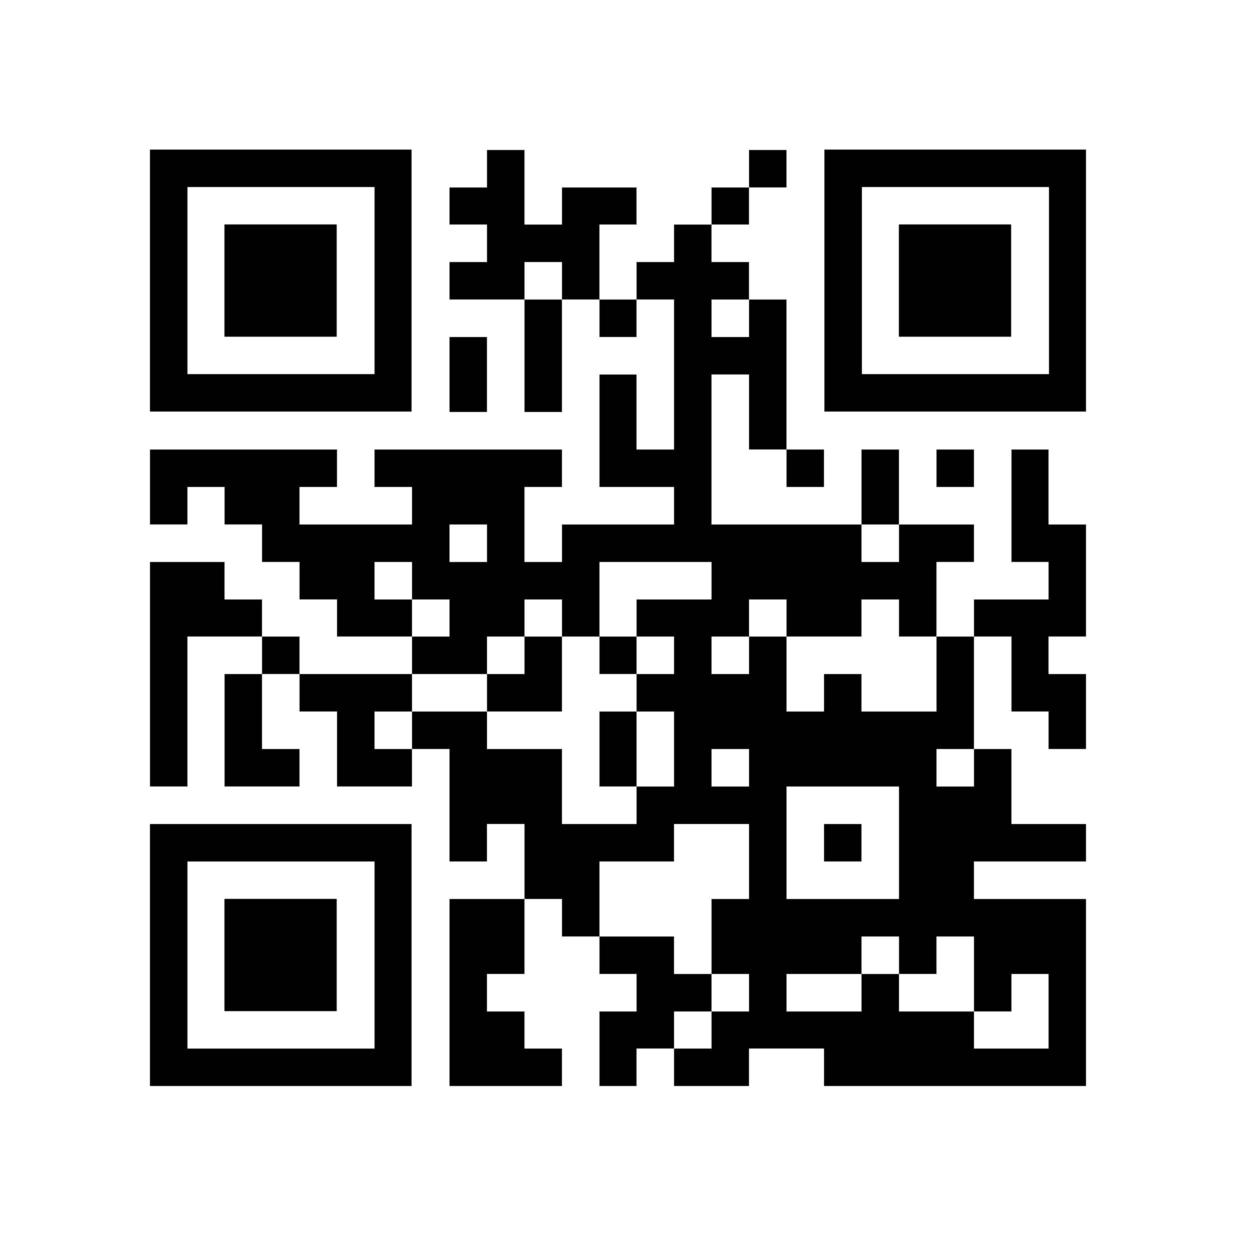





Discover
Resolve
Verify
Start here with a barcode, 2-D code or RFID on product or asset.
Optionally use your local copy of the UN trust list register for trusted issuers & IDR templates.
Or start here if QR on product or asset is already a URL to an identity resolver service
Or start here if you already have a direct link to a UNTP credential
The ultimate purpose is to discover and verify sustainability claims and disclosures from the value chain.
Scan
local copy
Scan
Scan
Verify
Scan and parse data carrier to get entity ID as URI
ID
Construct resolver URL from the ID
URL
IDR URL returns context aware link-set
Link-set
Follow links to find & verify UNTP credentials
DPP, DIA,..
Maintain supply chain graph with verified data
1
2
3
4
5
Confirm that identity anchor issuer is on trust list
Discover more identifiers in credentials
Notes:
How does that work? As easy as 123 (or D-R-V)

Slide 19


RFID Tag
DPP property
ID barcode
maps to
maps to
maps to
{URI scheme}:{Identifier scheme}:{identifier value}
maps to
maps to
maps to
DCC property
2D matrix
QR code

Slide 20

An RFID Tag
A printed 1D or
2D barcode
A machine-readable document
A QR Code
A QR Code
A machine-readable document
Read identifier string with custom device
Read identifier string with custom app
Parse identifier string with custom code
Scan with camera
Scan with camera
Parse DID with any wallet app..
Derive link resolver URL either with prior knowledge of ID scheme or using UN scheme register templates
ID resolvable?
Call Resolver URL
Resolver Service found?
Lookup resolver URL from DID document service endpoint
Returns lnkset with
UNTP link types?
Verify member workflow
Yes, ID is a known scheme
Yes, ID is a DID
Verify issuer workflow
Get and Verify UNTP Credential. Parse issuer ID and subject ID
DIA subject ID = Issuer ID?
Credential
subject ID matches
resolved ID?
DIA subject ID = Issuer ID?
DIA issuer ID = scheme
owner ID?
DIA issuer ID =
trusted context?

Slide 21

Human
- OR - Machine
Data consumer
Digital Product Passport
(DPP)
Scan product
Or find the Id in a document
Resolve id -> URL
Using ISO 18975
Return Link List
linktype:DPP
linktype:PCDS
Get DPP & verify it
Using W3C Verifiable Credentials
Identified product
Billions of these
Identity Register
One of these per ID scheme
Manufacturer or Brand
Thousands of these
1
Discover
2
Resolve
3
Verify
Notes:
How does that work? As easy as 123 (or D-R-V)

Slide 22
Maintained by UN
UNTP Sustainability Catalog
mapping
mapping
Coarse grained
IFRS
GRI
ESRS
UNEP
Other
Topic 1
Topic 1
Topic 1
Topic 1
Topic 1
Topic 2
Topic 2
Topic 2
Topic 2
Topic 2
Topic n
Topic n
Topic n
Topic n
Topic n
mapping
mapping
Criteria 1
Criteria 1
Criteria 1
Criteria 1
Criteria 1
Criteria 2
Criteria 2
Criteria 2
Criteria 2
Criteria 2
Fine grained
Criteria 3
Criteria 3
Criteria 3
Criteria 3
Criteria 3
Criteria n
Criteria n
Criteria n
Criteria n
Criteria n
PCDS
ISO 14000-x
Fair trade
IRMA
100’s more
Maintained by each standards authority
Notes:
ESG Vocabulary mapping architecture. UNTP maintains a coarse-grained catalog (using W3C DCAT and SKOS) that maps well established vocabularies so that when any credential maps their claims to any vocabulary then they can be universally understood.

Slide 23

Business
Authority
Auditor
issues
governs
issues
Product Passport
or Facility Record
Conformity Scheme Vocabulary
Conformity Credential
Product or facility ID
Scheme ID
Product or facility ID
includes
unambiguously
references
includes
unambiguously
references
includes
Claims
Criteria ID
Assessments
Standard classification of criteria
Schema for vocabularies
Catalog of schemes
UNTP Sustainability Vocabulary Catalog
Conformity Topic Classification
Conformity Scheme Register
Conformity Vocabulary Schema
Uses to inform claims
Uses to inform assessments
Notes:
ESG Vocabulary mapping architecture. UNTP maintains a coarse-grained catalog (using W3C DCAT and SKOS) that maps well established vocabularies so that when any credential maps their claims to any vocabulary then they can be universally understood.

Slide 24



Scheme document library
Digitally referenceable document library
Scheme & Criteria Management System
Extract to template
Add context & publish
Scheme/version
Extract criteria
many
many
Criterion
Automated publish of UNTP standard SVC
Classify criteria
many
many
Classification
Machine readable
Human readable
Notes:
ESG Vocabulary mapping architecture. UNTP maintains a coarse-grained catalog (using W3C DCAT and SKOS) that maps well established vocabularies so that when any credential maps their claims to any vocabulary then they can be universally understood.

Slide 25






Tailored checklist
Efficient
Auditor
Audit subject (facility / product)
UNTP DCC
Verifier
Scheme & Criteria Management System
Conformity Credential
Product or facility ID
Scheme/version
includes
Assessments
many
uses
many
Secure link
Criterion
Facility private data
Assessment co-pilot
Auditable evidence
many
many
Classification
Assessment tools
Notes:
ESG Vocabulary mapping architecture. UNTP maintains a coarse-grained catalog (using W3C DCAT and SKOS) that maps well established vocabularies so that when any credential maps their claims to any vocabulary then they can be universally understood.

