Slide 1
Business Case
Source Diagrams
Notes:
Climate change, biodiversity, water consumption, modern slavery
Carbon tariffs, due diligence directive, etc – 16 regs just in EU plus US IRA
80 Euro/ton tariff , market access, access to capital, consumer price uplift
60% of claims have no evidence and 40% are false or misleading – will get worse.
Sunlight is the best auditor – transparency – fair for legitimate traders, un-sustainable behaviour nowhere to hide

Slide 2

Benefits
Corporate value
Value
Brand reputation
Improved Disclosures
Costs
Revenue uplift
Transparency system
Market Access
Anti-counterfeiting
Capital
Unit price uplift
Operational
Cost reduction
Sustainable practice
Compliance costs
Process improvement
Finance costs
Digitalisation
Certification Fees
Sustainable and Digital Trade Facilitation Week I 8-12 July 2024 I Geneva
Notes:
Despite consumer appetite for more sustainable products, there is little evidence of significant unit price uplift. Total combined value may be between 0% and 5% of sales. It will be critical to minimise costs associated with DPP implementation and 3rd party certification so that there is margin left to improve sustainable practices.

Slide 3



UN Digital Product Passport
Corporate Sustainability disclosures
Organisation
Facility Data
UNTP
Product Information
Provenance Data
Sustainability Claims
ESG Performance
ESG Metric Value
Item/Batch Data
IFRS /AASB topic mapped
Traceability Events
Time
Product level transparency
Organisation level transparency
Rolls up to
Notes:
Few jurisdictions (so far) are planning to mandate DPPs. We hope others will follow the EU example. However, many jurisdictions are mandating corporate level sustainability disclosures to help drive their net zero commitments. Most corporates are using industry averages to account for their scope 3 (supplier) footprint. But without product level data, how will brands have the information to select supply to meet their corporate obligations? Will the market punish forms that don’t improve? Supplier DPPs provide the data. Just as payments, when coded to a GL account roll up to corporate financial statements, so DPPs when coded to IFRS categories, will roll up to corporate sustainability disclosures.

Slide 4
Monthly $$
Benefits scale up as volume of sustainable product trade increases. Benefits include:
Preferential trade finance
Unit price uplift
Market access uplift
Entity capital value uplift
Discovery phase
Alpha phase
Beta phase
Live phase
Break-even
Self-funded flywheel
Costs face an initial investment hump then drop to steady level. Costs include:
Sustainable practices
Third party certification
IT system integration
Consulting services
Up-front investment
4
12
24
Time in months
Notes:
Startup costs may stall action even for positive cases
On challenge is that early movers may face higher costs as they blaze the path for their industry. In some cases, startup costs are easily justified by future value streams. In other cases, future value may be too low to justify capital investments.

Slide 5
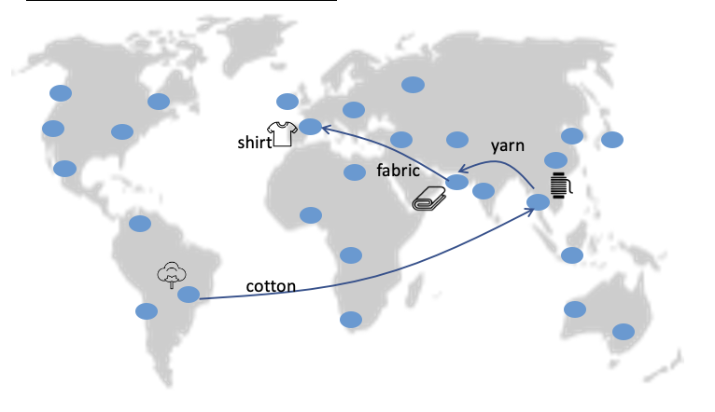
United Nations
Brings a trusted forum / governance, access to nations and governments via our regional commissions, the UNTP standards and implementer platforms
Industry Associations
Bring their members that want sustainability data from their suppliers
Supply chain actors
Brands: Bring their suppliers and IT solution providers to implement traceability at scale and liaise with Development Banks to set up supply chain finance programs.
Suppliers: receive supply chain finance, implement traceability at scale, bring visibility to their N-tier suppliers to also implement
Development banks
Bring innovative financial products and grant funding to assist the suppliers achieve sustainability targets
IT Solution Providers
Conform to interoperability protocol, allowing themselves to exchange and receive data with other platforms, thus ensuring their long-term survival
Trust marks (e.g. WWF, etc.)
Bring endorsement and expertise to the sustainability targets that underpin the funding
Notes:
When UNTP implementation is planned at community level and led by industry / member associations then a collection of motivated stakeholders with aligned incentives can come together to create a value flywheel that helps with up-front costs and ongoing value. This is the purpose of the UNTP Community Activation Program (CAP)

