Slide 1
Extensions Register
Source Diagrams
Notes:
Climate change, biodiversity, water consumption, modern slavery
Carbon tariffs, due diligence directive, etc – 16 regs just in EU plus US IRA
80 Euro/ton tariff , market access, access to capital, consumer price uplift
60% of claims have no evidence and 40% are false or misleading – will get worse.
Sunlight is the best auditor – transparency – fair for legitimate traders, un-sustainable behaviour nowhere to hide

Slide 2






UN Governance
UNTP Extension Methodology
Industry or National Governance
Textile DPP
Textiles Transparency Protocol
Implement
extends
Interoperable
Agriculture DPP
extends
Agricultural Transparency Protocol
Implement
Interoperable
UNTP
extends
Critical Raw Materials Transparency Protocol
Raw materials DPP
Implement
extends
National Transparency Protocol (Country X)
Interoperable
Implement
Country X
DPP
Notes:
Every industry needs supply from other sectors
UNTP provides a cross-industry re-usable “core”. Industry can create non-breaking extensions that suit their needs whilst maintaining cross-industry interoperability.

Slide 3
Notes:
Every industry needs supply from other sectors
UNTP provides a cross-industry re-usable “core”. Industry can create non-breaking extensions that suit their needs whilst maintaining cross-industry interoperability.

Slide 4





















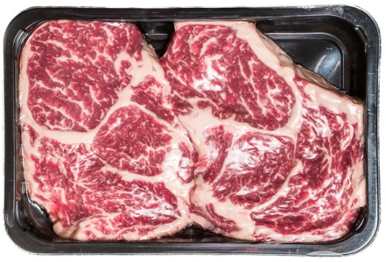

Sell herd
Sell fatter herd
Sell beef product
Sell grain
Take out your phones and scan this to get the sample app.
Certifier
Cattle farm
Grain farm
Saleyard
Feedlot
Processor
DAFF
EU Importer
Wagyu Wonder
Golden Grains
Fabulous Feeders
Pete’s Meats
Then scan the barcode on the meat product
Deforestation Credential
(cattle farm)
Movement Event
Feeding Event
Processing Event
6
Sale Event
And follow the linked data trail
Deforestation Credential
(grain farm)
5
4
Livestock Passport
Sale Event
Sale Event
1
7
Grain Passport
3
2
Livestock Passport
Product Passport
You!
Notes:
Demo – Australian Agricultural Traceability Protocol (AATP)
The more observant of you may have noticed that this presentation didn’t address the complexity of standards question nor the confidentiality vs transparency question. Not because we don’t have answers but because I want to keep these short. Lookout for the next ones that will have more details on how rec 49 solves these challenges.

