Slide 1


By Your Command
@chriskemp3000
chris@unchain.life
github.com/unchainlife/talks
Copyright © 2016 unchain life ltd

Slide 2
About Me
{
name: “Chris Kemp”,
positions: [“Developer”, “Manager”, “Owner”],
languages: [“Delphi”, “C#”, “Javascript”],
experience: { years: 18 },
hates: [
“Term: User”,
“IT Knows Best”,
“Tabs vs Spaces”
],
loves: [
“Talking about Software”,
“Integrated Teams”,
“Customer Focus”,
“DDD”,
“BDD”,
“Simple UX”
]
}
Copyright © 2016 unchain life ltd

Slide 3
By Your Command
Concepts
Business Processes
Sample Software
Benefits to the Business
Copyright © 2016 unchain life ltd

Slide 4
Concepts
CQS - Command Query Separation
CQRS - Command Query Responsibility Separation
Transaction Script Pattern
Event Sourcing
Copyright © 2016 unchain life ltd

Slide 5

CQS
Why I like this:
Simplicity
No unexpected side effects.
Defer execution
Remote execution
Command Query Separation
command(params) —> void
Does not return a value.
query(params) —> result
Does not mutate state.
Copyright © 2016 unchain life ltd

Slide 6
CQRS
Why I like this:
90% of application data access is reads.
Data stored in structure best suited to retrieval.
Data duplicated if needed.
Copyright © 2016 unchain life ltd

Slide 7
Transaction Script Pattern
Why I like this:
Serialisable
Decoration
Basically Single Responsibility
Express Commands as classes
{
type: ‘CreateUser’,
user_name: ‘john’,
display_name: ‘John Smith’,
roles: [ ‘employee’, ‘manager’ ],
}
Copyright © 2016 unchain life ltd

Slide 8
Event Sourcing
State as a series of events.
“Accountants don’t use erasers.”
var state = { balance: 0 }
state = process(state, { deposit: 50 });
state = process(state, { withdraw: 25 });
state = process(state, { deposit: 50 });
state = process(state, { withdraw: 25 });
state = process(state, { deposit: 50 });
state => { balance: 100 };
Why I like this:
Intent
Command Pipeline
Auditing
Security
Copyright © 2016 unchain life ltd

Slide 9
Business Processes
Copyright © 2016 unchain life ltd

Slide 10
Sample Software
Code Demo
“What could go wrong?”
Copyright © 2016 unchain life ltd

Slide 11
Benefits to the Business
Security in the pipeline
Training
Auditing
Understanding / Debugging
Copyright © 2016 unchain life ltd

Slide 12
Security in pipeline
audit >> secure >> execute
execute(command, security, credentials)
command: {
type: ‘promoteEmployee’,
id: 123,
date: ‘2016-04-01’,
position: ‘IT Director’,
salary: 100
}
security: {
‘promoteEmployee’: {
roleRequired: ‘senior’
}
}
credentials: {
username: ‘chris’,
roles: [‘junior’]
}
Copyright © 2016 unchain life ltd

Slide 13
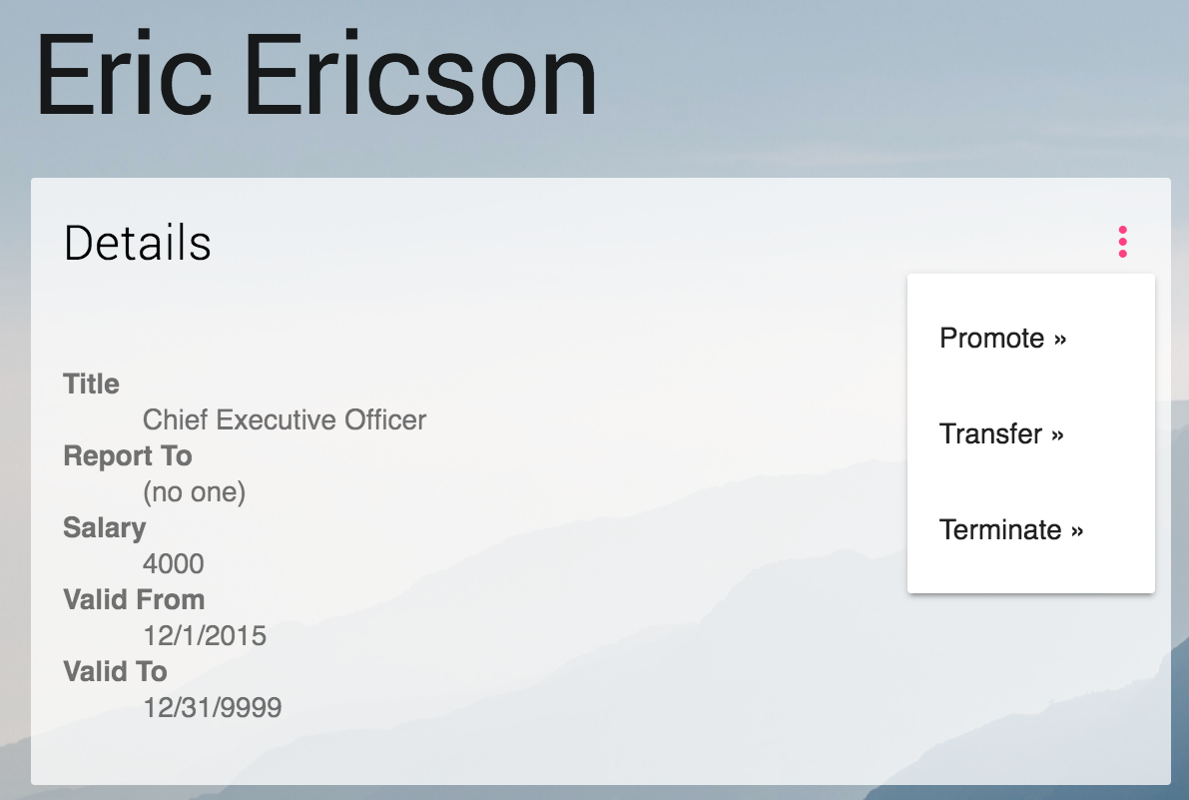
Training
Copyright © 2016 unchain life ltd

Slide 14
Auditing
SQL Triggers
Operation | Who | When | Table | Column | Id | Old | New
Insert | Chris | 2015-03-12 12:00 | Employee | Given_Name | 1234 |  | John
Insert | Chris | 2015-03-12 12:00 | Employee | Family_Name | 1234 |  | Smith
Insert | Chris | 2015-03-12 12:00 | Employee | Date_of_Birth | 1234 |  | 1965-12-04
Update | Chris | 2016-06-14 16:04 | Employee | Given_Name | 1234 | John | Jon
Update | Chris | 2016-06-14 16:04 | Employee | Family_Name | 1234 | Smith | Smith
Copyright © 2016 unchain life ltd

Slide 15
Auditing
command_history: [
{
type: ‘RecruitEmployee’,
id: 1234,
given_name: ‘John’,
family_name: ‘Smith’,
date_of_birth: ‘1965-12-04’,
_audit: {
who: ‘Chris’,
when: ‘2015-03-12 12:00’
}
},
{
type: ‘LegalChangeOfName’,
id: 1234,
given_name: ‘Jon’,
family_name: ‘Smith’,
_audit: {
who: ‘Chris’,
when: ‘2016-06-14 16:04’
}
}
]
Copyright © 2016 unchain life ltd

Slide 16

Understanding / Debugging
Time
Contract
Revision
Contract v1
Contract v2
v1
v2
v3
Copyright © 2016 unchain life ltd

Slide 17
Understanding / Debugging
command_history: [
{
command: ‘transfer’,
id: 123,
effective_date: ‘2014-08-01’,
who: ‘jenny’,
when: ‘2014-02-01’
},
{
command: ‘transfer’,
id: 123,
effective_date: ‘2014-06-01’,
who: ‘jenny’,
when: ‘2014-05-20’
}
]
Time
Contract v1
v1
v2
v1
v2
v3
Copyright © 2016 unchain life ltd

Slide 18
Questions
Copyright © 2016 unchain life ltd

