Slide 1
Yelp Recommender: Restaurants in Charlotte
By Broderick Turner

Slide 2
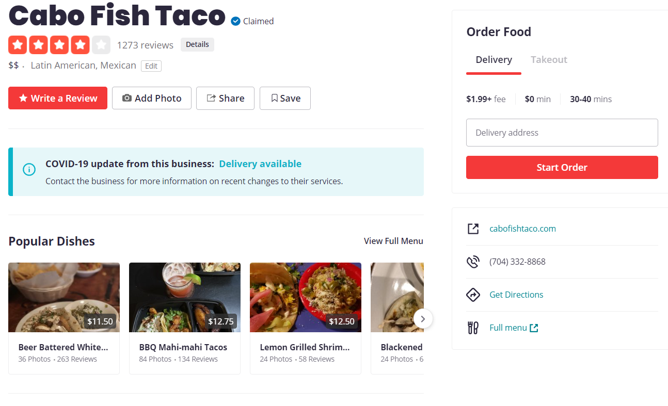
Overview of Yelp

Slide 3
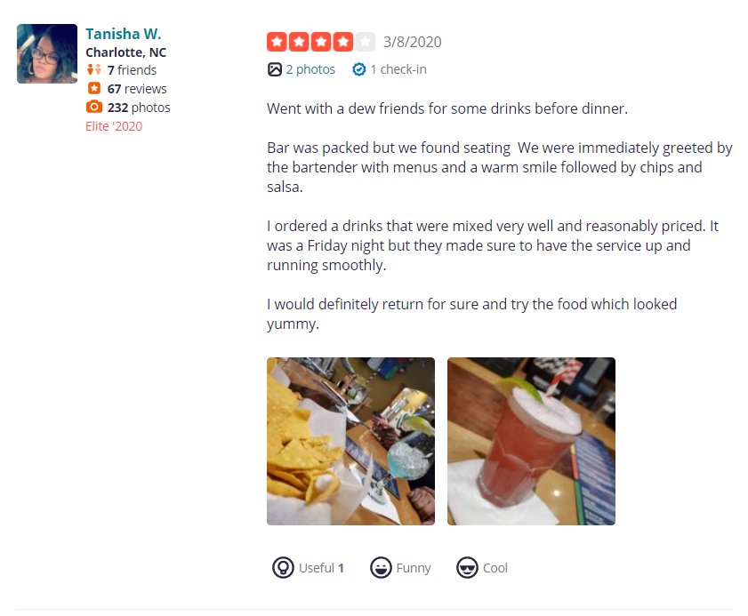
Overview of Yelp

Slide 4
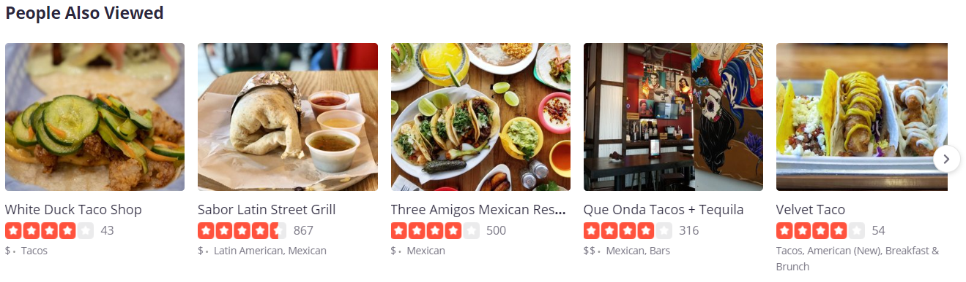
Yelp Recommendations

Slide 5




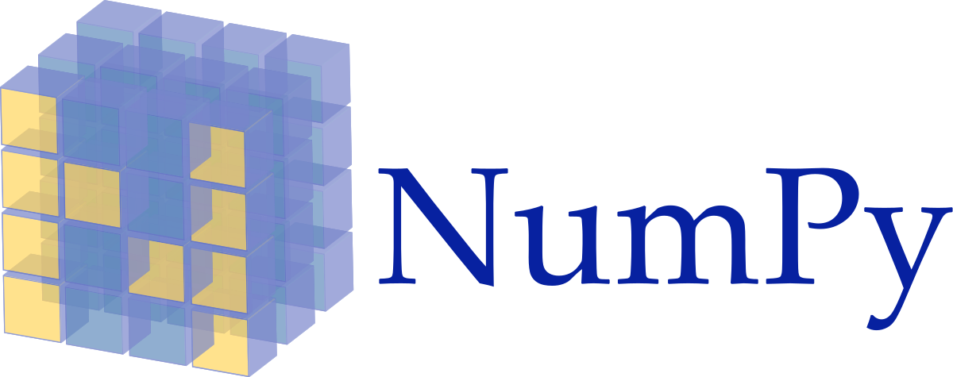


Technology Used

Slide 6
Exploring the Data
Statistics & Fun Facts

Slide 7
220,241
0.14%
78,494
2,103
2,032
435
Total User Reviews
Data Density
Unique users
Reviews for Tupelo Honey
Unique restaurants
Reviews from Abby, Charlotte Yelp’s MVP

Slide 8
146,135
0.45%
16,718
1,257
1,933
435
34%
228%
Total User Reviews
Data Density
79%
40%
Unique users
Reviews for Amelie’s French Bakery & Cafe
5%
Unique restaurants
Reviews from Abby, Charlotte Yelp’s MVP

Slide 9
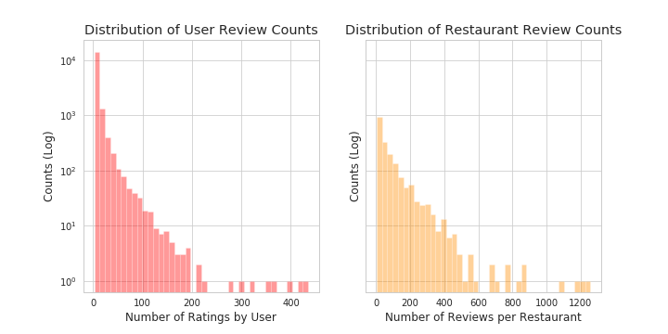
Data Visualization

Slide 10
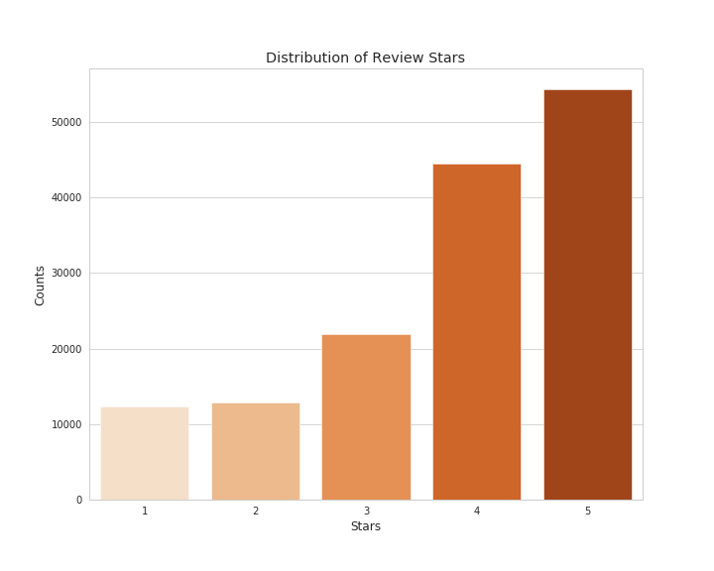
Data Visualization

Slide 11
Recommender Model
Results & Challenges

Slide 12
Train/Test Split Model Scores
 | RMSE | MAE
**Random | 1.800 | 1.429
Funk SVD | 1.129 | 0.895
SVD++ | 1.117 | 0.884
** This base model was created before additional data manipulation in order to have results for comparison

Slide 13
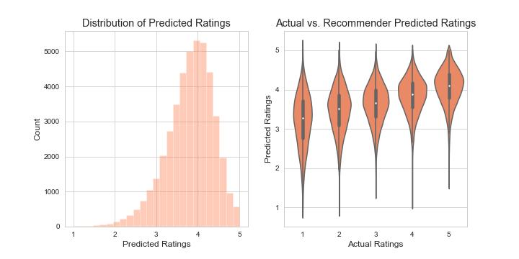
Challenges

Slide 14
Challenges
Explicit recommenders inherently skew toward centrality
Lack of flatness correlates negatively with performance
Preferred items are likely to be reviewed
Propose converting ratings into user percentiles in pre-processing
Mansoury, Burke, and Mobasher. “Flatter is better: Percentile Transformations for Recommender Systems.” arXiv.org, 10 July 2019. Accessed 4 June 2020.

Slide 15
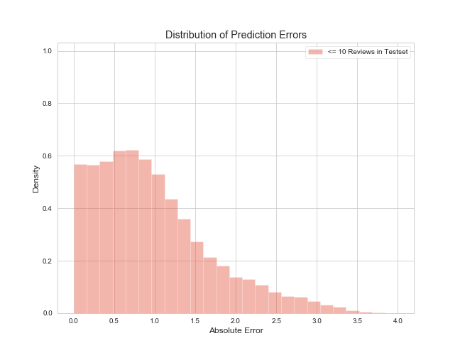
Predictions - Few Values in Trainset

Slide 16
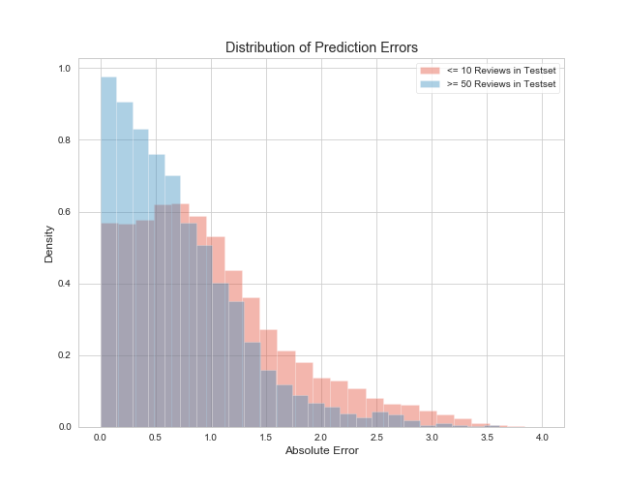
Predictions - Many Values in Trainset

Slide 17
Actual User Reviews
Top 10 Recommendations
Restaurant | Rating | Description
Diamond Restaurant | 3 | American
Jet’s Pizza | 4 | Pizza
Jasmine Grill | 3 | Mediterranean
Le Kebab Grill | 4 | Mediterranean
Mr. K’s Soft Ice Cream | 3 | Ice Cream
Kabuto Japanese Steakhouse | 5 | Sushi Bar
The Randazzos’ Grid Iron | 3 | Italian
Showmars Steele Creek | 4 | Greek
YAFO Kitchen | 2 | Mediterranean
Lorenzo’s Pizzeria | 1 | Pizza
Restaurant | Prediction | Description
Chili Man | 4.37 | Hot Dogs
Enat Ethiopian | 4.35 | Ethiopian
Lupitas Carniceria | 4.29 | Mexican
Bar Marcel | 4.28 | European
Alpha Omega Grill & Pizzeria | 4.26 | Mediterranean
Community Matters Cafe | 4.19 | Cafe
Greco Fresh Grille | 4.19 | Mediterranean
Peppervine | 4.17 | Small Plates
The Tasty Bowl Subs N Such | 4.17 | Subs/Salads
Salud Beer Shop | 4.16 | American
Example of a Recommendation

Slide 18
Looking Forward
Creating user interactivity
Further exploring ways to handle skewed data
Adjust recommender for serendipity & popularity
Build a hybrid recommender via neural network

Slide 19

Thanks!
Any questions?
You can find me at:
email: broderickturner92@gmail.com
github: github.com/unclebrod
linkedin: linkedin.com/in/broderickturner

Slide 20
Surprise’s SVD++
Matrix factorization
Takes into account implicit ratings
User & item bias
Learning rate & regularization term

Slide 21
Agenda
Background & Context
Technology Used
Data Overview
Results & Challenges
Next Steps
Questions

