Slide 1
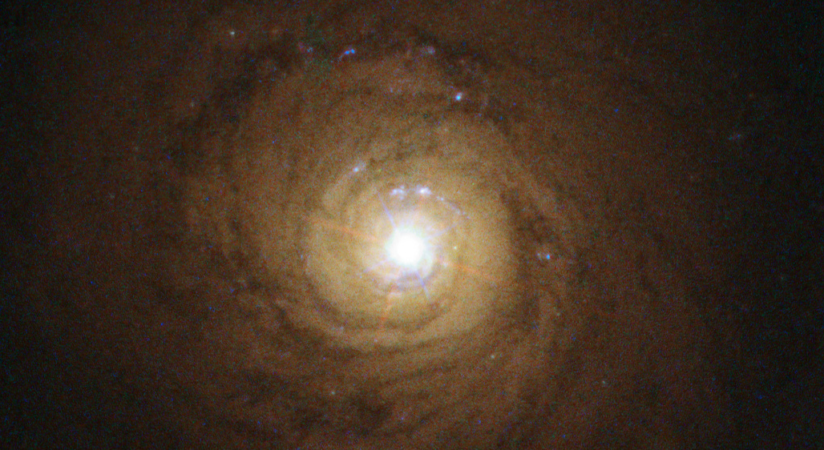
Diffuse Continuum Emission and BLR Time Delays in NGC 5548
Daniel Lawther, DARK/NBI, Uni.Copenhagen
Working on this with: Michael Goad, Kirk Korista,
Adam Otho.
Image: NGC 5548 in HST ACS+WFC3 photometry; NASA/ESA.

Slide 2
AGN structure
Broad Line Region
BH
Accretion disk
Torus (obscuring dust+gas)
~ Lightdays to -months

Slide 3
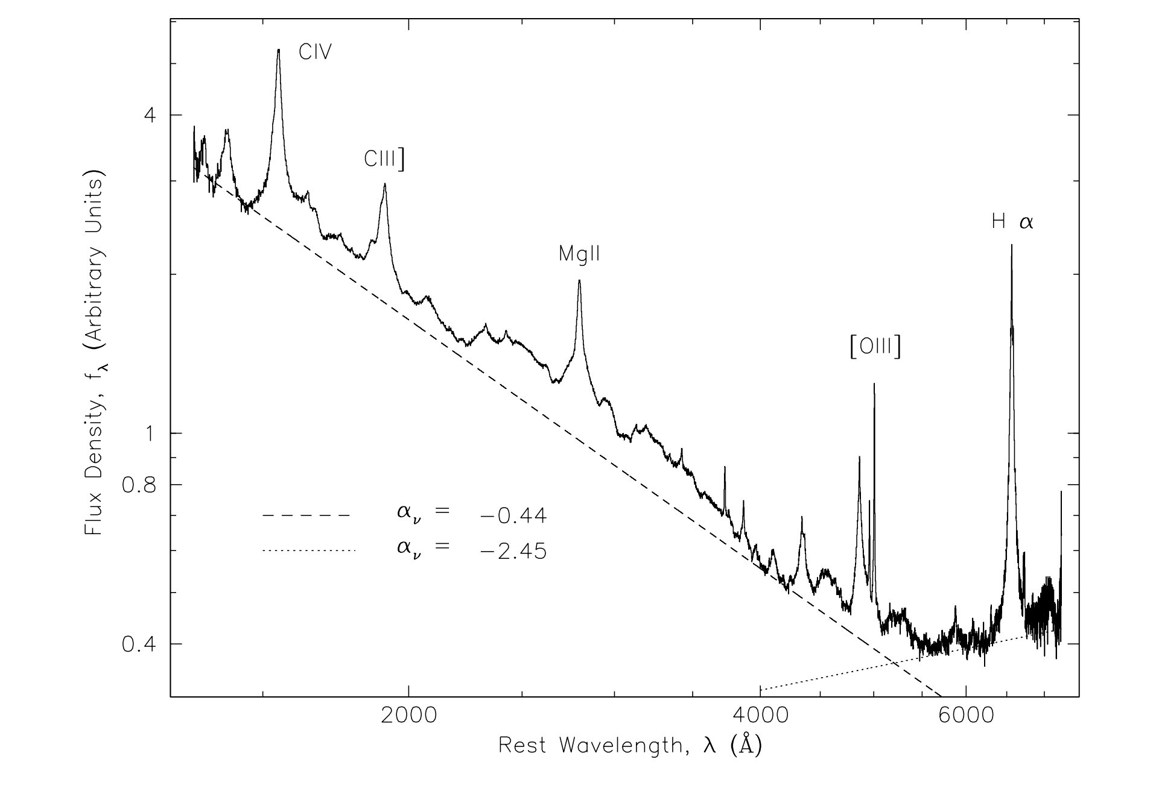
Nuclear continuum
BH
Flux
Density
Rest wavelength (Angstrom)

Slide 4
Broad emission lines
BH
Accretion disk

Slide 5
Reverberation mapping
BH
Accretion disk

Slide 6
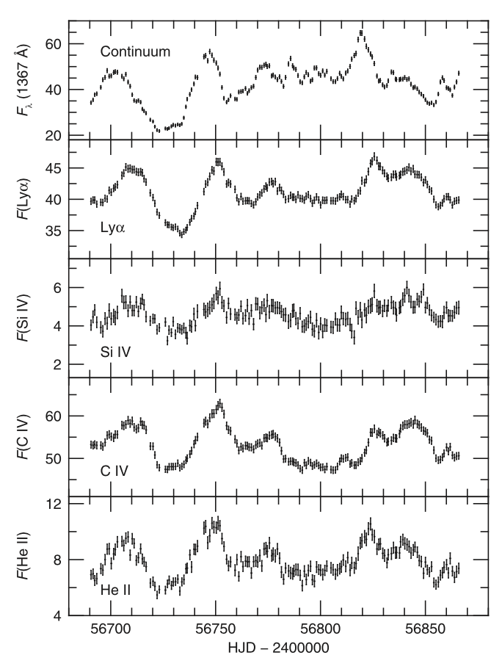
Reverberation mapping
BH
Day 0
Day 117
DeRosa+2015

Slide 7
Reverberation mapping
Typical simplifying assumptions:
- Continuum source is ‘point-like’ as seen from the BLR
- The observed continuum level is a good proxy for the ionizing continuum level
- BLR ions achieve ionization equilibrium ‘quickly’, i.e., BLR response is dominated by the light travel time.

Slide 8
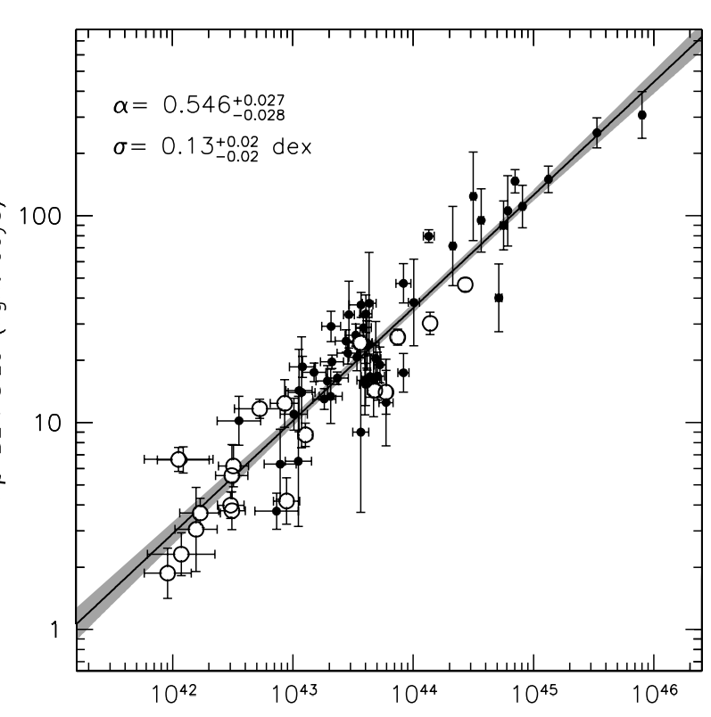
The Radius-Luminosity Relationship
BH
BLR
Effective
Radius
(lightdays)
Bentz+2013
Optical continuum luminosity

Slide 9
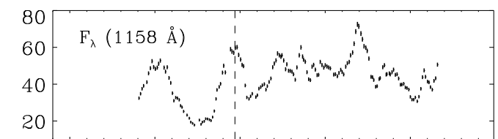
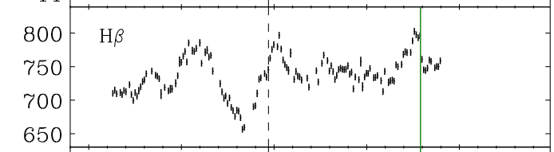
NGC 5548 in 2014: short lags!
De Rosa+2015 (HST, UV); Pei+2017 (optical, H-beta)

Slide 10
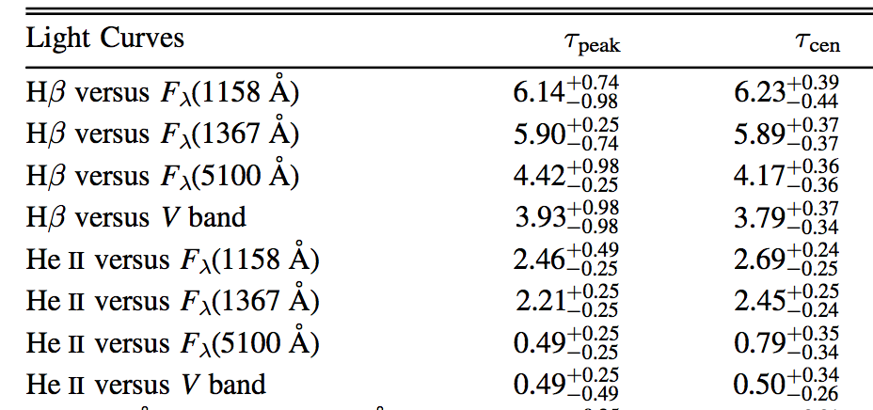
NGC 5548 in 2014: short lags!
AGN STORM campaign: Pei+2017

Slide 11
Continuum reverberation mapping!
BH
Hot
X-ray
Corona?

Slide 12
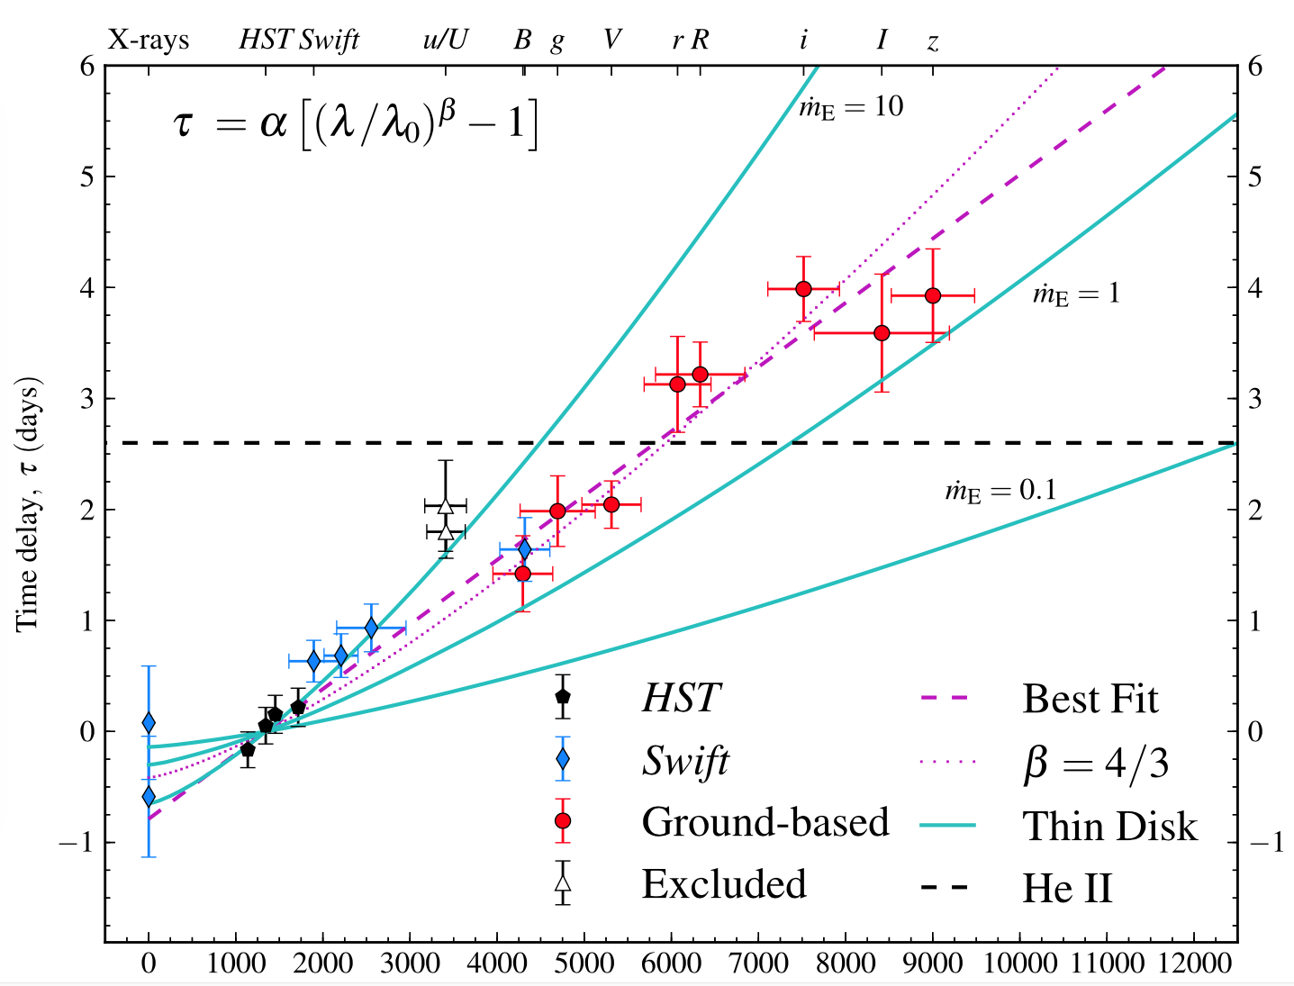
Continuum reverberation mapping!
Fausnaugh+2015

Slide 13
Diffuse continuum?
BH
Accretion disk

Slide 14
Modeling the BLR
Locally: photoionization modeling

Slide 15
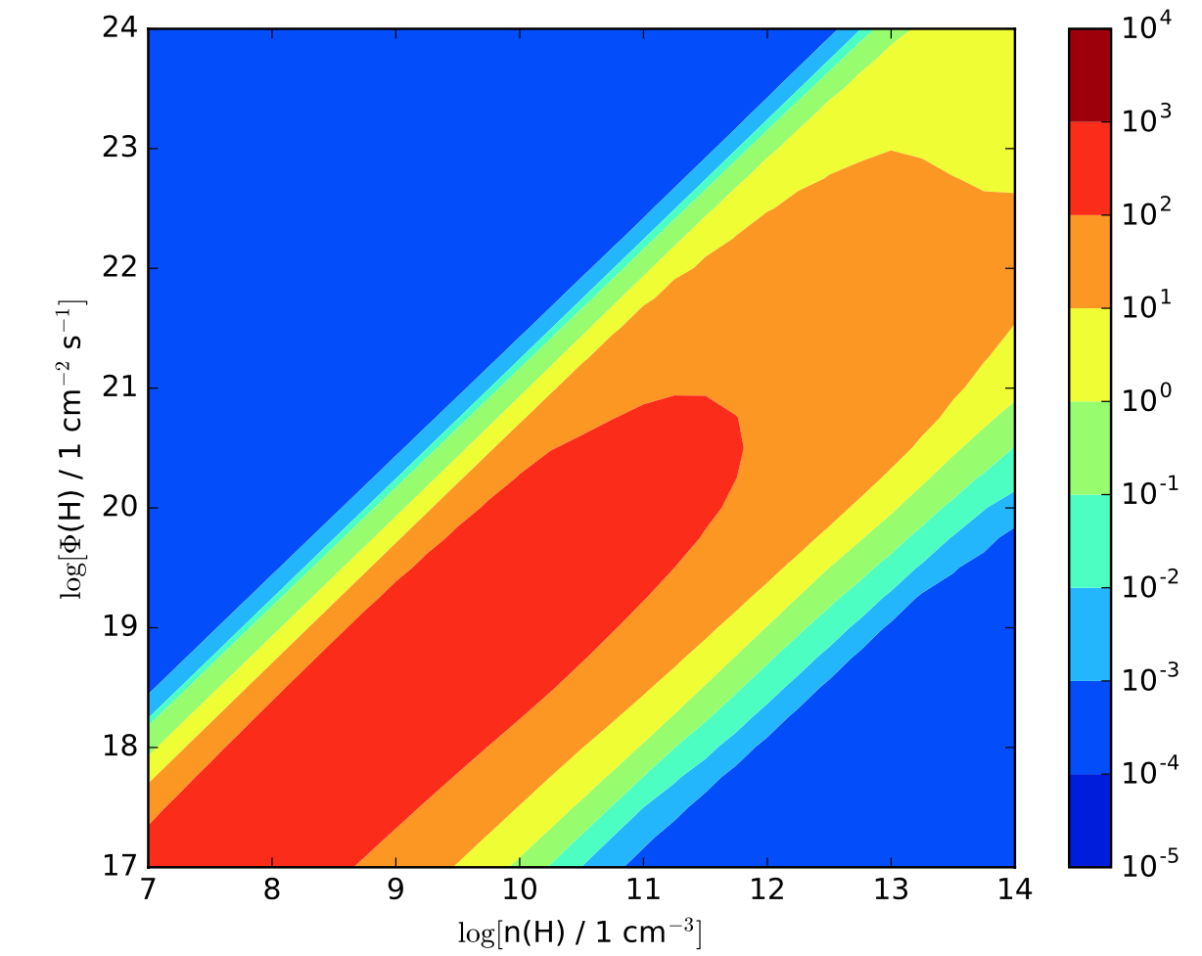
Modeling the BLR
Locally: photoionization modeling
Cloudy (Ferland 2013)
C IV
Ionizing
Flux at
surface
Colorbar:
Line
Equiv.
width
Number density of atomic H in cloud

Slide 16
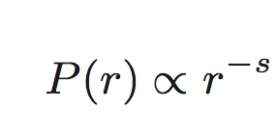
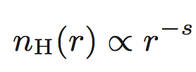
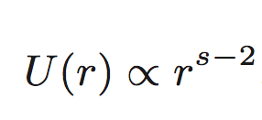
Modeling the BLR
Globally: Pressure laws! Simple prescriptions for ‘where to put the clouds’ :)
Gas pressure in cloud at r:
Density:
Ionization:
Limiting cases:
s=0 (constant pressure)
s=2 (constant ionization parameter)

Slide 17
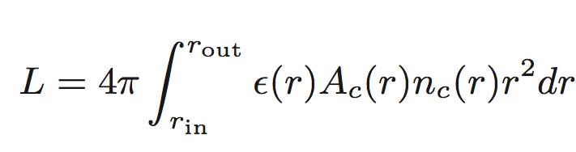
Modeling the BLR
Globally: Pressure laws! Simple prescriptions for ‘where to put the clouds’ :)
Emissivity at r (from Cloudy)
Line luminosity:
Number density of clouds at r

Slide 18
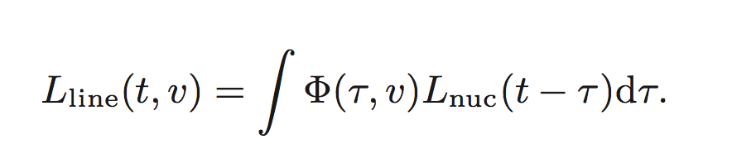
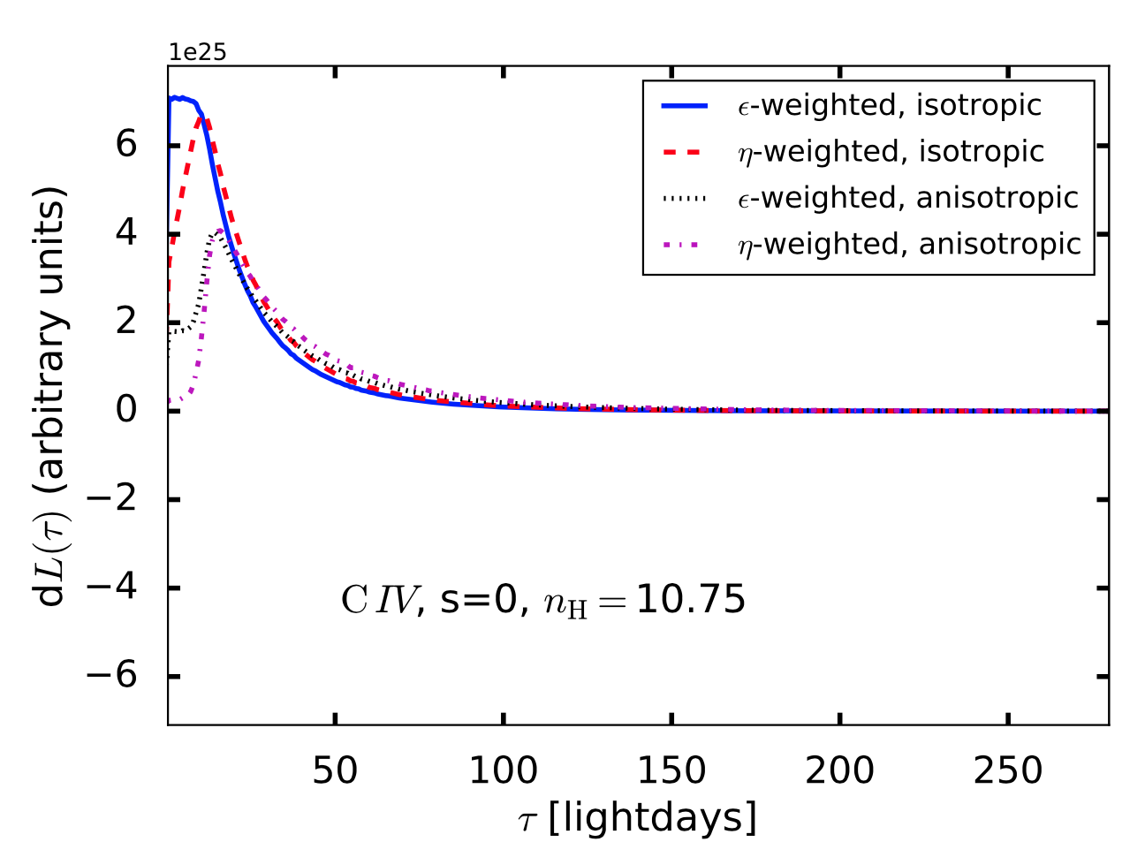
Modeling the BLR

Slide 19
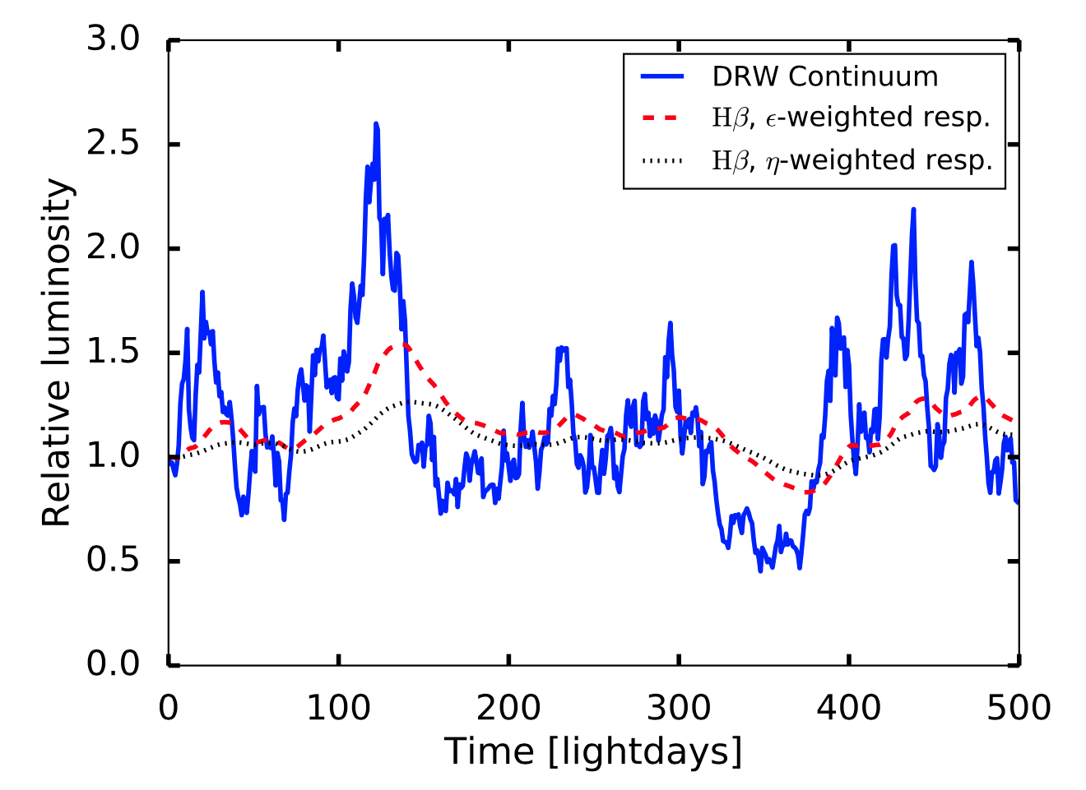
Driving the BLR

Slide 20
Driving the BLR
- Driven model lags still factor ~4 larger than for 2014 campaign!

Slide 21
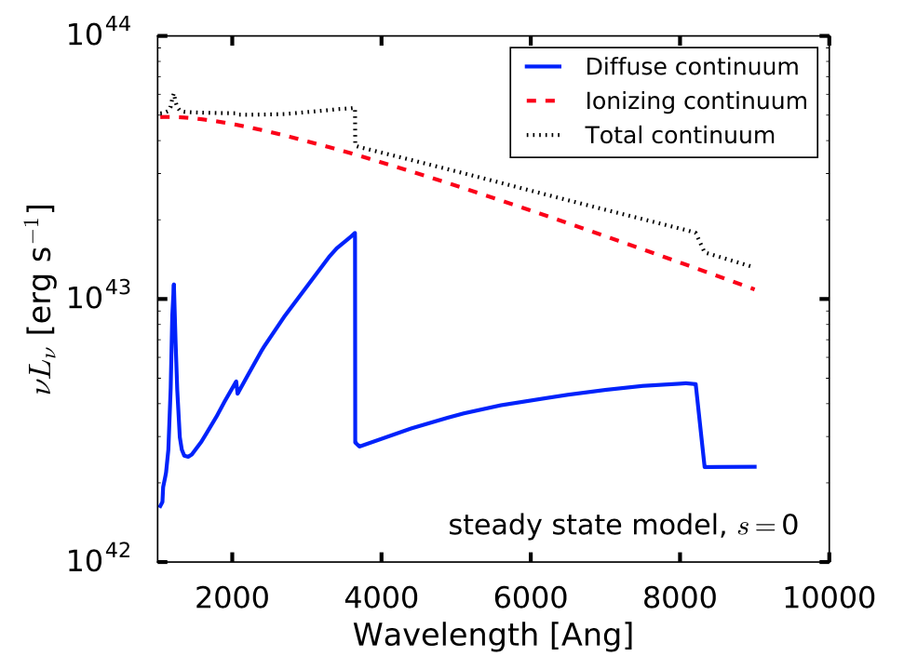
Diffuse Continuum

Slide 22
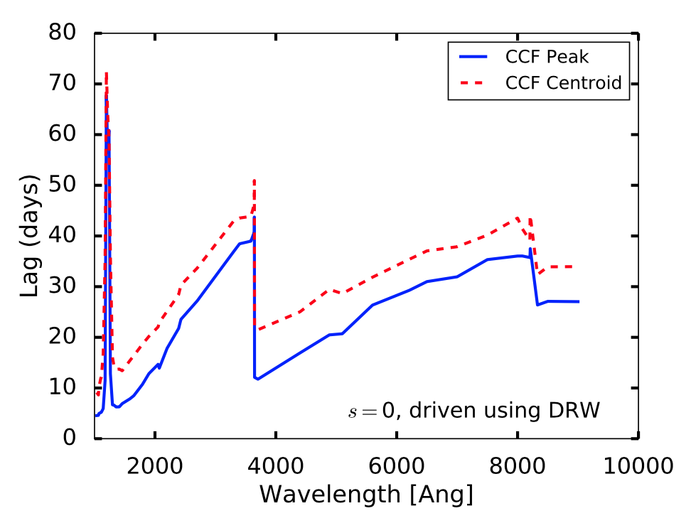
Driving the Diffuse Continuum

Slide 23
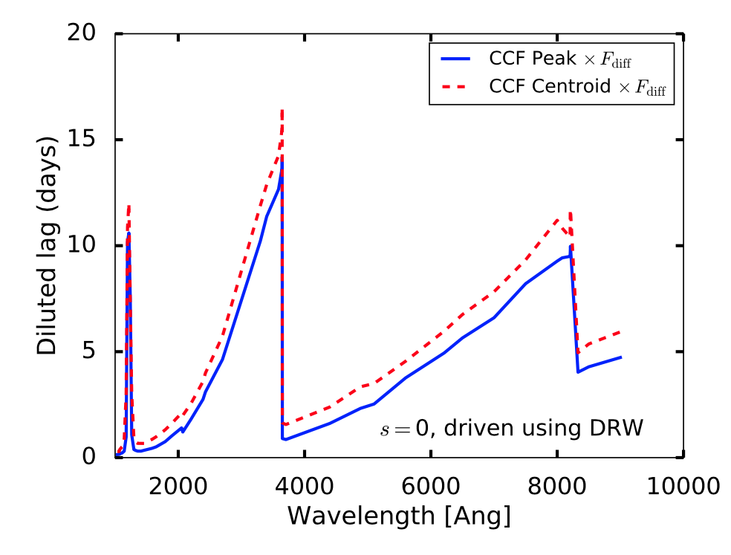
Driving the Diffuse Continuum

Slide 24
Conclusions
For reasonable pressure-law models of the NGC 5548 BLR, there is a substantial contribution from diffuse continuum.
The observed UV continuum may effectively lag the ionizing continuum by ~1-2 days, due to a substantial diffuse component.
Insufficient to explain short observed lags relative to UV cont.
The Balmer feature in the diffuse continuum may explain the observed anomalous continuum lag (+1 day) in UVOT U.
The variability behavior of the nuclear continuum can shorten observed lags relative to actual BLR radii.

Slide 25
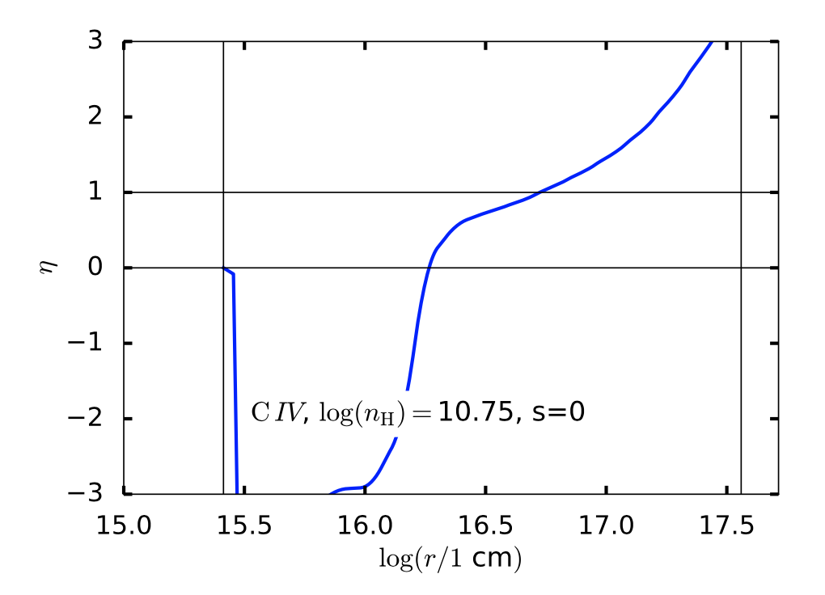
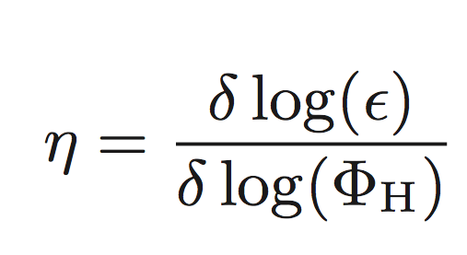
Modeling the BLR
Responsivity
Anisotropy

Slide 26
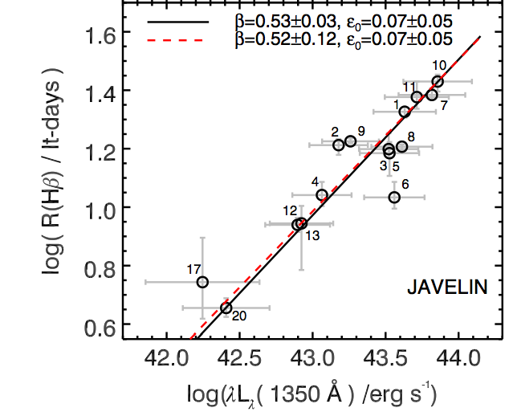
The Radius-Luminosity Relationship
BH
For NGC 5548:
Kilerci Eser+2013

Slide 27
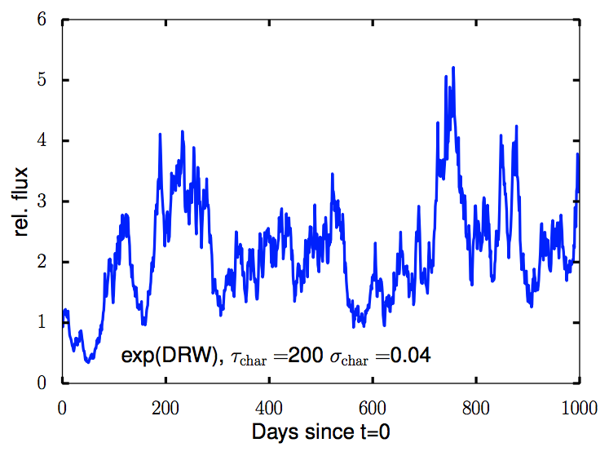
Driving the BLR
AGN continua act like Damped Random Walks in the log of the flux! (e.g., Collier+Peterson 2001, Uttley+2005)

Slide 28
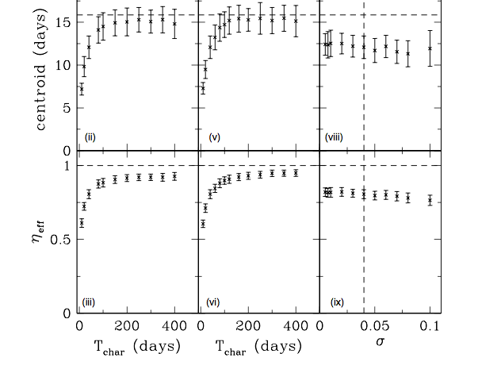
Driving the BLR
The measured lag depends on the variability characteristics of the continuum (Goad+2014)
σ=0.04
(σT) const.
T=40 d
For NGC 5548,
T_char ~ 40 days
and σ=0.04

