Slide 1
SQL Server on Linux for the Windows DBA Presented By: Jim Donahoe

Slide 2




A Little About Me!
DBA(Does ‘Bout Anything) | Cloudie|Video Game Enthusiast | Nerd |
Not-so-Big Data | Azure Enthusiast | United States Marine(’99 -’05)
Meetups: meetup.com/PittsburghSQL/
Email: JamesDonahoe1983@gmail.com
Twitter: @SQLFlipFlopsDBA

Slide 3
Why SQL On Linux?
Growth of Linux
Linux Popularity
Customer Demand
Microsoft’s Commitment to Open Source
Notes:
Key Points:
There are many high-level reasons that SQL Server has been developed for the Linux operating system.
Linux has been growing in market share
Linux a popular platform for many purposes
Customers have been asking for a Linux offering for SQL server
Linux has wide adoption in devops and part of this is due to containers. Docker containers primarily use the Linux kernel and are popular for many reasons. Containers are lightweight and unlike virtual machines do not need to emulate an entire hardware stack to operate.
Linux is popular in the Big Data space as well. Hadoop, Cloudera, and Hortonworks are also popular on Linux
In the Cloud, Linux is the popular operating platform of choice. The Linux install base continues to grow.

Slide 4
Customers are happy with SQL Server but want options
Customers want flexibility
Choice of platform in the cloud and on-premises
Choice of development language that interacts with SQL server
Customers are looking for a lower cost of ownership
Customers are increasingly looking for open source software
Customers are asking for support of multiple languages and frameworks to interact with SQL Server
Support for Node.js, PHP, Python, Ruby and others is available

Slide 5
Supported Linux version(s)
Distribution Name | Supprted Version(s)
Red Hat Enterprise Linux | 7.4 – 8.6
SUSE Linux Enterprise Server | V12 SP2 – v15 SP3
Ubuntu | 16.04 – 20.04 LTS
Docker Engine | 1.8+

Slide 6
Pre-installation considerations
CPU
Do you have a template for your installs today on Windows? It is still relevant in Linux(CPU, Memory, Disk, etc.)
CPU Frequency Governor - Set to performance - High clock performance no power saving
Energy_perf_bias - set to performance
min_perf_pct set to 100
C-states - set to C1

Slide 7
Pre-installation considerations
NUMA
NUMA - non-uniform memory access
Most servers today have each processor set to access local memory first
Automatic NUMA balancing moves tasks(threads or processes) closer to the memory they are accessing
This is a kernel setting – not an application setting

Slide 8
Pre-installation considerations
Disk Settings
Disk Readahead – loading file contents into cache
Set to 4096

Slide 9
Pre-installation considerations
Virtual Address Space
Each process from an OS runs in its own memory “sandbox”, or space – the VAS
Default vm.max_map_count is 65536 bytes – not high enough
Should be set to 256k

Slide 10
Pre-installation considerations
swapfile
Similar to the Windows paging file
Ensure it is properly configured – consult your Linux Administrator

Slide 11

Pre-installation considerations
Dynamic Memory on VMs

Slide 12
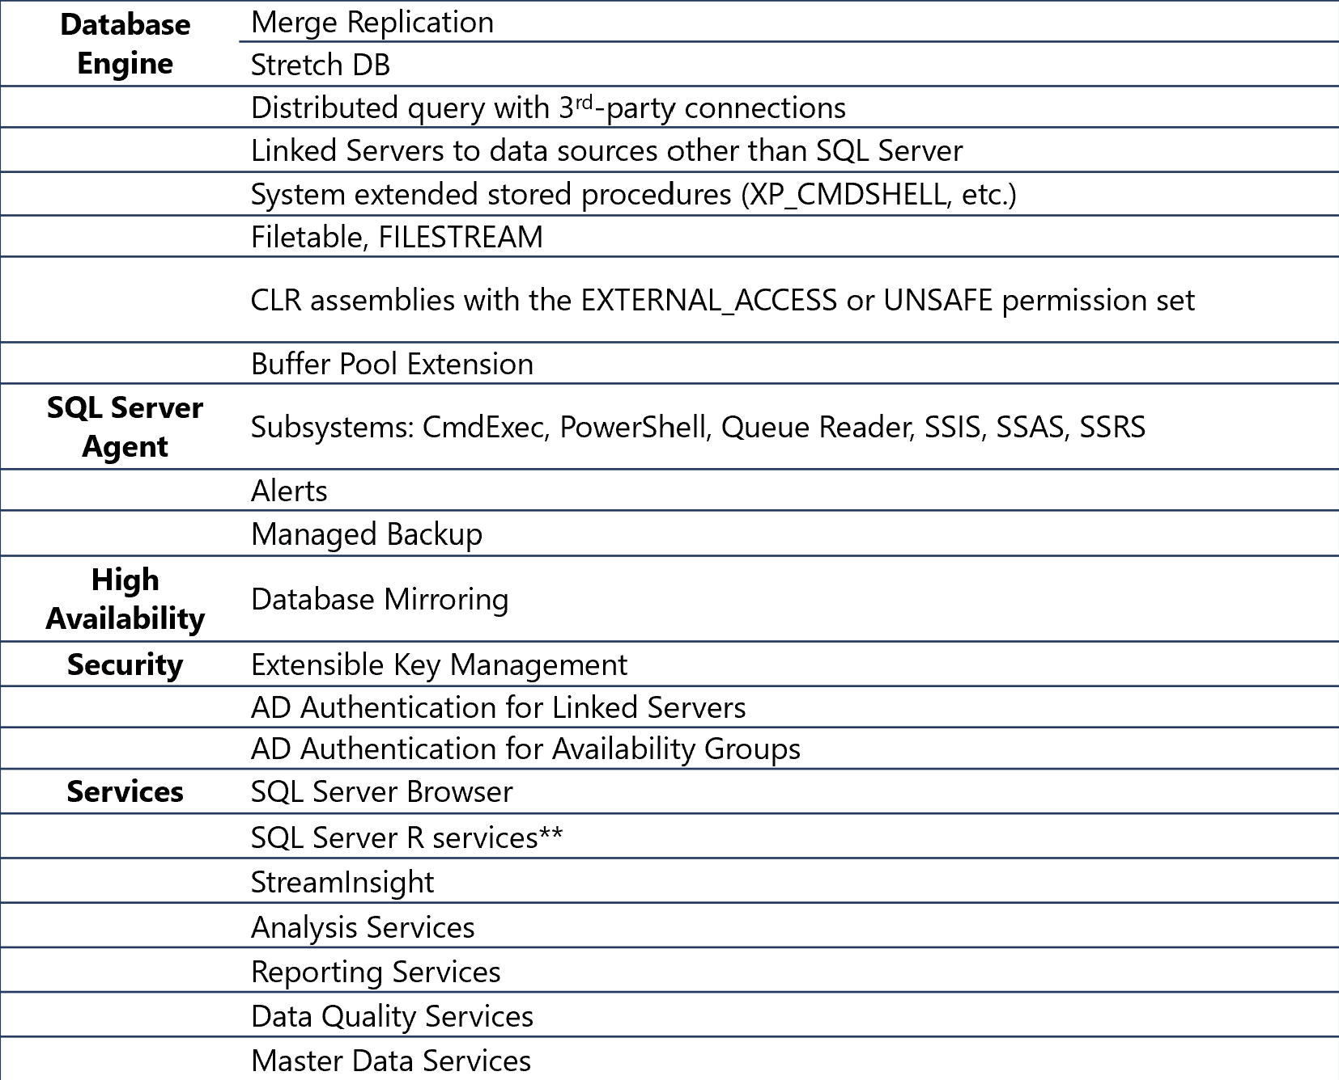
Unsupported Features(probably old)
https://learn.microsoft.com/en-us/sql/linux/sql-server-linux-editions-and-components-2019?view=sql-server-ver16

Slide 13
Installation

Slide 14
Steps to install SQL Server on Linux
The actual process varies depending on the Linux distribution and the type of shared storage, but the general steps are:
Import public repository keys & Configure a source repository
Update cached repositories
Install SQL Server (and dependencies)
Run SQL Server setup (mssql-conf)
Optional: Install SQL Server Tools

Slide 15
noatime
By default, Linux tracks when files were last accessed
This can add significant overhead to frequently accessed files
Add the noatime (A) attribute to SQL server data and log files for optimal performance
To set the attribute for all files in the data directory
sudo chattr –R +A /var/opt/mssq/data
To confirm that its’ been set
sudo lsattr /ar/opt/mssql/data

Slide 16
Limit SQL Server’s memory use
By default Linux will only allow the SQL Server process to use 80% of the physical RAM
On large servers this can leave a lot of memory unused
On smaller servers it may leave inadequate memory for the OS and other server processes
Configure an appropriate memory.memorylimitmb setting using mssql-conf

Slide 17
OOM Killer
On Linux systems when there is memory pressure the kernel will choose a process to be killed to restore smooth operation of the system.
SQL Server, having a large memory footprint, is a likely target, so it’s memory limit must be carefully chosen.
There is no "Lock Pages in Memory" functionality currently available in Linux

Slide 18
Linux Basics

Slide 19
Basic Linux navigation
More Useful commands
cat - list file contents (catalog)
mkdir – creates a new directory
rmdir – removes an empty directory
pwd – present working directory (where am I?)
mv – move files
cp – copy files
rm – remove files or directories
ls – list directory contents
sudo – execute commands as a superuser.
You must have been granted rights to do so and you will be prompted for your password

Slide 20
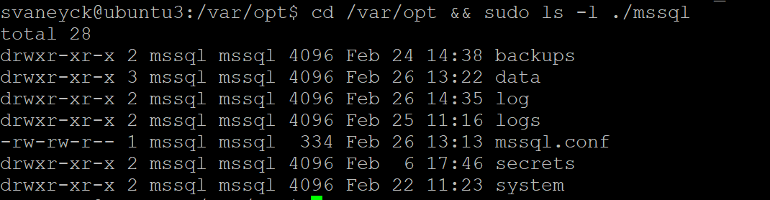
File and folder permissions
Permission groups
Owner
Group
Everyone
Permission types
Read (r)
Write (w)
Execute (x)
chmod - change permissions
chown - change ownership
Group permissions
Owner permissions
Everyone permissions
d=directory
drwxr-xr-x

Slide 21
Root
Every Linux server has an admin account named root
You DO NOT want to log in and run commands as root
Instead, use “sudo”- super user do!
Example:
Restarting your SQL Server service
sudo systemctl restart mssql-server

Slide 22
The service account - mssql
During installation, the mssql user and group are created
The SQL Server processes must run under this account
All SQL Server-related files must be owned by the mssql user and group

Slide 23
Correcting File Ownership
If SQL Server is accidentally started with a user other than mssql file ownership will be transferred to that user
Ownership must be transferred back to mssql
To change ownership of all files under /var/opt/mssql to the mssql user, run the following command
sudo chown -R mssql:mssql /var/opt/mssql/

Slide 24
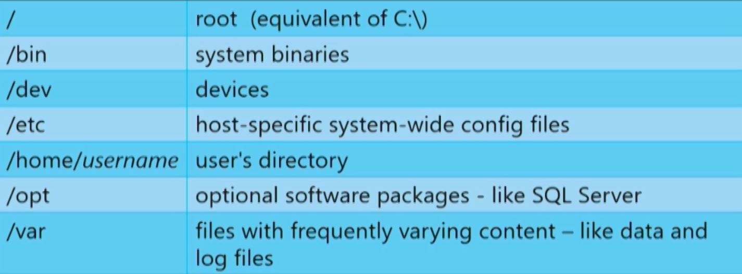
File System Structure

Slide 25
Where to find SQL Server files
Logs
/var/opt/mssql/log
Error logs
SQL Agent logs
Default trace
Configuration file
/var/opt/mssql/mssql.conf
Server Master Key
/var/opt/mssql/secrets/machine-key
Binaries
/opt/mssql/bin
mssql-conf
sqlservr
Data, transaction log, and backup files
/var/opt/mssql/data

Slide 26
Some useful Linux Monitoring commands
df – file system disk usage
dstat –system statistics
free – free and used memory
htop – interactive process viewer
iostat – CPU and I/O statistics
mpstat – processor-related statistics
pidstat – statistics for tasks
Use man <command> to get help on syntax and options

Slide 27

Show me the good stuff already!

Slide 28
Resources
An Introduction to Linux Basics
Get started with the CPU Governor
Performance best practices and configuration guidelines for SQL Server on Linux
SQL Server Instant File Initialization: SetFileValidData (Windows) vs fallocate (Linux)
Installation guidance for SQL Server on Linux

