Slide 1
Microsoft Azure
Azure Portal Overview and General Best Practices
Jim Donahoe
Database Administrator/Azure SME

Slide 2
We’re Here to Talk About
Cloud computing
Microsoft Azure basics
How to use the Azure portal
Managing resources
Portal
CLI
PowerShell
Best practices
Resources to facilitate learning

Slide 3
Jim Donahoe
A little about me
DBA(Does ‘Bout Anything) | Cloudie|Video Game Enthusiast | Nerd |
Not-so-Big Data | Azure Enthusiast | United States Marine(’99 -’05)
Website: SqlFlipFlopsDBA.com
Meetups: meetup.com/PittsburghSQL/
Email: Jim-Donahoe@SqlFlipFlopsDBA.com
Twitter: @SQLFlipFlopsDBA

Slide 4
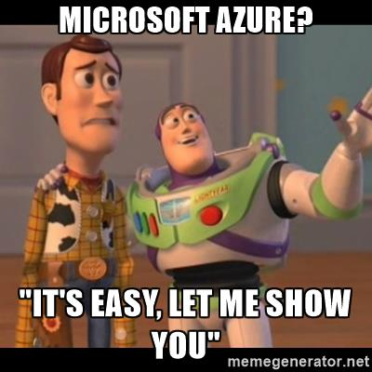
Flow of Conversation
Overview of Cloud Computing and Azure
Azure Portal Demos
Best Practices / Tips
Q&A
Feel free to put your hand up and ask questions along the way!

Slide 5
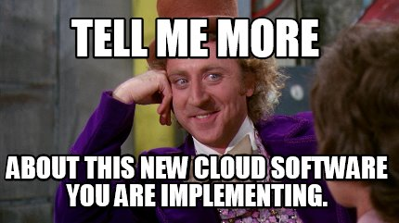
Tell me about cloud computing

Slide 6

Cloud Computing
Delivery of hosted services over the internet(that’s right, it’s not cloud, its just somebody else’s computer)
As opposed to using a local machine
Resources are often virtualized
Pay on a usage basis
Email, store pictures, watch videos
Common terms:
Deployment Models
Types of Cloud Services

Slide 7
Deployment Models
Public Cloud
Private Cloud
Hybrid Cloud
Offered over public network and available to anyone for purchase
Microsoft Azure, AWS
Infrastructure and resources operated solely for a single organization
Private network
Can be hosted by third party (Rackspace, Sunguard) or on-prem
Combination of public and private clouds bound together
DB servers on-prem, web app in cloud

Slide 8
Types of Cloud Services: Cloud Computing Stack
IaaS
PaaS
SaaS
Base Layer
User will purchase, install, configure, and manage, including update, your own software/OS
Examples:
VM/VM Scale Sets, Containers, Hard Drive (Storage), Network, Load Balancers
VM with SQL Server installed
Usage:
Data Analysis, research, high computing needs, IT
IaaS plus operating system, programming language execution environment, database, web server, etc.
User manages data and applications, provider manages everything else
Examples:
Azure SQL Server, HDInsight, App Services, Functions
Usage:
Develop apps, developers
Cloud based applications offered over the internet
Examples:
Google Apps, Office 365
Usage:
Consumers

Slide 9
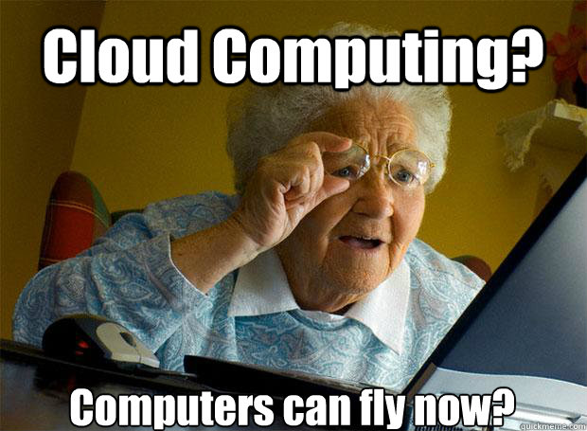
This is great stuff! Now, what can you tell me about Azure?

Slide 10
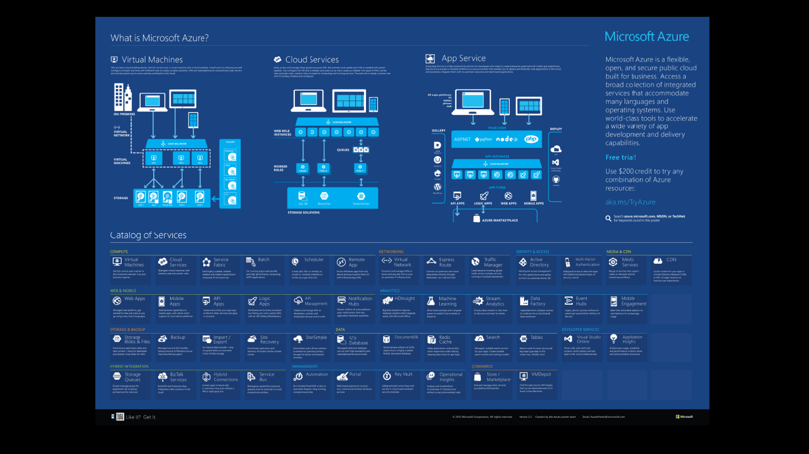
*Graphic from: https://azure.microsoft.com/en-us/resources/infographics/azure/

Slide 11
Azure Basics
Compute
Platform to execute applications
VM, App Service, Functions
Data Management/Storage
Azure SQL Server, DocumentDB, SMB, Blob, Table
Networking
Virtual Networks, ExpressRoute, Traffic Manager, CDN
Notes:
Azure DocumentDB manages JSON data through well-defined database resources. ... All resources within DocumentDB are modeled and stored as JSON documents. Resources are managed as items, which are JSON documents containing metadata, and as feeds which are collections of items.
SMB = Server Message Block Protocol. Both SMB 2.1 and SMB 3.0 are supported.
Azure Blob storage is a service for storing large amounts of unstructured object data, such as text or binary data, that can be accessed from anywhere in the world via HTTP or HTTPS. You can use Blob storage to expose data publicly to the world, or to store application data privately.
The Azure Table storage service stores large amounts of structured data. The service is a NoSQL datastore which accepts authenticated calls from inside and outside the Azure cloud. Azure tables are ideal for storing structured, non-relational data

Slide 12

SHOW ME THE MONEY!

Slide 13
Best Practices/ Tips and Tricks
Names are very important
Environment-ProductName-Purpose-AzureEntity-DataCenter
Prod-CRM-UI-Web-EastUS2
prodcrmstreastus2
Might need a numbering system based on scenario
App service plan
Represents a set of features and capacity that you can share across multiple apps
Shared Infrastructure per environment
Prod-SharedInfrastructure-RG-EastUS2
Must be S1 Instances to use CNAMEs

Slide 14
Best Practices/ Tips and Tricks cont.
SQL Server Firewall rule: Dynamic IPs will get you
Working from home
SQL Server itself, watch any internal monitoring
SQL Server users
No parity between Azure and on prem – watch role creation(AzureAD is your friend here)
Georeplicated secondary – Create users on both, they do not replicate
App Services
Use Connection String to hide secrets
Key Vault

Slide 15
Best Practices/ Tips and Tricks cont.
Tags on all resources
Billing
Schedule deletes of old resources
Locks on Resource Groups
Prevent accidental deletion
Set up Service Principal for automation
Allows non-interactive login
Service Account

Slide 16
Best Practices/ Tips and Tricks cont.
Adapt to constant change
The Azure Portal is updated almost weekly.
New features/fixes are always coming.
Azure Roadmap is your friend. Will keep you informed on what is coming, and what is already available:
Azure Roadmap - Click Here

Slide 17
Resources
Azure Overview: https://docs.microsoft.com/en-us/azure/fundamentals-introduction-to-azure
Architecture and best practice for setting up and configuring cloud architectures: https://docs.microsoft.com/en-us/azure/architecture/
Azure Resource Explorer: https://resources.azure.com/
Videos: Friday.azure.com
AzCopy command line utility: https://docs.microsoft.com/en-us/azure/storage/storage-use-azcopy
Azure Data Movement Library: https://docs.microsoft.com/en-us/azure/storage/storage-use-data-movement-library

Slide 18
Resources
Tags: https://docs.microsoft.com/en-us/azure/azure-resource-manager/resource-group-using-tags
Azure Datacenter IP Ranges: https://www.microsoft.com/en-us/download/details.aspx?id=41653
Resource Manager/ARM Template:
https://docs.microsoft.com/en-us/azure/azure-resource-manager/resource-group-overview
https://docs.microsoft.com/en-us/azure/azure-resource-manager/resource-group-template-deploy
https://docs.microsoft.com/en-us/azure/azure-resource-manager/vs-azure-tools-resource-groups-deployment-projects-create-deploy
Create Usage and Billing Power BI Report: https://github.com/Microsoft/AzureUsageAndBillingPortal
Free Azure Online Training
https://openedx.microsoft.com

Slide 19
Questions? Comments?

Slide 20

Thank You!

