Slide 1
Linux Fundamentals
Jim Donahoe
Premier Field Engineer
Data/AI

Slide 2




A Little About Me!
DBA(Does ‘Bout Anything) | Video Game Enthusiast | Nerd |
Not-so-Big Data | Azure Enthusiast | United States Marine(’99 -’05)
Website: SqlFlipFlopsDBA.com
Meetups: meetup.com/PittsburghSQL/
Email: Jim@SqlFlipFlopsDBA.com
Twitter: @SQLFlipFlopsDBA

Slide 3
Agenda
Basic Commands
Installation Prep
Installing Linux
Configuring SQL on Linux
Monitoring/Troubleshooting

Slide 4
Why run SQL on Linux?
Choice!
Microsoft wanted to present choices since there is more than one OS!
Containers!
Ability to containerize your applications, then implement them into a DevOps model has been invaluable.

Slide 5
What do you NEED to know about Linux?
Distribution Name | Supported Version(s)
Red Hat Enterprise Linux | 7.4 or 7.4
SUSE Linux Enterprise Server | V12 SP2
Ubuntu | 16.04
Docker Engine | 1.8+

Slide 6
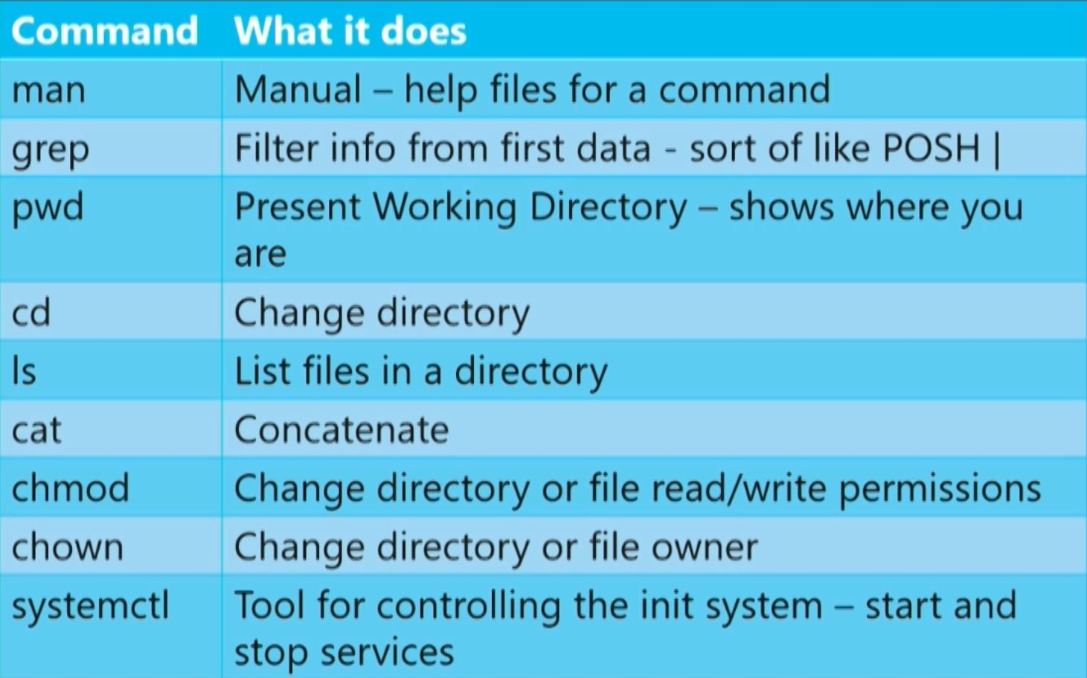
Basic Linux Commands

Slide 7
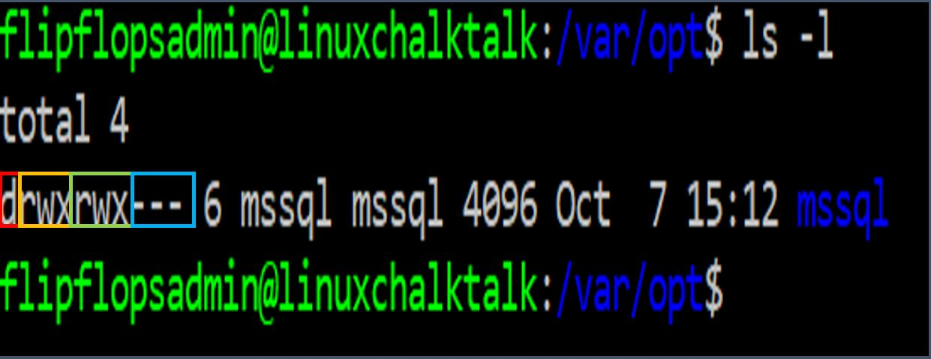
File and Folder Permissions
Permission Groups
Owner
Group
Everyone
Permission Types
Read(r)
Write(w)
Execute(x)

Slide 8
Root
Every Linux server has an admin account named root
You DO NOT want to log in and run commands as root
Instead, use “sudo”- super user do!
Example:
Restarting your SQL Server service
sudo systemctl restart mssql-server

Slide 9
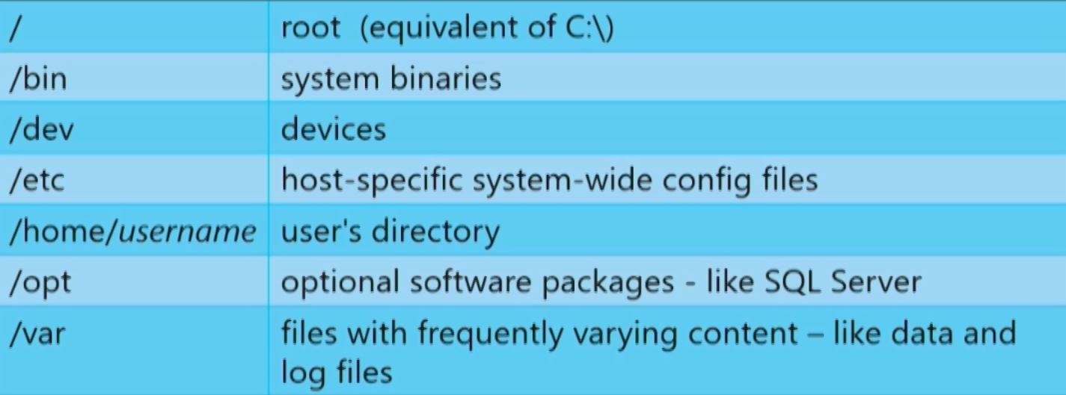
File System Structure

Slide 10
Pre-installation considerations
CPU
Do you have a template for your installs today on Windows? It is still relevant in Linux(CPU, Memory, Disk, etc.)
CPU Frequency Governor - Set to performance - High clock performance no power saving
Energy_perf_bias - set to performance
min_perf_pct set to 100
C-states - set to C1

Slide 11
Pre-installation considerations
NUMA
NUMA - non-uniform memory access
Most servers today have each processor set to access local memory first
Automatic NUMA balancing moves tasks(threads or processes) closer to the memory they are accessing
This is a kernel setting – not an application setting
It also moves application data to memory closer to the tasks that reference it
Enabled by default, should be disables(set to 0)

Slide 12
Pre-installation considerations
Disk Settings
Disk Readahead – loading file contents into cache
Set to 4096

Slide 13
Pre-installation considerations
noatime
“No access time” – disables the OS from tracking when the files were last accessed
Add to data AND log files for optimal performance

Slide 14
Pre-installation considerations
Virtual Address Space
Each process from an OS runs in its own memory “sandbox”, or space – the VAS
Default vm.max_map_count is 65536 bytes – not high enough
Should be set to 256k

Slide 15
Pre-installation considerations
swapfile
Similar to the Windows paging file
Ensure it is properly configured – consult your Linux Administrator

Slide 16

Pre-installation considerations
Dynamic Memory on VMs

Slide 17
Installing SQL Server on Linux

Slide 18
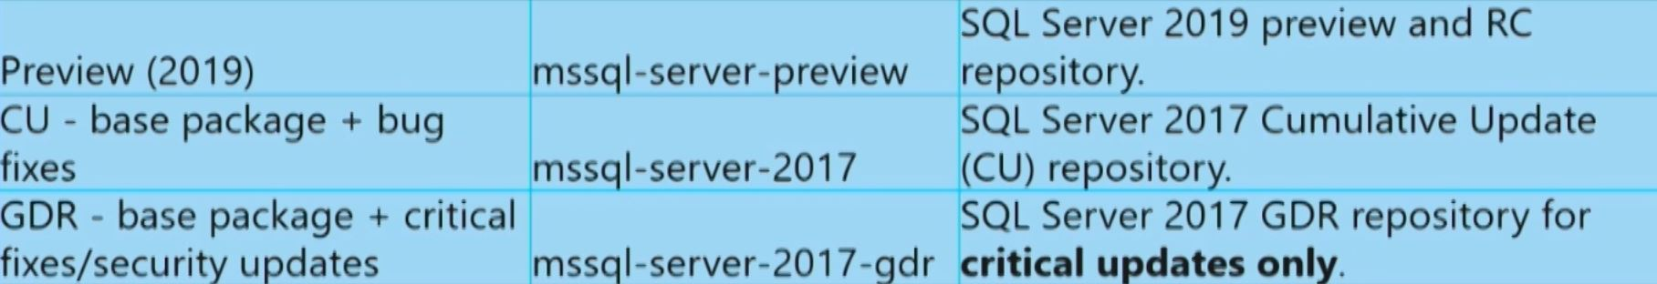
When you install SQL Server on Linux, you MUST configure a Microsoft repository
This repository is used to acquire the database engine package, mssql-server, and related to SQL Server packages
There are currently three main repositories:

Slide 19
Installation Steps
Import public repository keys
Configure a source repository
Update the repository
Install SQL Server

Slide 20
DEMO

Slide 21
Post-Installation
Multiple TempDB data files – Same guidelines from Windows
1 per core up to 8
If contention is identified, add in multiples of 4
Configure Memory – Default is 80%
Do not use sp_configure
Use mssql-conf – memory.memorylimitmb
There is no setting for lock pages in memory for Linux
Instant File Initialization – Similar functionality is enabled by default with Linux

Slide 22
Post-Installation
Tools
sqlcmd - command-line query utility
bcp - bulk import/export utility
dstat - Dstat allows you to view all of your system resources instantly
htop - Htop is a free (GPL) ncurses-based process viewer for Linux
mpstat -The mpstat command writes to standard output activities for each available processor

Slide 23
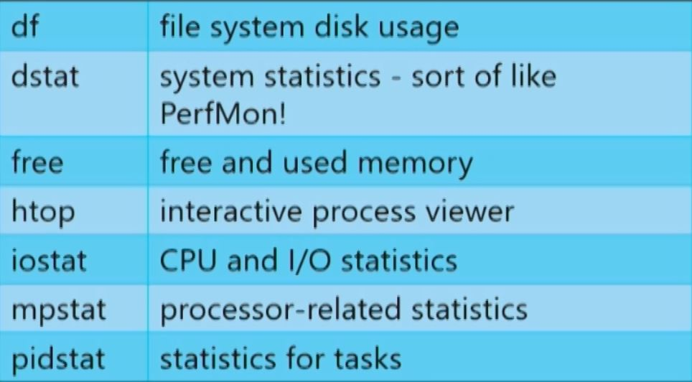
Useful Linux Monitoring Commands

Slide 24
Demo

Slide 25
Resources
An Introduction to Linux Basics
Get started with the CPU Governor
Performance best practices and configuration guidelines for SQL Server on Linux
SQL Server Instant File Initialization: SetFileValidData (Windows) vs fallocate (Linux)
Installation guidance for SQL Server on Linux

Slide 26
Questions?

Slide 27
Thank You!
Contact me here
James.Donahoe@Microsoft.com

