Slide 1
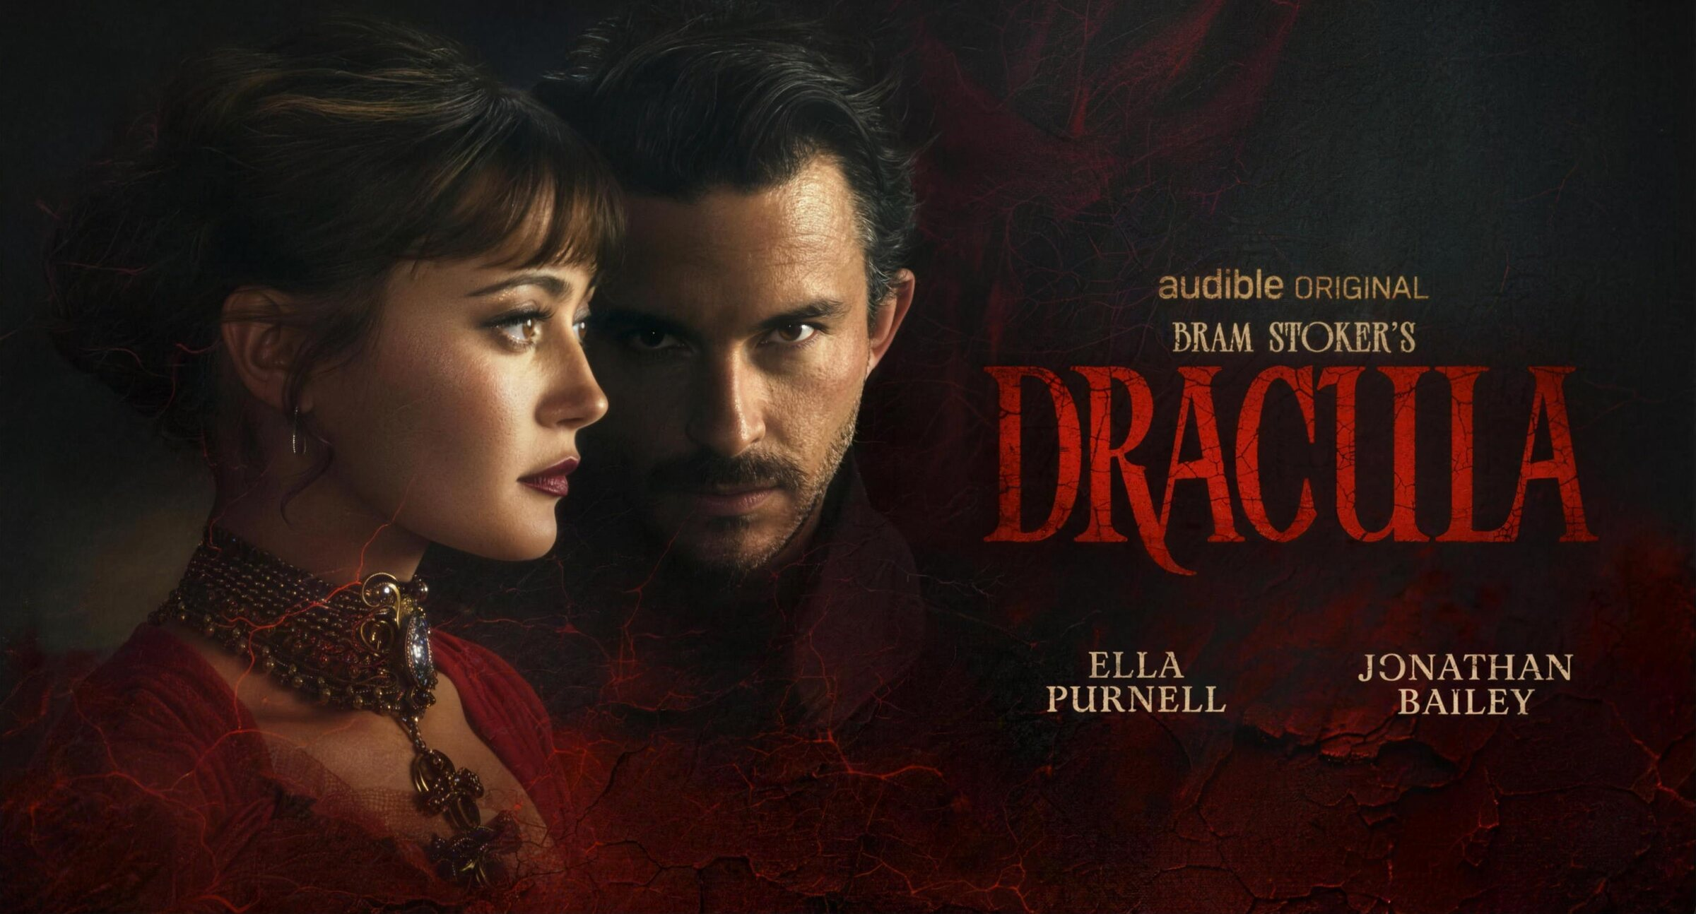

PRESENTED BY NOWTHIS X AUDIBLE
CAMPAIGN KICKOFF EXPERIENCE 2026

Slide 2
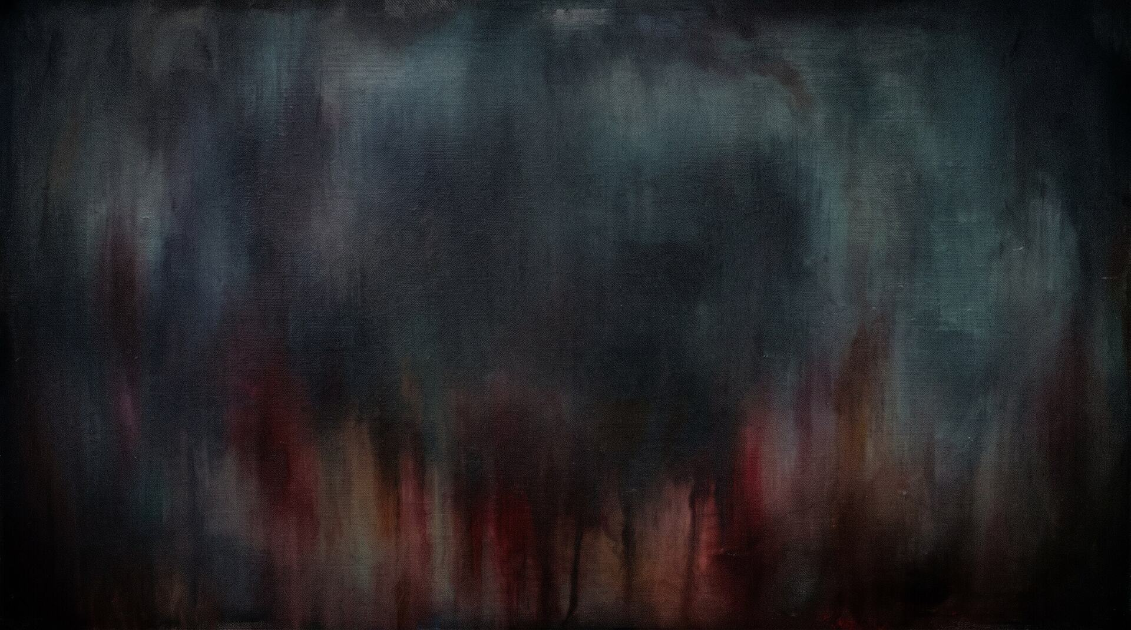
STRUCTURE
How The
Night Unfolds
PART I — THE HUNT
PART II — THE REVEAL
Guests enter The Hunt and explore Dracula through hidden journal entries, immersive audio, and interactive discoveries throughout the venue.
One final discovery completes The Hunt and leads guests to Audible, where they can continue listening to uncover how Dracula ends.

Slide 3

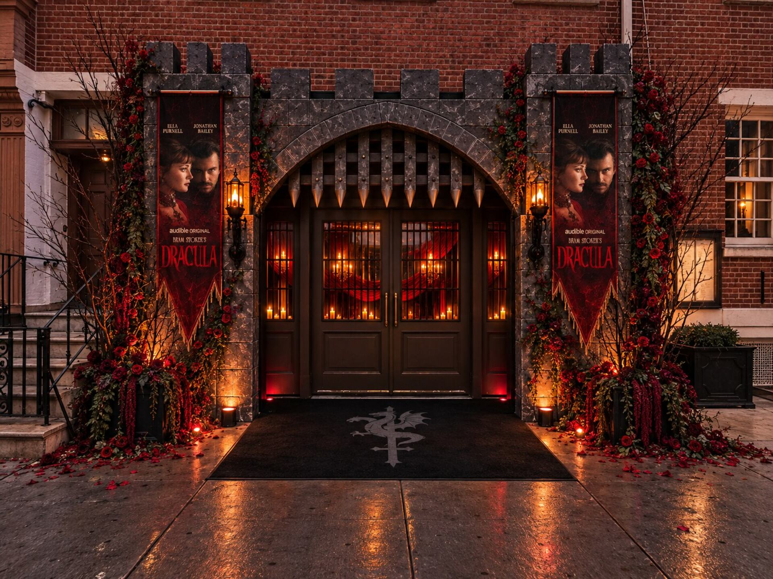
ONE NIGHT ONLY
One Night Only
For one night only, Audible transforms a chic New York venue into The Hunt. Drawn from the haunting pages of Dracula, the evening blends decadent dining, gothic luxury, and interactive storytelling into New York's most coveted invitation.
A stylish New York venue is transformed into Dracula's dining room through candlelight, dramatic tablescapes, and lavish details inspired by gothic luxury. Fog creeping over the floors, dramatic lighting, and luxurious gothic touches leave no doubt where this evening is taking place.

Slide 4
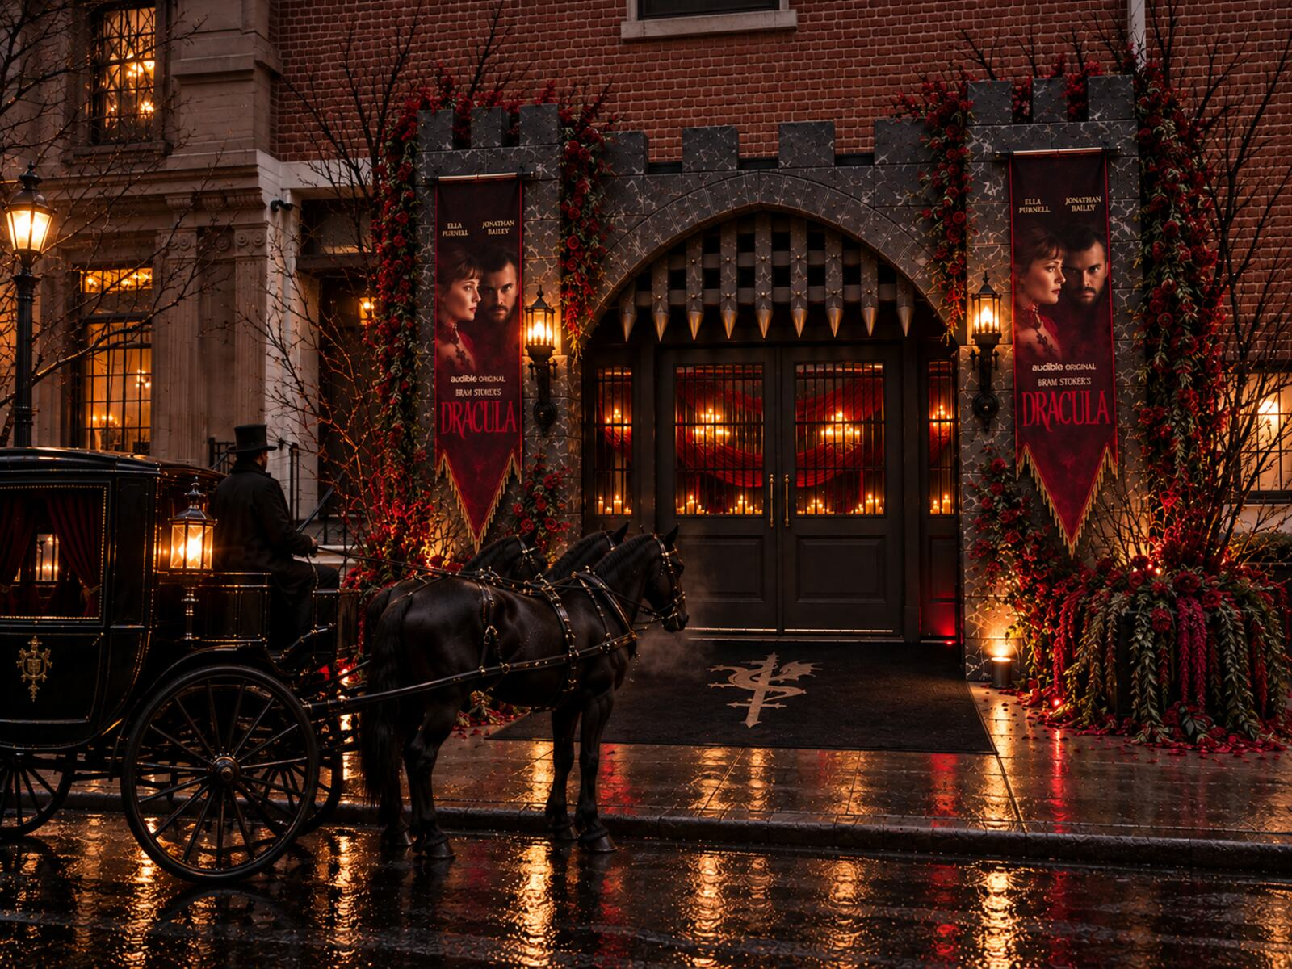
ARRIVAL
You May Enter

Slide 5
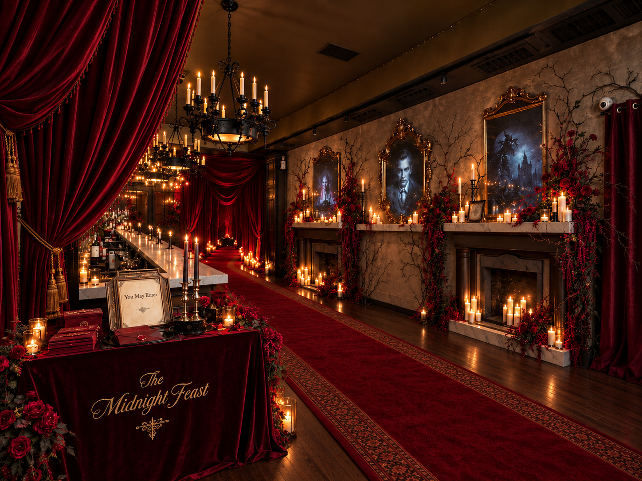
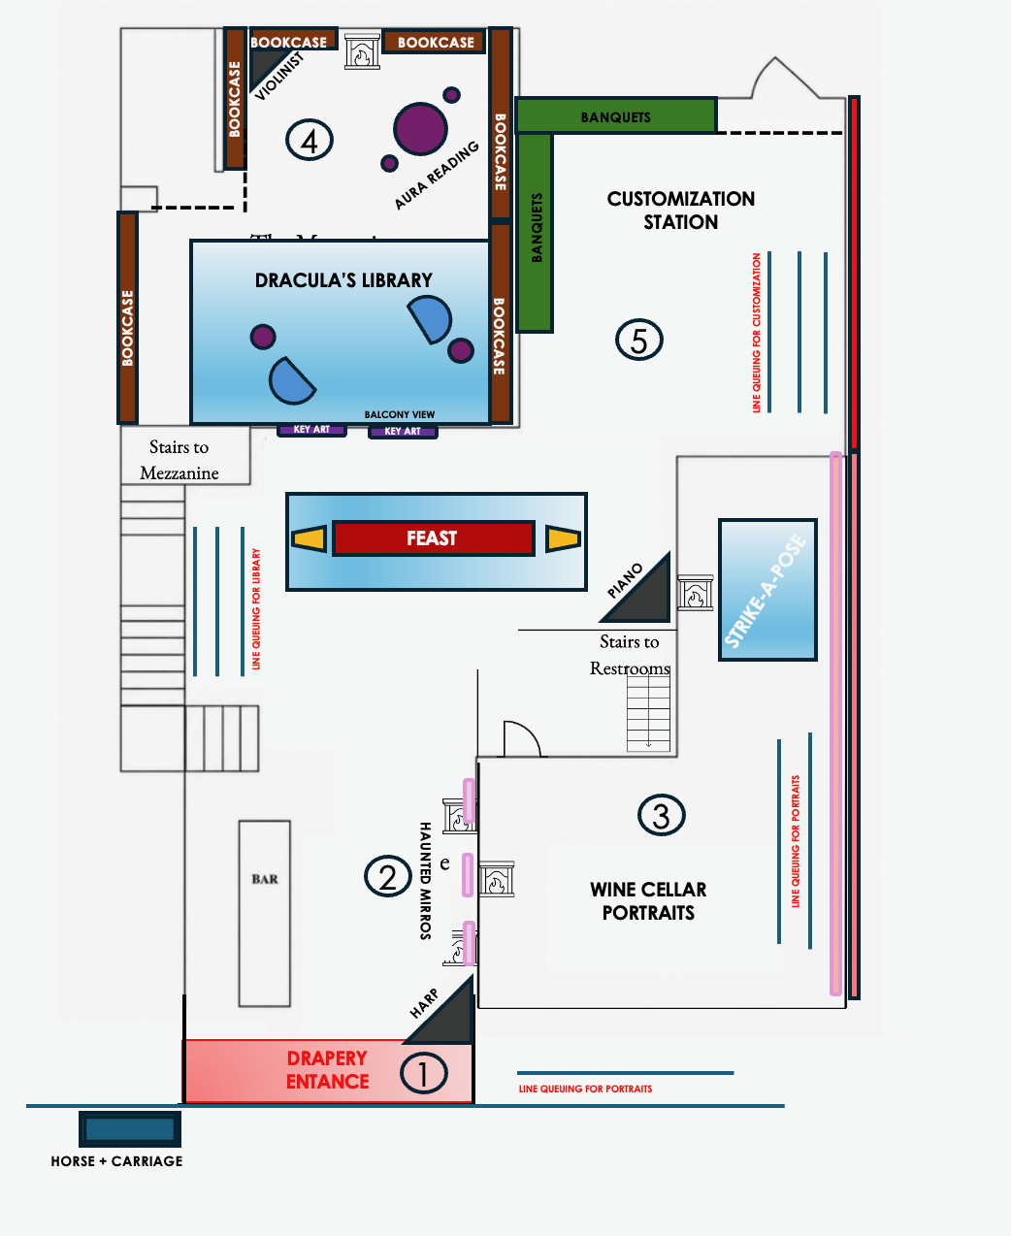
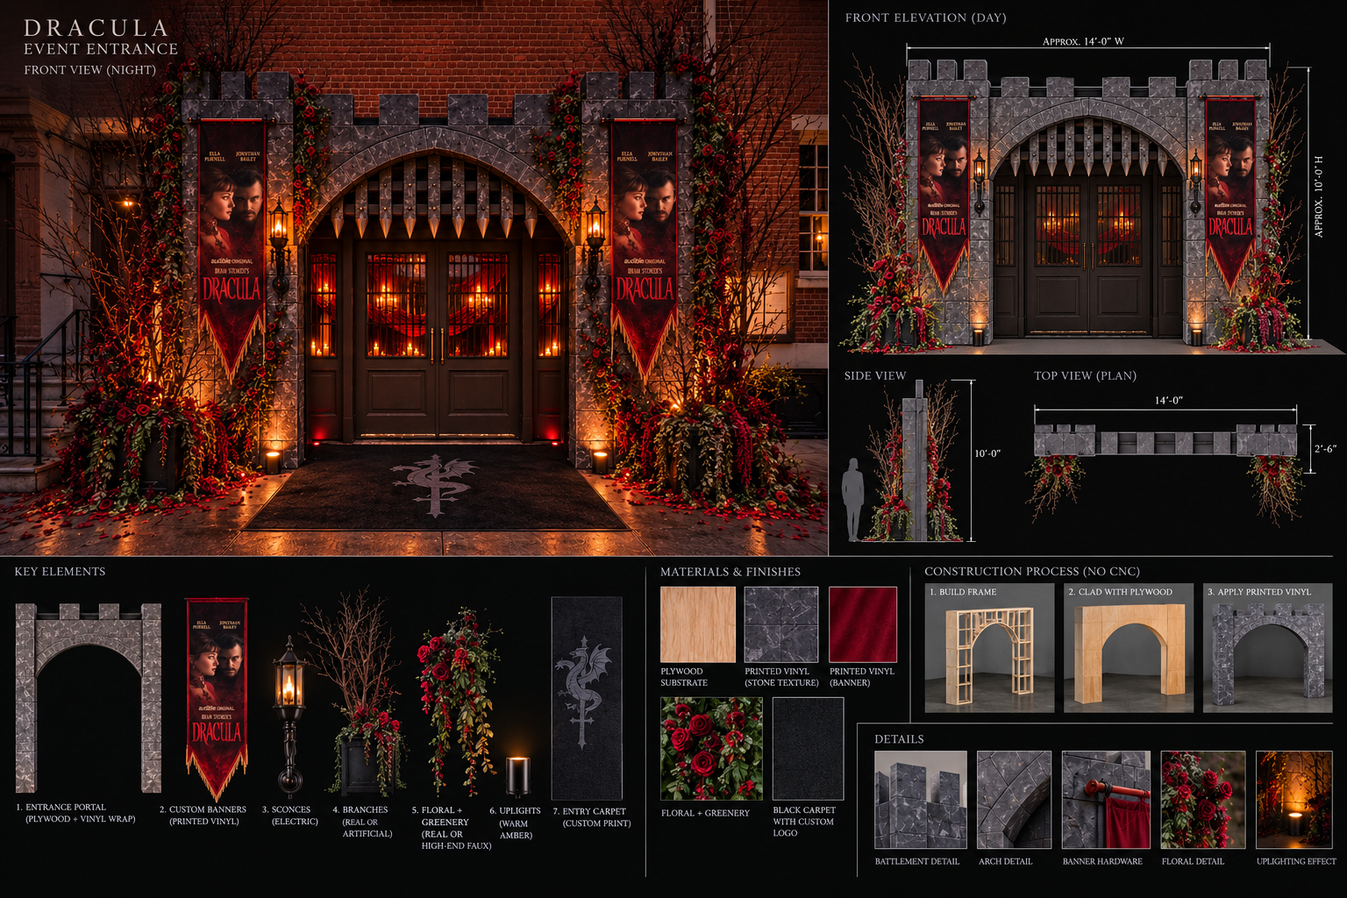
ENTRANCE DESIGN
Building The Threshold
EXPERIENCE
GUEST FLOW
PRODUCTION
Arrival Environment
Floor Plan
Entrance Build Plan
A candlelit reception environment introduces guests to the world of Dracula through velvet drapery, portrait mirrors, florals, and the first invitation to enter.
The floor plan coordinates arrival, activation queues, the feast, portraits, aura readings, the library, and the customization station across the venue.
The entrance elevation, materials, lighting, branded banners, florals, and modular construction details translate the threshold concept into a buildable installation.

Slide 6
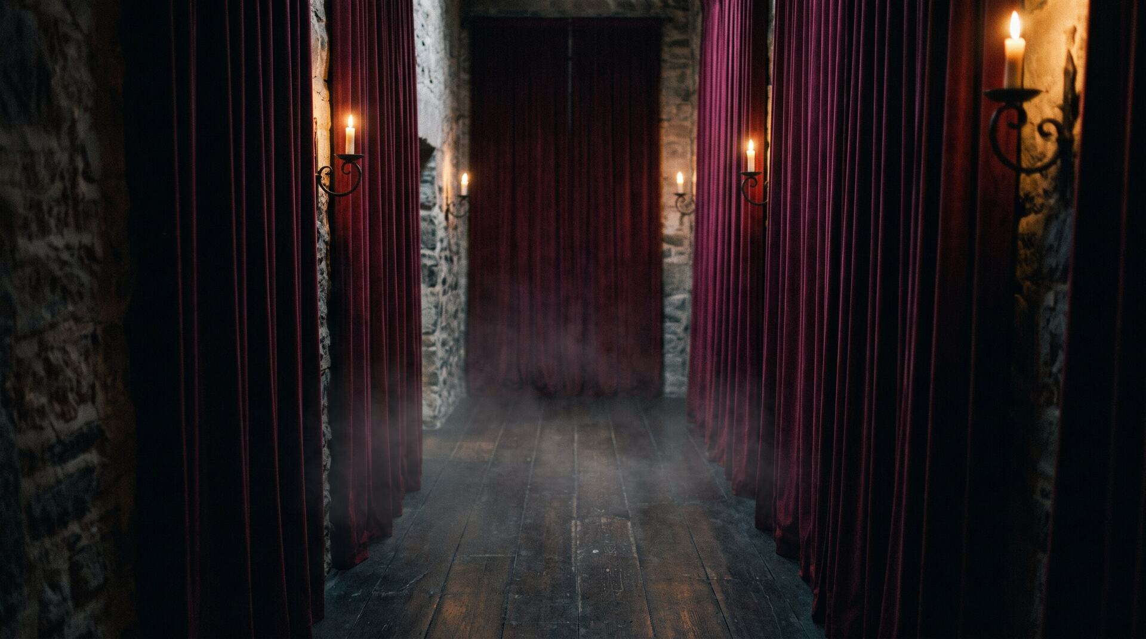
THRESHOLD
Into The Castle
Guests step into the Count's castle through a candlelit corridor, where flickering light and dramatic drapes blur the line between reality and Dracula's world.
Audio clips from Audible's Dracula play, letting guests know they are entering his realm. They receive a wax-sealed envelope, seemingly created in another time and place.

Slide 7
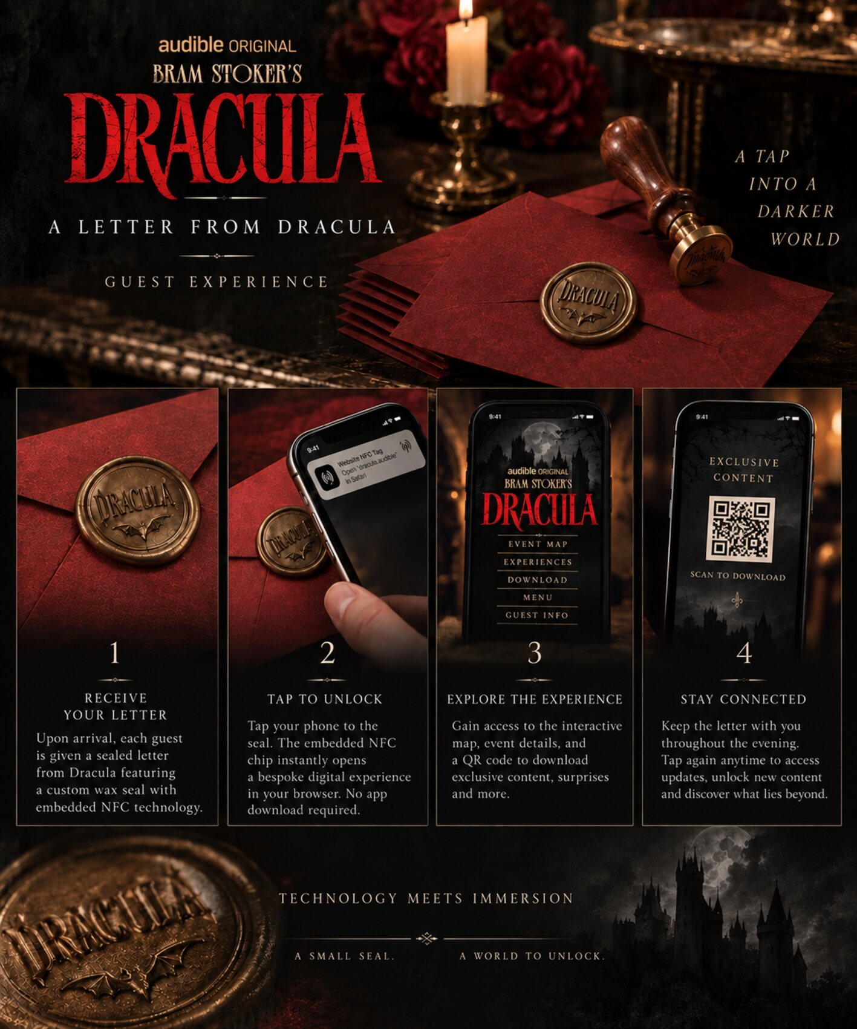
THE INVITATION
Open If You Dare
Inside each wax-sealed envelope is an illustrated map that lays out the evening, providing further instructions for The Hunt. As the night unfolds, the map becomes their guide, leading them to each immersive activation where they'll uncover clues, collect stamps, and piece together Dracula's story.

Slide 8
GUESTS
The Dress Code
The Hunt invites guests to interpret Dracula through high fashion, embracing dramatic silhouettes, rich textures, and couture rooted in gothic glamour. Think modern vampire, not costume, where every look feels worthy of the front row.

Slide 9
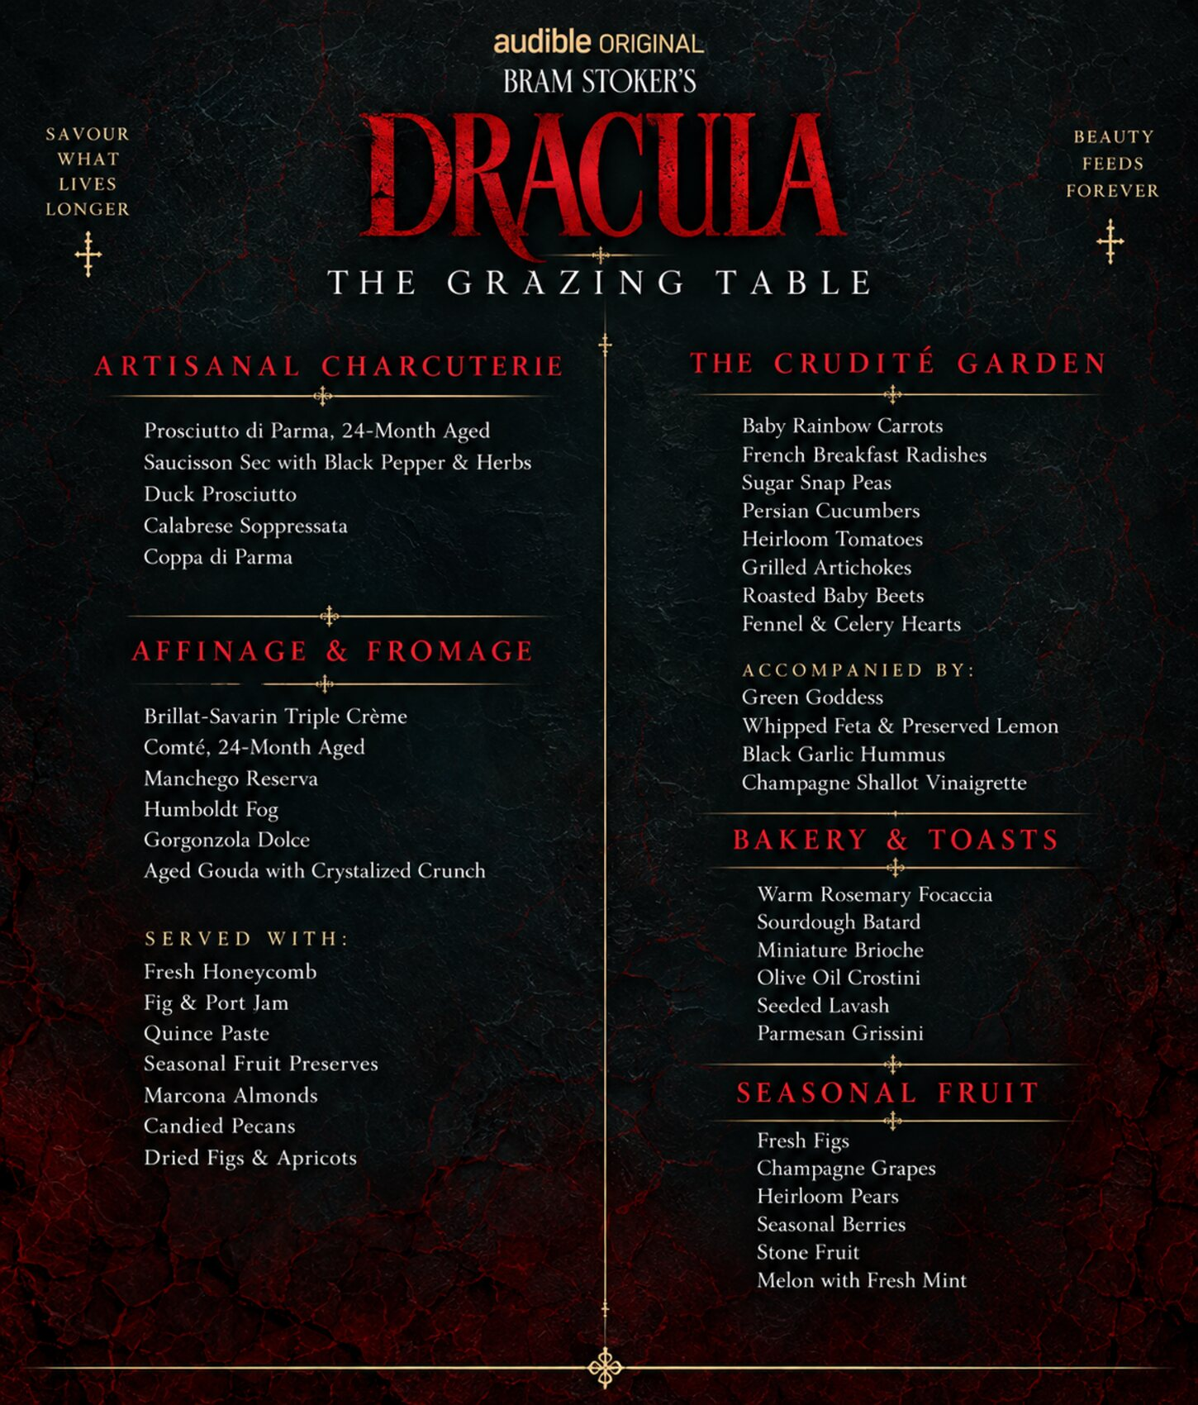
DINING
The Menu
TABLE / The Grazing Table / A dramatic grazing table reimagines Dracula through elevated bites featuring blood oranges, black cherries, dark chocolate, and other sophisticated nods to vampire lore. Each dish draws from iconic symbols and moments from the novel.
DRACULA / Smoked Old Fashioned / With blood orange.
MINA / Elderflower & Champagne Spritz
LUCY / Black Cherry Gin Cocktail

Slide 10
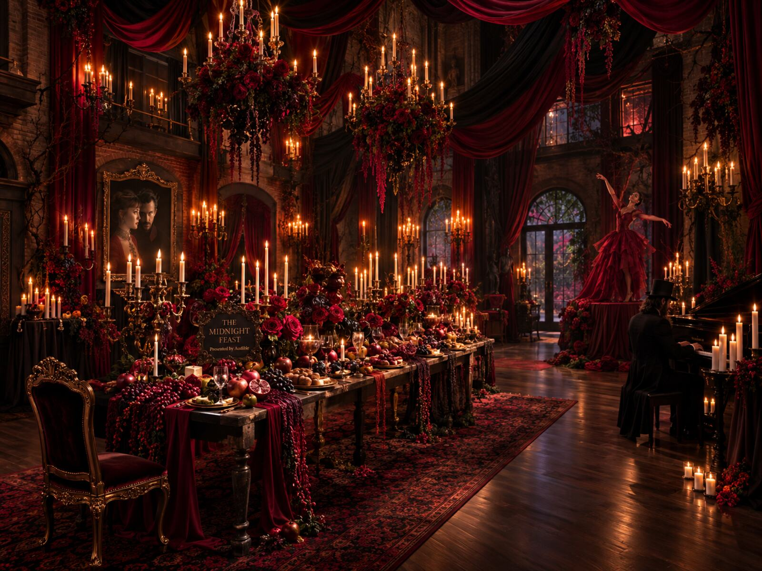
ATMOSPHERE
The Castle
Comes To Life
THE TABLE BECOMES THE CENTERPIECE
THE FEAST HAS A SOUNDTRACK
Lavish tablescapes overflowing with moss, florals, and candlelight
Hidden journal pages reveal forgotten moments from the novel before the investigation begins
A live string quartet sets the tone as guests arrive and dine
Immersive sound design fills the space with whispers, turning pages, church bells, and wolves
Exclusive moments from Audible's narration drift through the dining room, surrounding guests with the voices of Dracula

Slide 11
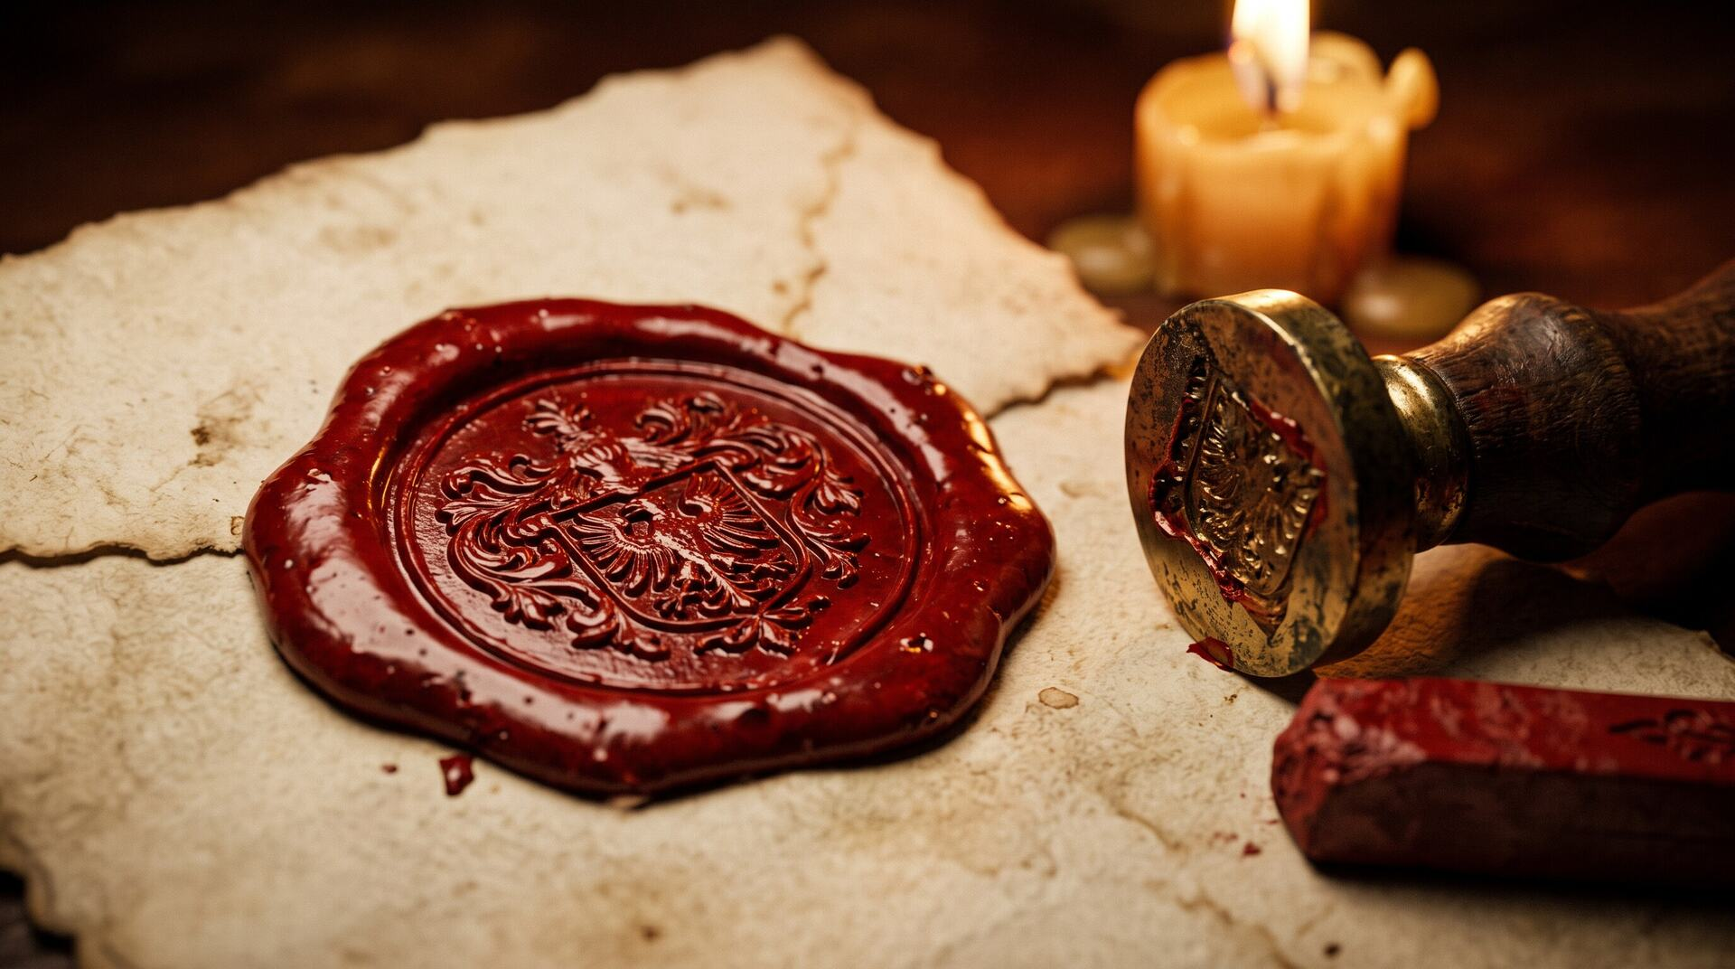
Using the map they received upon arrival, guests must visit every activation hidden throughout the venue to piece together the answer. At each stop, they uncover a new part of the story through audio, prophecy, or visual clues and receive a custom blood-red Audible stamp marking their progress.
Each clue reveals more. Each branded stamp brings them closer. Only guests who complete the entire Hunt and collect every stamp can unlock The Midnight Revelation.
THE MECHANIC
The Hunt For Dracula

Slide 12
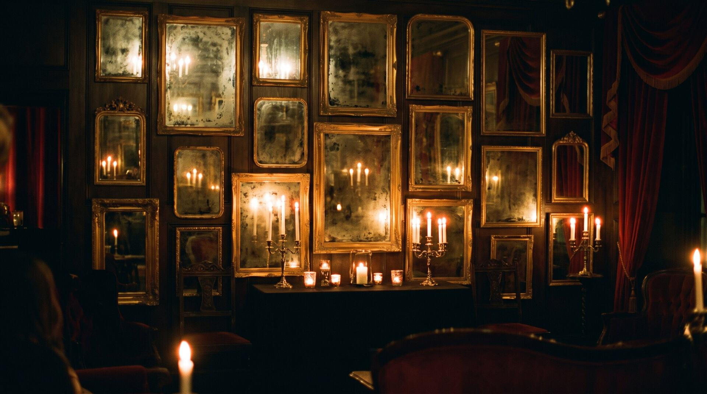
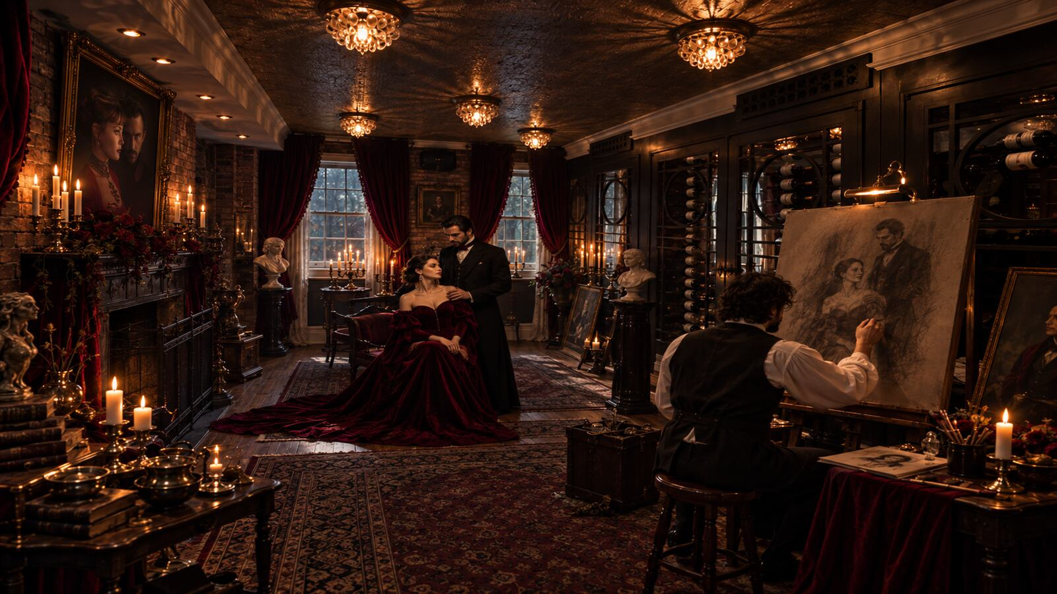
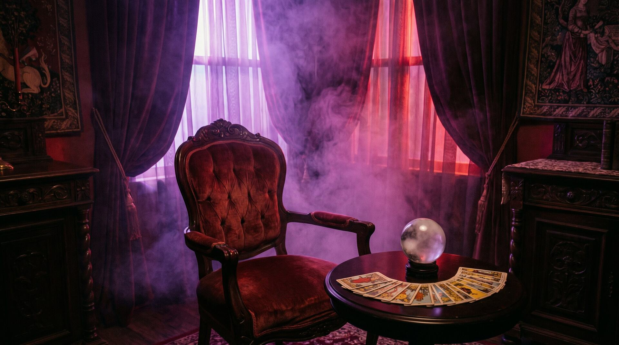
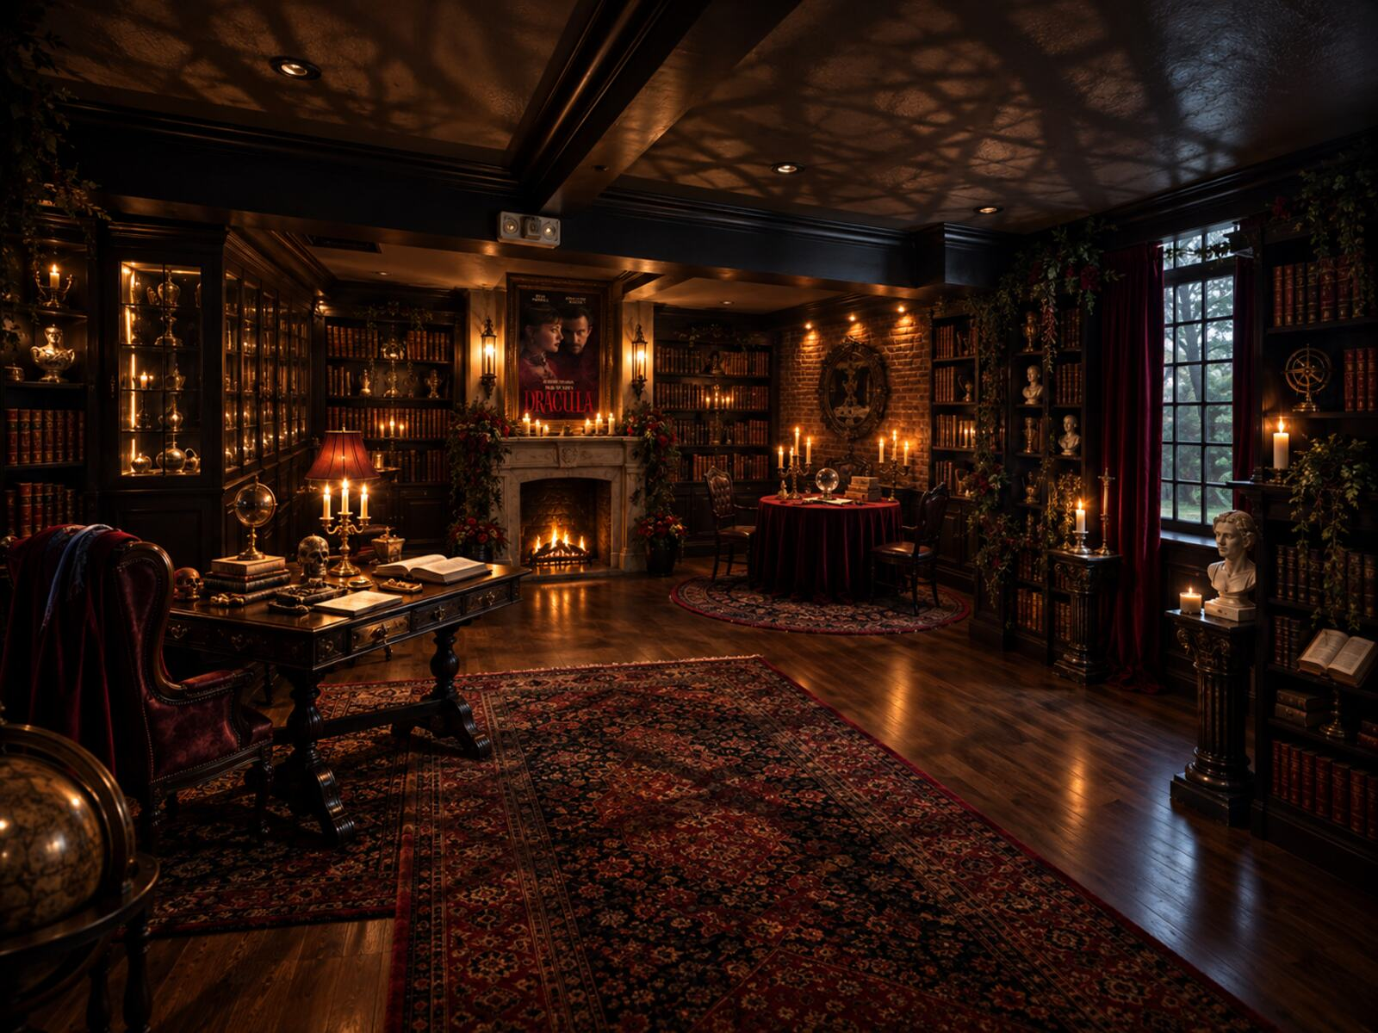
FOUR ACTIVATIONS
Four Clues
DECODE
CAPTURE
DIVINE
LISTEN
The Mirrors
The Portrait Booth
The Aura Reading
Dracula's Library
Antique mirrors conceal messages and visual illusions within their reflections. Guests must determine which reflection reveals the hidden message. The message uncovers another piece of Dracula's fate.
Guests step into the wine cellar's ornate Victorian portrait booth and become part of Dracula's world. Audio clips play as their portrait is captured. They must examine the finished portrait to uncover a hidden detail.
A dramatic aura reading captures the energy Dracula would see in you. Your aura reveals your fate: resistant to his influence, or dangerously easy to lure in. Guests leave with an aura portrait and personalized reading.
Guests search Dracula's library for books that unlock immersive audio. Integrated speakers create intimate listening moments. Guests must listen closely to uncover the clue hidden within.

Slide 13
COMPLETION
Four Clues. One Revelation.
In order to receive the final clue of the evening, guests must complete the
four Dracula experiences and receive their associated Audible stamps. Upon
completion, guests display their stamped map and receive the final revelation.

Slide 14
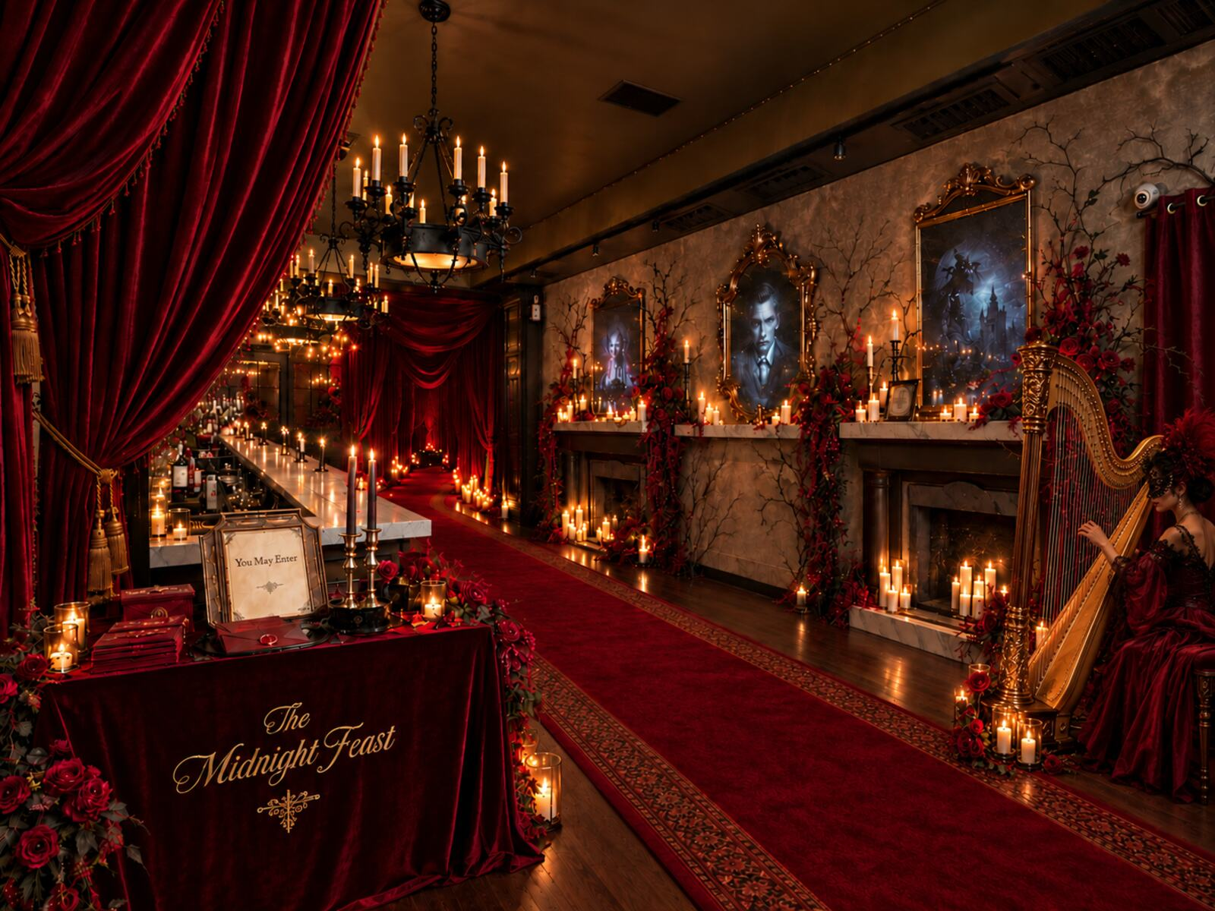
With all four tasks complete and their final stamp secured, guests unlock The Midnight Revelation: an ornate handheld mirror created exclusively for the evening.
Hidden within the reflection is one final message: "Not everything can be seen. Some things must be heard." A discreet QR leads guests to Audible, where they can listen to uncover Dracula's ending for themselves.
THE MIDNIGHT REVELATION
The Reveal

Slide 15
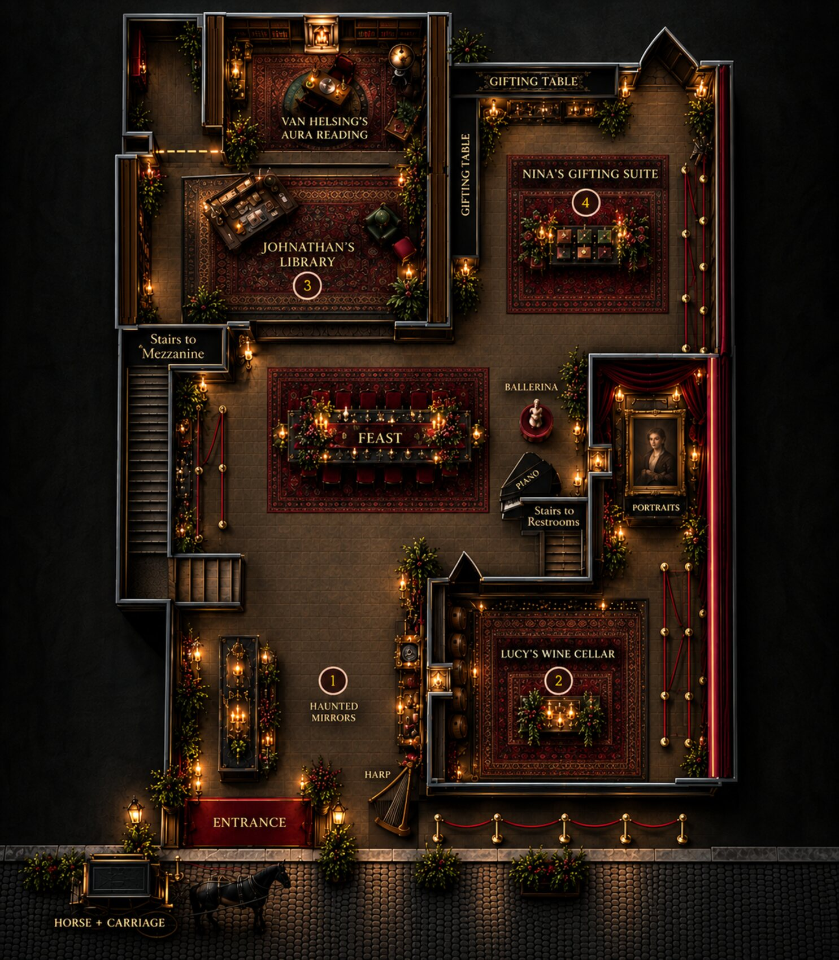
VENUE - CONFIRMED
One if by Land, Two if by Sea
17 Barrow St, New York, NY 10014
Landmarked 1767 carriage house, formerly Aaron Burr's. Recognized for its classic menu, long history, and beautiful decor - often cited as the most romantic restaurant in New York City, and its old world touches fit the bill for Dracula.
A barrel-vaulted stone tunnel runs from the building toward the old Hudson shoreline. Dracula arrives by sea. The passage is already there.
130 SEATED
200 COCKTAIL
3 ROOMS, PIPED SOUND
PRIVATE GARDEN
CLOSED MONDAYS - AVAILABLE FOR PRIVATE EVENTS

Slide 16
FOR DISCUSSION
Open Items
01
Audio integration - when and where clips play without disrupting the dining experience. Audio is mandatory to some extent; placement needs sign-off.
OWNER
02
Leave-behind production - the branded gift box is specified at 175 pcs and carries the QR component. Confirm final contents and approval path.
OWNER
03
Guest flow and throughput - the venue floor plan now maps activation zones. Model timed waves or staggered arrivals for the aura reading and portrait booth before final guest count.
OWNER
04
Talent and performance involvement - none currently scoped beyond the string quartet. Confirm whether Bailey, Purnell, or the costumed grand-feast performance shown in the render is in play.
OWNER
05
Date, final guest count, and budget band - date and budget are not yet set. Reconcile final guest count against the 175-box production quantity.
OWNER
06
Key art motion treatment - confirm brand-team approval for scroll-based parallax on the delivered key art composition.
OWNER

Slide 17


