Slide 1
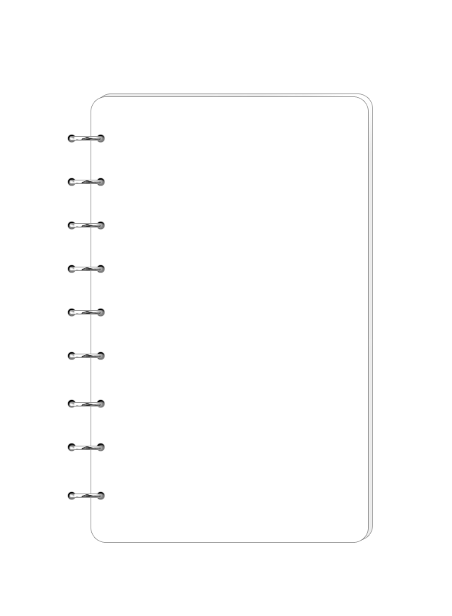
Incident management process enriched event log
Shuyu CHEN

Slide 2
1 Introduction
This event log was extracted from data gathered from the audit system of an instance of the ServiceNow platform used by an IT company and enriched with data loaded from a relational database.
It contains the entire process of incident management, including key points in time, Id of responsible persons, etc.
The dataset contains 141712 events of 24918 incidents.

Slide 3
2 Type of variables
36 variables in total:
5 time (date) variables
15 different categories of ids
4 Boolean variables
3 int variables
9 categorical variables

Slide 4
3 Target variable
Change all the time variable to timestamp
Target variable is generated by subtracting “sys_updated_at” variable from “closed_at” variable

Slide 5
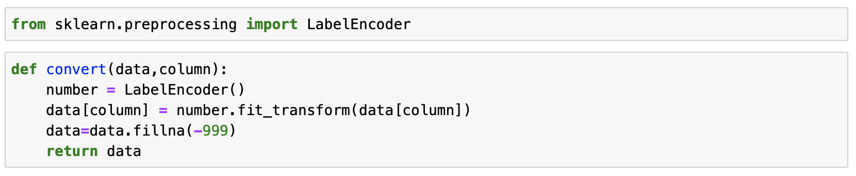
4 Label encoder
Since the target is numeric, regression related method (algorithm) should be used. Also, because covariates include different types of data (e.g., category, bool, etc.), label encoder were used to change them into a format that can be processed.

Slide 6
5 feature engineering
Random Forest (RF) were firstly used to select covariates that contributed most.
“resolved_at” is the most contributing variable. The accuracy of RF model can decrease from about 0.96 to 0.78 after delete this variable.
I also deleted all columns whose importance (MDA) equals about 0

Slide 7

6 Methods
decision tree regression (score$≈$0.92)
random forest (score$≈$0.96)
grid search to find the best hyperparameters.

Slide 8
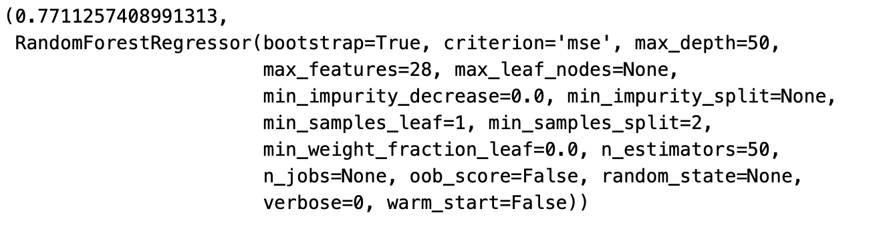
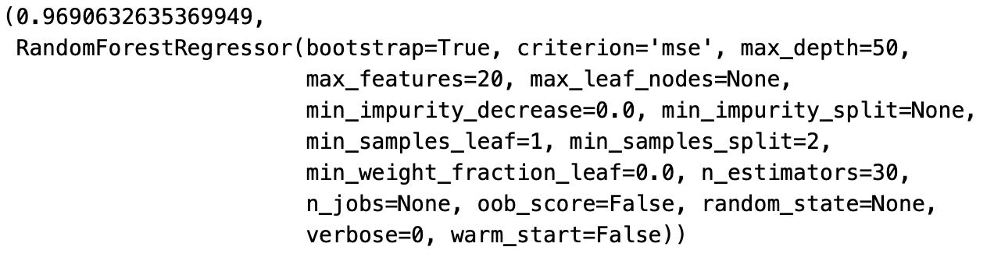
7 result
Result without feature engineering
Result with feature engineering

Slide 9
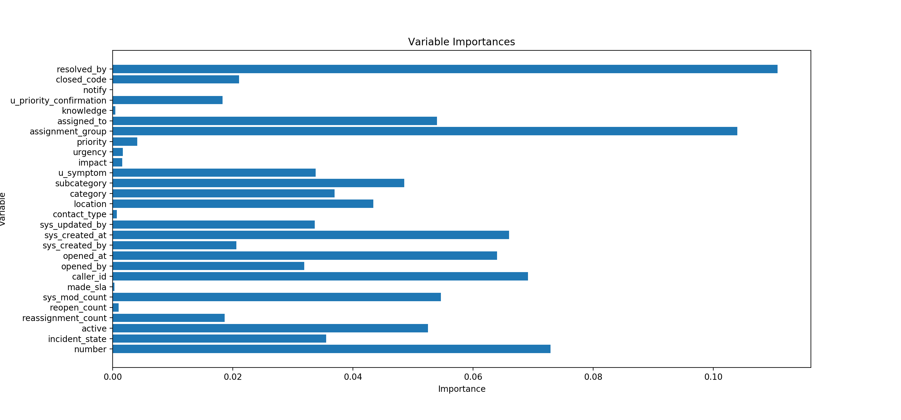
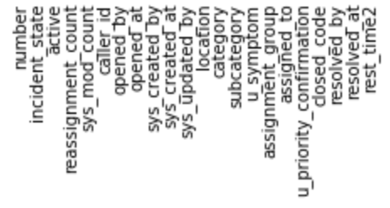
8 feature importance
Final chosen variables:

Slide 10
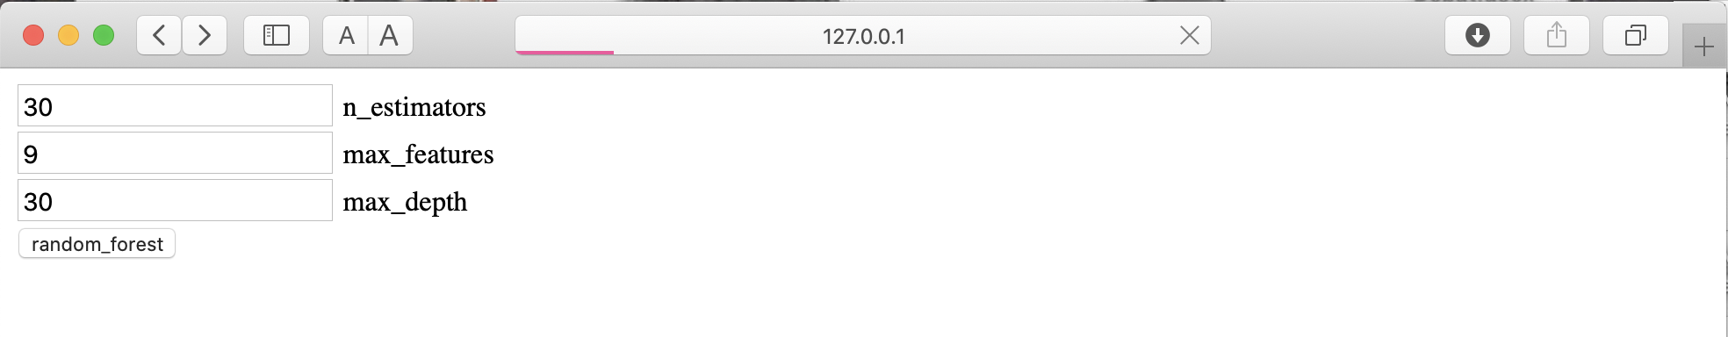
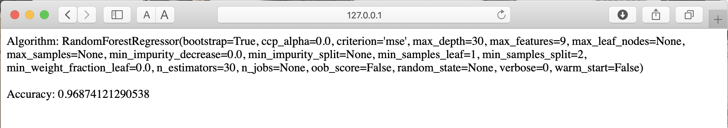
9 Flask API
Choose hyperparameters to build model

Slide 11
Thank you for your evaluation

