Slide 1
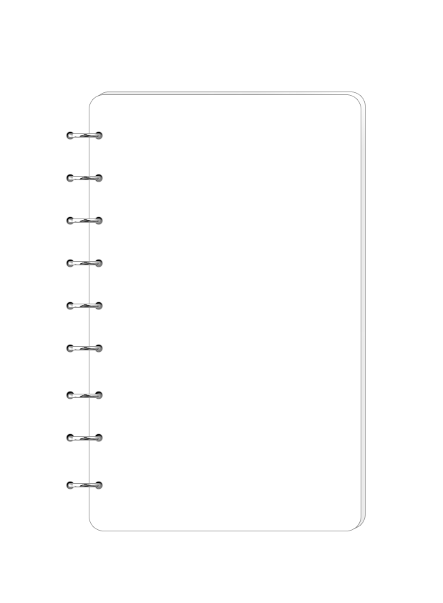
Incident management process enriched event log
Shuyu CHEN

Slide 2
1 Introduction
This event log was extracted from data gathered from the audit system of an instance of the ServiceNow platform used by an IT company and enriched with data loaded from a relational database.
It contains the entire process of incident management, including key points in time, Id of responsible persons, etc.
The dataset contains 141712 events of 24918 incidents.

Slide 3
2 Type of variables
36 variables in total:
5 time variables
15 different categories of ids
4 Boolean variables
3 int variables
9 categorical variables

Slide 4
3 Target
Change all the time variable to timestamp
Target variable is generated by subtracting “sys_updated_at” variable from “closed_at” variable

Slide 5
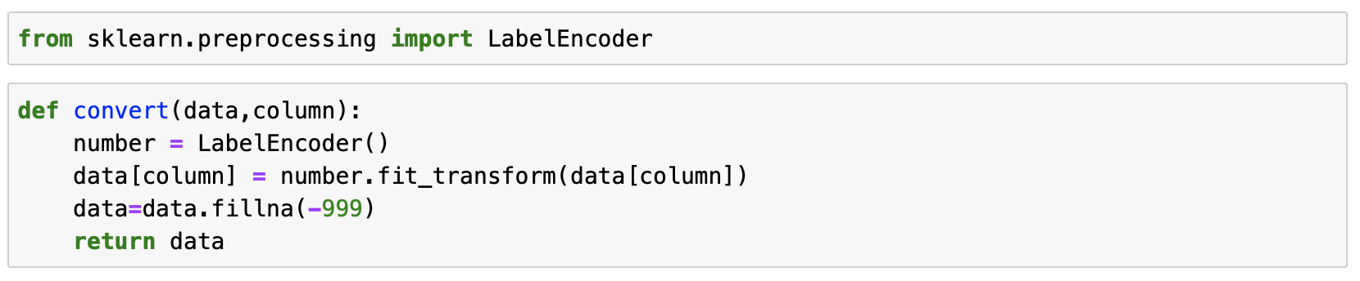
4 Label encoder
Regression would be used, so the data type should be numeric, so I used label encoder to change category and bool type data to numeric.

Slide 6

5 Methods
decision tree regression (score$≈$0.92)
random forest (score$≈$0.96)
grid search to find the best hyperparameters.

Slide 7
6 feature engineering
First, I used the dataset with “resolved_at” column. The score is about 0.96 but the feature importance showed that “resolved_at” variable is the most important.
So, I deleted “resolved_at” column, and build a new random forest model. But the score was about 0.78.
Then I deleted all columns whose importance equal 0, and built a new model, then the score increased to 0.96.

Slide 8
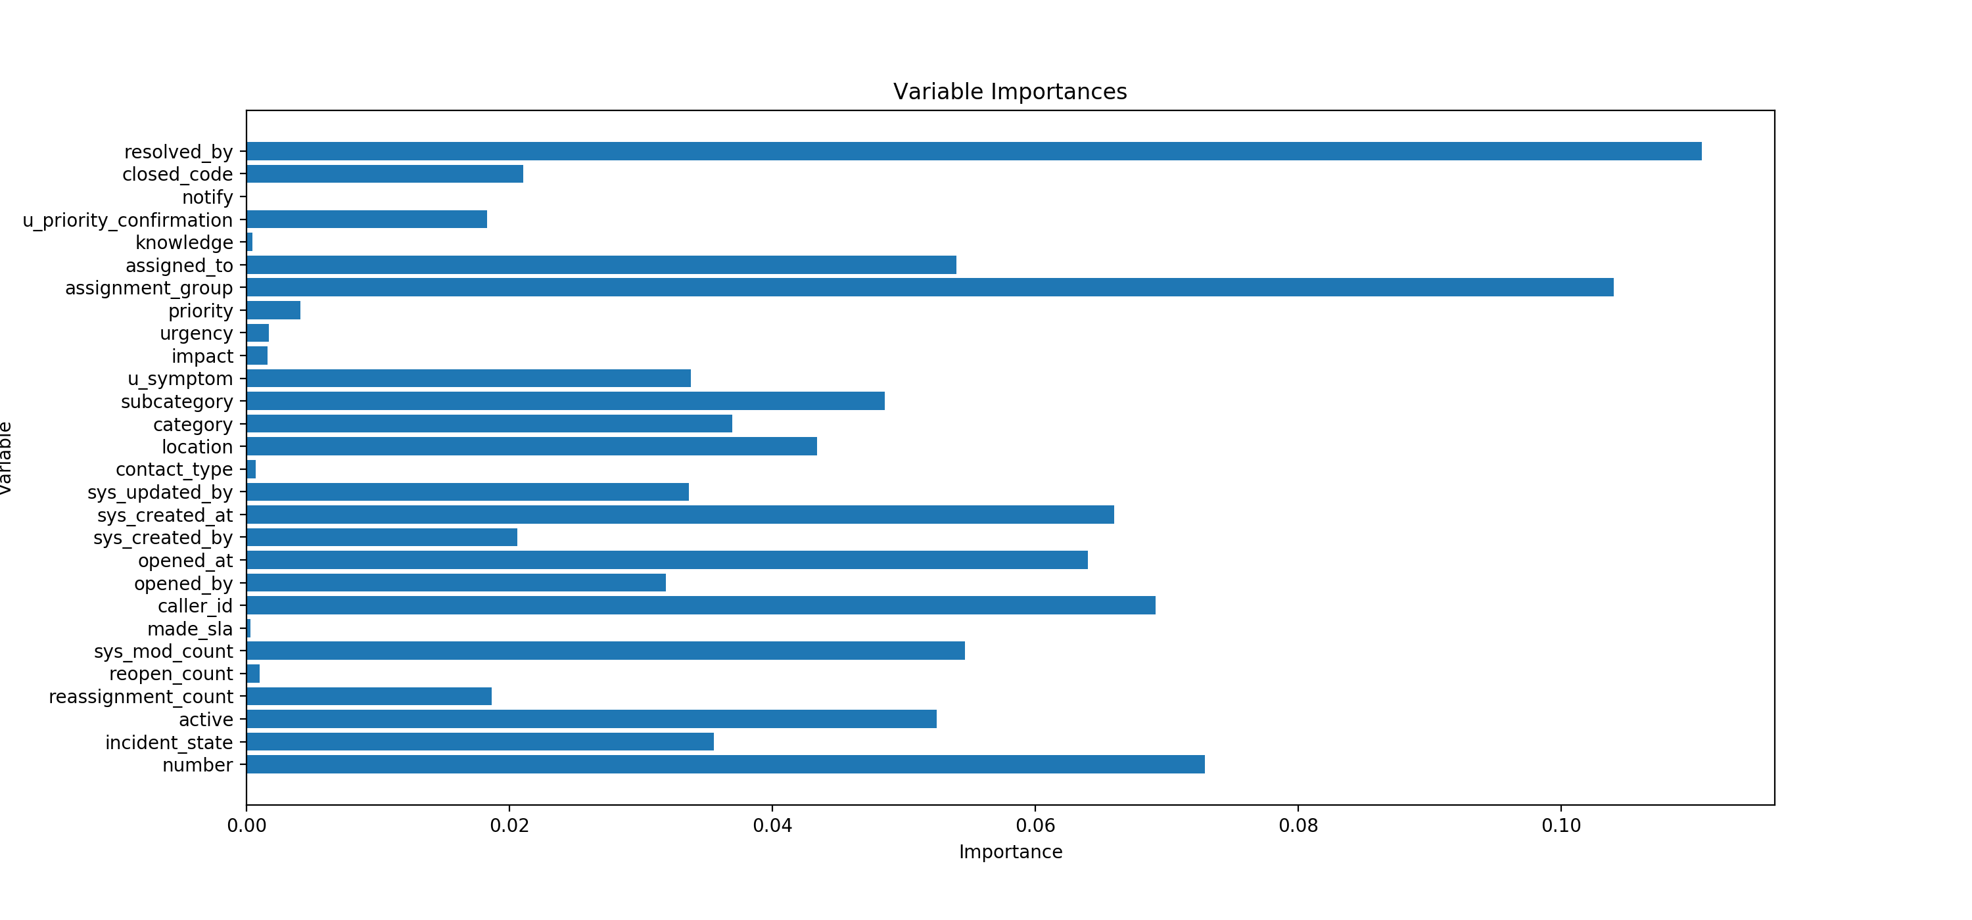
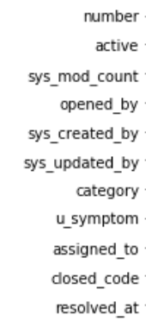
7 feature importance
Final chosen variables:

Slide 9
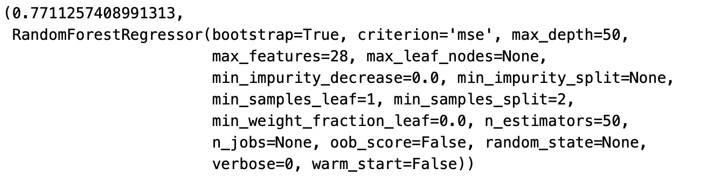
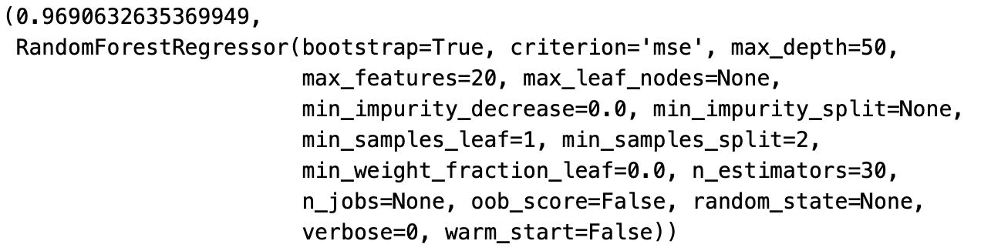
8 result
Result without feature engineering
Result with feature engineering

Slide 10
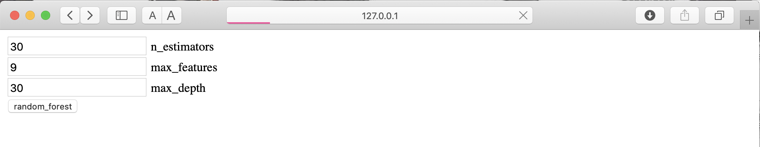
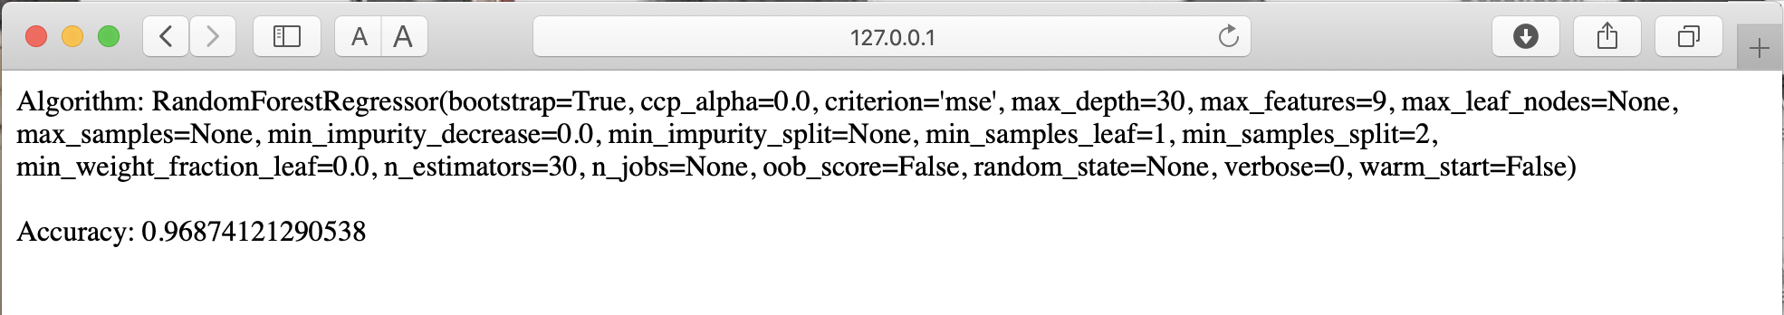
9 Flask API
Choose hyperparameters to build model

Slide 11
Thank you for your evaluating

