Slide 1
Customer Churn Analysis and Prediction
Using machine Learning
Stephen Ogodo
unclesteve2k4@yahoo.com

Slide 2
Content
1- Introduction
2-Problem statement
3- Aim and Objectives
4- Step-by-Step Actions undertook
5- Data Pre-processing
6- EDA and Feature Engineering
7- Machine Learning: Training, testing, criteria/metrics for model selection, hyper-parameter tuning, features Importance
8- Recommendation

Slide 3
1. Introduction
Deciphering Customer Churn: A Journey to Retention and Growth
In the competitive landscape of modern business, customer churn poses a formidable challenge. Understanding its intricate dynamics is essential, as each departed customer holds valuable insights. By combining data science, psychology, and strategy, businesses can anticipate churn and implement targeted interventions. Join us on this journey to decode churn, harness insights, and foster enduring customer relationships. The case study at hand is that of ConnectTel- a telecommunication company facing a very serious customer churn also known as customer attrition.

Slide 4
2. Problem Statement
ConnectTel Telecom Company faces the pressing need to address
customer churn, which poses a significant threat to its business
sustainability and growth. The company's current customer retention strategies lack precision and effectiveness, resulting in the loss of valuable customers to competitors. To overcome this challenge, ConnectTel aims to develop a robust customer churn prediction system to handle the problem and proffer solutions. By leveraging advanced analytics and machine learning techniques on available customer data, the company seeks to accurately forecast customer churn and implement targeted retention initiatives. This proactive approach will enable ConnectTel to reduce customer attrition, enhance customer loyalty, and maintain a competitive edge in the highly dynamic and competitive telecommunications industry

Slide 5
3. Aim and Objectives
The aim of this project is to develop a predictive model that can identify customers who are at risk of churning.
By proactively identifying these customers, the company aims to implement targeted retention strategies to reduce churn rates and improve customer retention ultimately resulting in increase revenue. The following objectives are identified:
1- To Understand the factors contributing to customer churn.
2- To Develop a predictive model using machine learning techniques.
3- To Identify actionable recommendations to reduce churn and improve customer retention.

Slide 6
4. Step-by-Step Actions Undertook
Data cleaning- including handling missing data and duplicate
Feature Engineering
Exploratory Data Analysis- Creating new features and encoding categorical variables
Data Splitting
- Split the dataset into training and test sets: with 80%:20% respectively.
Evaluation model performance using appropriate metric (F1-Score and ROC-AUC)
Hyper parameter tuning
Analysis of Feature importance

Slide 7
5. DATA PRE-PROCESSING
DATA CLEANING: – Removing strange characters,
-Dealing with inconsistency in data format
- Correcting Datatypes where necessary
e.g. TotalCharge, which was numerical data came as an object datatype
HANDLING MISSING DATA:
Under the TotalCharge Column, 11 entries have no values, having NAN
The entire dataset has 7043 entries and 21 columns originally.
So, I decided to remove the 11 rows where NAN was the value- removing 11 out of 7,043 entries won’t have any consequence
CHECKING FOR AND REMOVING DUPLICATES: No duplicate was found
Feature Engineering: Some Features were merged to form a single feature other new ones were created for easy and more revealing Analysis

Slide 8
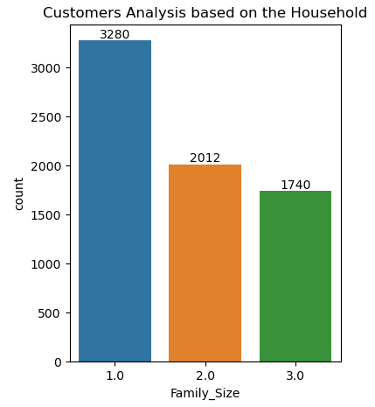
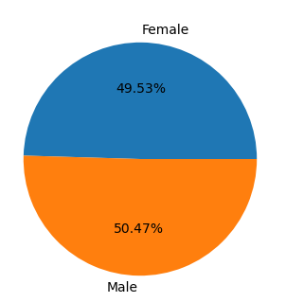
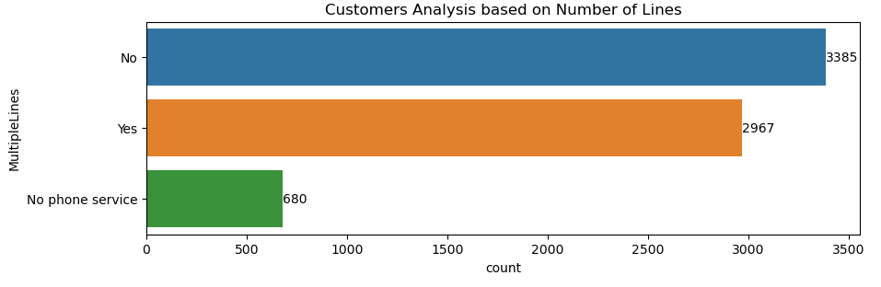
Univariate Analysis
6. EDA and Feature Engineering

Slide 9
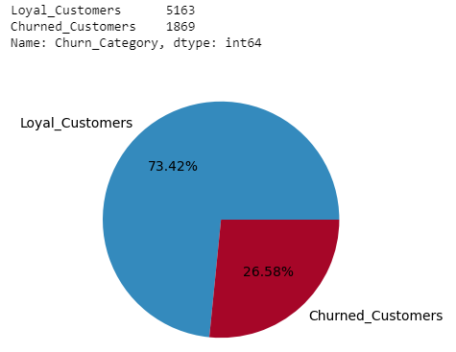
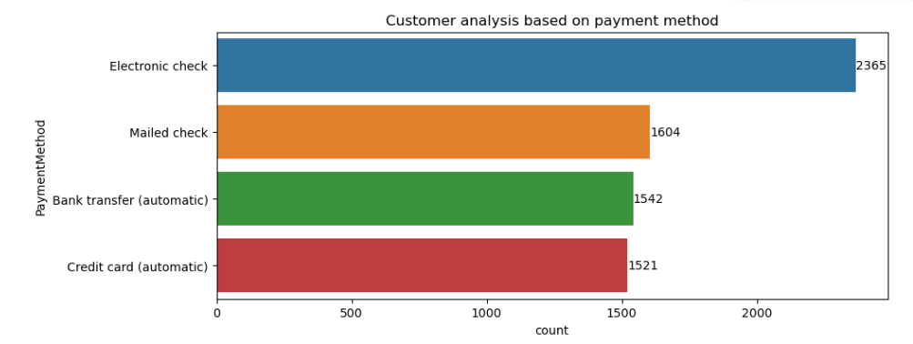
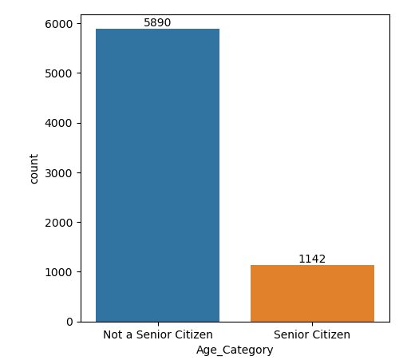
Univariate Analysis Cont’d

Slide 10
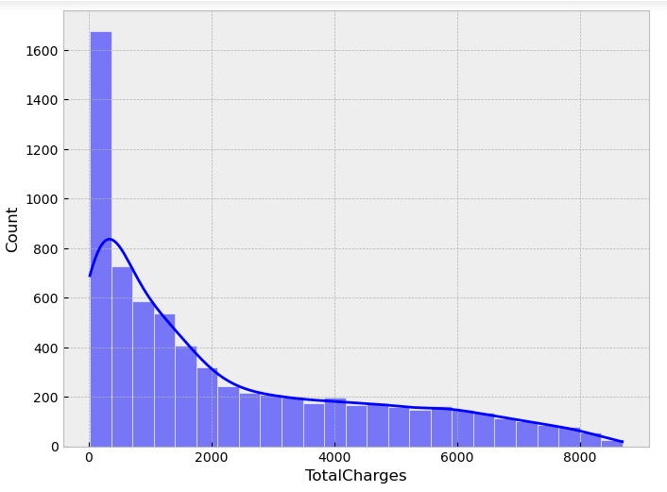
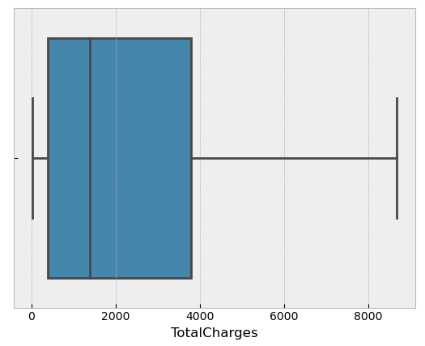
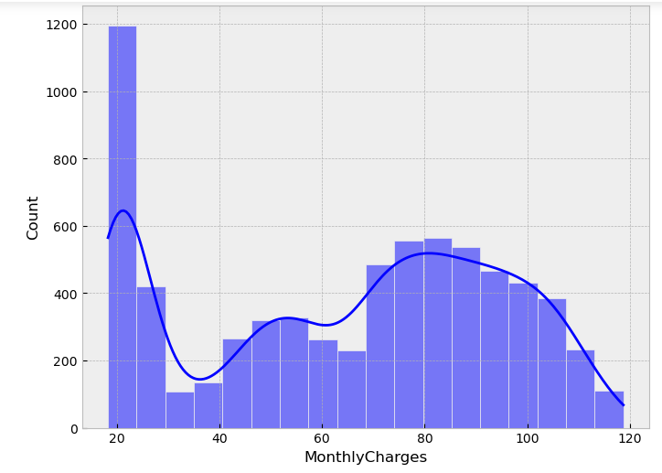
Numerical Data Visualization

Slide 11
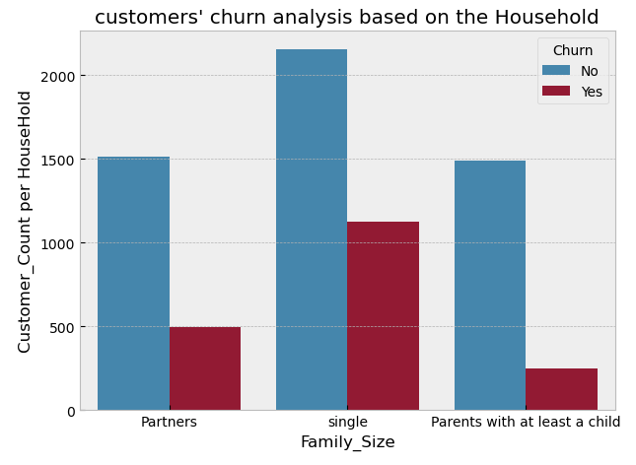
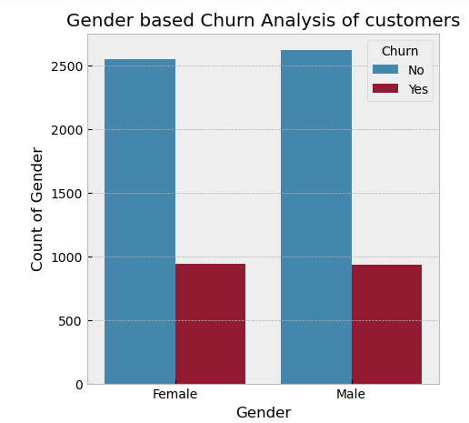
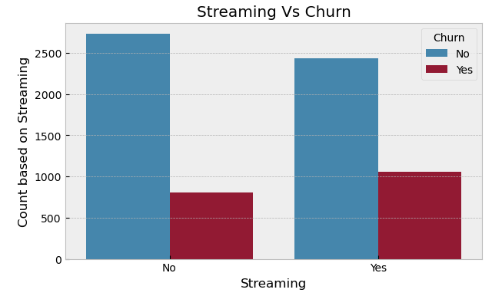
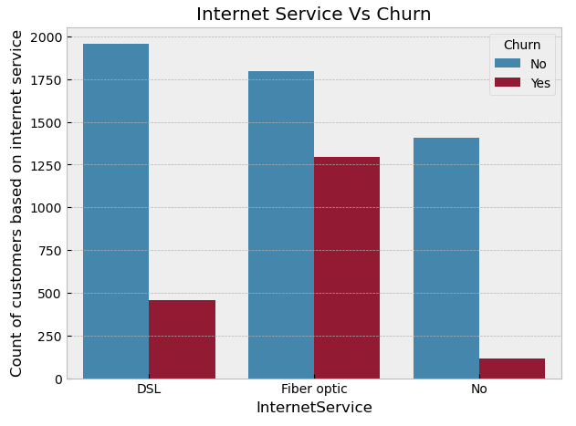
Bivariate Analysis Visualizations

Slide 12

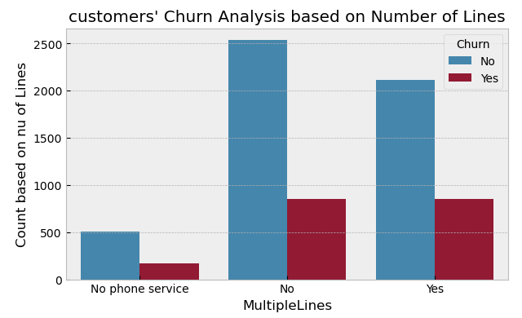
Bivariate Analysis Visualization Cont’d

Slide 13
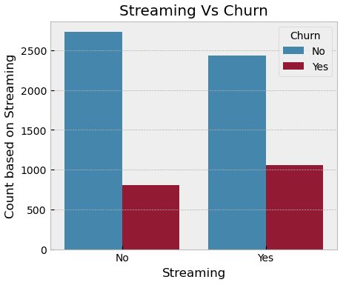
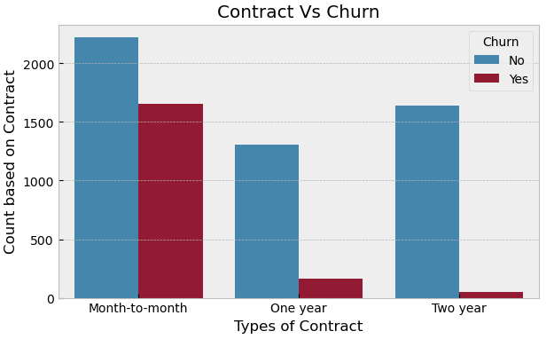
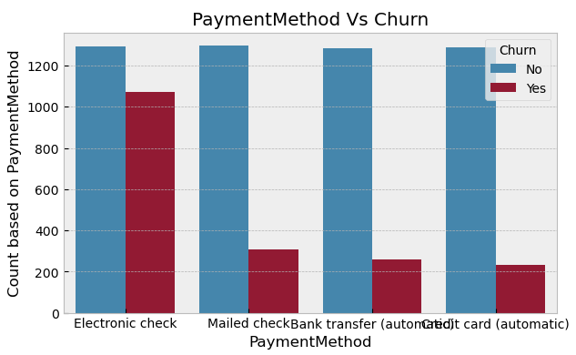
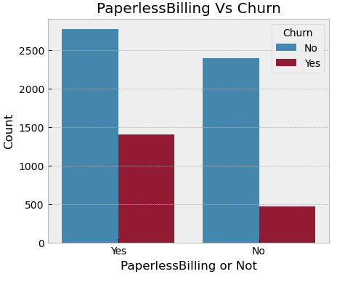
Bivariate Analysis Visualization Cont’d

Slide 14
7. Machine Learning Report
logistic Regression
Random Forest Model
Support vector Classifier (SVM)
XGBOOST Classifier
Ensembles Classifier

Slide 15
Analysis and selection of Model
Since our target data is an imbalance data (the two unique classifications of "churned" and yet to "churn" customers are not equally distributed, loyal customers are in the overwhelming majority), using accuracy or precision as our metrics that determine the performance and hence the choice our model would be misleading.
The more appropriate metrics to consider in this case are F1_Score and ROC_AUC. They are often considered more appropriate metrics for evaluating models on imbalanced datasets because they take into account both the true positive rate (sensitivity) and the true negative rate (specificity), providing a more balanced view of model performance.
going by the above: the logistic regression model outperformed all other models that were tested in this ML project, including the ensemble.
Hence, the logistic regression model is the model of choice for this particular project.

Slide 16
1
​
IMPROVEMENT DUE TO HYPER PARAMETE TUNING
After the hyper parameter tuning, there is a marginal mprovement in the performance of our model in terms of F1_score and ROC-AUC.
Before hyper-parameter tuning:
F1-Score: 0.5557206537890045
ROC-AUC: 0.6957889641819943
After the hyper-parameter tuning:
F1-Score: 0.5763195435092725
ROC-AUC: 0.7095500877460903
F1-score = 55.57% ====> 57.63%
ROC-AUC: 69.58% ====> 70.96%

Slide 17
Confusion Metrics Log-Reg B4 & After Hyper-parameter tuning
Comparing the confusion matrices of the pre and the post-hyperparameter tuning,
the improvement due to hyper-parameter tuning is manifested in the increase in
the number of True Positives from 187 (logistic regression) to 202 after the tuning of the Logistic Regression
identifying more of the customers that are likely to churn and proactively preventing them from churning is the main goal of this project.
We can also see a reduction in the false negative from 187 to 172. This is in line with our objective
 | Logistic Regression b4 tuning | Log-Reg After Tuning
True Positive | 187 | 202
True Negative | 921 | 908
False Positive | 112 | 125
False Negative | 187 | 202

Slide 18
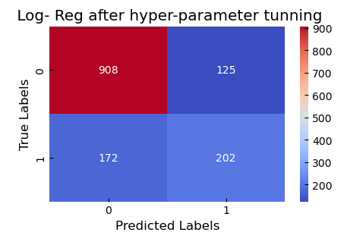
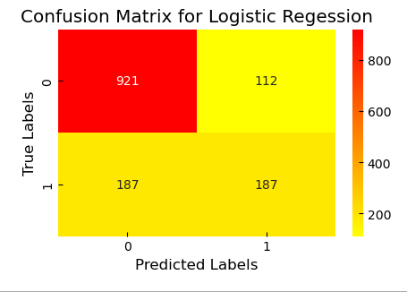
The effect of Hyper-parameter tuning

Slide 19
Effect of Hyperparameter Tuning
After the hyperparameter tuning, there is a marginal improvement in the
performance of our model in terms of F1_score and ROC-AUC.
Before hyper-parameter tuning:
F1-Score: 0.5557206537890045
ROC-AUC: 0.6957889641819943
After the hyper-parameter tuning:
F1-Score: 0.5763195435092725
ROC-AUC: 0.7095500877460903
F1-score = 55.57% ====> 57.63%
ROC-AUC: 69.58% ====> 70.96%

Slide 20
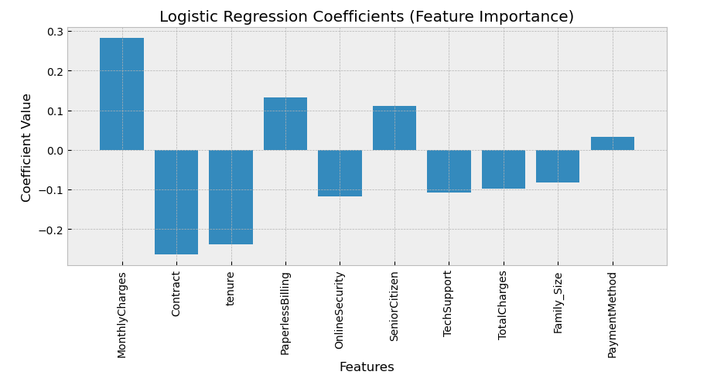
FEATURE IMPORTANCE

Slide 21
RECOMMENDATIONS
1- Since it was evident that short-contract customers(1 month) are the most prone to churn, Connecttel might want to incentivize longer duration contracts- 1 year, 2 years and even introduce longer ones like 3 years with mouth-watering incentives
2- Offer more incentives and packages that will attract more household customers as evidence has shown that households are more likely to stay with the company than single customers
3- The company might want to do something to upscale its quality of fiber optic service urgently as more of those subscribed to this service have churned than other services
4- The electronic check payment method customers recorded the highest churn. The company might want to zoom in and investigate this unhealthy exodus peculiar to this group of customers to remedy the negative trend
5- Connecttel might want to introduce more lower-price subscription packages as lower-priced subscriptions have more customers. 2ndly, fewer of these are likely to churn than the higher-priced subscription customers

Slide 22

THE END
Thank You for Listening

