Slide 1
b
0
1
2
3
4
A
0
1
1
c
2
2
3
7
3
3
0
block1
1
1
0
4
2
2
X
3
5
block2
3
X
0
N+1
Nmax
Nmax
Jc
Ir
Pr

Slide 3
a
b
cs
Thread1
c1
a1
a2
.....
×
b1
b2
.....
.....
Block
c2
×
Thread2
sum_1
cn
×
Threadn
Thread1
c1
×
Block
Thread2
c2
Result
×
sum_2
cn
×
Threadn
×
ck
Block
Threadk
...
sum_n
×

Slide 4
b
c
A
a1
a2
a3
a4
a5
a6
a7
........
block1
block2
block3
block4
block5
block6
block7
......
c1
X
c2
c3
c4
c5
c6
c7
...

Slide 6
b
0
1
2
3
4
A
0
1
1
c
2
2
3
7
3
3
0
BLOCK1
1
1
0
4
2
X
3
2
5
BLOCK2
3
X
0
N+1
Jc
Nmax
Nmax
Pr
Ir

Slide 7
Dreieckförmige Summation
0 | 1 | 2 | 3 | 4 | 5 | 6 | 7
Iterationsschritte
0 | 1 | 2 | 3 | 4 | 5 | 6 | 7
0 | 1 | 2 | 3 | 4 | 5 | 6 | 7

Slide 9
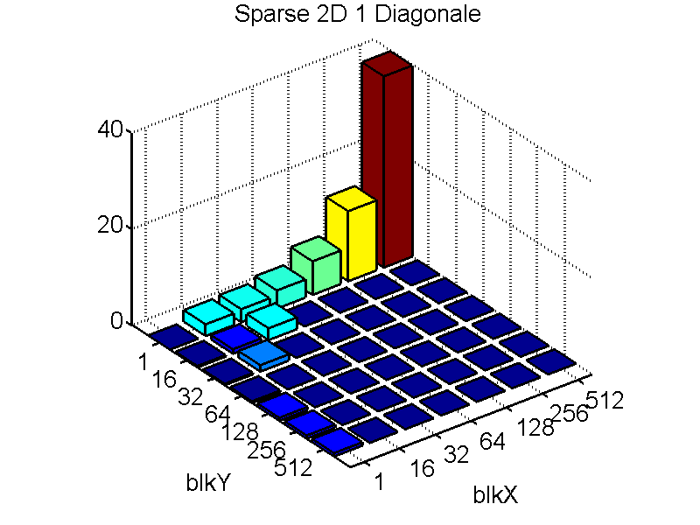
BlkY\BlkX | 1 | 16 | 32 | 64 | 128 | 256 | 512
1 |  | 2.41 | 2.714 | 3.77 | 6.98 | 14.56 | 39.76
16 | 0.3 | 0.93 | 2.45
32 | 0.3 | 1.33
64 | 0.36
128 | 0.65
256 | 0.67
512 | 0.71
(ms)
Matrix:
100000x100000
1 Diagonale
GPU:GTX260
Grid size:1024

Slide 10
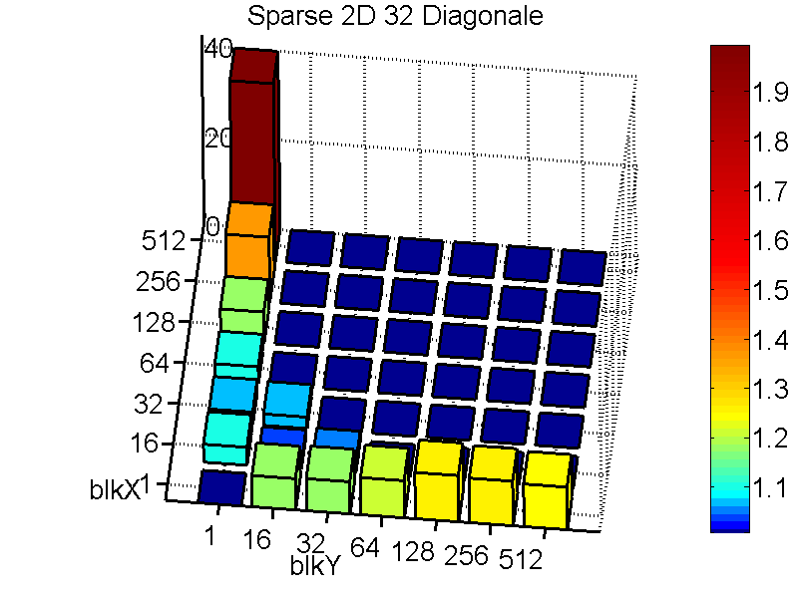
BlkY\BlkX | 1 | 16 | 32 | 64 | 128 | 256 | 512
1 |  | 4.013 | 2.7824 | 3.8195 | 6.96 | 14.572 | 39.82
16 | 7.0009 | 1.52 | 2.56
32 | 7.19 | 2.11
64 | 8.3125
128 | 10.354
256 | 9.97
512 | 9.54
Matrix:
100000x100000
32 Diagonale
GPU:GTX260
Grid size:1024

Slide 11
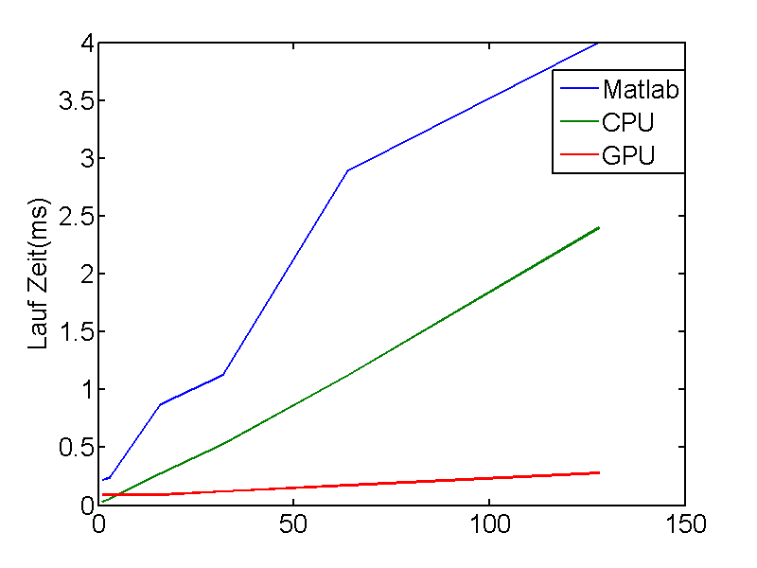
Matrix:5000x5000
Quad CPU: Q6700@2.66GHZ
RAM:3.25GB
GPU:GTX260
Grid size:1024
Block size: 16x16
Matlab version: 2009b
Diagonale | 1 | 3 | 16 | 32 | 64 | 128
matlab | 0.219 | 0.241 | 0.878 | 1.129 | 2.898 | 4
CPU | 0.0355 | 0.059 | 0.2789 | 0.5348 | 1.126 | 2.399
GPU | 0.0917 | 0.091 | 0.0932 | 0.1191 | 0.1739 | 0.2805

Slide 12
(ms)
Matrix:
100000x100000
1 Diagonale
GPU:GTX260
Grid size:1024
BlkY\BlkX
1
16
32
64
128
256
512
1
2.41
2.714
3.77
6.98
14.56
39.8
16
0.3
0.93
2.45
32
0.3
1.33
64
0.36
128
0.65
256
0.67
512
0.71

Slide 13
BlkY\BlkX | 1 | 16 | 32 | 64 | 128 | 256 | 512
1 |  | 4.013 | 2.7824 | 3.8195 | 6.96 | 14.572 | 39.82
16 | 7.0009 | 1.52 | 2.56
32 | 7.19 | 2.11
64 | 8.3125
128 | 10.354
256 | 9.97
512 | 9.54
Matrix:
100000x100000
32 Diagonale
GPU:GTX260
Grid size:1024

Slide 15
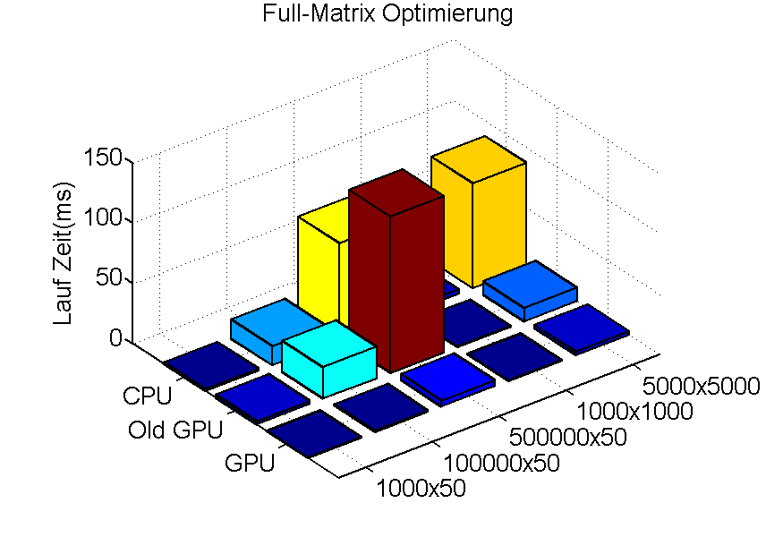
Quad CPU:
Q6700@2.66GHZ
RAM:3.25GB
GPU:GTX260
Grid size:1024
Block size: 8x64
M x N | 1000 x50 | 100000 x50 | 500000 x50 | 1000 x1000 | 5000 x5000
CPU | 1.56 | 15.94 | 80 | 3.44 | 87.19
Old GPU | 2.669 | 26.059 | 130.038 | 0.564 | 11.216
GPU | 0.207 | 1.056 | 4.963 | 0.176 | 2.998

