Slide 1
b
0
1
2
3
4
A
0
1
1
c
2
2
3
7
3
3
0
BLOCK1
1
1
0
4
2
2
X
3
5
BLOCK2
3
X
0
N+1
Jc
Nmax
Nmax
Pr
Ir

Slide 2
b
0
1
2
3
4
A
0
1
1
c
2
2
3
7
3
3
0
BLOCK1
1
1
0
4
2
X
3
2
5
BLOCK2
3
X
0
N+1
Jc
Nmax
Nmax
Pr
Ir

Slide 3
Dreieckförmige Summation
0 | 1 | 2 | 3 | 4 | 5 | 6 | 7
Iterationsschritte
0 | 1 | 2 | 3 | 4 | 5 | 6 | 7
0 | 1 | 2 | 3 | 4 | 5 | 6 | 7

Slide 4
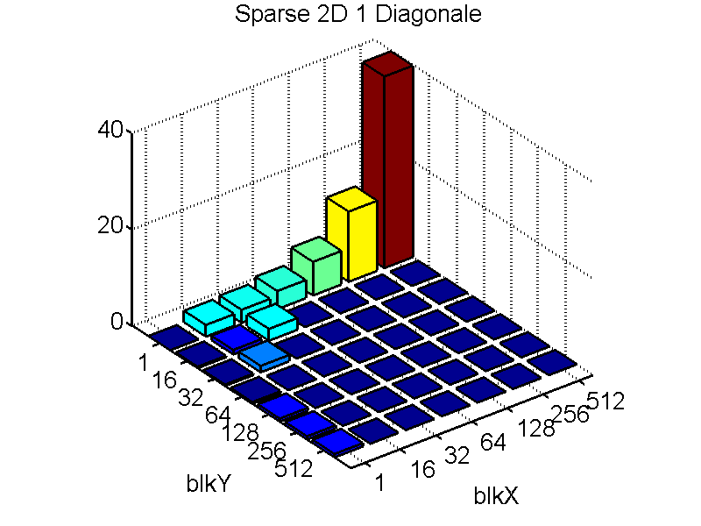
(ms)
Matrix:
100000x100000
1 Diagonale
GPU:GTX260
Grid size:1024
BlkY\BlkX
1
16
32
64
128
256
512
1
2.41
2.714
3.77
6.98
14.56
39.8
16
0.3
0.93
2.45
32
0.3
1.33
64
0.36
128
0.65
256
0.67
512
0.71

