Slide 1
BEFORE SESSION
Make sure all students
  Have ACCESS account (pass + username)
  Have a GitHub account
  Using their own computers have PuTTY

Slide 2
Introduction to
High Performance Computing
& EXPANSE
Katy Boot & Qianqian Liu
Cyberinfrastructure Training 2024

Slide 3
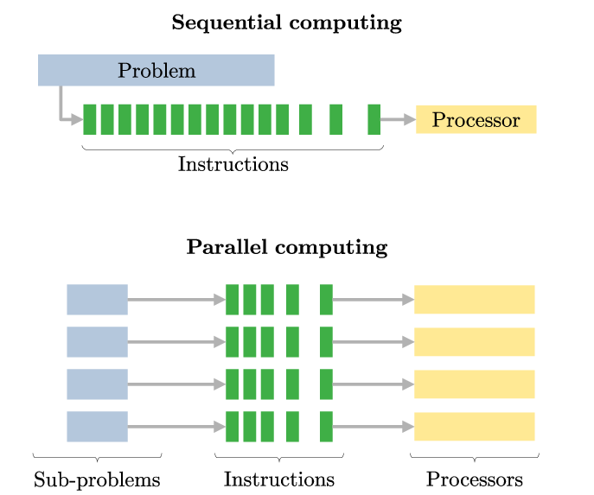
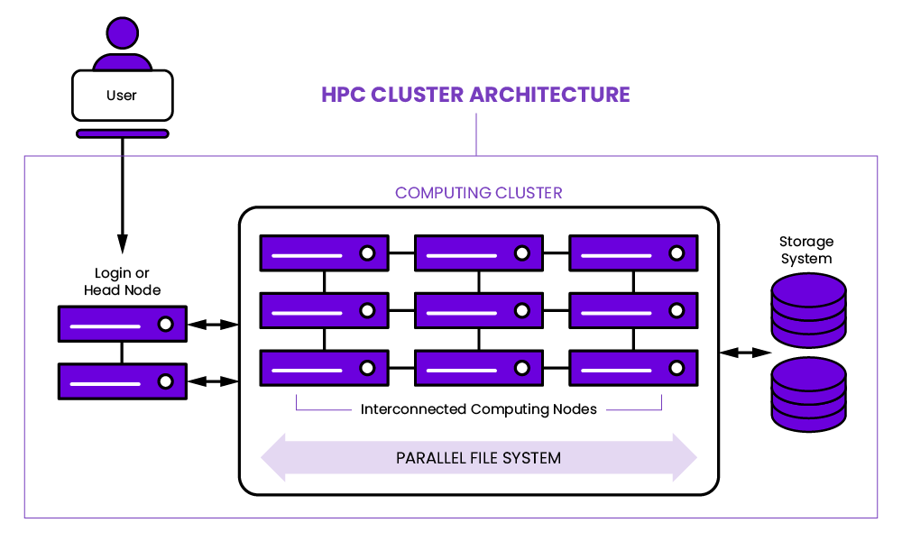
What is High Performance Computing (HPC)?
Notes:
In sequential computing, operations are performed in order one at a time - Solves problems principally by dividing the workload into tasks, and then executing them in sequence on one processor—serial computing.
In parallel computing, the program is broken into smaller steps, some of which are performed at the same time.
HPC:
Computing clusters (multiple high-speed computer servers, called nodes, networked together. Just one HPC cluster may include over 100,000 nodes.)
parallel computing (multiple computers breaking down individual tasks to work together simultaneously)
high-performance resources and components.

Slide 4

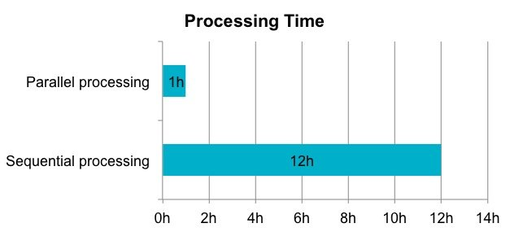
What is Expanse HPC?
Advanced Cyberinfrastructure Coordination Ecosystem: Services and Support (ACCESS)
NSF-funded San Diego Supercomputer Center (SDSC)
***Process data and perform complex calculations at high(er) speeds***
Notes:
Expanse is a user portal for the San Diego Supercomputer Center
Command line: Use the hostname login.expanse.sdsc.edu
Web-based access: Use the Expanse User Portal
Two-factor authentication: Use Google Authenticator

Slide 5
Expanse Help
Google: SDSC Expanse User Guide
https://www.sdsc.edu/support/user_guides/expanse.html
https://www.sdsc.edu/services/hpc/expanse/index.html
** Every HPC system has a user guide!**
** Also a variety of educational videos & seminars **

Slide 6
1. Access EXPANSE (Windows)
Open the PuTTY Application
Input host name ---> $USERNAME@login.expanse.sdsc.edu
Port --> 22
Select Connection Type --> SSH
Optional: Enter a name for your connection ‘EXPANSE Login’ and Save for fast login later (‘Load’ the correct saved connection and ‘Open’ to avoid inputting every time)
Click Open --> window should open and request password --> enter ‘Password’
***Use the password for your ACCESS account***

Slide 7
1. Access EXPANSE (MacBook Terminal)
Open the Terminal Application
Input host name ---> $ ssh $USERNAME@login.expanse.sdsc.edu
Optional: Add an alias shortcut to your shell (zsh/bash)
Password Request --> enter ‘Password’
***Use the password of your ACCESS account***
Notes:
a shell is a command-line interpreter that processes commands

Slide 8
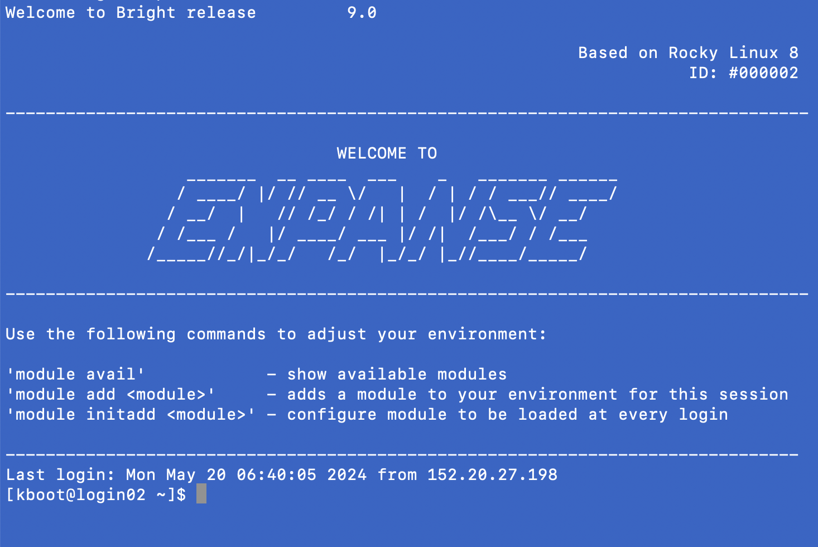
EXPANSE Login Screen
Useful Module Suggestions
Command Line
(login node)
Uploading data,
Managing files,
Compiling software,
Editing scripts,
Checking on or managing jobs
Notes:
"Compute" nodes are for actually running the program. Any process that uses a significant amount of compute or memory resources must be run on a compute node.

Slide 9

2. EXPANSE Directories -- HOME
HOME directory (/home/$USERNAME/)
Automatic location after login
Should be used only for source code, environment and module storage.
Limited in space (100GB)
Jobs should NEVER be run from the home file system; it is not set up for high performance computing.
Print Working Directory
$ pwd
$ ls

Slide 10
2. EXPANSE Directories - PROJECT
2. PROJECTS directory (/expanse/lustre/project)
Project space will be purged 90 days after allocation expires.
Store & access longer-term project data files, code, GitHub Repositories, model & code outputs, etc.
Navigate to ‘Projects’ directory:
$ cd /expanse/lustre/projects/unc107/$USERNAME
Practice checking current directory
$ pwd
Check contents of directory
$ ls
$ ls -la
Notes:
SDSC Expanse Lustre file system --> Projects & Scratch File Systems
NOT an archival file system and IS NOT backed up

Slide 11
2. EXPANSE Directories - SCRATCH
Navigate to ‘Projects’ directory:
$ cd /expanse/lustre/scratch/$USERNAME
Practice checking current directory
$ pwd
Check contents of directory
$ ls
$ ls -la
3. SCRATCH directory (/expanse/lustre/scratch/$USERNAME/temp_project)
Scratch files will be purged 90 days from creation date.
  Create a shell script to “touch” files and prevent purge
  Move outputs to ‘Projects’ directory
File storage limit --> 2 million files per user.

Slide 12
2. EXPANSE Directories - SCRATCH
3. SCRATCH directory (/expanse/lustre/scratch/$USERNAME/temp_project)
Use this directory to run jobs - run times can be extended to one week.
Request interactive compute-node to open and run an application (Python, Matlab, etc.) and test code live (30 mins)
Set up a job-request shell script (ie run.sh) to run code in sequence for a particular job through SLURM Workload Manager

Slide 13
3. EXPANSE – SCRATCH Directory ‘Jobs’
Request interactive compute-node to open and run an application (Python, Matlab, etc.)
$ srun --partition=debug --pty --account=unc108 --nodes=1 --ntasks-per-node=4 --mem=32G -t 00:30:00 --wait=0 --export=ALL /bin/bash
$ source ~/.bashrc
$ module load cpu/0.15.4
$ module load intel/19.1.1.217
$ module load intel-mpi/2019.8.254
$ module load anaconda3/2020.11
$ ipython Sensitivity_NOAA_Sept.py; ipython Sensitivity_NRE.py
1. Request compute-node allocation
(30 min max for live compute node)
Pending --> Run Job
2. Load modules for run
3. Activate program (ipython) and run code files
consecutively
Notes:
** Shared-node jobs (more than one job on a single node)
improves job throughput
provides higher overall system utilization, and
allows more users to run on Expanse
shorter job-request wait time

Slide 14
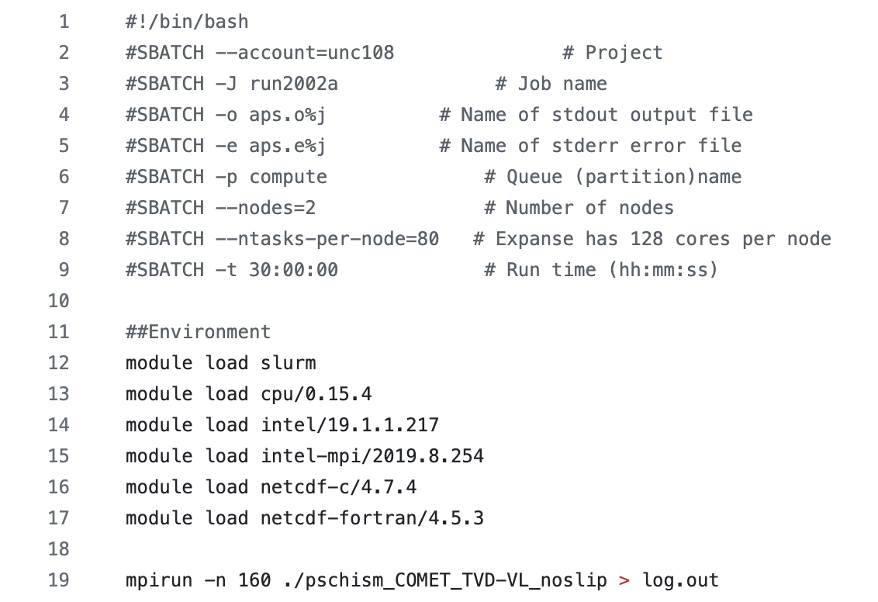
3. EXPANSE – SCRATCH Directory ‘Jobs’
1. Request allocation (Pending --> Run Job)
2. Load modules for run
3. Activate and run code
Set up a job-request batch script (ie run.sh) to run code in sequence for a particular job through SLURM Workload Manager.
Import codes & files to directory
Build & customize your shell script
Run shell script
$ ./run.sh
Notes:
Please note: every HPC has a different language or method for submitting job-requests for parallel-node computation depending on the job manager software that is employed by the HPC cluster.
SLURM Workload Manager
Portable Batch System (PBS) Works
Adaptive Computing
UNIVA Grid Engine
Open Grid Scheduler

Slide 15
4. EXPANSE Modules
Environment Modules --> dynamic, personalized modification of your shell (or working) environment
Module commands set, change, or delete environment variables, for a particular application.
Choose between different versions of the same software or different combinations of related codes.

Slide 16
4. EXPANSE Modules
Look at the modules available
$ module avail
You can use "module load" to load python.
$ module load python3
Module command set, change or delete environment variables. They let the users choose between different versions of the same software. Use the command below to check all versions of python available.
‘spider’ command gives more information for loading a particular module
$module spider python

Slide 17
5. File transfer to/from EXPANSE
GitHub
Pros – ideal to preserve code & files against purge
Cons – sometimes issue push/pulling with EXPANSE
Globus
Pros – Recommended file-transfer system by ACCESS/EXPANSE managers
Cons – Connectivity issues & complex setup (time-consuming)
Other options include:
FileZilla – alternative to Globus
$ scp to/from a local device (ie pull from Expanse using local)
scp -r [$USERNAME@login.expanse.sdsc.edu:/expanse/lustre/projects/] [local/directory/path]

Slide 18
Introduction to GitHub
Katy Boot & Qianqian Liu
Cyberinfrastructure Training 2024

Slide 19
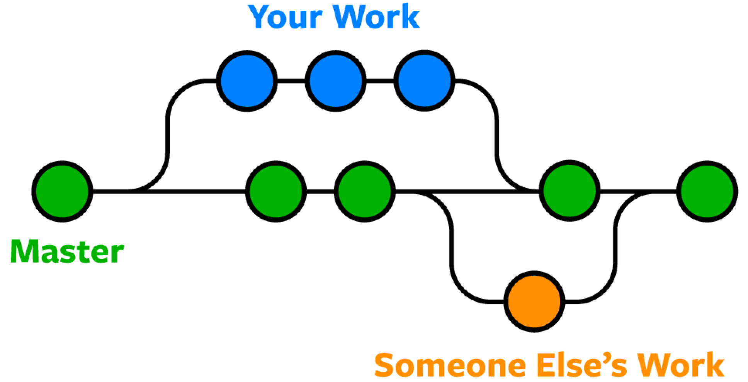
What is GitHub?
R & RStudio
.Rdata – R formatted data
.rmd - R Markdown
.r – R code
Matlab
.mat - MATLAB formatted data
.m – functions/code
.mlx – livescript
Python
.py – functions/code
.ipynb – Interactive Python Notebook
Data Storage
.nc – NetCDF
.txt – Text File
.csv – Spreadsheet
Code
Documents
Data
File storage
Figures
Etc.
Cloud-based, open-source platform
Store, share, and write ANY code and data
Project collaboration
Limited file storage & transfer limits
  2 GB max file size storage
  50 MiB max transfer limit
Project Repository Version Control

Slide 20
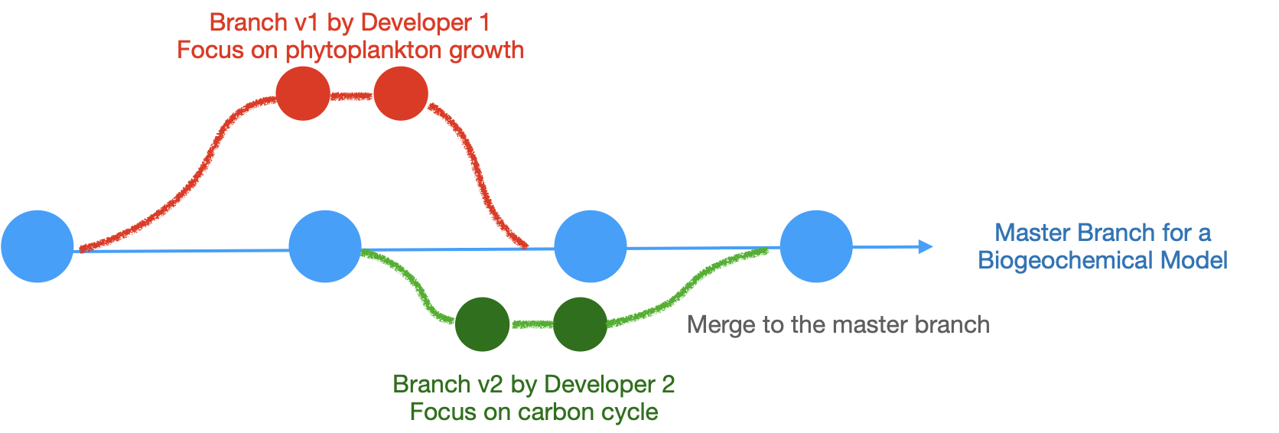
What are the benefits?
  Track and manage file changes over time
  Branch projects and utilize version control for files
  Share project updates
  Clone & Customize completed projects (ie Zhengui’s Pylib Library)
  Collaborate on a project, allowing individual and integrative file changes

Slide 21
1. Create a GitHub account
https://github.com/
2. Available Resources
Basic GitHub: https://docs.github.com/en
HPC + GitHub: https://github.com/sdsc-hpc-training-org/basic_skills
When in doubt? Google it… (Stack Overflow)
Chat GPT, CoPilot, & AI resources
– not very useful for structure management
(but good for coding typos)

Slide 22
3. GitHub: Create a Repository & Initial Setup
Create a Repository in browser “CI_2024”
README.md, VI Code (in browser & application paired w/ CoPilot)
  Create CodeSpace
  Manually create a branch
  Tab Walkthrough
Create Access Tokens for local repositories (ie laptop, EXPANSE, etc.)
settings --> developer settings --> personal access tokens --> Tokens (classic)
Copy the token, you will not be able to find it through the page again.
Notes:
Issues can be used to keep track of bugs, enhancements, or other requests (also read-only access)
Actions provides a delivery platform to automate your build, test, and deployment pipeline.
Projects tables give you a live canvas to filter, sort, and group issues and pull requests
Wikis provide a place in your repository to lay out the roadmap of your project, show the current status, and document software better, together.

Slide 23
Optional: Automatic Token/Login Credential Entry
Create Access Tokens for local repositories (ie laptop, EXPANSE, etc.)
settings --> developer settings --> personal access tokens --> Tokens (classic)
Copy the token from the token creation page, you will not be able to find it through the page again.
Save your login credentials to Expanse
$ cat ~/.netrc --> should be empty
$ vi ~/.netrc --> open your shell access
machine github.com login <login-id> password <token-password>
Then in the future, you don't need to input the token every time when using git.
** You can also make this modification on your local device, not just HPC Resources **
Notes:
netrc is a hidden file in a user's home directory and must be owned either by the user executing the command or by the root user.
a shell is a command-line interpreter that processes commands

Slide 24
4. Code-Along Tutorial:
Cloning a repository to EXPANSE
** Linux quick-guide
https://www.macs.hw.ac.uk/~hwloidl/Courses/LinuxIntro/linux-quickref.pdf
pwd - print working directory path
ls - show contents of a directory
ls –la - to display more information, file size, etc.
cd <path> - change directory
** Navigate to your PROJECTS directory **
$ cd /expanse/lustre/projects/unc107/$USERNAME
Clone your GitHub repository to the PROJECTS directory
git clone [repository address copied from browser]

Slide 25
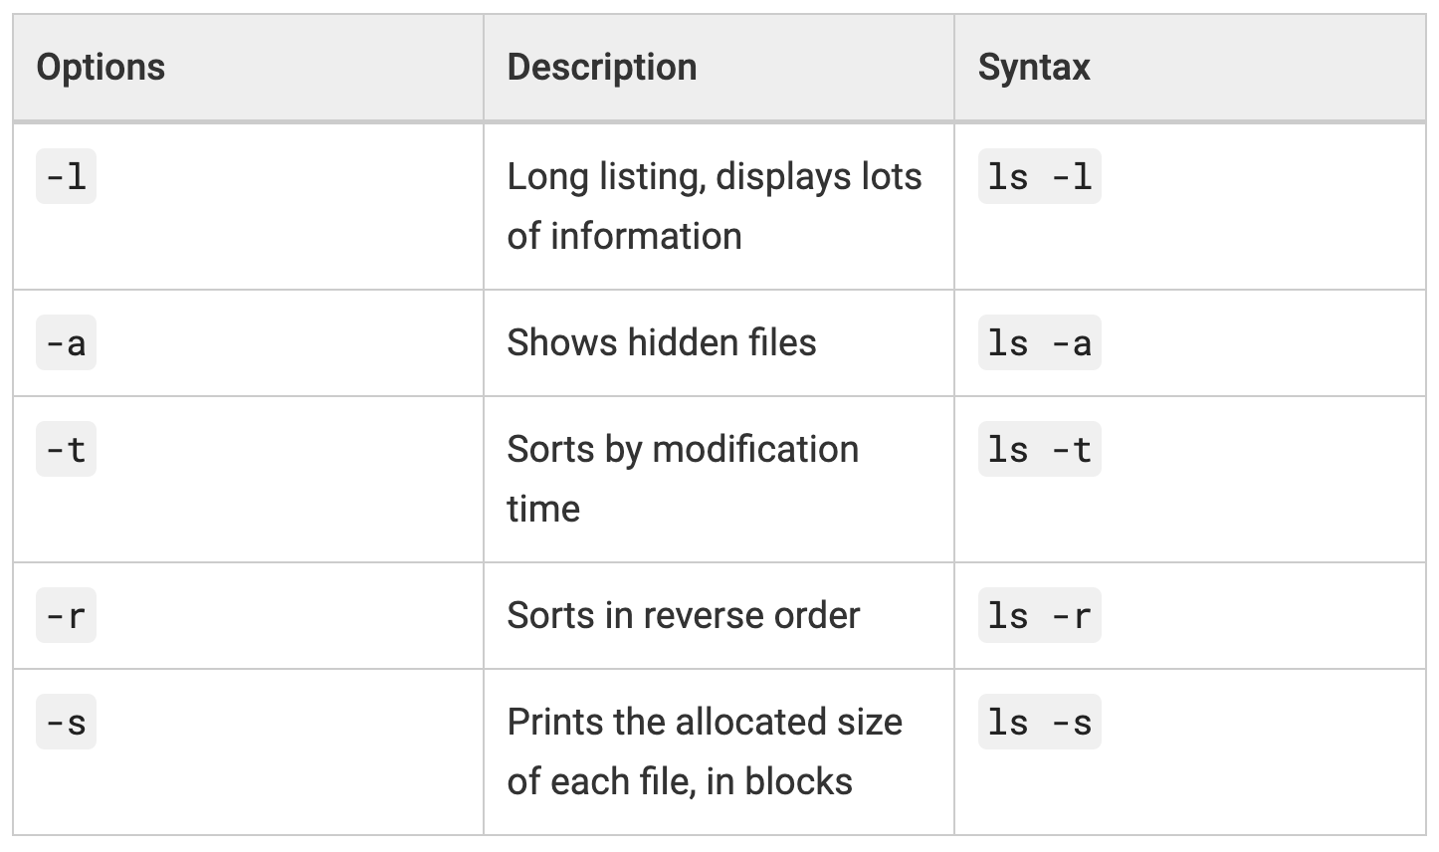
4. Code-Along Continued: File Editing
2. Make a directory ‘ci_files’
mkdir [directoryname]
3. Make a file in your directory, open the file and edit by adding a line (write ; quit)
nano [filename] – create a new file (follow prompts)
vi [filename] – open the vi editor to modify a file (used for text file, code, etc.)
4. Display the contents of your file
cat [filename]
5. Duplicate the file
cp [filename] [new_filename]
scp – copy a directory or file across systems
Notes:
Windows uses its own operating system, while macOS uses Linux.
Windows is a graphical user interface (GUI) based operating system developed by Microsoft.
macOS is based on Unix, along with Ubuntu Linux.
Windows 10 is written by Microsoft and runs on their kernel, the Windows NT kernel.
Linux is written in C, with many userland apps written in Python.

Slide 26
4. Code-Along Continued: Permissions
6. Check file permissions access
ls –l
7. Edit file permissions if needed ( +rxw --> add read/edit/write)
chmod +rxw [filename.py]
** Trouble sharing a file or project? -->
Always check user permission access to directories and files **
** You can also explore editing GitHub repository permissions (private vs public)
Some other useful Linux commands:
mv <directory_path> <destination_path>
rm - remove (BE CAREFUL, no undo or trash folder unless specified)
rmdir – remove a directory (may need –r or –f modifier for contents)
rmdir - rf [directory name] – remove a directory
Notes:
Windows uses its own operating system, while macOS uses Linux.
Windows is a graphical user interface (GUI) based operating system developed by Microsoft.
macOS is based on Unix, along with Ubuntu Linux.
Windows 10 is written by Microsoft and runs on their kernel, the Windows NT kernel.
Linux is written in C, with many userland apps written in Python.

Slide 27
4. Code-Along Continued: Add and Commit Local Changes to Remote Repository
8. Check your working branch – should be “main” branch right now
git branch
9. Add your changes to the branch - This step allows you to choose what you are going to commit (see https://git-scm.com/docs/git-add and https://github.com/git-guides/git-add for more information)
git add . --> add all files in the current directory
git add [filename] --> add a particular file
7. Commit your changes and add comment. This is like a snapshot of your repository at a specific time.
git commit –m “commit comment here”
Notes:
git merge --squash <local directory>
Alternative to git add, assuming you’ve checked out to the main directory
Git add
selects that file, and moves it to the staging area, marking it for inclusion in the next commit. You can select all files, a directory, specific files, or even specific parts of a file for staging and commit.

Slide 28
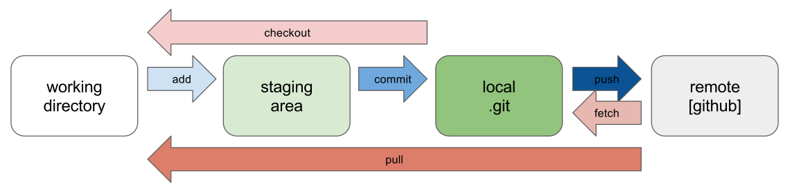
4. Code-Along Continued: Push to Remote Repository (cloud)
8. Push your commit from your local repository to the remote repository (GitHub Cloud)
git push
9. Use Login credentials and Access Token if needed
Typical GitHub Workflow

Slide 29
5. GitHub: Cloning vs Forking vs Branching
Cloning: downloads a repository for local development
Forking: independent copy of an original repository
Branching: parallel development within the same repository
Main project --> multiple collaborators & components (branches)
Requires communication & coordination for branch management
Repository Home Page --> Settings --> Collaborators --> Add People
** Collaborators need to accept invitation
** Collaborators have read/write/edit access to your Repository
Notes:
Forking creates an independent copy of a project, branching allows for parallel development within the same repository, and cloning downloads a repository to your local machine for local development.

Slide 30
5. GitHub: Branch Management & Collaboration
Remote Origin (GitHub Cloud) --> browser-display repository
  Main Branch
  Sub-branches
Local Repository Clone (your device or Expanse account)
  Cloned Main Branch, aka the Local Main Branch
  Local-only Branches ( can be shared to the remote origin if needed)
More information/branch walkthrough: https://www.varonis.com/blog/git-branching
Notes:
branching allows for parallel development within the same repository

Slide 31
Branch Workflow Options
Local-only branch
Sub-project branch
Version control for a final project (ie: Pylib versions)
Pull to LOCAL
Edit
Add changes
Commit changes to branch
Push to
REMOTE

Slide 32
6. Code-Along – Branch Management
Check available branches
git branch --list
2. Create a new LOCAL branch
git branch <branch name> --> creation only
git branch
git push origin <branch name> --> push branch to REMOTE (optional)
3. Switch to the new branch to make changes
git switch <branch name>
4. Make changes to the local branch
mkdir <directory name>
cd <directory name>
vi <filename> --> edit this file (“i” to insert, “esc” to stop editing)
Notes:
The two commands are somewhat interchangeable. git switch is recommended for branch operations due to improved safety checks, while git checkout is a more robust and versatile tool for file and commit operations
Git checkout switches to the branch you want to merge into

Slide 33
6. GitHub Code-Along – Branch Management
5. Select the changes to merge with the main branch
git add <directory name>
git commit –m “update new directory”
6. Merge from local branch to the local main branch (aka a fast-forward merge)
Select the LOCAL branch to merge final updates into
git checkout main
Merge changes from the edited branch to the main branch
git merge <local branch name> --> LOCAL merge

Slide 34
6. GitHub Code-Along – Branch Management
7. Push the LOCAL main branch to the REMOTE main branch (final project update)
Set the “upstream origin” branch (typically only needs to be done once per branch) from LOCAL repository to the REMOTE git repository (this is already true for main branch) so that “pushing” the branch contents sends them to the remote GitHub cloud, otherwise they will only be stored on your local device or account.
git push --set-upstream origin <branch name>
Push general branch updates
git push
*** Check browser GitHub to verify push ***
Notes:
Windows uses its own operating system, while macOS uses Linux.
Windows is a graphical user interface (GUI) based operating system developed by Microsoft.
macOS is based on Unix, along with Ubuntu Linux.
Windows 10 is written by Microsoft and runs on their kernel, the Windows NT kernel.
Linux is written in C, with many userland apps written in Python.

Slide 35
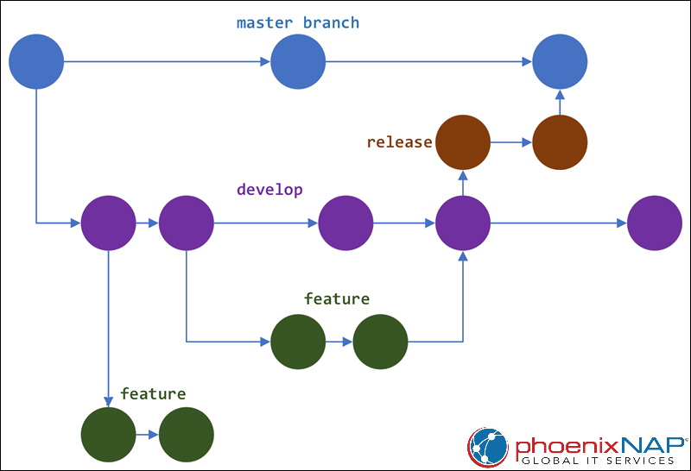
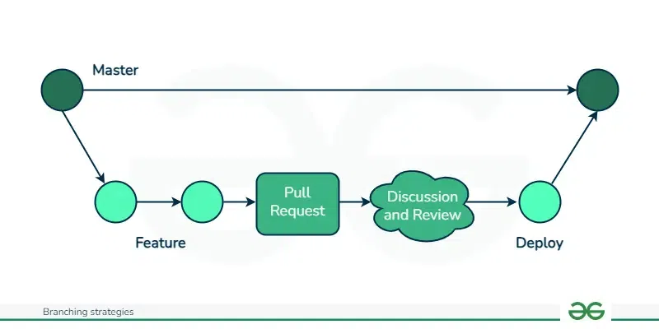
Branch Workflow Strategies – https://www.geeksforgeeks.org/branching-strategies-in-git/ https://phoenixnap.com/kb/git-branching-strategy
GitFlow Method
GitHub Flow
Pull to LOCAL
Edit
Add changes
Commit changes to branch
Push to
REMOTE
Trunk-based Development
General Workflow

Slide 36
Other useful git commands
See LOCAL commit/push history
git log
Retrieve a branch from REMOTE repository (cloning only brings the ”main” branch over)
git pull origin <remote branch name> --> pull from REMOTE
Delete a branch
git branch --delete <branch name> --> LOCAL
git push origin --delete <branch_name> --> REMOTE
https://git-scm.com/docs

Slide 37
Branch Example 1: local branch --> local main --> remote main
In your local branch:
$git add *
$git commit -m "add updates"
After a while of coding, you decide to merge the local branch ‘v0523’ to the local main branch:
$git checkout main
$git merge v0523
Push the LOCAL main branch to the REMOTE main branch
$git push origin main

Slide 38
Example 2:
Bring a local folder to a remote git repository
First, create a new repository called 2024_CI_clustering on GitHub and copy the repository SSH address
>> git init # initialize the local directory as a Git repository
>> git add . # add all files
>> git commit -m "bring on the code"
>> git remote add citraining <repository address/website address>
>>git push citraining

Slide 39
6. Code-Along Tutorial:
Troubleshooting – version control, pushing updates, branches
Version revert using GitHub
Look at your commit history and revert to a previous branch
git log
git revert {commit_id} --> revert a commit
git revert -m 1 <merge-commit-hash> --> revert a merge
Merge error between collaborators? – communication first, then detailed review using browser, VSCode, GitHub Desktop
Worst case scenario – save your files outside the folder, then delete and re-clone (manual file sorting)

Slide 40
Interactive 10-20 mins
Create a repository w/ ‘main’ branch
Add people in your row as collaborators to the repository
One person makes a new .ipynb (or .py) file on the desktop and save to the repository
Each student clones the repository to your local device
Create a .py file (or .ipynb?) – print(‘Hello World’) --> each student pulls the branch, adds a line to the code to the file (git add, commit), and pushes back to the repository
** main branch only **
Notes:
Extra Task?
Create a branch for each collaborator – each team member makes a plot (x,y) and corresponding figure in their branch, then pushes
Resolve the merge

Slide 41
GitHub for your Hackathon Project
Create a project repository for your group
Upload the dataset to a ‘data’ folder within the repository
Decide who will be working on what aspects of the project
  For example:
  Person 1 --> Data cleaning & subsetting
  Person 2 --> Statistical model
  Person 3 --> Deep learning neural network
  Person 4 --> results analysis & PowerPoint presentation
Set up a branch for each person to work on their local device and eventually push to the remote main branch as needed

