Slide 1
Pegasus Tutorial
Mina Gachloo
mg4265@uncw.edu
UNC Wilmington

Slide 2
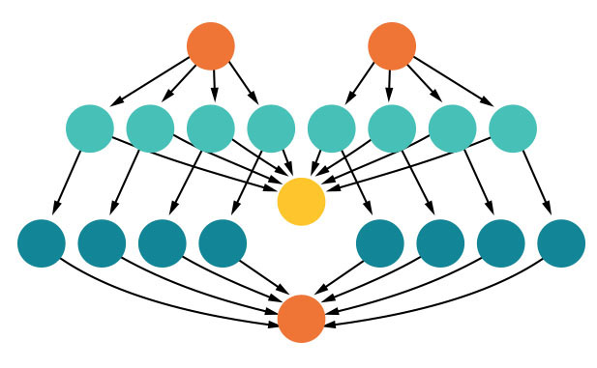
Introduction to Pegasus
https://pegasus.isi.edu/
Scientific workflows allow users to easily express multi-step computational tasks, for example retrieve data from an instrument or a database, reformat the data, and run an analysis.
The Pegasus project encompasses a set of technologies that help workflow-based applications execute in a number of different environments including desktops, campus clusters, grids, and clouds.
And their technical support team responds fast!

Slide 3
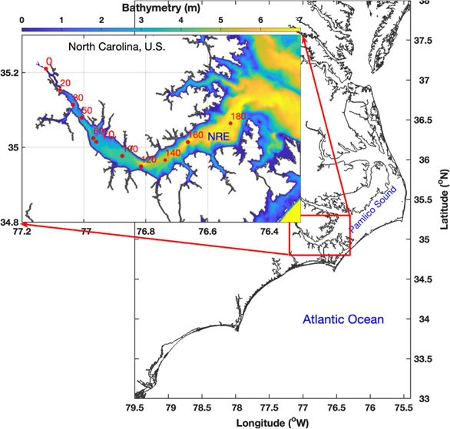
Our dataset and research task
Neuse River
Dissolved oxygen (DO) shows the amount of oxygen that is available to fish, invertebrates, and organisms in the water. The DO concentration must be above certain levels to support aquatic life and assure the stability of the aquatic ecosystem.
We have already done most of the data cleaning before the file is uploaded to Pegasus.

Slide 4

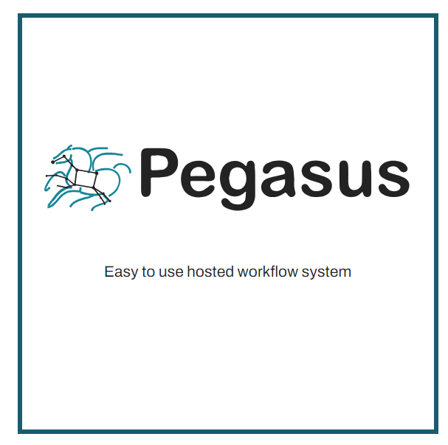
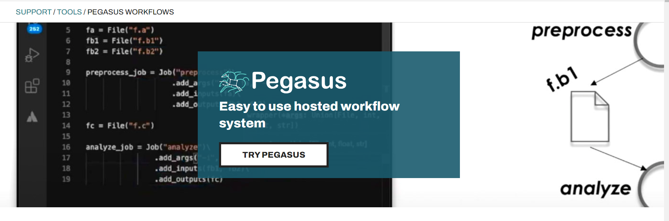
0. Use your NSF ACCESS to visit Pegasus
https://support.access-ci.org/

Slide 5
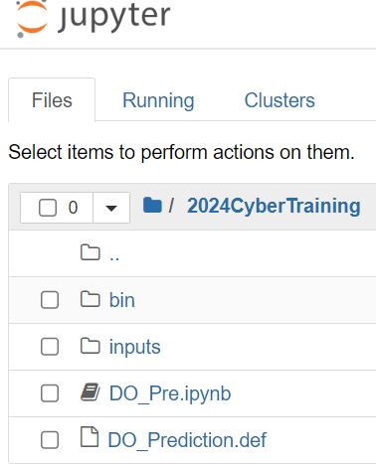
1. Move a few program files and datafiles to Pegasus
Create a folder ‘2024CyberTraining’ in your Pegasus Jupyter server.
Go into this folder.
Create a new ‘bin’ folder and put in “lstm_model.py” and “data_pre.py”.
  In the lstm_model file, we define how the model is evaluated. We will see the output information later.
  In the data_pre.py, we define what are the input features for the model, what is the target for prediction, how the data is split into training and testing set, etc.
Still under ‘2024CyberTraining’, create another ‘inputs’ folder and put in “Station100_2.csv”, “Station100_2_train.csv” and “Station100_2_test.csv”.
Still under ‘2024CyberTraining’, upload the “DO_Pre.ipynb” and “DO_Prediction.def” files.

Slide 6
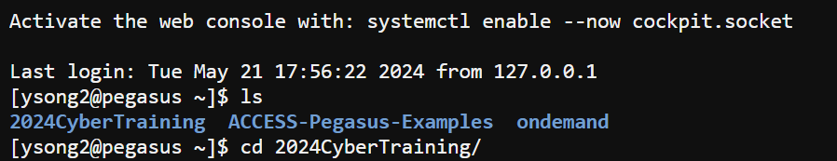
2. Creating a container for your Pegasus workflow
“DO_Prediction.def” file should list all the modules you are using like numpy.
Go to “Local Shell Access”
apptainer build DO_Prediction.sif DO_Prediction.def

Slide 7
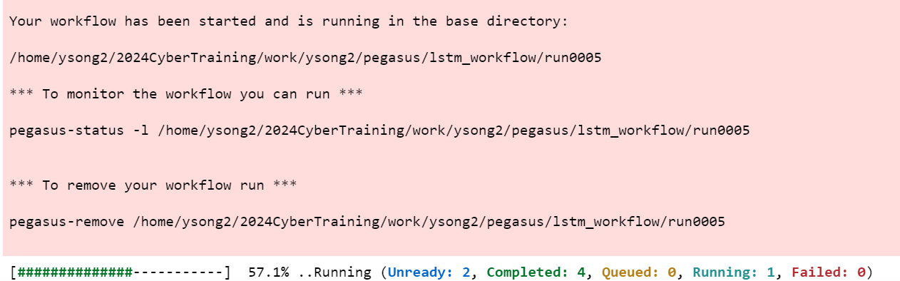
3. Run the .ipynb file
This file defines the components of the Pegasus workflow, and execute the workflow on Pegasus.
Depending on the server status, sometime this task may take long (like 10+ min).

Slide 8
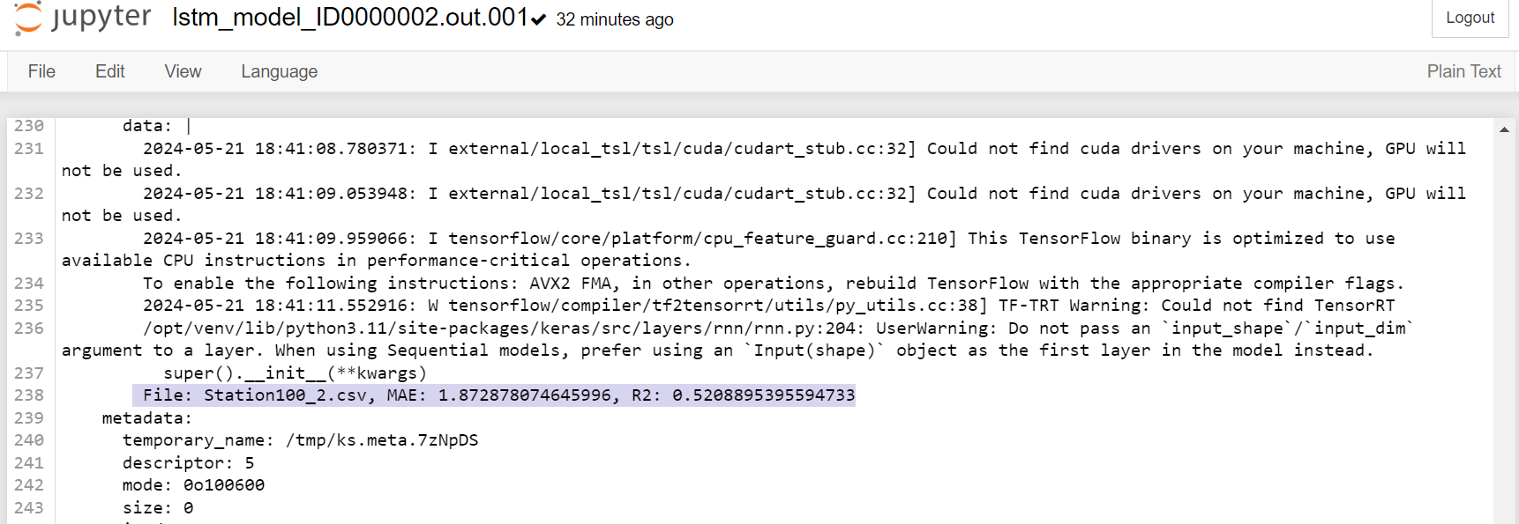
4. Locate and read the output
Find the output files of the most recent successful execution of your code. For me it’s here -

Slide 9
Summary
In this tutorial, we show how to make a small workflow on Pegasus. We started from
A cleaned datafile
A data preprocessing program
A model-building program
And this pipeline can be extended to include more stations, different depth for each station, and trying different possible models (such as RNN).
As the data size and the complexity of your workflow grow, you will better see the value of CyberInfrastructure (CI) for scientific domains.

