Slide 1



Collaborative Research: CyberTraining: Pilot: A Cybertraining Program to Advance Data Acquisition, Processing, and Machine Learning-based Modeling in Marine Science
PIs: Qianqian Liu¹, Yang Song¹, Zhengui Wang², Gulustan Dogan¹
Students: Mina Gachloo¹, Katherine Boot¹
1.
2.

Slide 2
Marine Science Data Acquisition and Analysis
Marine science is a highly interdisciplinary and data-intensive field, a particular research project always depends on various types of ocean datasets, including
In-situ observations
Remote sensing data
Model results
Lab data
Data in marine science are often indexed differently and stored in different formats.
With oceanographic data having time scales ranging from microseconds to decades or even centuries, spatial scales ranging from centimeters to thousands of kilometers, collected by different agencies with different formats, the active development of CI makes it possible for data processing, storage, and dissemination among users with an internet connection
The data acquisition and analysis processes are not always straightforward
Notes:
However, it can still be hard for inexperienced scientists because of the different processes for data acquisition (such as FTP, tailored HTTP links) and different data formats (such as NetCDF, CSV, GeoTIFF) from different data sources (Figure 1). Most scientists are expected to pick up the data acquisition and processing skills independently, ending up with spending hours on things that could be done in minutes [17]–[19]. This unnecessarily wastes researchers’ time and even discourages young scientists from taking marine science as their career. Although various training courses have been implemented to promote skills in CI and data acquisition and analysis among researchers, including the Software Carpentry program [19], [20], there are few programs focused on marine science data acquisition and processing on CI.

Slide 3
Machine Learning in Marine science
Mechanistic models have been used – Limited for multiple reasons
They rely on an accurate hydrodynamic model
Ecological models usually simplify phytoplankton community to include a few functional groups
Parameters are often estimated based on lab studies or empirical observations from similar water bodies in literature
Heavy computational resources
Machine learning models are rapidly gaining marine scientists’ attention due to the promising results. It requires Extensive Availability of Data. “Data-driven Models”

Slide 4
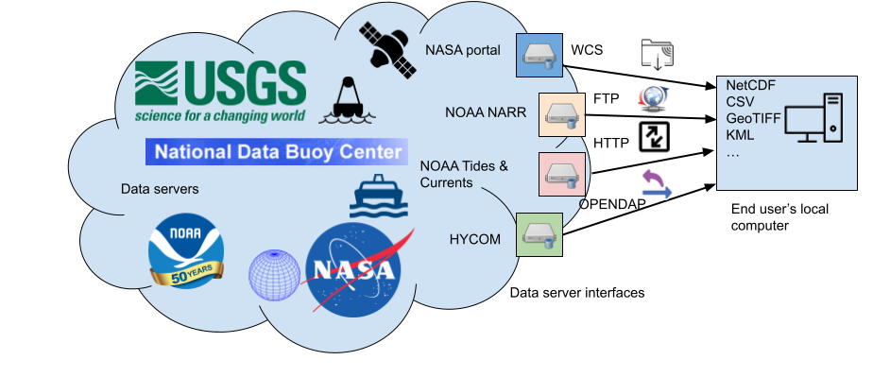
Goals:
Advance the adoption of data science/machine learning cyber infrastructure by marine science researchers and enhance researchers' abilities in utilizing CI tools.
NOAA Tides and Currents
National Data Buoy Center (NDBC)
USGS streamflow
HYCOM ocean model results
North American Regional Reanalysis
Satellite Data
HPC (Expanse)
GitHub for Collaboration and Version Control
etc.
Training Time:
05/20/2024 - 05/24/2024
Notes:
Data acquisition, analysis and visualization from major databases.
cyberinfrastructure to describe research environments that support advanced data acquisition, data storage, data management, data integration, data mining, data visualization and other computing and information processing services distributed over the Internet beyond the scope of a single institution. In scientific usage, cyberinfrastructure is a technological and sociological solution to the problem of efficiently connecting laboratories, data, computers, and people with the goal of enabling derivation of novel scientific theories and knowledge.

Slide 5
Goals:
Advance the adoption of data science/machine learning cyber infrastructure by marine science researchers and enhance researchers' abilities in utilizing CI tools.
Hands-on experience with machine-learning application in marine science projects.
Hackathon project!!
Training Time:
06/05/2023 - 06/09/2023
Notes:
A hackathon is a tech event where amateur and professional coders/programmers put up challenges related to hardware or software and figure out a workable solution in a stipulated time

Slide 6
Why Python?
As an open-source programming language, Python is becoming more and more popular in marine science research with its ocean of libraries of great functionalities. Compared to other programming languages (e.g., MATLAB), Python is memory-managing efficient, and user-friendly to different operating systems (e.gs. Linux, Windows, Mac).

Slide 7
What will we do with Python?
● We will provide many standard Python scripts regarding the following aspects:
● systematically downloading ocean datasets from different sources
● reading and processing the raw ocean data
● organizing the ocean data and transforming the data into a database
● implementing predictive machine learning, deep learning and spatial-temporal models
● executing the scripts on CI

Slide 8
Python packages you will learn to manage:
NumPy
Pandas
Matplotlib
Pylib
U-tide
netCDF4
Pydap
etc

Slide 9
What you will learn:
Successfully completing the program, workshop participants will:
be able to use Python and related packages/toolkits for marine science data acquisition, analysis, and visualization
gain basic Python programming skills (variables, loops, conditionals, etc.)
have hands-on experience with machine learning and data science topics, and know how to apply them in solving marine science-related research questions
get familiar with version control with GitHub

Slide 10
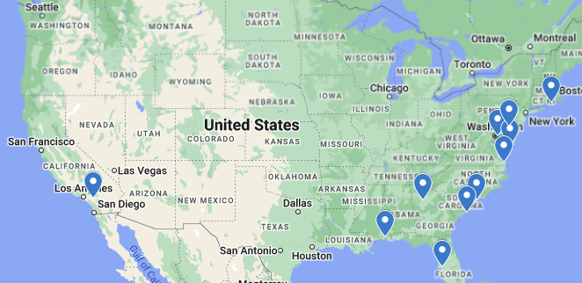
2023 Cybertraining Participants
21 selected participants from 12 Institutions
Graduate/undergraduate students
UNCW
University of Maryland
University of South Alabama
Coastal Carolina University
University of Rhode Island
University of Maryland Eastern Shore
University of California, Riverside
University of South Florida
Georgia Institute of Technology
Old Dominion University
College of Charleston/ University of Vermont
University of Delaware

Slide 11
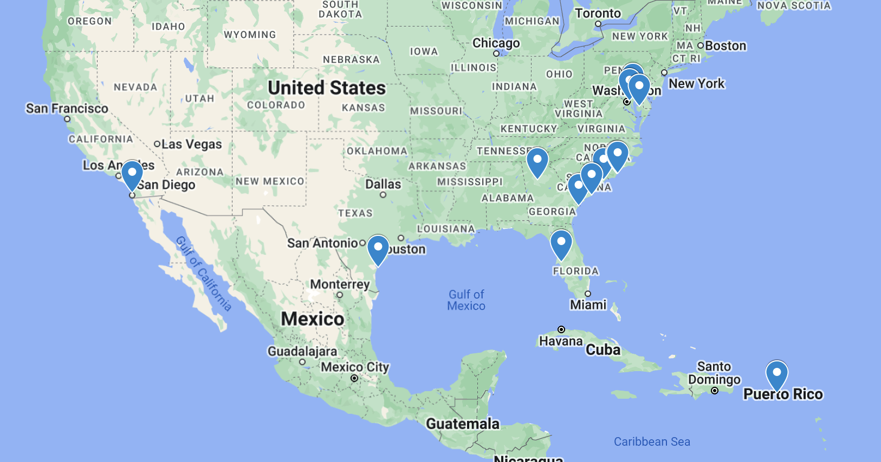
2024 Cybertraining Participants
20 selected participants from 12 Institutions
Graduate/undergraduate students

Slide 12
Time |  |  | Topics | Instructor
05/20 | Morning | 9:10AM-11:55AM | Icebreak talk, Python environment setup, basic syntax, data types | Dogan and Liu
 | Lunch | 12:00PM-1:30PM | Lunch
 | Afternoon | 1:30PM-4:30PM | pandas, numpy, dataframe, data processing and cleaning | Song
05/21 | Morning | 9:10AM-11:30AM | Data visualization with Matplotlib, data acquisition | Liu and Wang
 |  | 11:30AM-12:00PM | Coastal Engineering Wave Flume Tour | Dr. Long and Benjamin Middour
 | Lunch | 12:30PM-1:30PM | Lunch
 | Afternoon | 1:30PM-3:25PM | Hands on data analysis and visualization, plot tuning; statistics, low-pass filter, … | Liu and Wang
 |  | 3:30PM-4:30PM | More about data acquisition and analysis | Liu and Wang
05/22 | Morning | 9:10AM–9:55AM 10:10AM–11:55AM | Machine learning (minor prediction and more classification) Introduction to HPC, GitHub for version control | Song Liu and Boot
 | Lunch |  | Lunch
 | Afternoon | 1:30PM–2:30PM | Introduction to Pegasus | Gachloo
 |  | 2:30PM–4:30PM | Free time
05/23 | Morning | 9:10AM–11:55AM | Deep Learning, CNN+RNN, Discussion about Hackathon project | Dogan, Liu, Wang and Song
 | Lunch |  | Lunch
 | Afternoon | 1:30PM–4:15PM | Hackathon Project | Dogan, Liu, Wang and Song
05/24 | Morning | 9:10AM–11:55AM | Hackathon Project | Dogan, Liu, Wang and Song
 | Lunch |  | Lunch | Review Session for Final Exam
 | Afternoon Session | 1:30PM–4:15PM | Hackthon Presentation

Slide 13
Center for Marine Science, UNCW
Master in Marine Science Program
ACOS (Applied Coastal & Ocean Science) program
https://uncw.edu/academics/majors-programs/cms/applied-coastal-ocean-sciences-phd/

Slide 14
On-campus Housing
No permit needed for visitor parking

Slide 15
PIs
Qianqian Liu
Assistant Professor in Physics and Physical Oceanography and Center for Marine Science, UNCW
Research Interests:
Coastal and Estuarine Dynamics; Hydrodynamic and Biophysical Simulations; Machine Learning Models
Yang Song
Assistant Professor in Computer Science, UNCW
Research Interests:
Data mining; Data sciences and analytics; Machine Learning

Slide 16
PIs
Gulustan Dogan
Assistant Professor in Computer Science, UNCW
Research Interests:
Artificial Intelligence, Data Science; Machine Learning; Internet of Things; Motion Analytics and Learning Analytics
Zhengui Wang
Assistant Research Scientist in Center for Coastal Resources Management, Virginia Institute of Marine Science
Research Interests:
Numerical/Hydrodynamic Modeling; Phytoplankton and Nutrients Dynamics

