Slide 1

Integrations möglichkeiten: -IDE Plugins -Gitlab code review Alternativen: -copilot: https://www.itprotoday.com/development-techniques-and-management/github-copilot-vs-chatgpt-which-tool-better-software -llama: https://sourceforge.net/software/compare/Bard-vs-ChatGPT-vs-GitHub-Copilot-vs-LLaMA -snyk: https://snyk.io/de/ Bad: https://www.dataprotectionreport.com/2023/04/everyone-is-using-chatgpt-what-does-my-organisation-need-to-watch-out-for/ "5. confidentiality, security and data protection (c) (...) If you use the OpenAI API for the processing of "personal data" as defined in the GDPR (...), please fill out this form to request the execution of our data processing addendum.“ "Note that this agreement is only applicable to our business service offerings (APIs for text completion, images, embeddings, moderations, etc.) and NOT our consumer services (ChatGPT, DALL-E Labs)."
Businesses that use ChatGPT without proper training and caution may unknowingly expose themselves to GDPR data breaches, resulting in significant fines, reputational damage, and legal action taken against them. As such, usage as a workplace tool without sufficient training and regulatory measures is ill-advised.

Slide 2
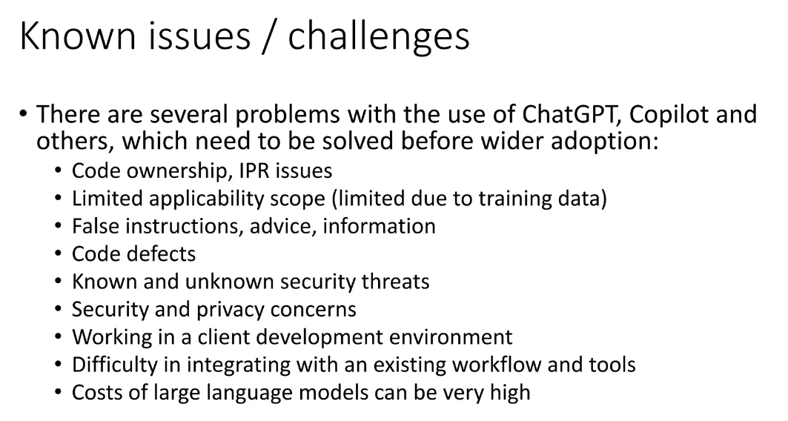

Slide 3
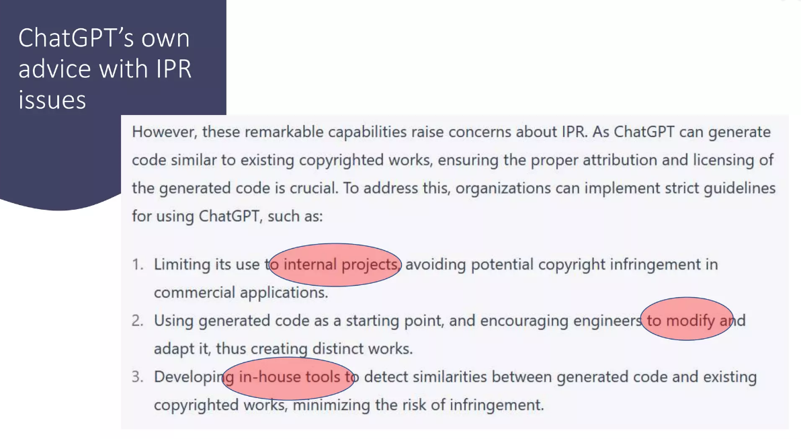

Slide 4
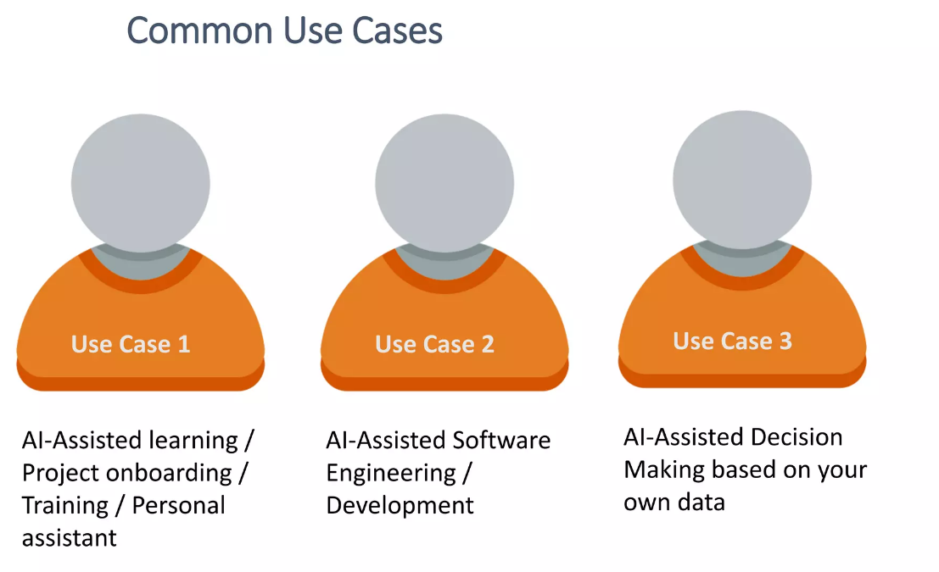

Slide 5
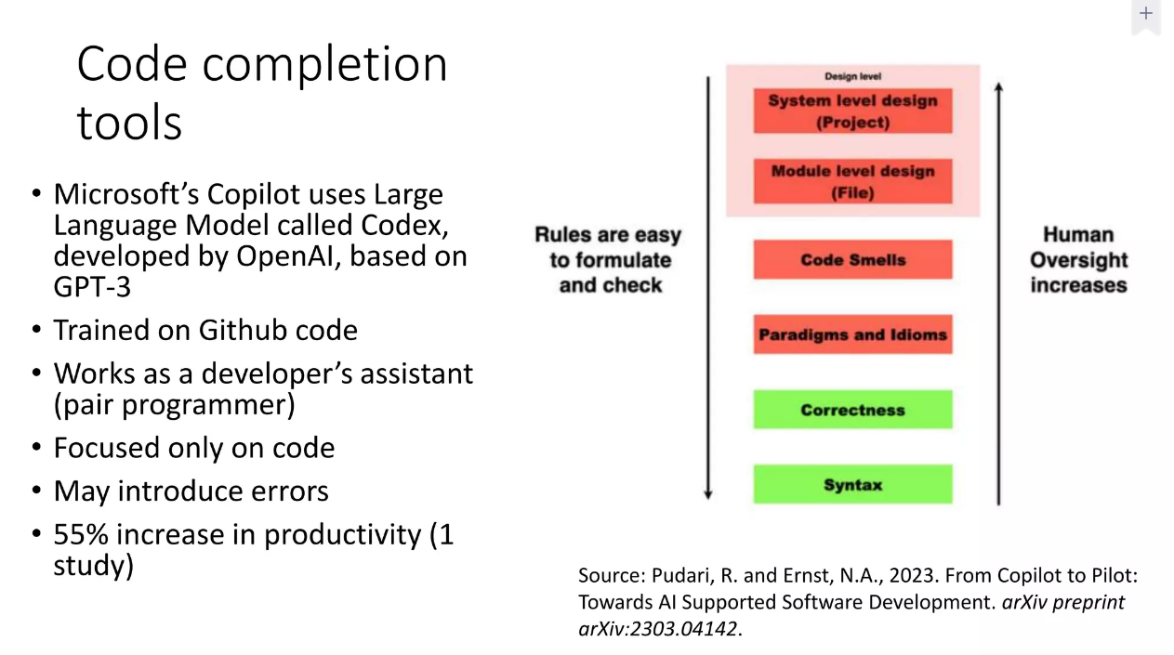

Slide 6
