Slide 1

CREATE WATCH SHOP ON WEBSITE
GROUP 7
Lâm Hưng Phú - 3118411021
Lê Quang Sang - 3118411023
Ochiai Shigeru - 3118410367
Instructor: PSG. TS. Trần Minh Quang

Slide 2
TABLE OF CONTENTS
01
02
03
INTRODUCTION ABOUT BUSINESS PRODUCT
INTRODUCTION ABOUT BUSINESS PLATFORM
DEMO WEBSITE

Slide 3
01
INTRODUCTION
ABOUT
BUSINESS PRODUCT

Slide 4
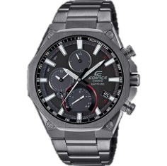
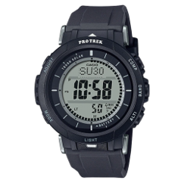
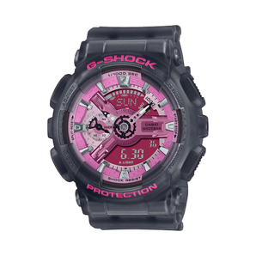
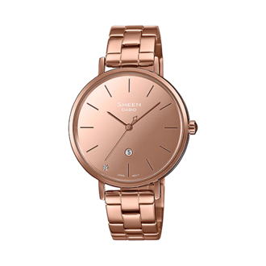
INTRODUCTION
We’re selling CASIO watches on our website.
They are separated into 4 types of watch:
EDIFICE
PROTREK
G-SHOCK
SHEEN

Slide 5
PROS AND CONS
PROS
CONS
Flexibility
​Ability to start your business from home
Scalable​
Meaningful business connections
High margins​
Quick build time​
Crowded space
​Finding the right supplier
Motivation of employees​

Slide 6
02
INTRODUCTION
ABOUT
BUSINESS PLATFORM

Slide 7
5 ADVANTAGES
OF
USING OPENCART
TO
START YOUR BUSINESS​

Slide 8
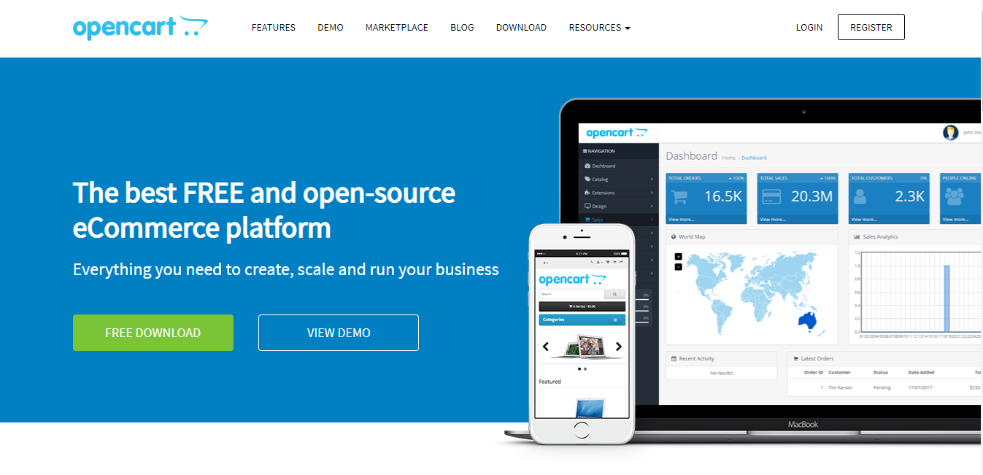
FREE TO USE
You only need to buy your domain to host your site. The system is open source which means a lot of contributors.​

Slide 9

Development friendly
If you have PHP experience before, the development step should be pretty easy for you. But even if you are not familiar with technology, it is still a pleasant platform to work with.​

Slide 10
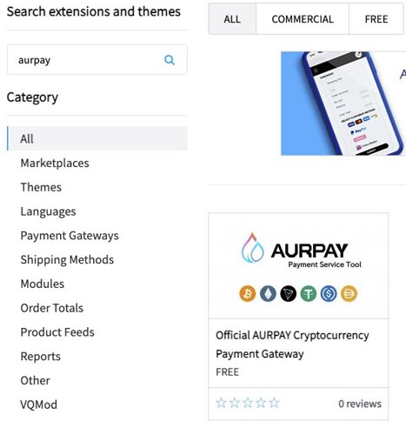
Lots of extensions
and modules​
There are more than 10k Plugins out there in Opencart marketing places.​
Categories include:​
*You can enjoy selling your products through the OpenCart platform.​

Slide 11

Unlimited products collection
As a business owner, you can sell unlimited products across categories. You will be able to show details of your products, such as ratings, comments, descriptions.​

Slide 12
SEO friendly
Opencart is probably the best e-commerce platform for optimization. You can edit form fields such as meta description, alt tags for images and titles.​
You can submit an HTML sitemap to Google, use lazy load to improve your website’s speed.​
E.g., put into robots.txt so web crawlers can find your site easily.​

Slide 13
03
DEMO WEBSITE

Slide 14
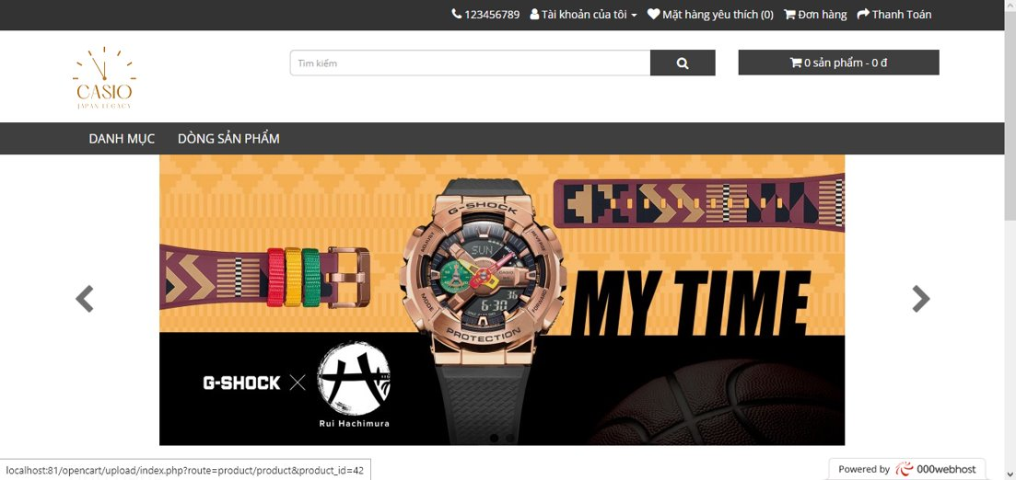

Slide 15
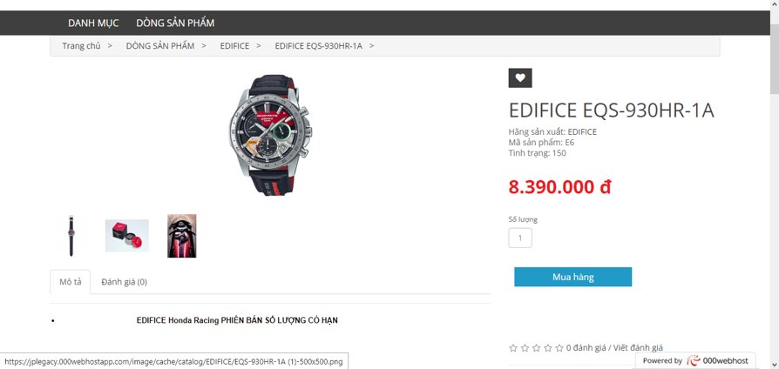

Slide 16
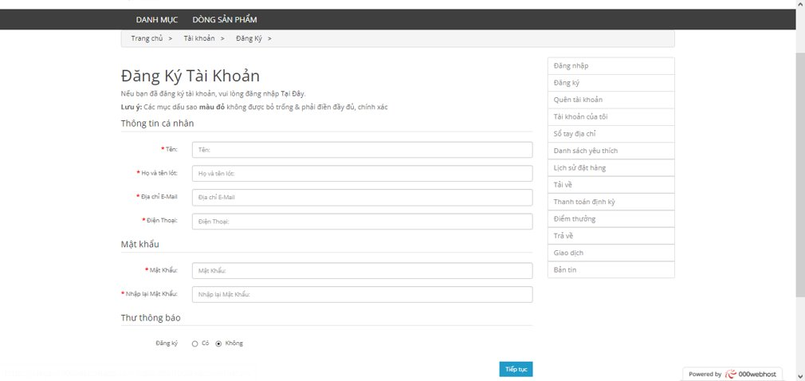

Slide 17
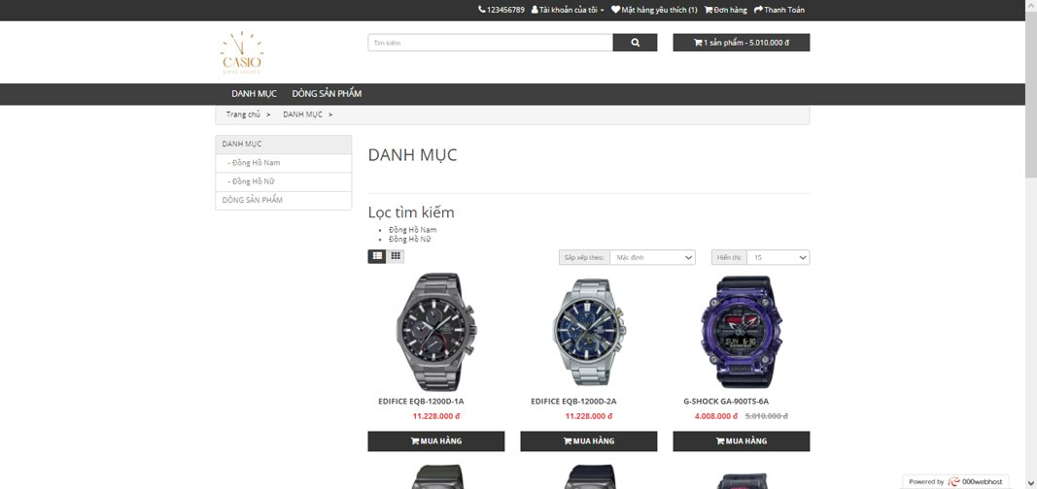

Slide 18
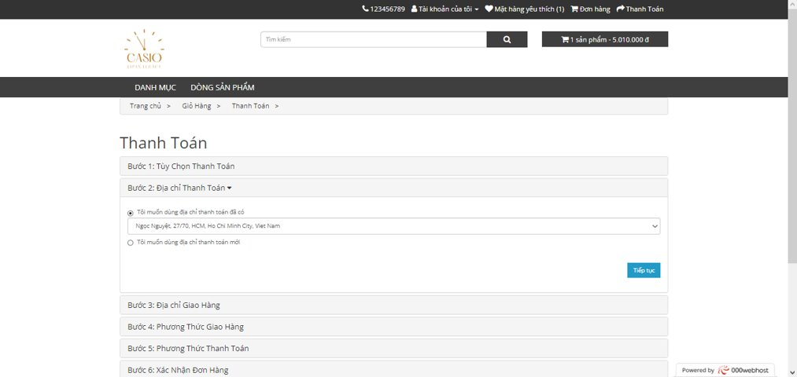

Slide 19
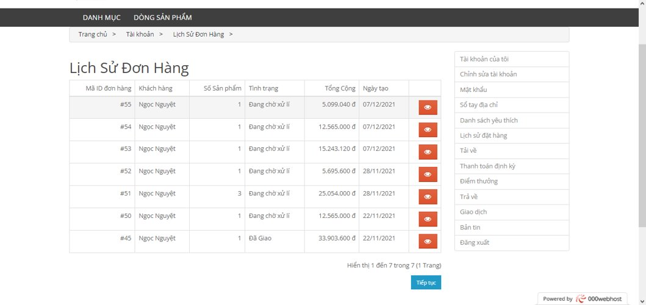

Slide 20
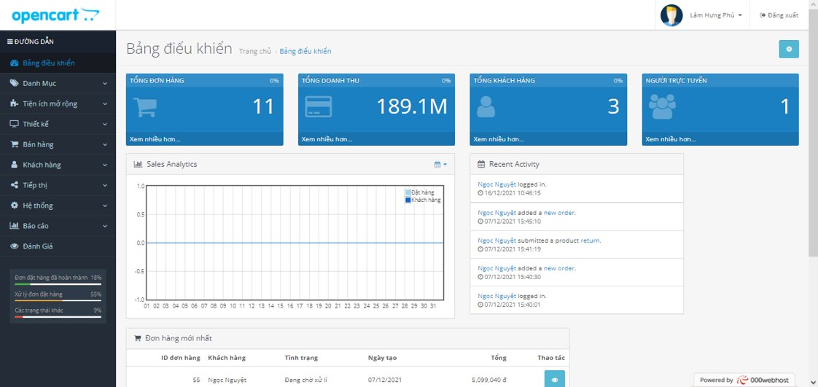

Slide 21
THANK YOU
FOR
WATCHING

